Slide 1
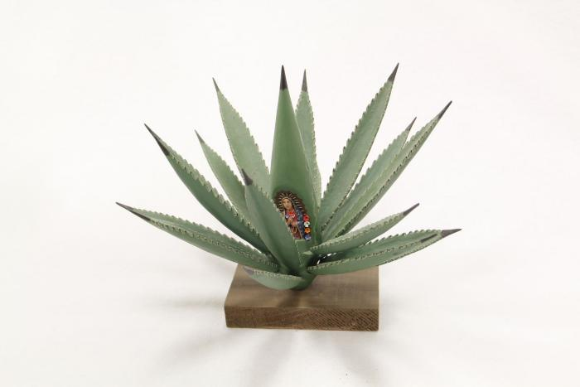
Agave Plant with Virgin of Guadalupe (SH1)

Slide 2
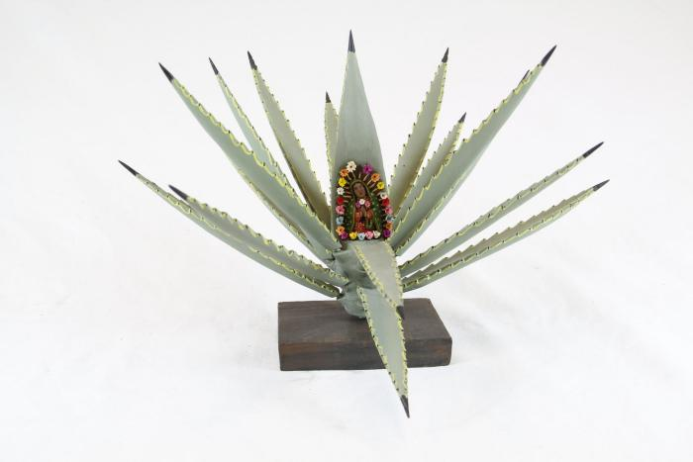
Agave Plant with Virgin of Guadalupe (SH2)

Slide 3
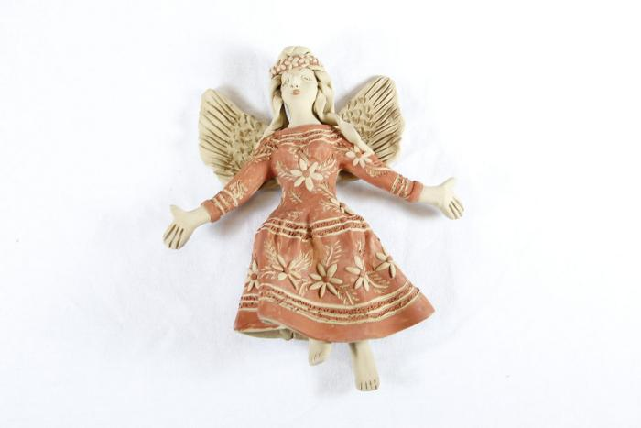
Angel (SH3)

Slide 4
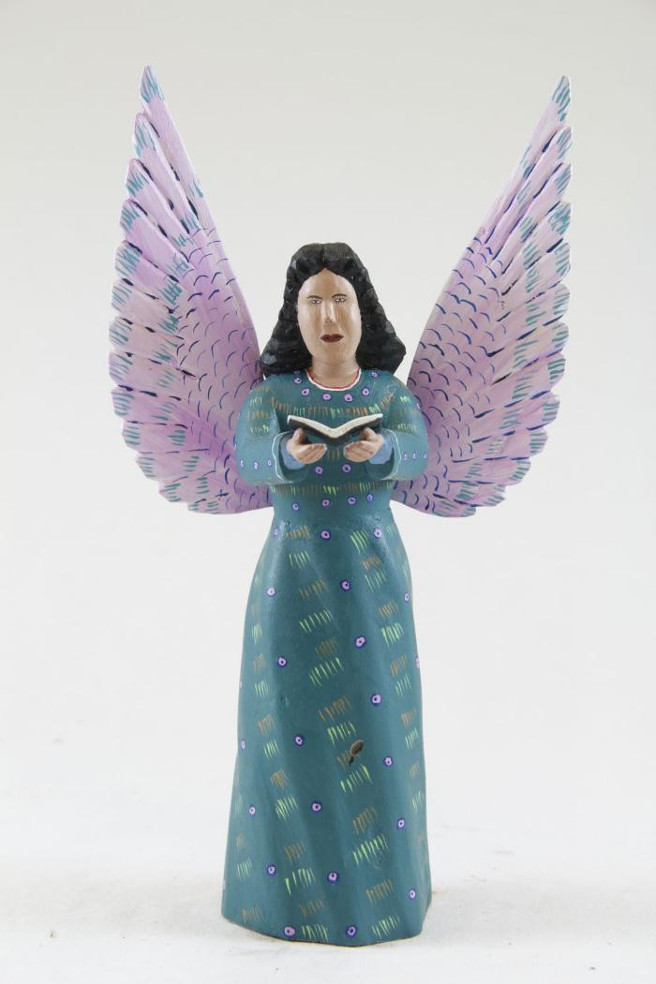
Angel (SH4)

Slide 5
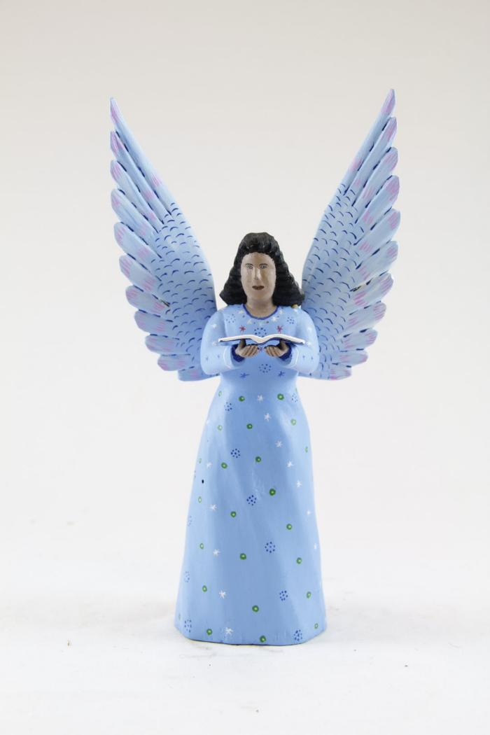
Angel (SH5)

Slide 6
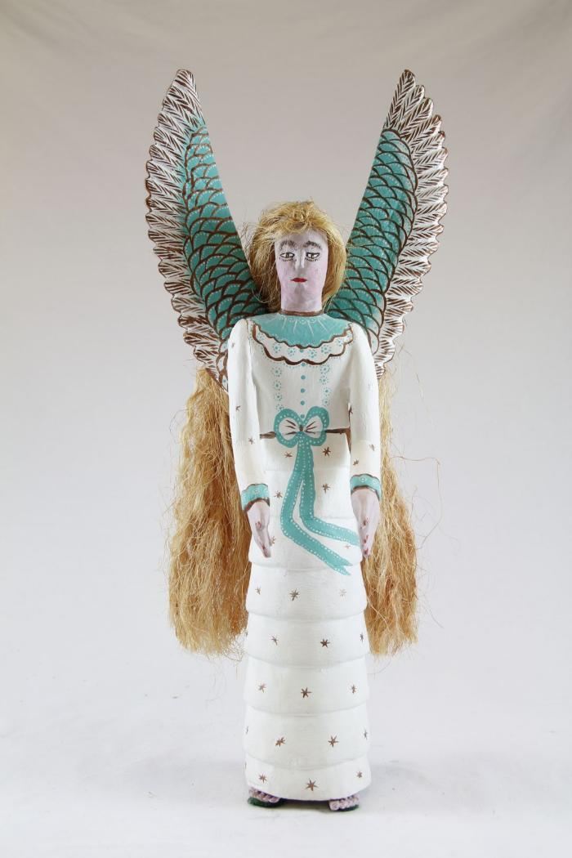
Angel (SH6)

Slide 7
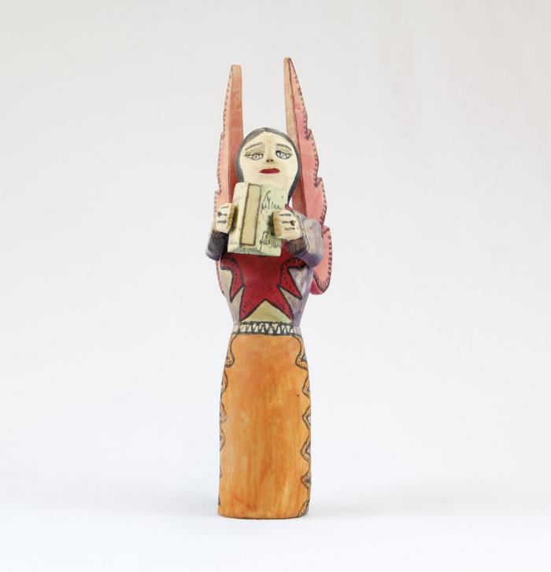
Angel holding Book (SH7)

Slide 8
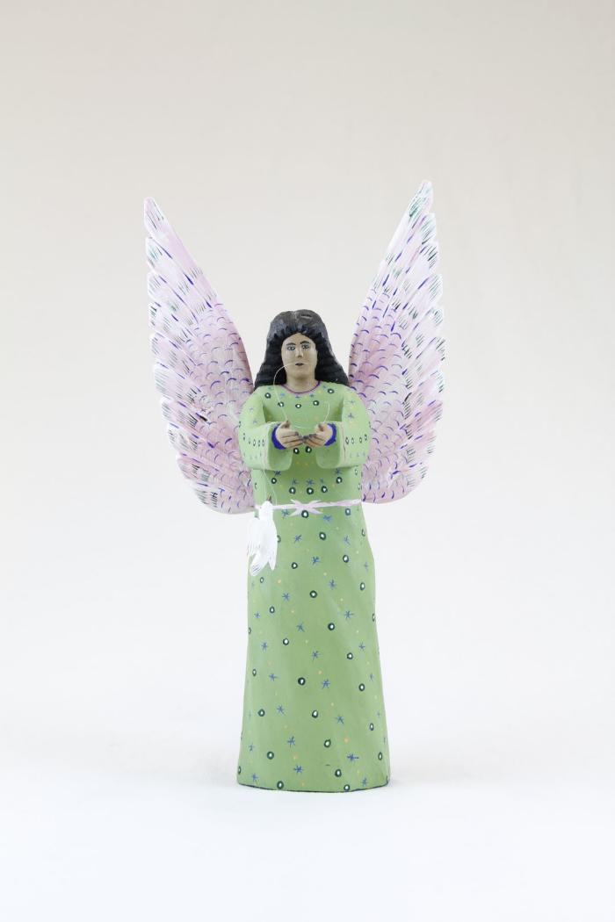
Angel holding Dove (SH8)

Slide 9
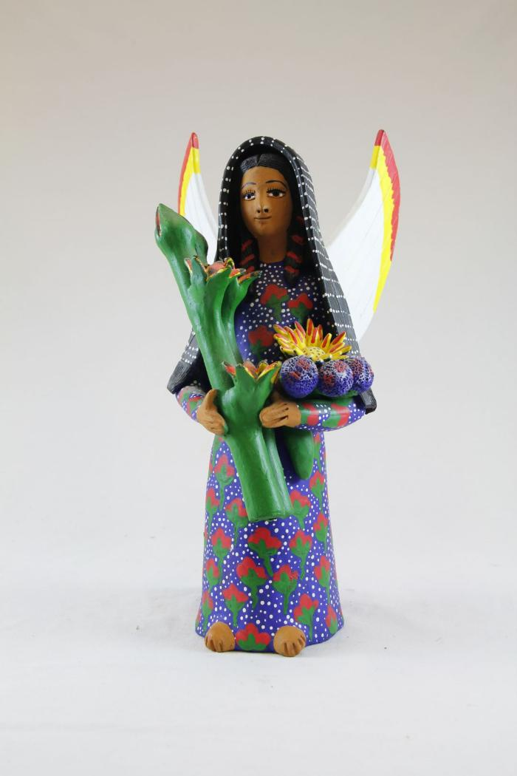
Angel holding Flowers (SH9)

Slide 10
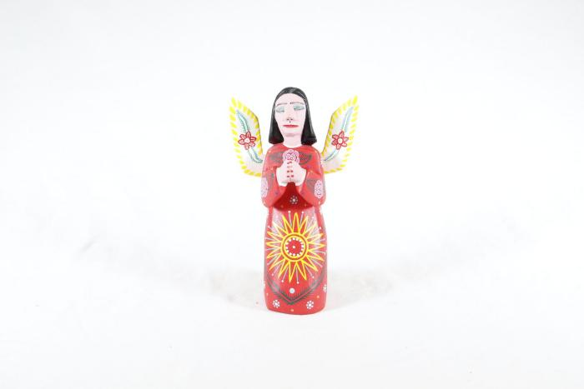
Angel kneeling (SH10)

Slide 11
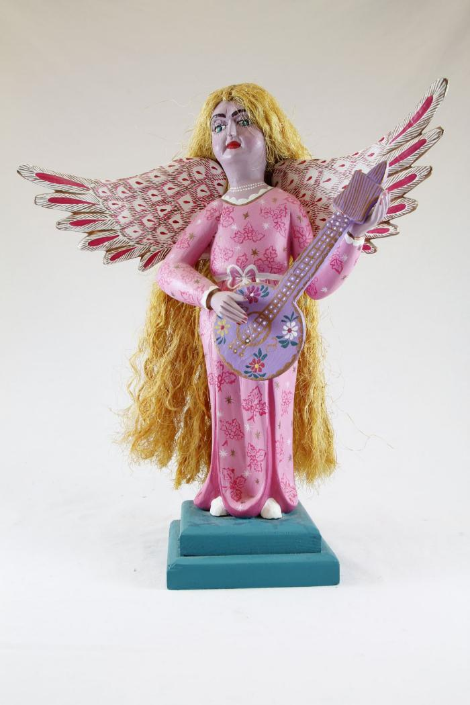
Angel playing Guitar (SH11)

Slide 12
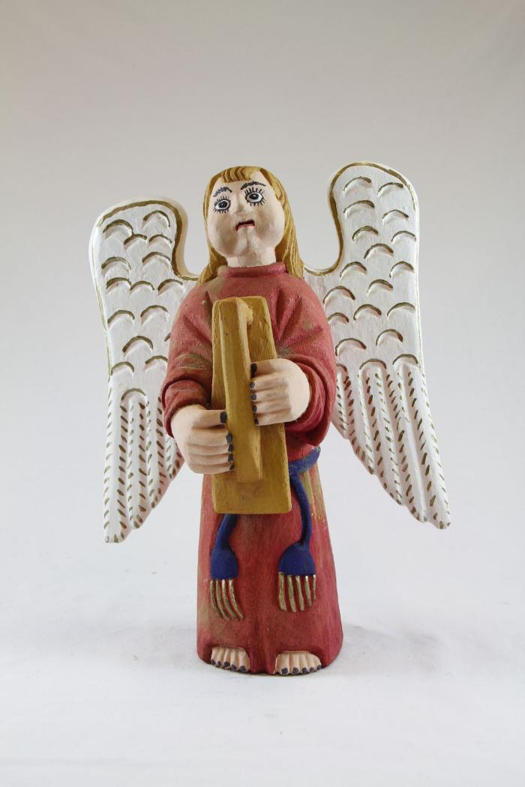
Angel playing Harp (SH12)

Slide 13
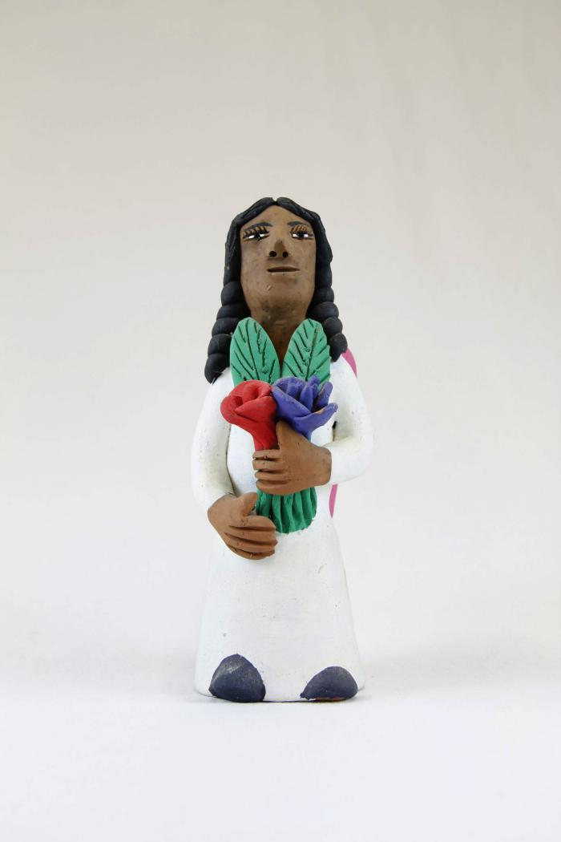
Angel with Purple and Red Flower (SH13)

Slide 14
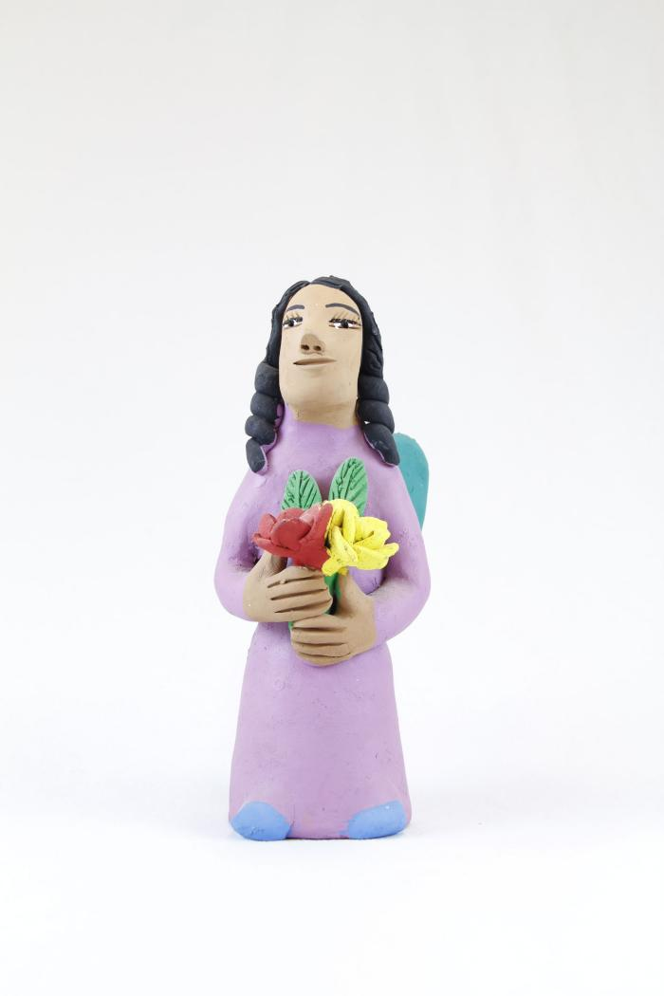
Angel with Red and Yellow Flower (SH14)

Slide 15
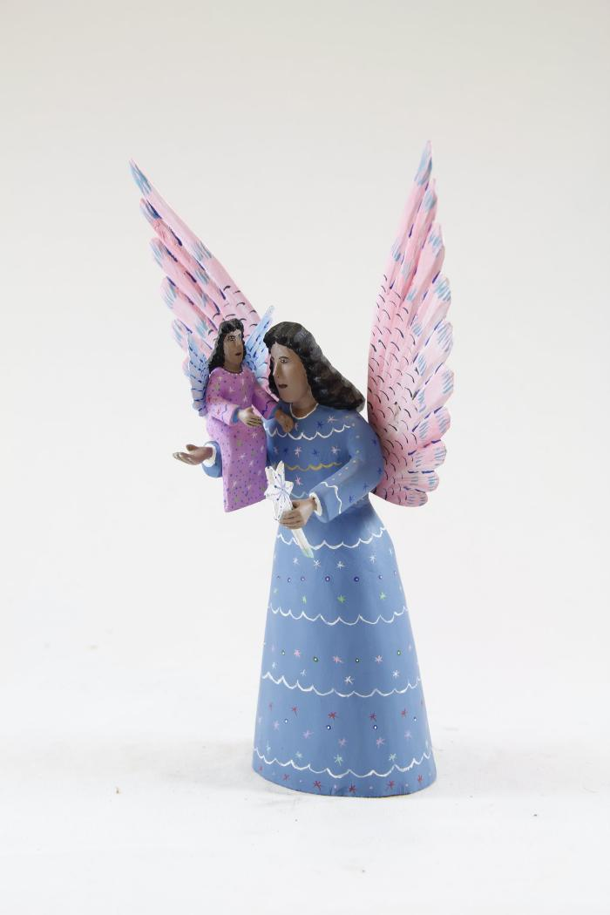
Angel with Small Angel (SH15)

Slide 16
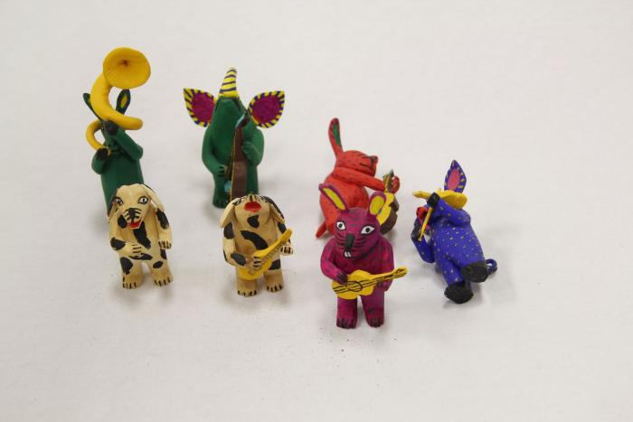
Animal Band (SH16)

Slide 17
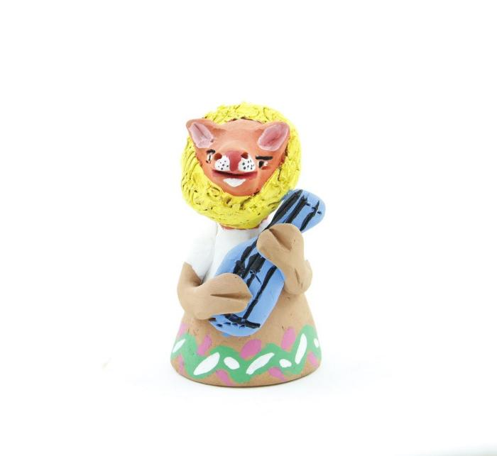
Animal Bell (SH17)

Slide 18
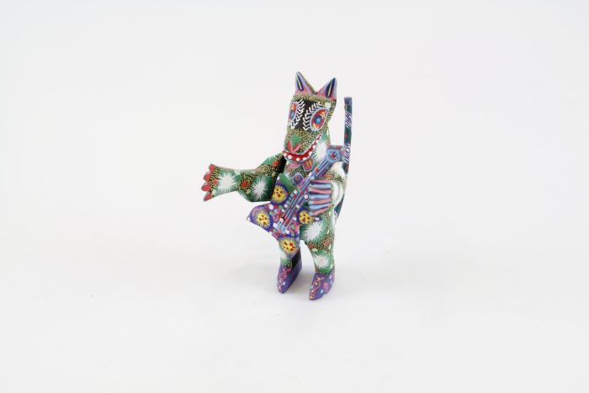
Animal playing an Electric Guitar (SH18)

Slide 19
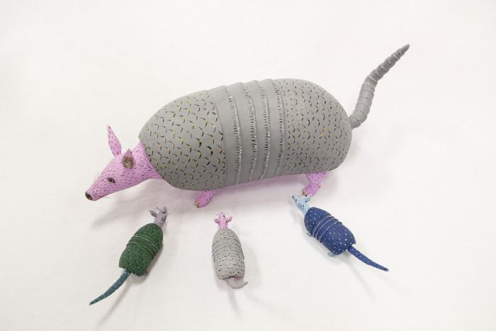
Armadillo (SH19)

Slide 20
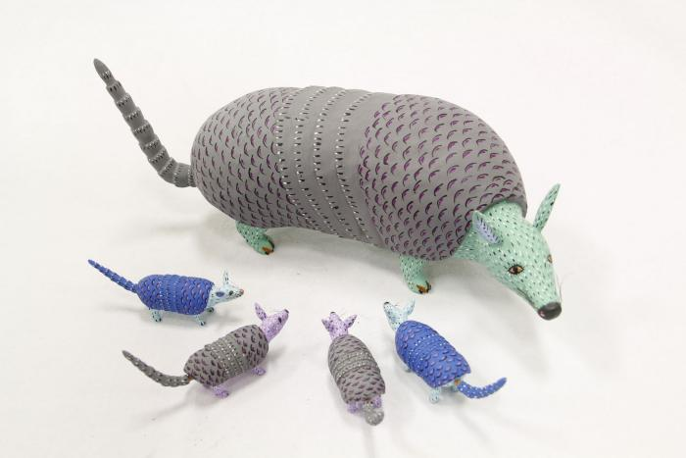
Armadillo (SH20)

Slide 21
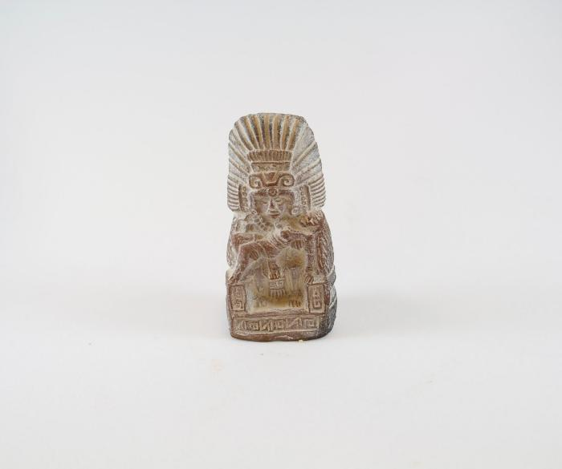
Aztec / Mayan holding Woman (SH21)

Slide 22
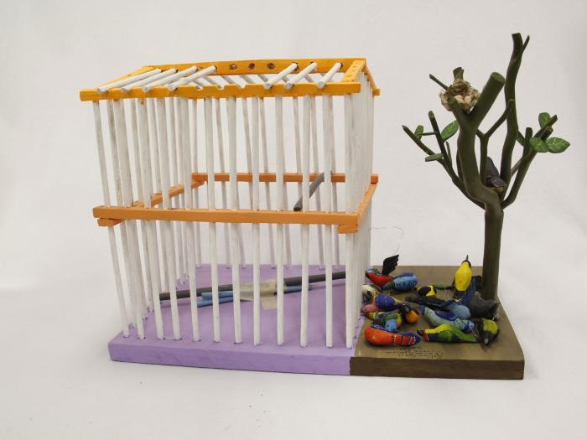
Bird Cage with Tree (SH22)

Slide 23
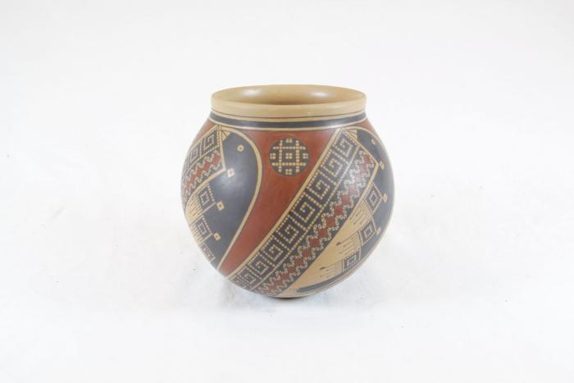
Black and Red Vase (SH23)

Slide 24
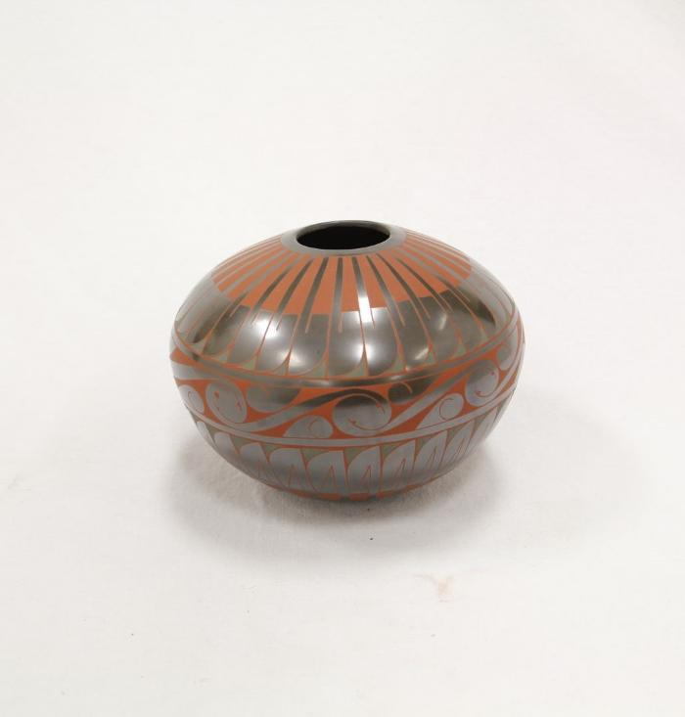
Black Green and Red Vase (SH24)

Slide 25
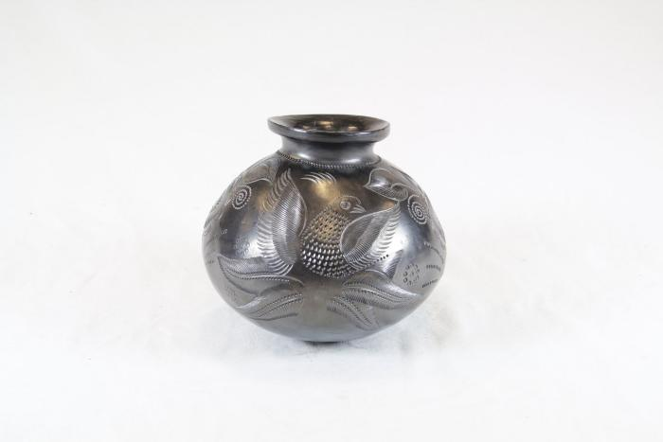
Black Vase (SH25)

Slide 26
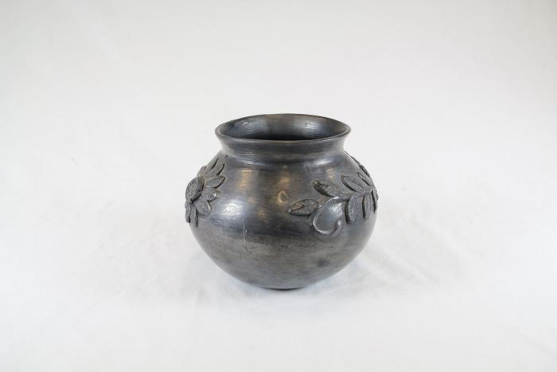
Black Vase (SH26)

Slide 27
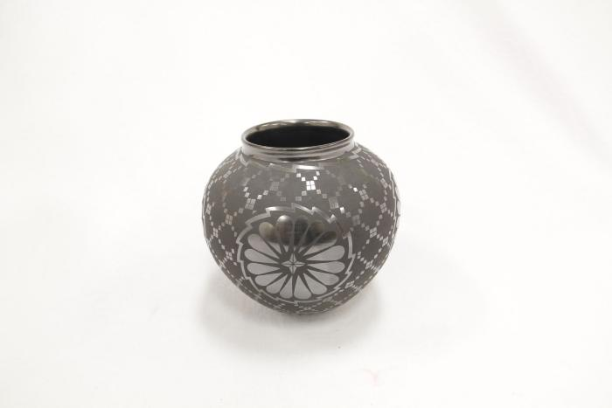
Black Vase (SH27)

Slide 28
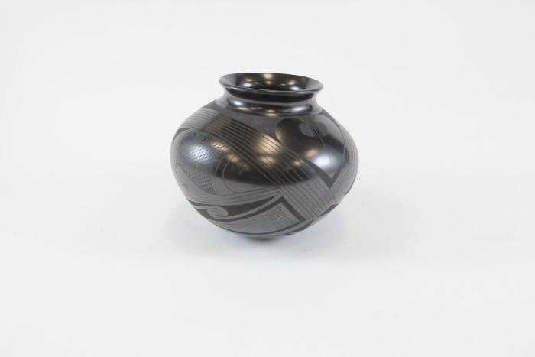
Black Vase (SH28)

Slide 29
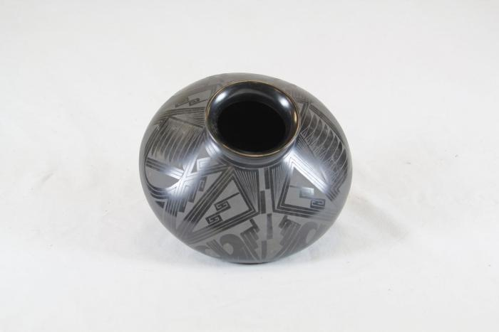
Mata Ortiz Black Vase (SH29)

Slide 30
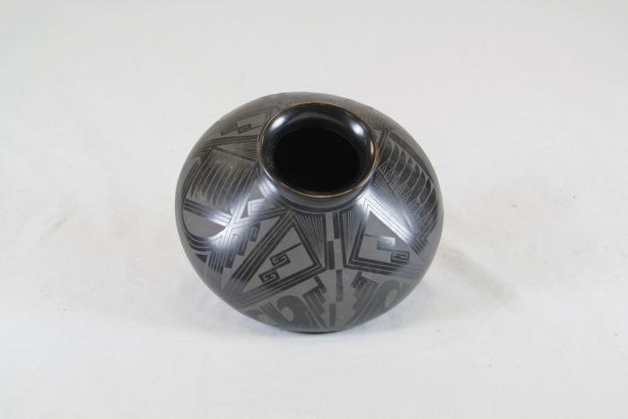
Black Vase (SH30)

Slide 31
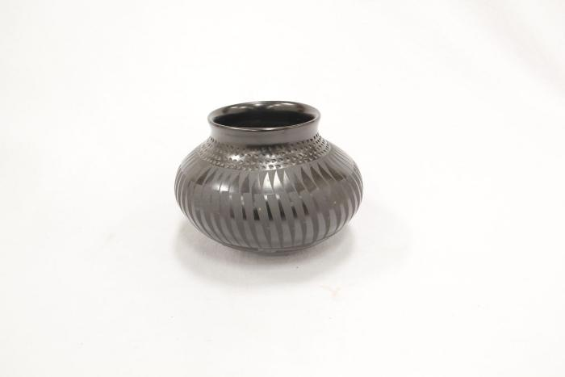
Black Vase (SH31)

Slide 32
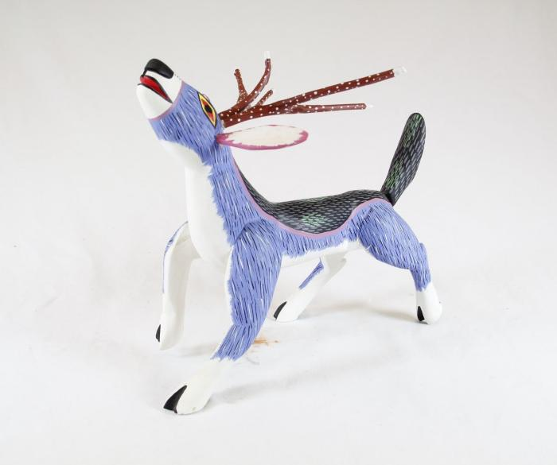
Blue Animal (SH32)

Slide 33
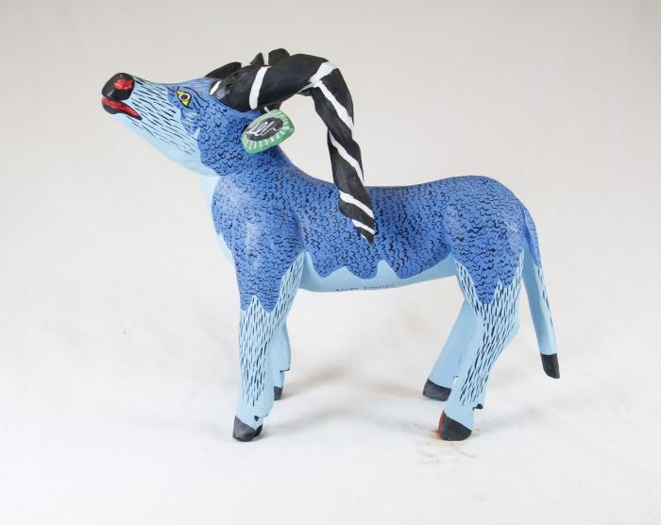
Blue Goat (SH33)

Slide 34
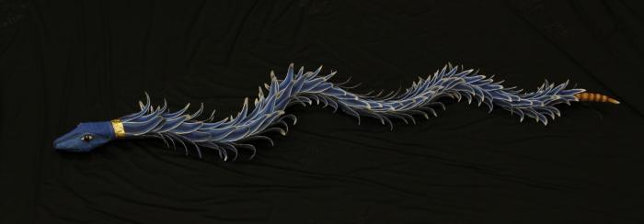
Blue Rattle Snake (SH34)

Slide 35
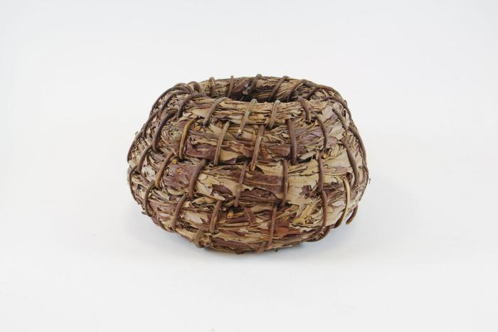
Willow Kumeyaay PaiPai Basket (SH35)

Slide 36
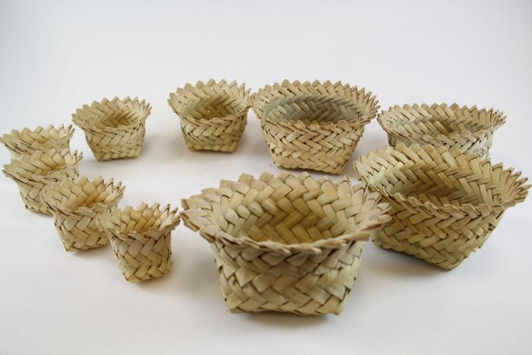
Tarahumara Indian Baskets (SH36)

Slide 37
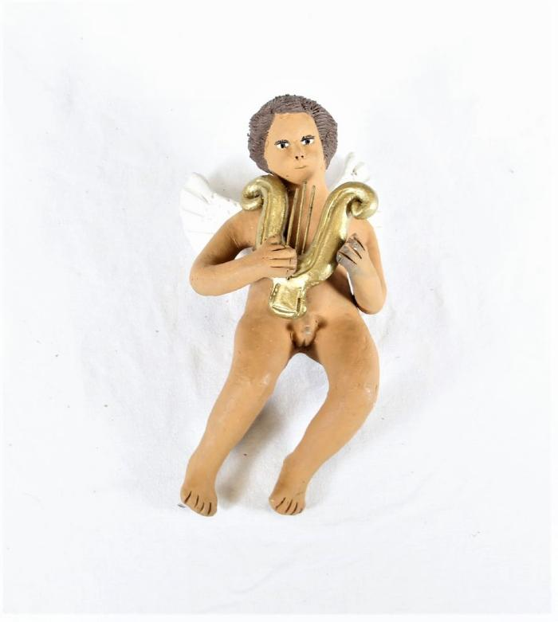
Boy Angel playing Harp (SH37)

Slide 38
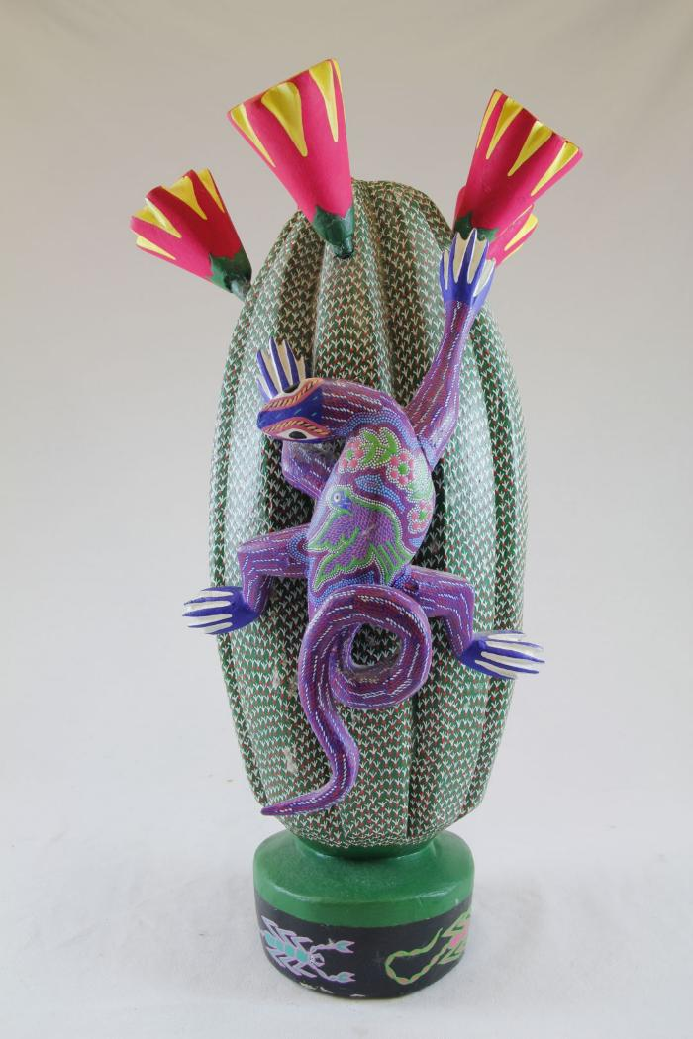
Cactus (SH38)

Slide 39
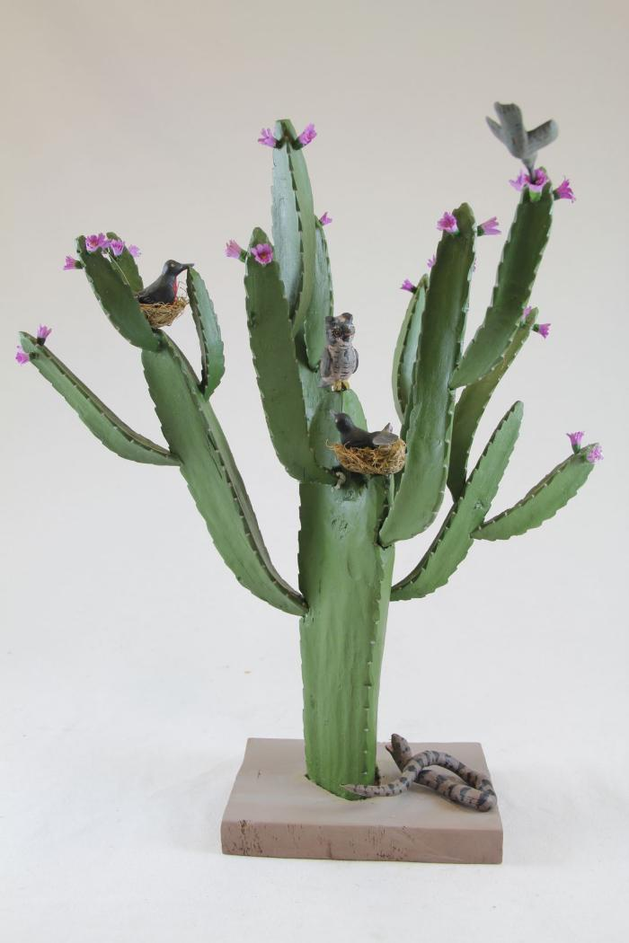
Cactus blooming Pink Flower (SH39)

Slide 40
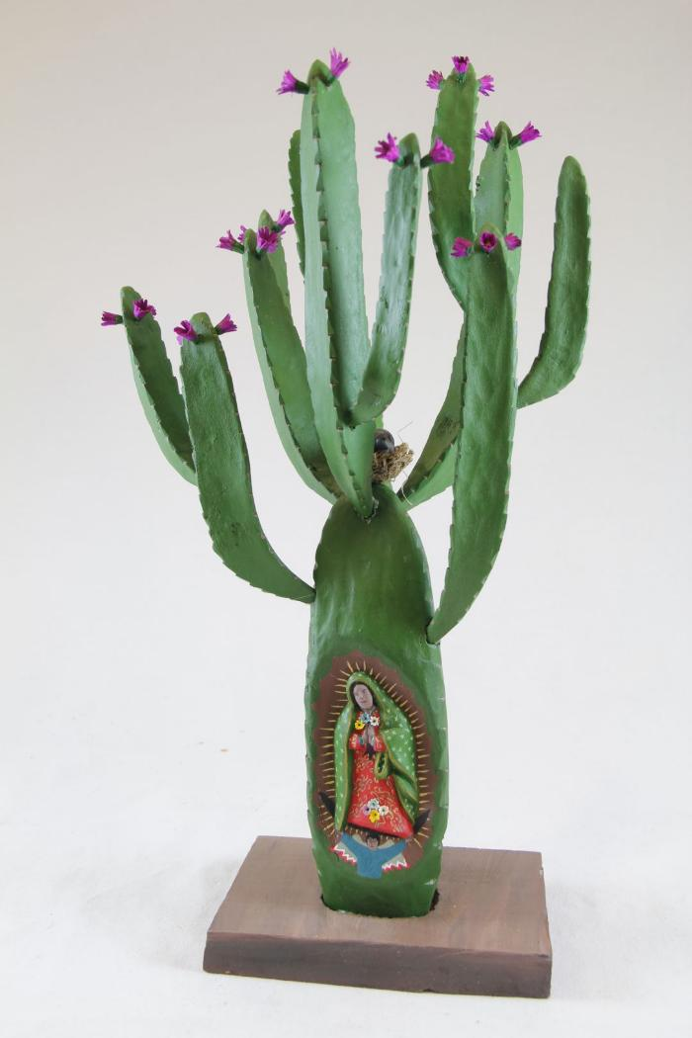
Cactus with Three Virgins (SH40)

Slide 41
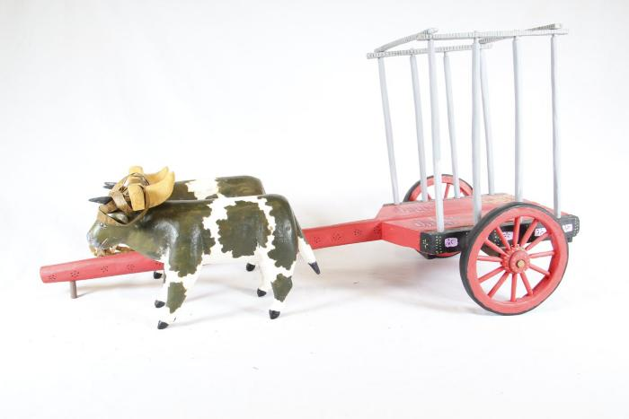
Cart with Cows (SH41)

Slide 42
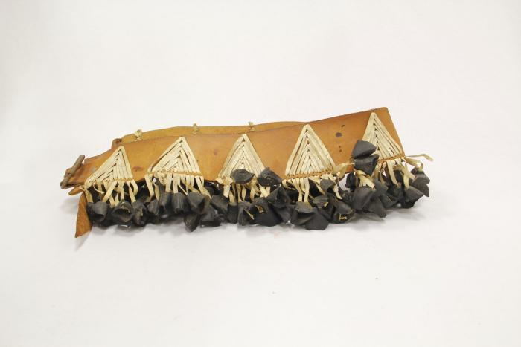
Celebration Belt (SH42)

Slide 43
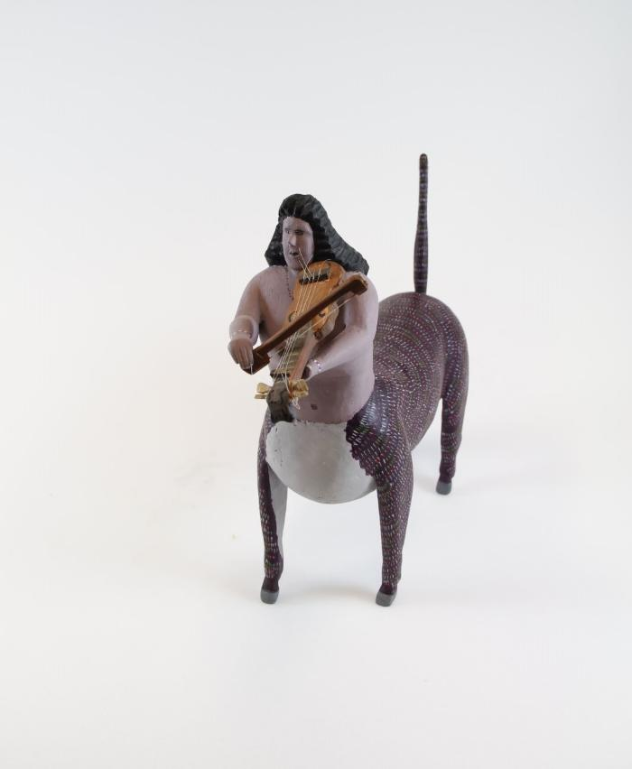
Centaur playing Violin (SH43)

Slide 44
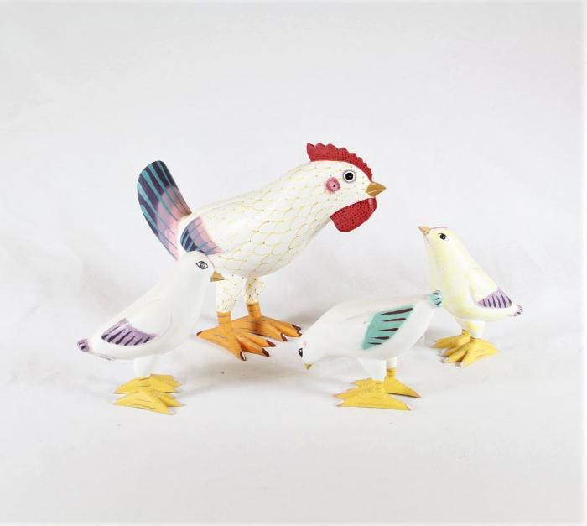
Chicken with Chicks (SH44)

Slide 45
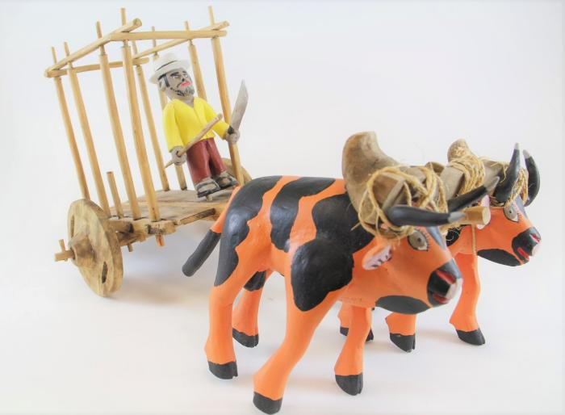
Cows with Cart (SH45)

Slide 46
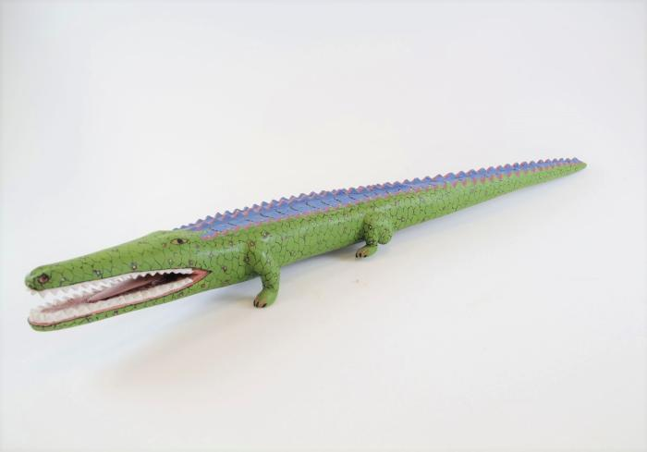
Crocodile (SH46)

Slide 47
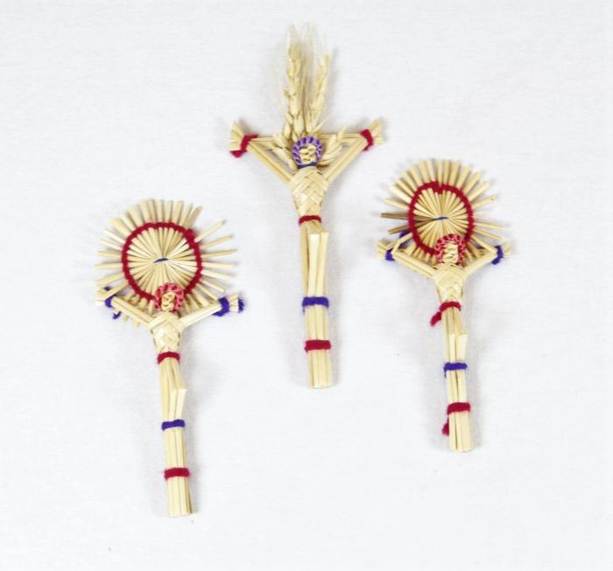
Crucification (SH47)

Slide 48
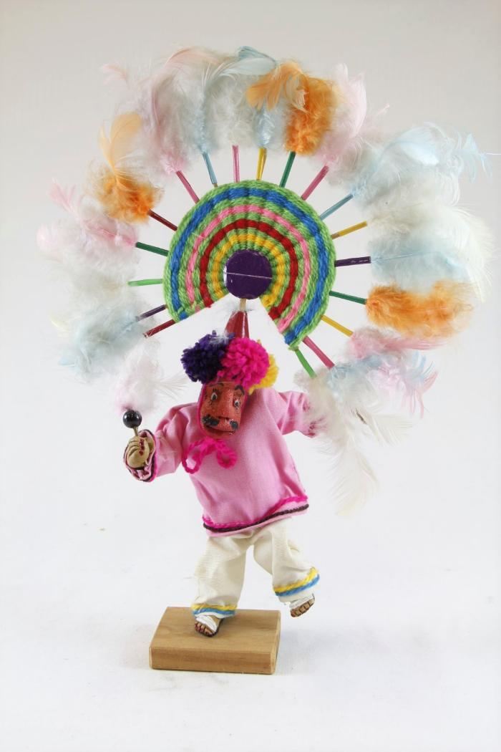
Danza de la Pluma (SH48)

Slide 49
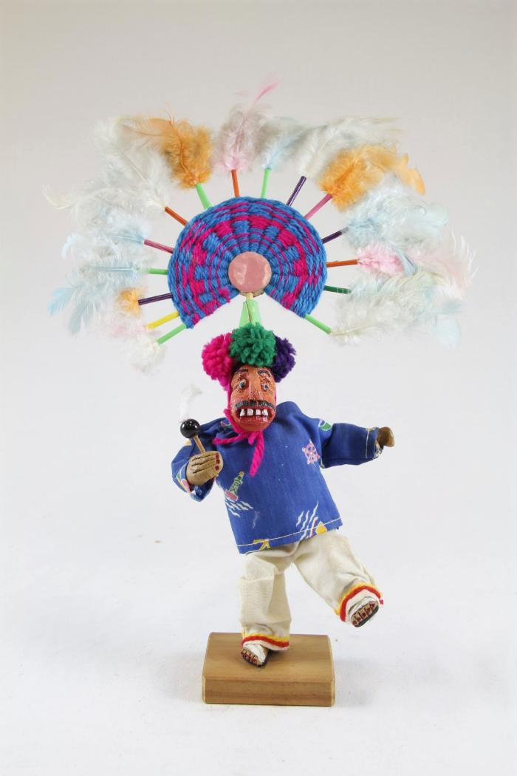
Danza de la Pluma (SH49)

Slide 50
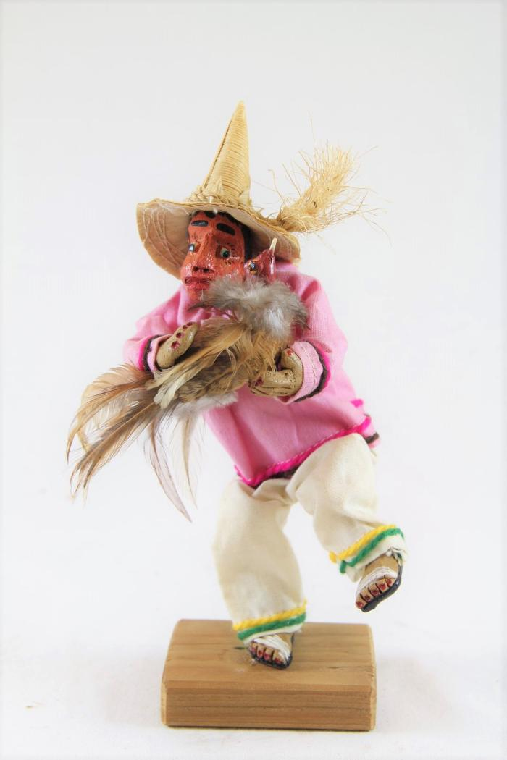
Dancing Man with Bird (SH50)

Slide 51
Torito Dancer with Fireworks (SH51)

Slide 52
Dancing Man with Cow Fireworks (SH52)

Slide 53
Decorated Cows with Cart (SH53)

Slide 54
Desert Scene (SH54)

Slide 55
Dog playing Guitar (SH55)

Slide 56
Dragon (SH56)

Slide 57
Dragon (SH57)

Slide 58
Dragon (SH58)

Slide 59
East African Ngoma (SH59)

Slide 60
Elephant (SH60)

Slide 61
Farmers on Parade (SH61)

Slide 62
Makonde Shetani Sculpture (SH62)

Slide 63
Firework Castle (SH63)

Slide 64
Firework Dancing man (SH64)

Slide 65
Frog Pitcher Set (SH65)

Slide 66
Garuda (SH66)

Slide 67
Giant Vase (SH67)

Slide 68
Goat with Guitar (SH68)

Slide 69
Devil Masked Peasant Dancer (SH69)

Slide 70
Hookah (SH70)

Slide 71
Deer Alebrije (SH71)

Slide 72
Humming Bird (SH72)

Slide 73
Kneeling Angel (SH73)

Slide 74
La Serina playing Horn (SH74)

Slide 75
La Virgen de San Juan de los Lagos (SH75)

Slide 76
La Virgen del Apocalipsis (SH76)

Slide 77
Women selling Goods (SH77)

Slide 78
Woman with White Flowers (SH78)

Slide 79
Tigrada Parade Cornhusk Doll (SH79)

Slide 80
Tigrada Parade Cornhusk Doll (SH80)

Slide 81
Lion (SH81)

Slide 82
Lizard (SH82)

Slide 83
Lizard (SH83)

Slide 84
Lizard (SH84)

Slide 85
Longhaired Maiden (SH85)

Slide 86
Man displaying Virgin (SH86)

Slide 87
Man riding with Animals (SH87)

Slide 88
Man with Maracas (SH88)

Slide 89
Man with Whip (SH89)

Slide 90
Many Faces of Mata Ortiz (SH90)

Slide 91
Mermaid with Frog (SH91)

Slide 92
Mermaids on Beach (SH92)

Slide 93
Monk with Bird (SH93)

Slide 94
Mother Skunk (SH94)

Slide 95
Multi Color Bikini Cat Band (SH95)

Slide 96
Oaxacan Plume Dancer (SH96)

Slide 97
Ethiopian Canoe Gambella Basket (SH97)

Slide 98
Palm Tree with Feeding Bird (SH98)

Slide 99
Pink Flower (SH99)

Slide 100
Purple Angel holding Flower (SH100)

Slide 101
Rabbit (SH101)

Slide 102
Rat Woodcarving (SH102)

Slide 103
Red Green and Silver Vase (SH103)

Slide 104
Red Vase (SH104)

Slide 105
Rooster (SH105)

Slide 106
Saint Francis of Assisi (SH106)

Slide 107
Saint Michael (SH107)

Slide 108
Serpent Pottery Vessel (SH108)

Slide 109
Skeleton Band (SH109)

Slide 110
Small Red Vase (SH110)

Slide 111
Small Red Vase (SH111)

Slide 112
Tea Pot (SH112)

Slide 113
Toucan (SH113)

Slide 114
Wood Carved Turtles (SH114)

Slide 115
Vase (SH115)

Slide 116
Virgen de la Soledad (SH116)

Slide 117
Virgin de Guadalupe (SH117)

Slide 118
Virgin de Guadalupe (SH118)

Slide 119
Virgin de Guadalupe (SH119)

Slide 120
Virgin de Guadalupe (SH120)

Slide 121
Virgin de Guadalupe (SH121)

Slide 122
Virgin de la Soledad (SH122)

Slide 123
Virgin De Rosary (SH123)

Slide 124
Virgin Mary (SH124)

Slide 125
Virgin Mary (SH125)

Slide 126
Virgin Mary with Man kneeling (SH126)

Slide 127
Virgin of Guadalupe (SH127)

Slide 128
Virgin of Guadalupe Cactus (SH128)

Slide 129
Chalupa Boat (SH129)

Slide 130
Woman making a Rug (SH130)

