Slide 1
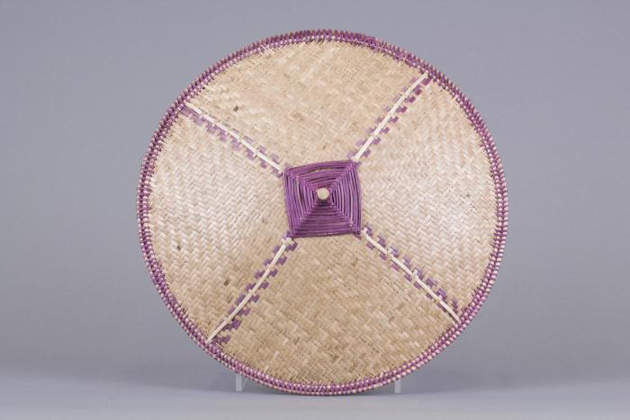
Woven Bamboo Conical Hat (FR4)

