Slide 1
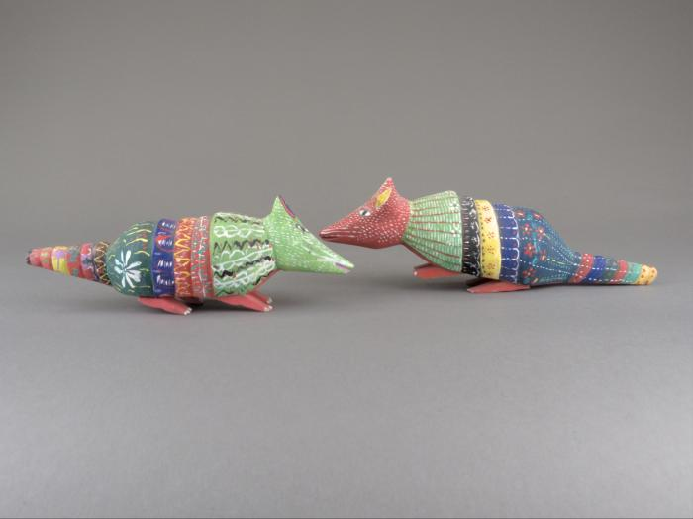
Wood Carved Armadillos (FR103)

