Slide 1
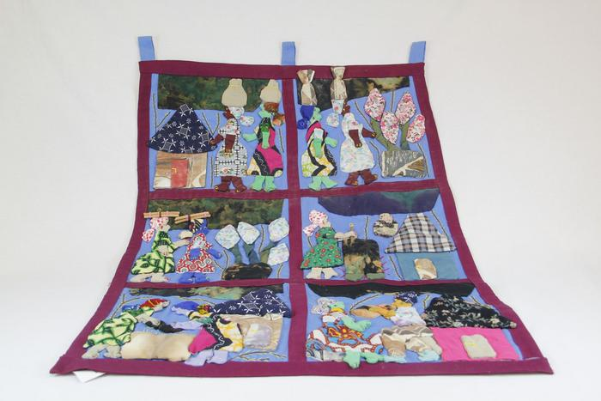
Zimbabwean Quilt (EH7)

