Slide 1
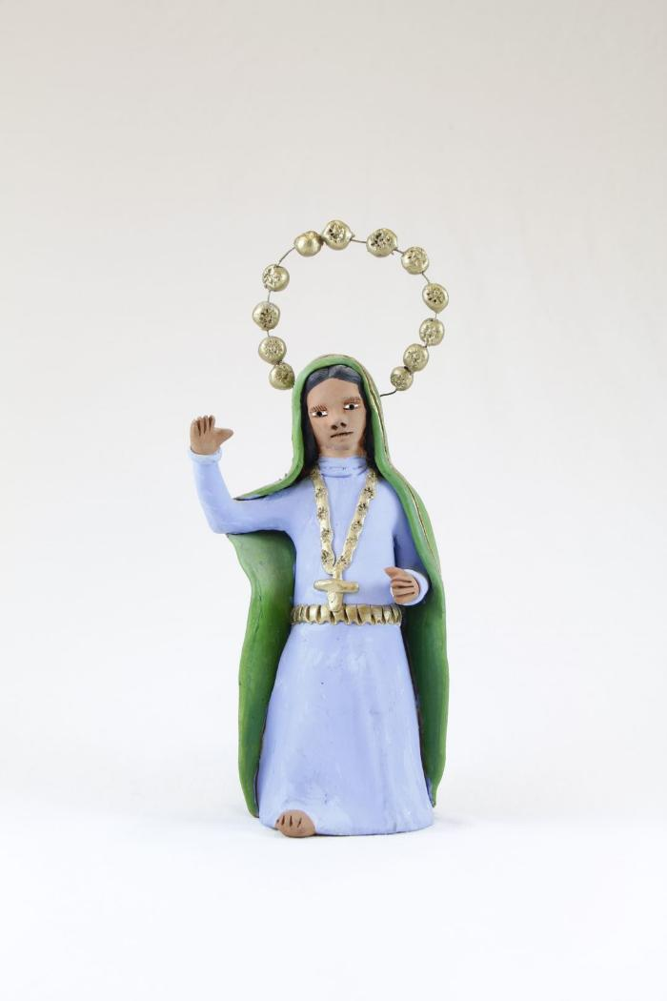
Virgin De Rosary (SH123)

