Slide 1
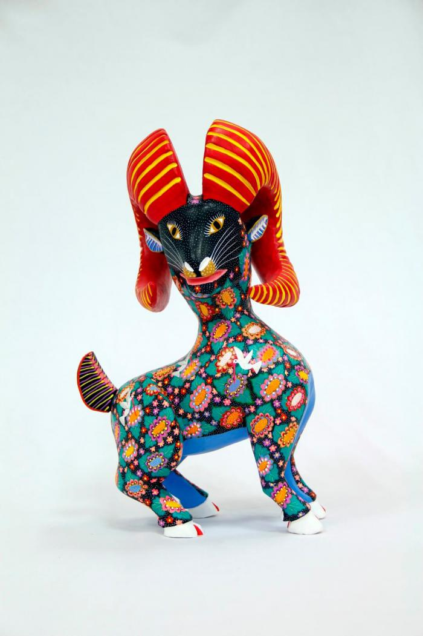
Horned goat (CA8)

