Slide 1
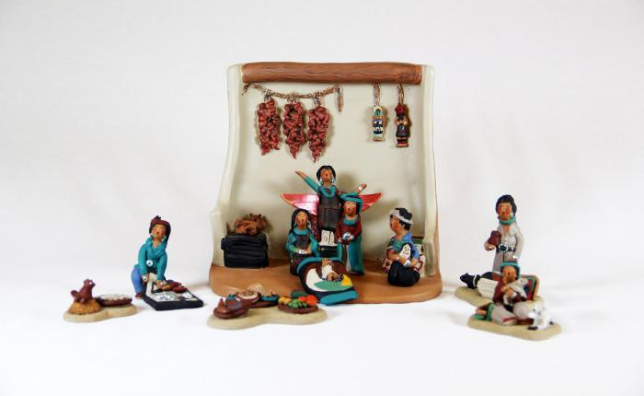
Native American Nativity (13 pieces) (M1068)

Slide 2
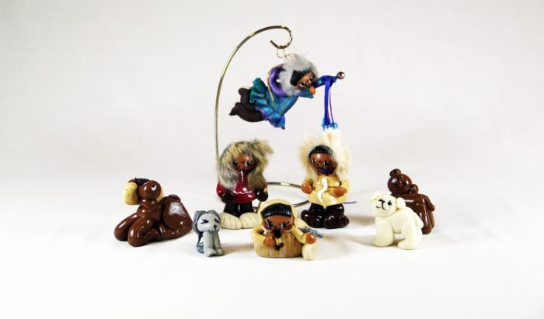
Eskimo Nativity (14 pieces) (M1096)

Slide 3
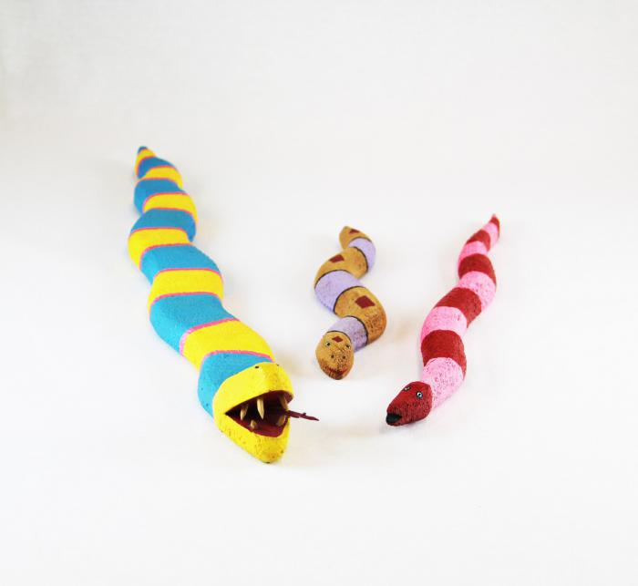
3 Native American Fantasy Snakes (MU3472)

Slide 4
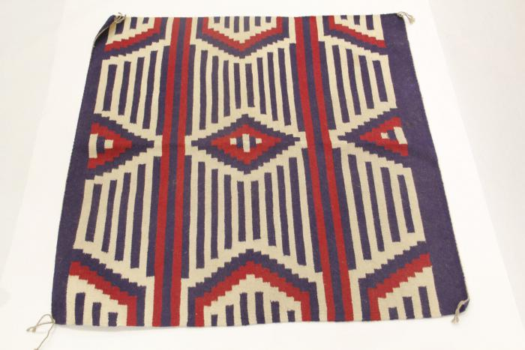
Red, White & Blue Woven Wool Rug (MU3473)

Slide 5
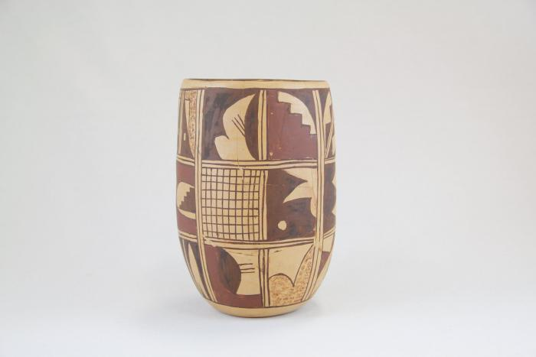
Zuni Burnished Pot (Cracked & Repaired) (MU3479)

Slide 6
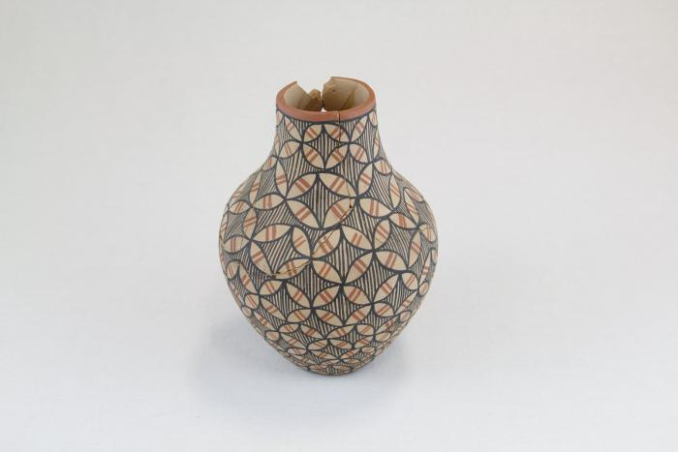
Zuni Terra Cotta Pot with Brown & Red Accents (MU3480)

Slide 7
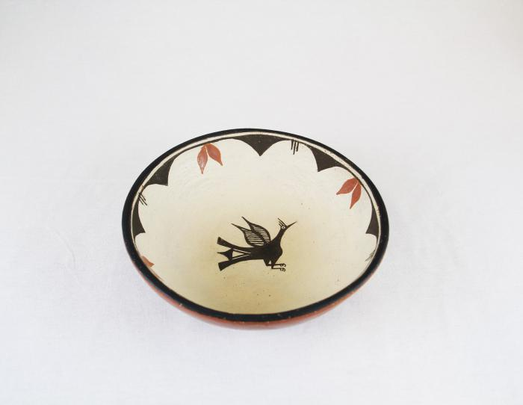
Terra Cotta Bowl with Bird in Center (MU3483)

Slide 8
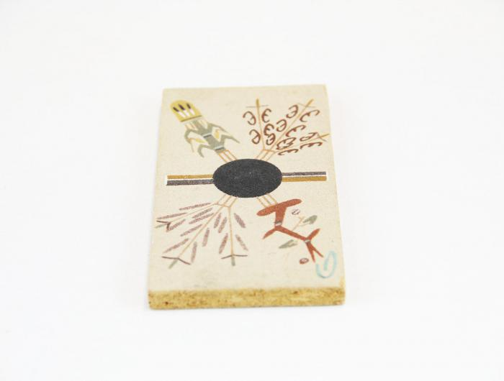
Painted Particle Board (MU3484)

Slide 9
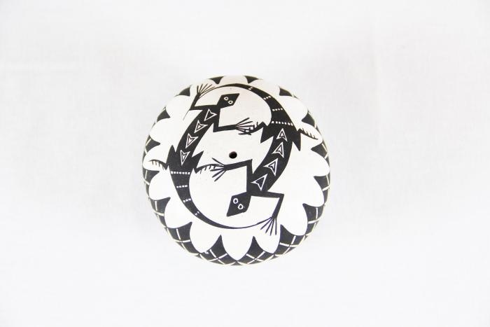
Black & White Seed Pot with lizards (MU3485)

Slide 10
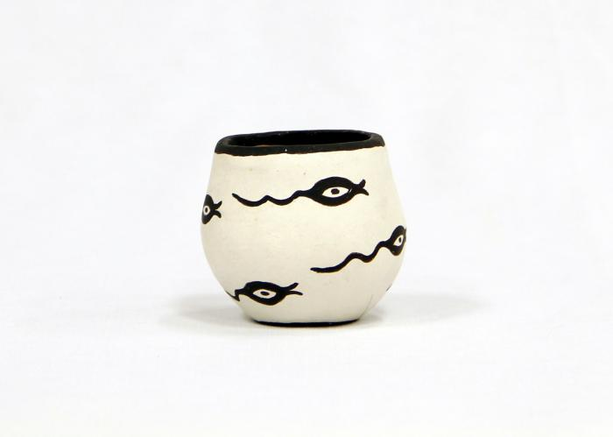
Black & White Zuni Pot with Tadpole Motif (MU3486)

Slide 11
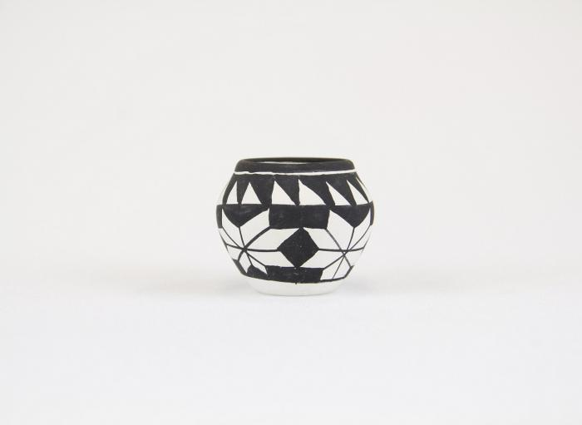
Clay Black & White Acoma Pot (MU3487)

Slide 12
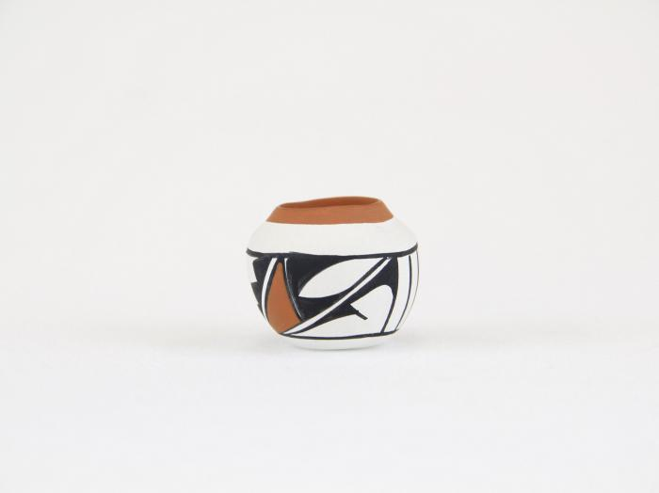
Small Clay White, Black & Tan Painted Pot (MU3488)

Slide 13
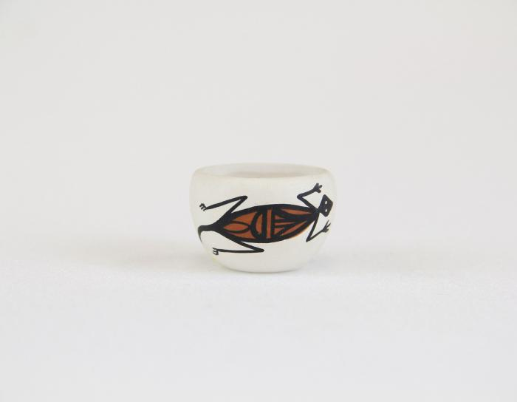
Small Painted Acoma Pot with Lizard Design (MU3489)

Slide 14
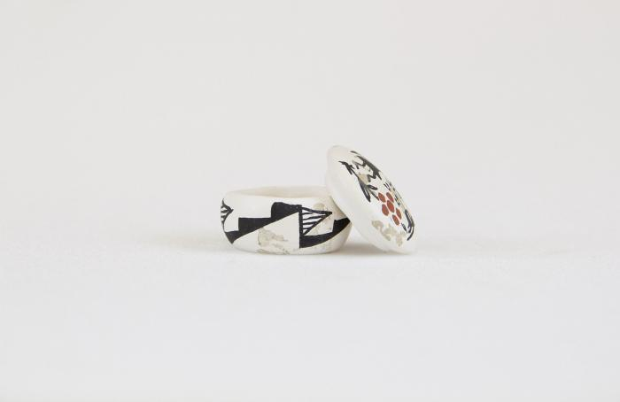
Small painted Acoma Pot with Lid & Kokopelli design (MU3490)

Slide 15
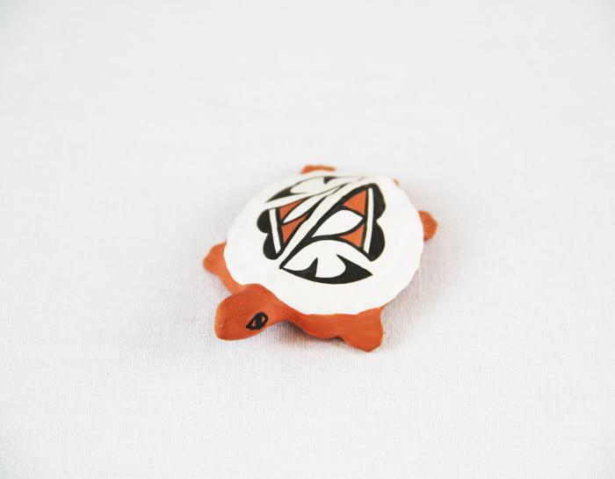
Small Painted Clay Turtle (MU3491)

Slide 16
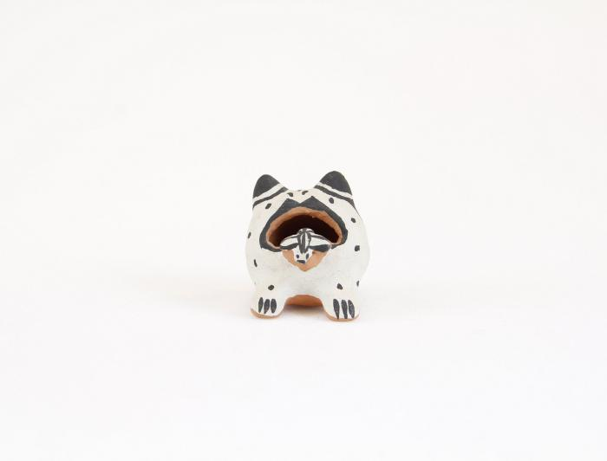
Cochiti Pueblo Ceramic Frog (MU3492)

Slide 17
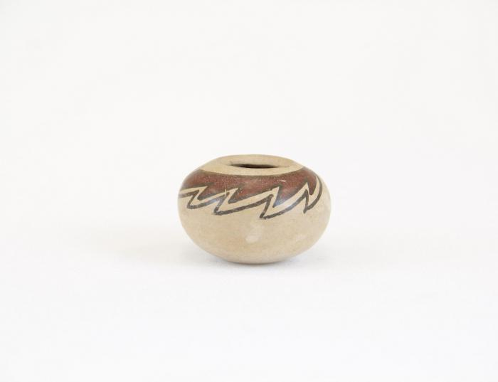
Small Clay Brown and Tan Painted Pot (MU3493)

Slide 18
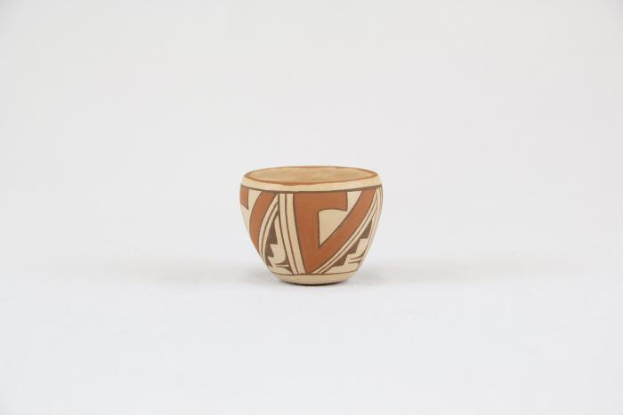
Small Clay Painted Pot (MU3494)

Slide 19
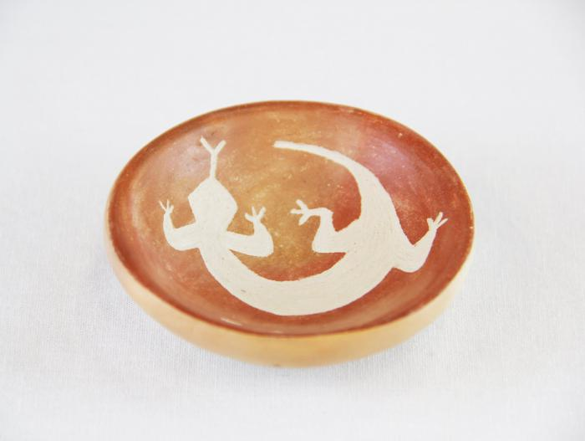
Small Clay Brown & Tan Painted Incense Burner with Lizard Design (MU3495)

Slide 20
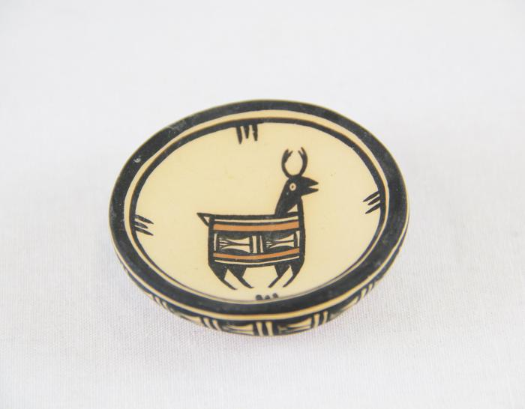
Small Clay Black & White Painted Bowl with Deer Design (MU3496)

Slide 21
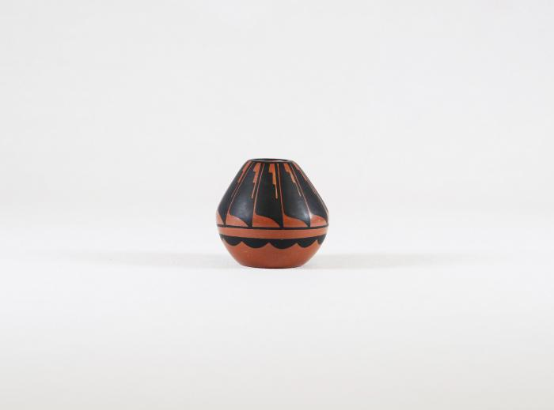
Small Painted Brown & Black Ceramic Pot (MU3498)

Slide 22
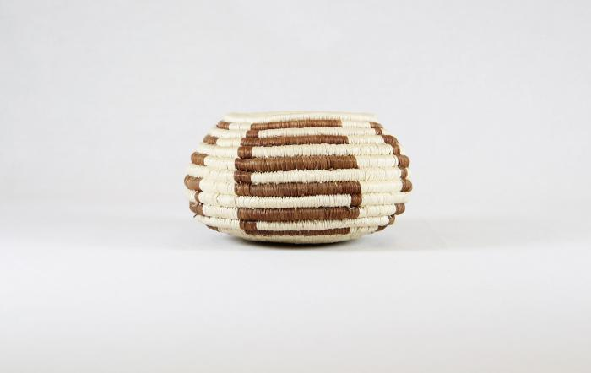
Tohona-O’Odham Small Woven Cream & Brown Coil Pot (MU3500)

Slide 23
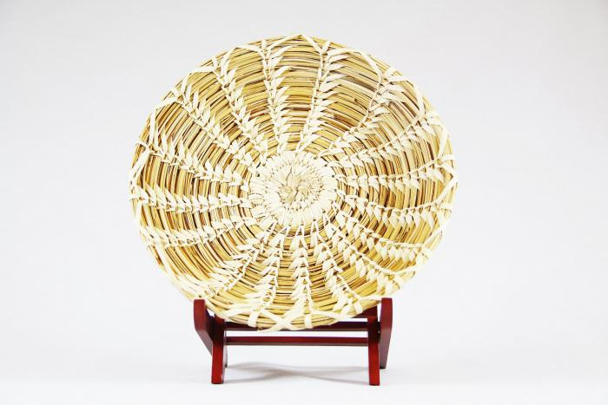
Tohona-O’Odham Yucca & Devil Claw Round Basket with Rim (MU3501)

Slide 24
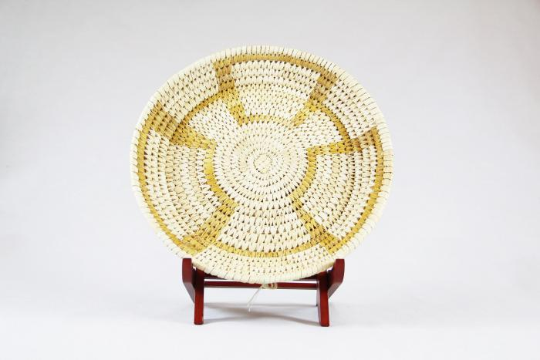
Tohono-O’Odham Woven Yucca Round Basket (MU3502)

Slide 25
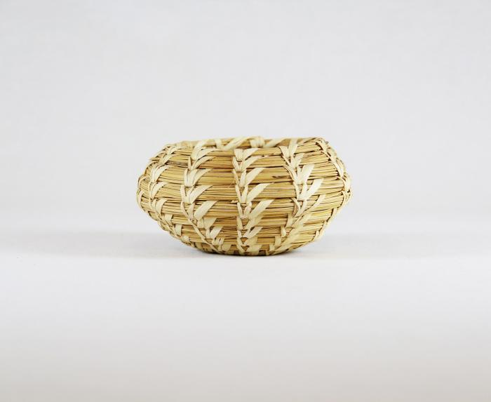
Tohono-O’Odham Woven Yucca Basket (MU3503)

Slide 26
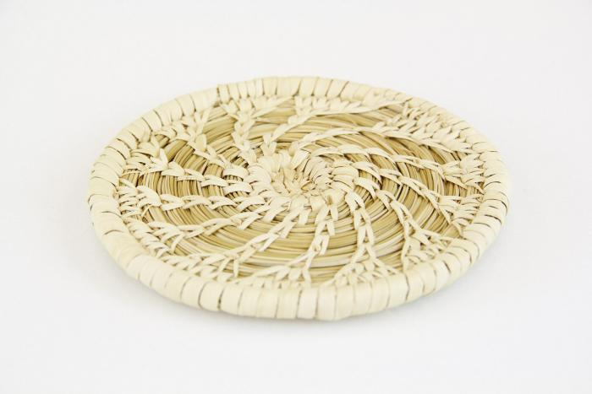
Tohono-O’Odham Flat, Round Basket with Yucca Flower Pattern (MU3504)

Slide 27
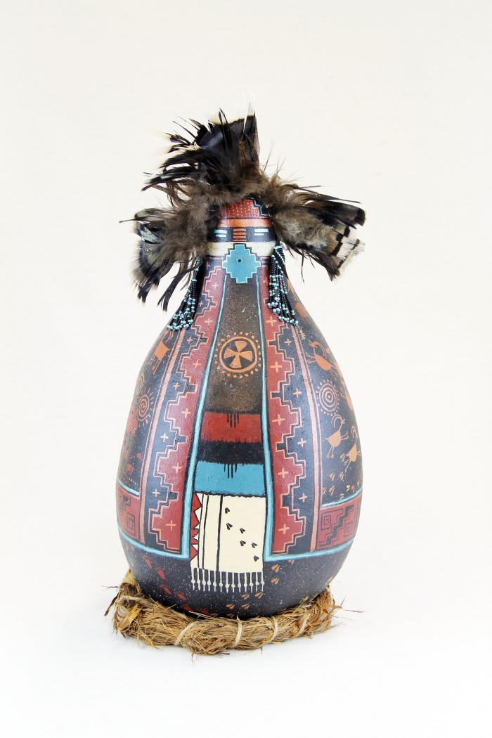
Gourd Doll on Grass Ring Pedestal (MU3506)

Slide 28
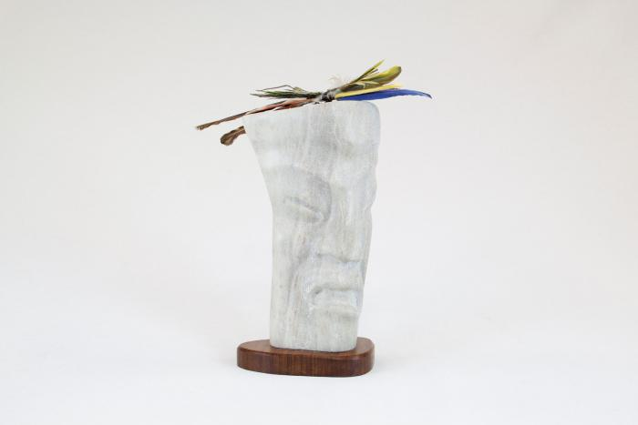
Singer Stone Figure Sculpture with Bird Feathers (MU3507)

Slide 29
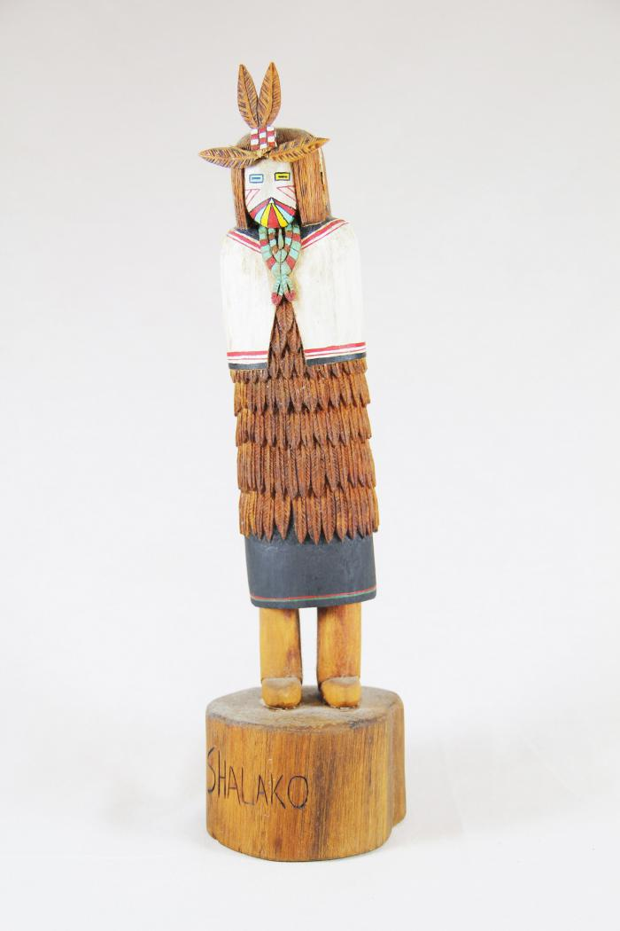
Kachina Doll (Shaloko) (MU3508)

Slide 30
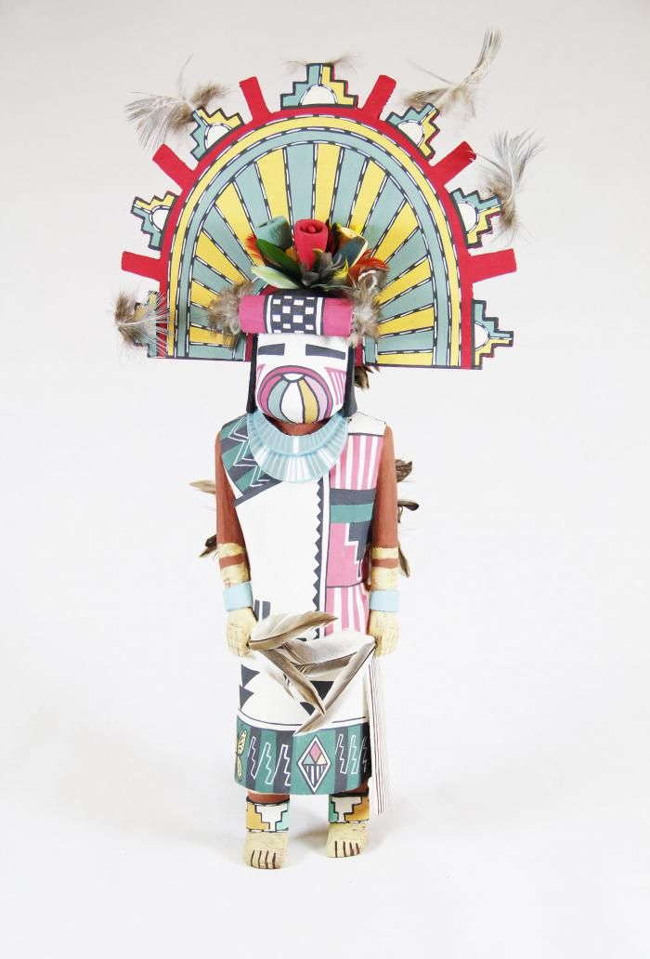
Kachina Doll (Palhik Mana) (MU3509)

Slide 31
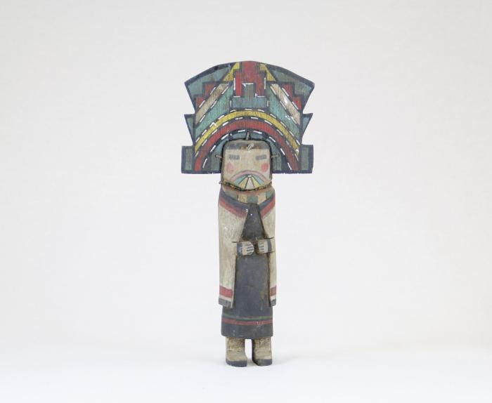
Kachina Doll (MU3510)

Slide 32
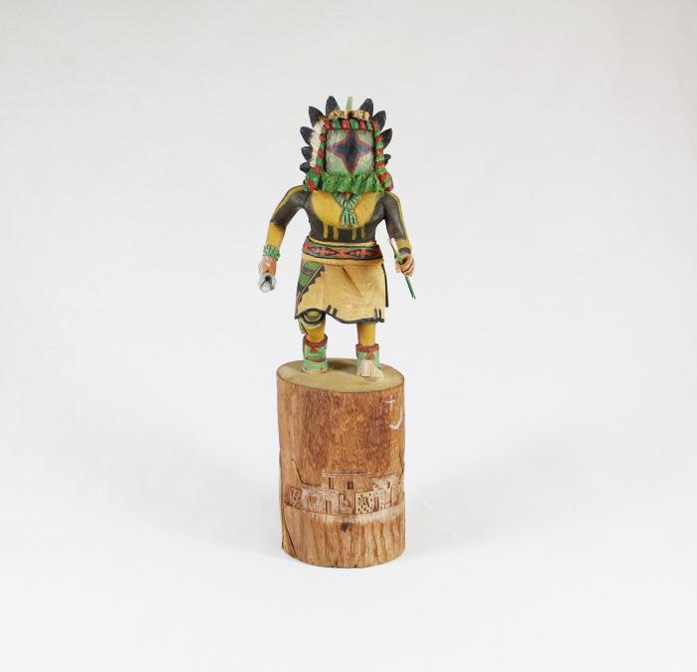
Kachina Doll (Chasing Star) (MU3511)

Slide 33
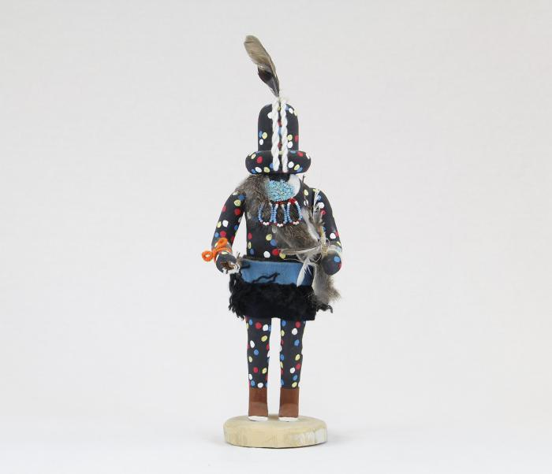
Kachina Doll (Zuni Fire God) (MU3512)

Slide 34
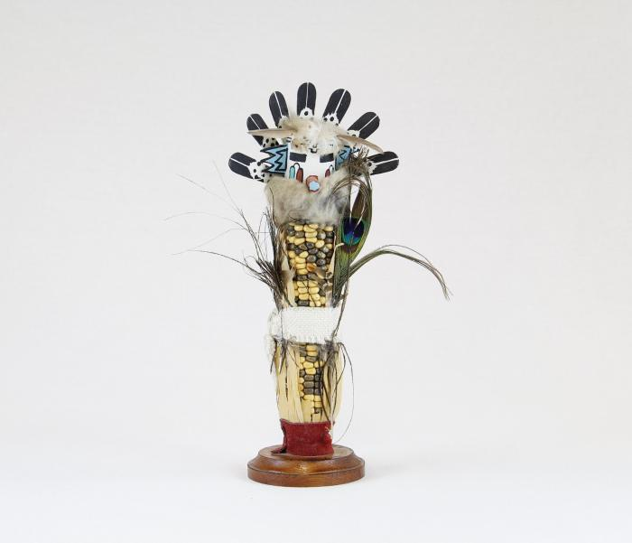
Kachina Doll (Corn Maiden) (MU3513)

Slide 35
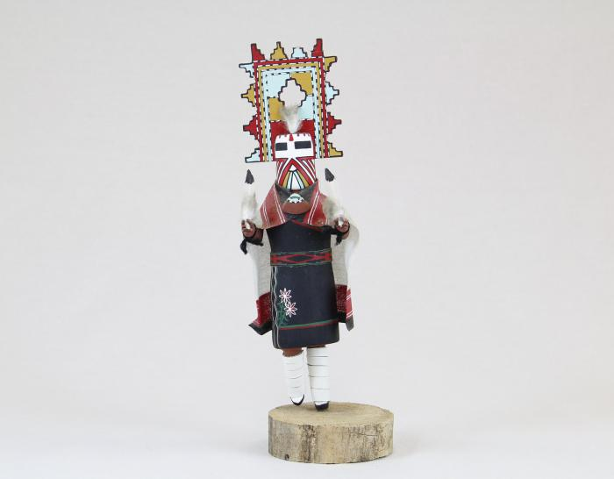
Kachina Doll (Palhik Mana) (MU3515)

Slide 36
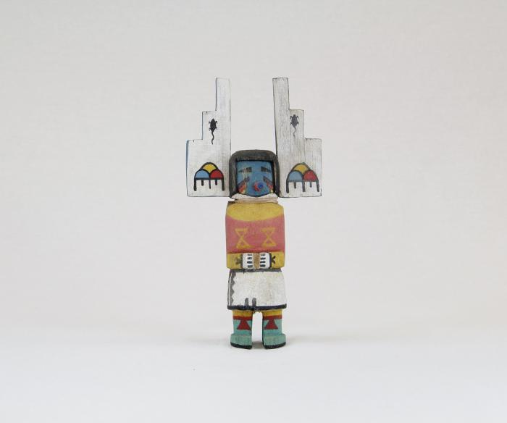
Kachina Doll (MU3516)

Slide 37
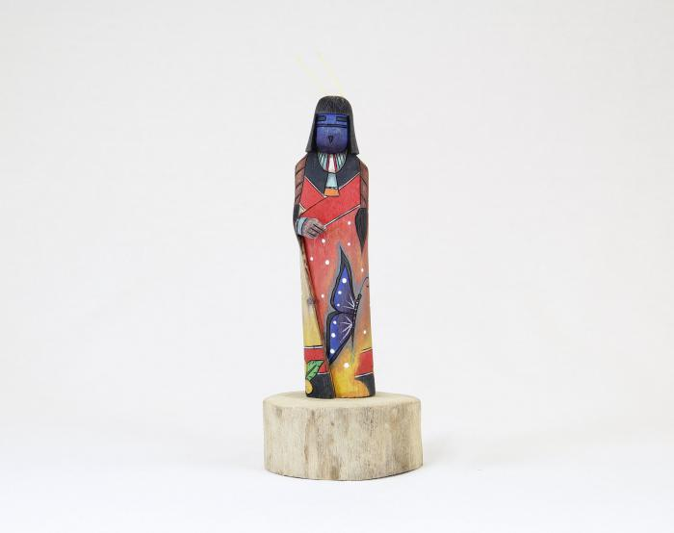
Kachina Doll (Shalako) (MU3517)

Slide 38
Kachina Doll (Ogre Woman) (MU3518)

Slide 39
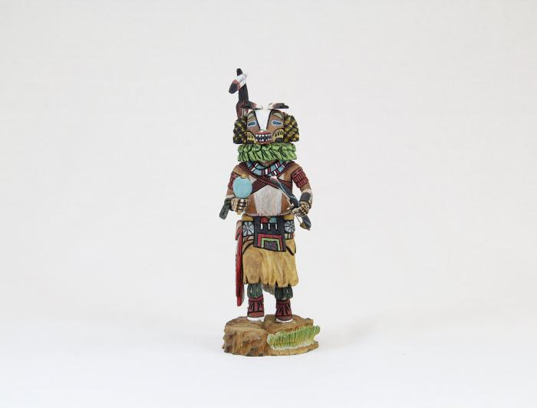
Kachina Doll (Badger) (MU3519)

Slide 40
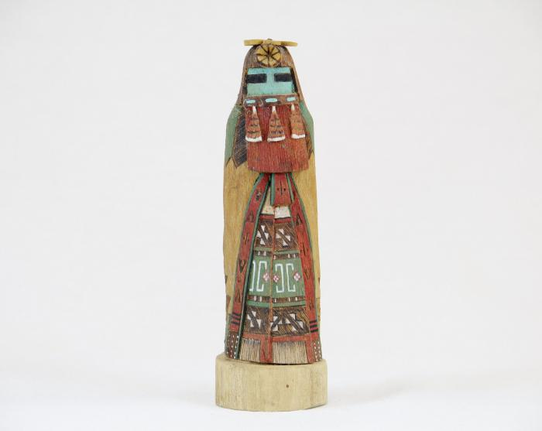
Kachina Doll (Hopi - Red Beard Long Hair) (MU3520)

Slide 41
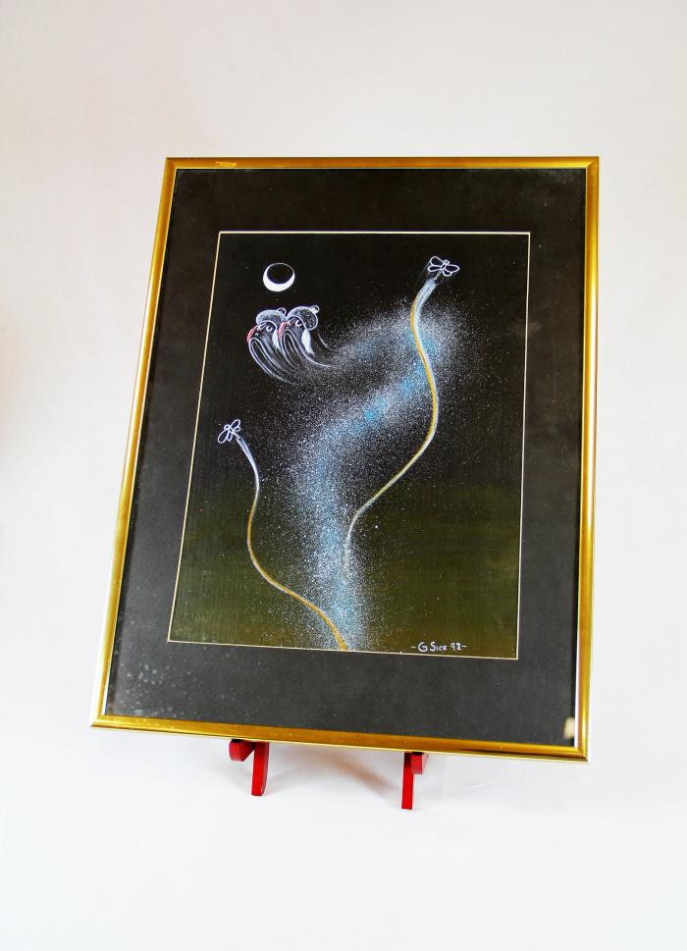
"4th World" Painting (MU3523)

Slide 42
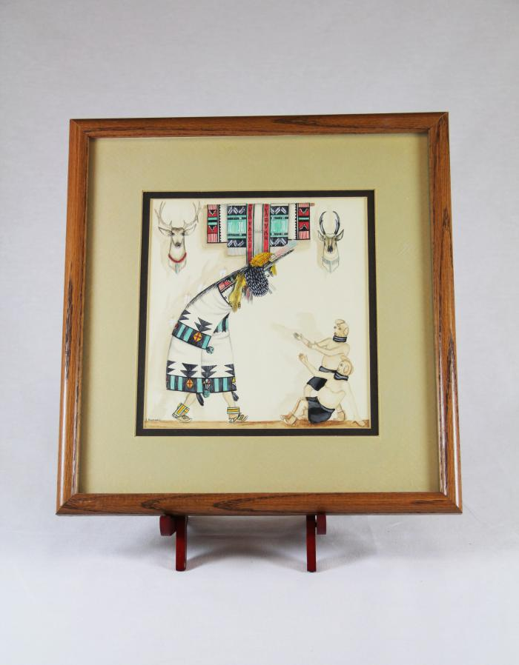
Zuni Shalako Kachina Painting (MU3525)

Slide 43
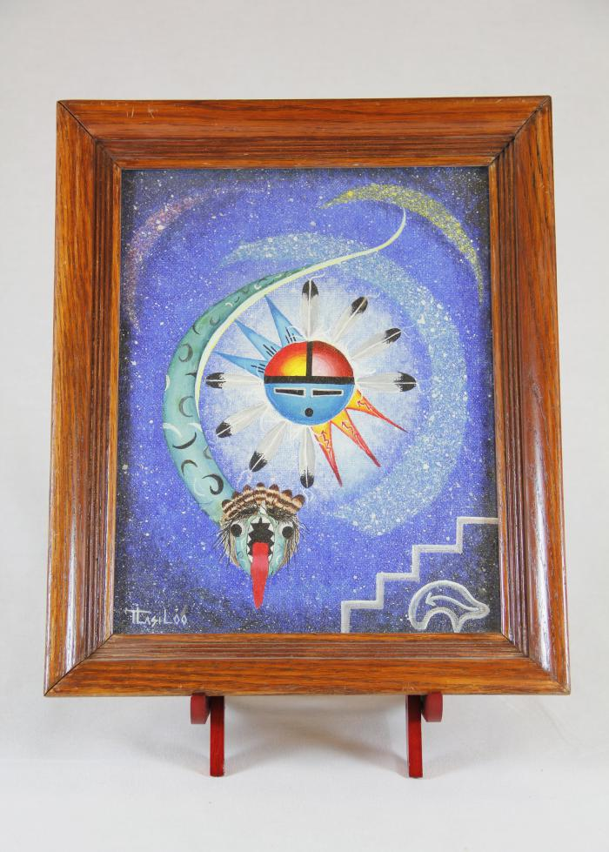
Sun Father and Snake Painting (MU3526)

Slide 44
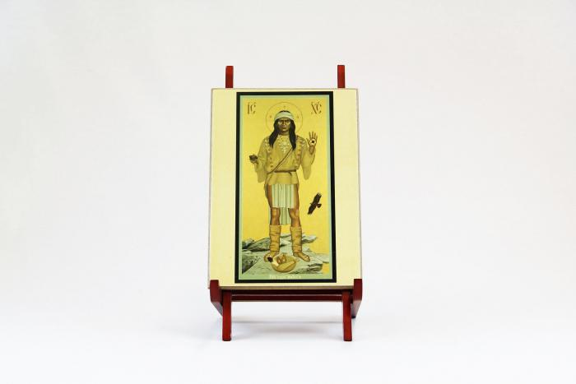
Apache Christ (MU3527)

Slide 45
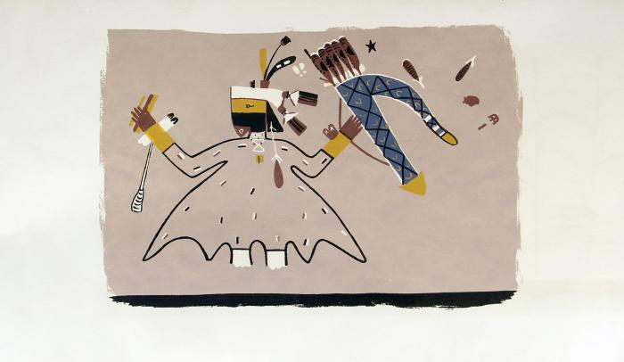
Paper scroll with rendering of mural on the interior walls of a painted kiva in the Southwest area (MU3528)

Slide 46
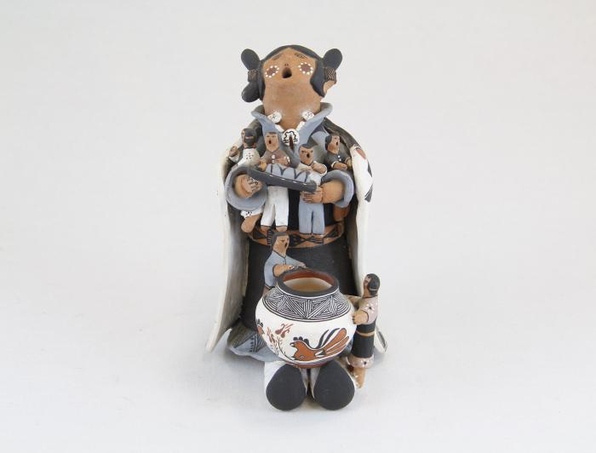
Storytelling Woman, "Naya" (MU13)

Slide 47
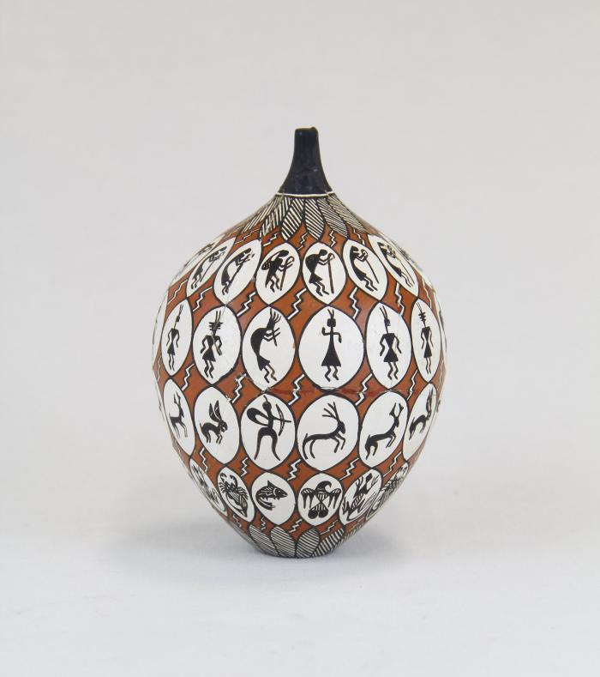
Storytelling Painted Clay Pot (MU14)

Slide 48
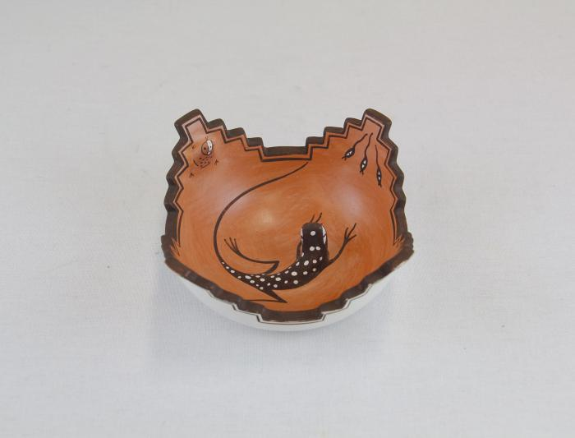
Zuni Pot with Lizard in Center (MU15)

Slide 49
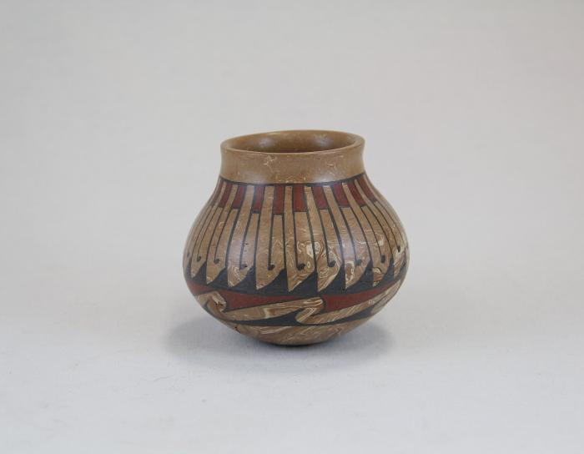
Repeated Wave Pot (MU16)

Slide 50
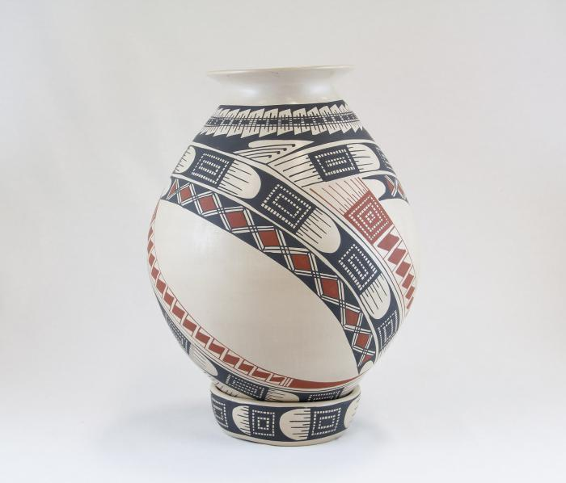
Jar with belt pattern and base (MU17)

Slide 51
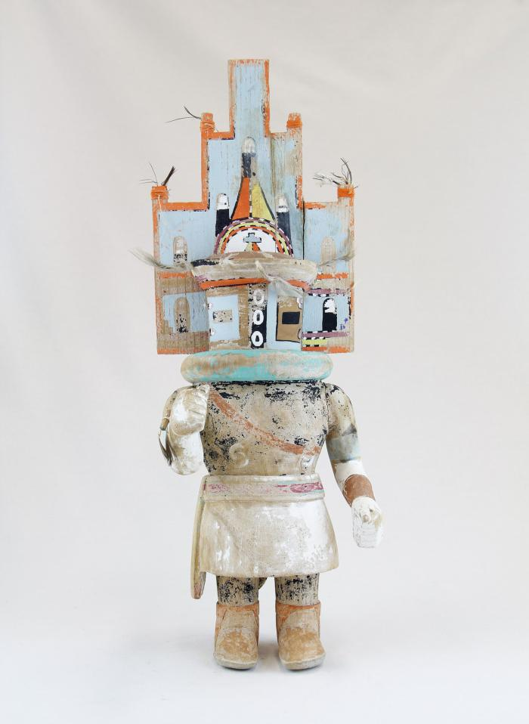
Hopi Hemis Kachina (MU18)

Slide 52
Kachina doll (Hilili) (MU3514)

Slide 53
Kachina Doll (Handprint Racer) (MU3521)

Slide 54
Oil Painting of Kachina Figure Framed in Wood (MU3524)

Slide 55
Face Jug (EH4)

Slide 56
Three Minstrels (EH10)

Slide 57
Jumex Ceramic Heart with Nails (EH16)

Slide 58
Wolf Head on Metal Band (EH17)

Slide 59
"Sisters in Progress", Painted Rock Paperweight (EH19)

Slide 60
Woman Riding Elephant in Glass Case (EH20)

Slide 61
George Washington (EH21)

Slide 62
Woman Guitarist (EH23)

Slide 63
Three Sitting Dogs Playing Cards on Green Plank (EH25)

Slide 64
Cowboy Alligator (EH26)

Slide 65
Two Carved Wood Indoor Scenes (EH29)

Slide 66
Howard Finster Eagle and Poem on Board (EH30)

Slide 67
Woman and Child (EH32)

Slide 68
Polar bear with Cub (AC1)

Slide 69
Boy Fishing (AC2)

Slide 70
Humpback whale (AC3)

Slide 71
Spirit of the Mountain (AC4)

Slide 72
Two-Headed Statue (AC5)

Slide 73
Caribou Skin Mask with Black Ink Tattoos (AC6)

Slide 74
Stages of Marriage Bracelet (AC7)

Slide 75
Eagle and Fish (AC8)

Slide 76
Miniature Mountain Spirit Mask (AC9)

Slide 77
Loon Birds Earrings (AC10)

Slide 78
Kayak Necklace (AC11)

Slide 79
Ivory Swan Pendant (AC12)

Slide 80
Lucky Halibut (AC13)

Slide 81
Round Earrings (AC14)

Slide 82
Rhombus Earrings (AC15)

Slide 83
Beluga Whale (AC16)

Slide 84
Baby Seal (AC17)

Slide 85
Baby Polar Bear (AC18)

Slide 86
Bird Pendant (AC19)

Slide 87
Button Face Native Doll (AC20)

Slide 88
Yupik Bone Doll (AC21)

Slide 89
Yupik Bone Doll (AC22)

Slide 90
Chevak Cup'ik Doll holding Berries (AC23)

Slide 91
Chevak Cup'ik Doll (AC24)

Slide 92
"Land Carer" (PE1)

Slide 93
"Mother Earth" (PE2)

Slide 94
Bird House and Flowers (HA1)

Slide 95
Man smoking pipe with cat and flowers (HA2)

Slide 96
Two girls and chickens (HA3)

Slide 97
Cat sits on chair surrounded by flowers (HA4)

Slide 98
Catrina (ME1)

Slide 99
Vollis Simpson Whirligig (HN1)

Slide 100
Three Figures (DA1)

Slide 101
Pima Coil Basket (FR152)

Slide 102
Robert Rivera Gourd with Flute Player (FR153)

Slide 103
Amish Dolls (FR154)

