Slide 1
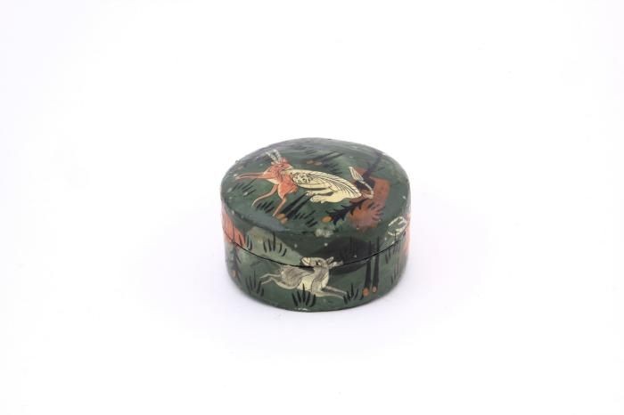
Lacquer Box from Kashmir (FR54)

