Slide 1
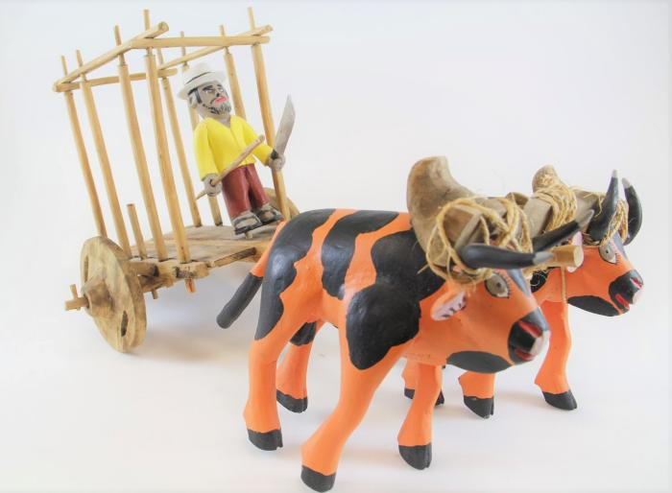
Cows with Cart (SH45)

