Slide 1
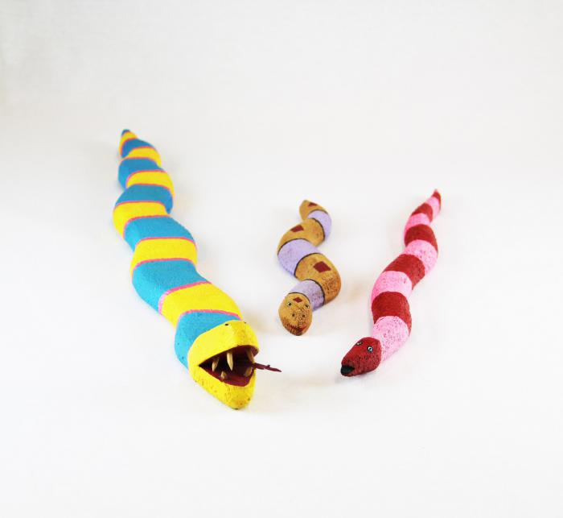
3 Native American Fantasy Snakes (MU3472)

