Slide 1
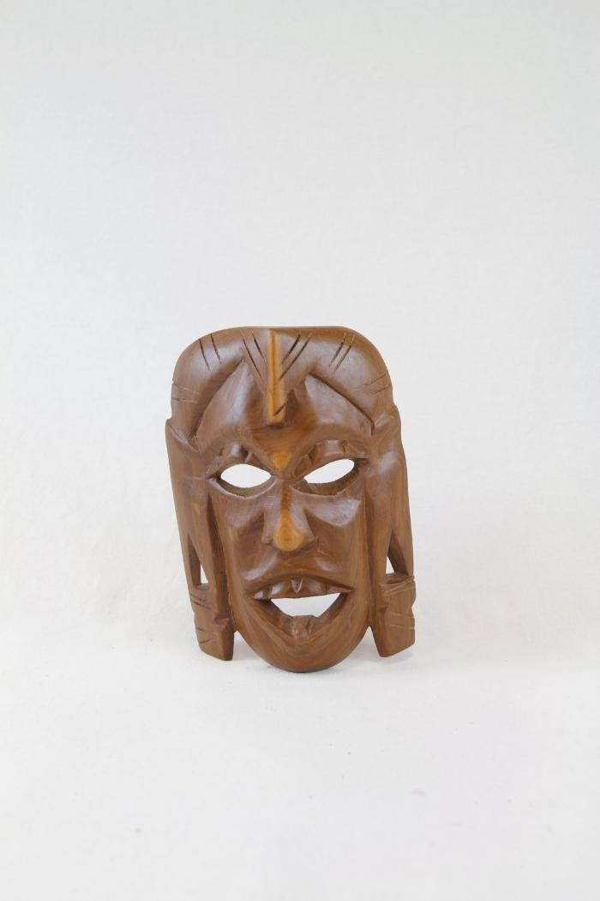
Maasai mask (PR55)

Slide 2
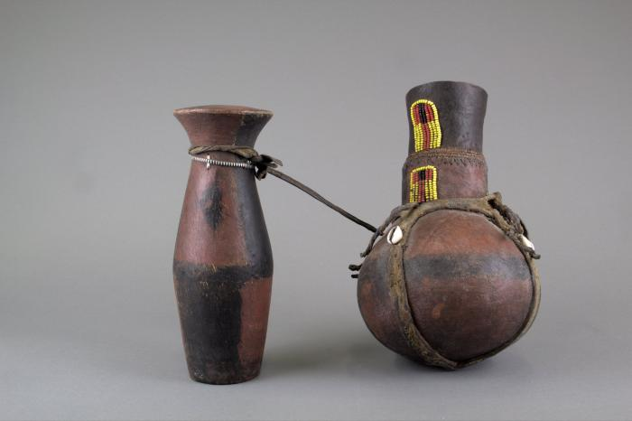
Beaded Kenyan Jugs (FR79)

