Slide 1
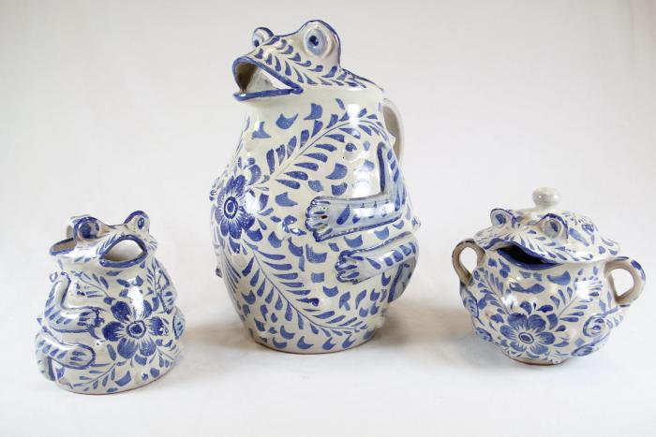
Frog Pitcher Set (SH65)

