Slide 1
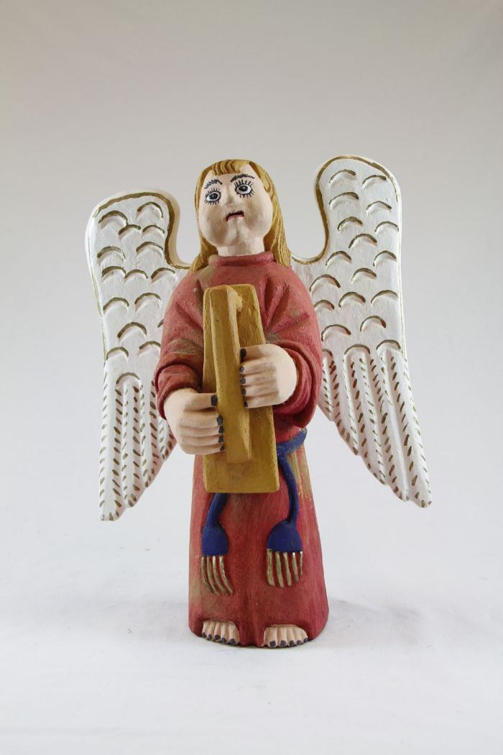
Angel playing Harp (SH12)

