Slide 1
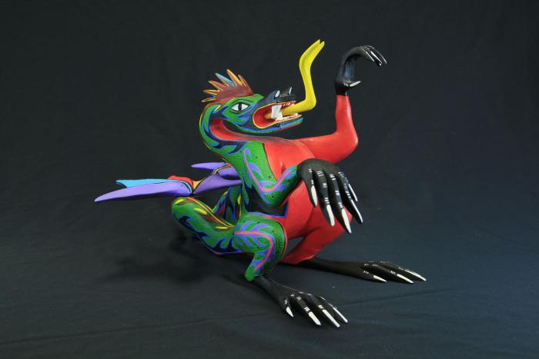
Dragon (SH58)

