Slide 1
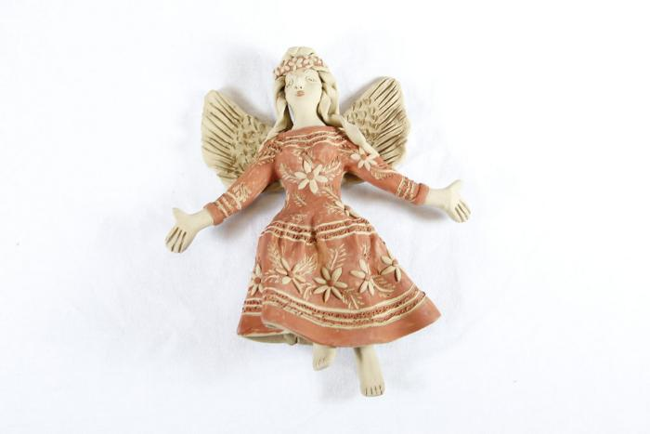
Angel (SH3)

Slide 2
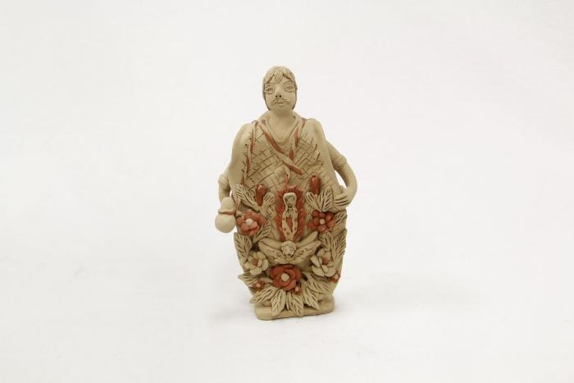
Man displaying Virgin (SH86)

Slide 3
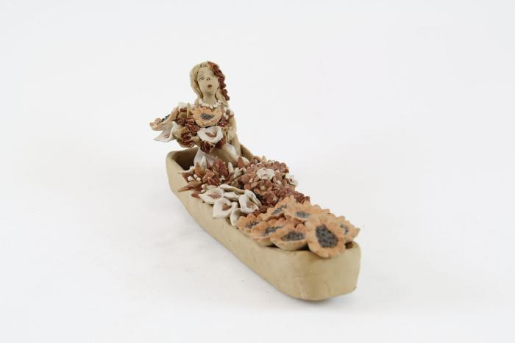
Chalupa Boat (SH129)

