Slide 1
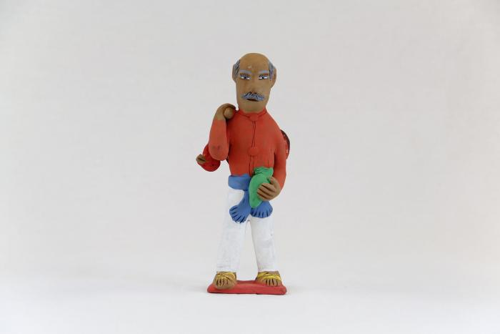
Man carrying Turkey (VM1)

Slide 2
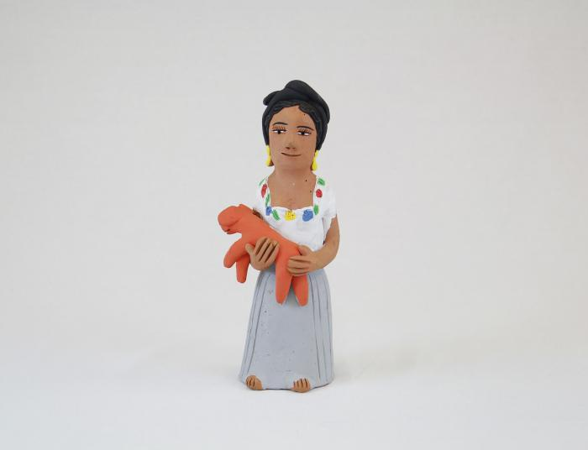
Muñeca holding Dog (VM2)

Slide 3
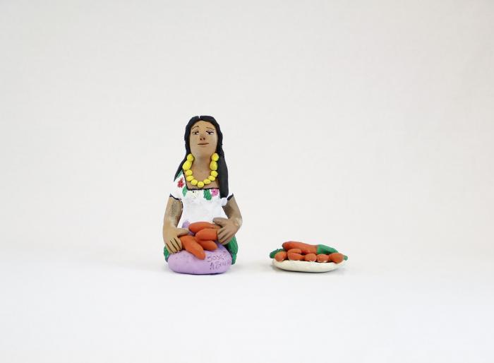
Kneeling Muñeca in White and Purple Dress with Carrots and Plate of Carrots (VM3)

Slide 4
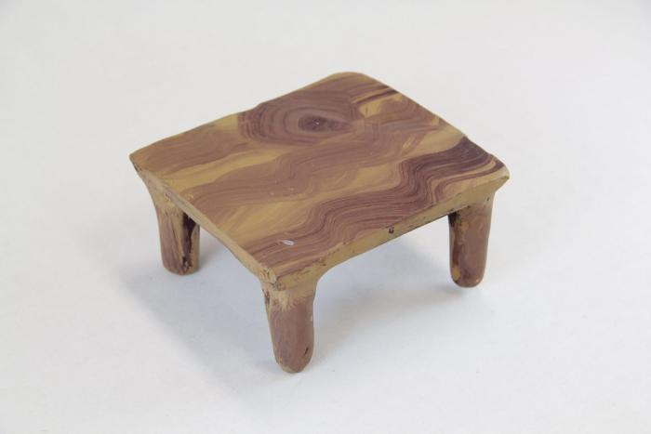
Small Clay Table (VM4)

Slide 5
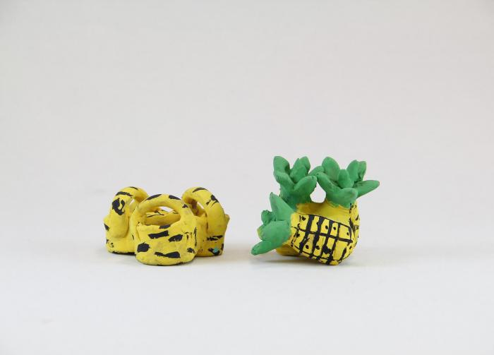
Three Yellow Baskets / Three Pineapples (VM5)

Slide 6
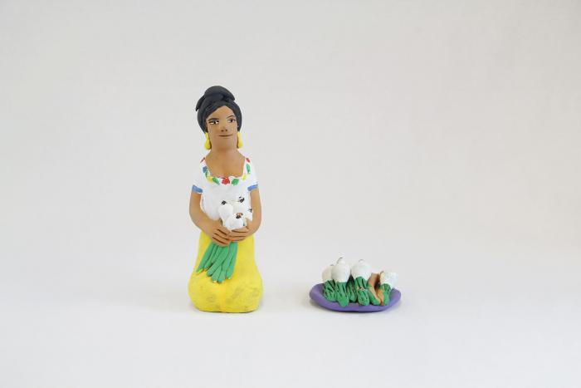
Kneeling Muñeca with Onions and Plate of Onions (VM6)

Slide 7
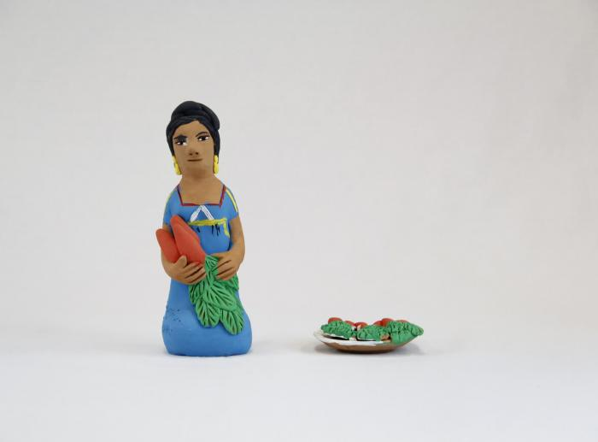
Kneeling Muñeca in Blue Dress with Carrots and Plate of Carrots (VM7)

Slide 8
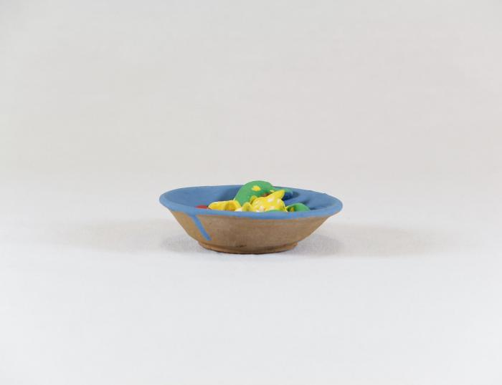
Bowl of Fruit (VM8)

Slide 9
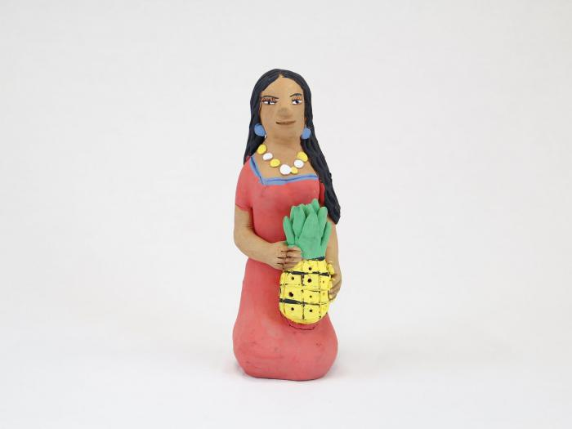
Kneeling Muñeca with Pinneapple (VM9)

Slide 10
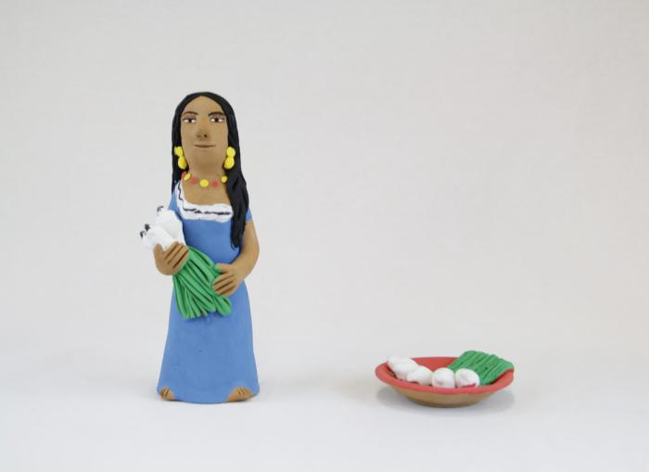
Standing Muñeca with Onions and Plate of Onions (VM10)

Slide 11
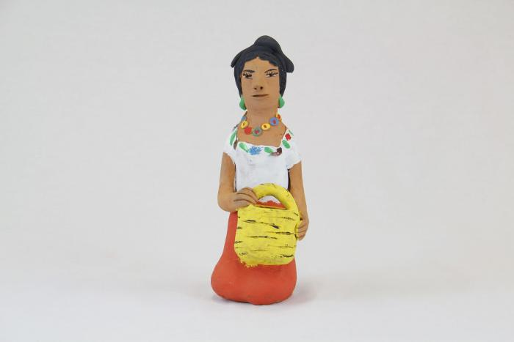
Kneeling Muñeca with Basket (VM11)

Slide 12
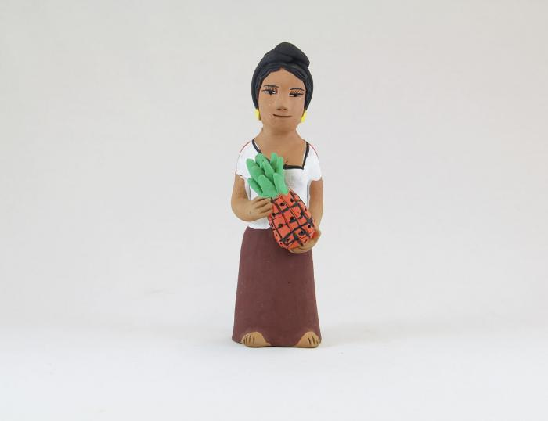
Standing Muñeca with Pinneapple (VM12)

Slide 13
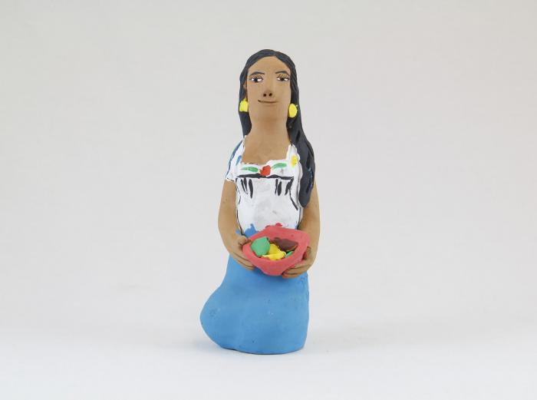
Muñeca with Fruit Bowl (VM13)

Slide 14
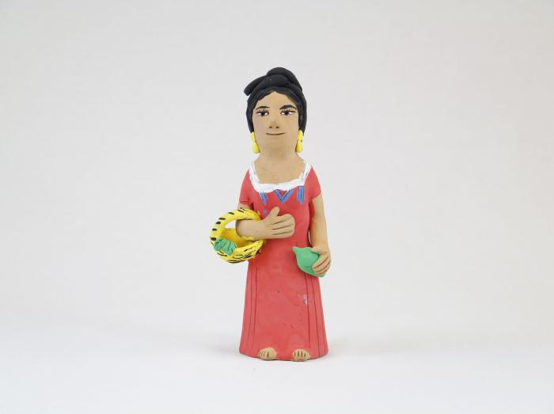
Muñeca Holding Basket and Lime (VM14)

Slide 15
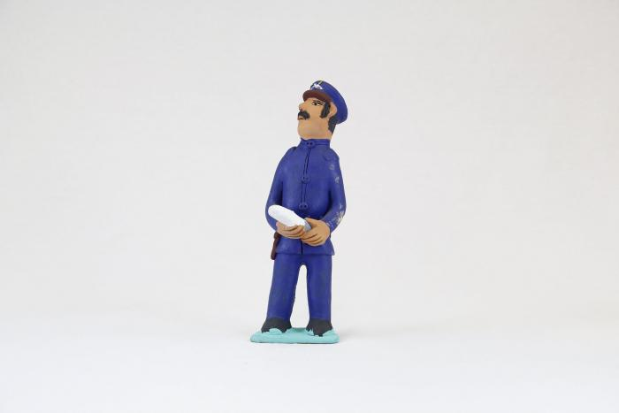
Police Officer Holding White Object (VM15)

Slide 16
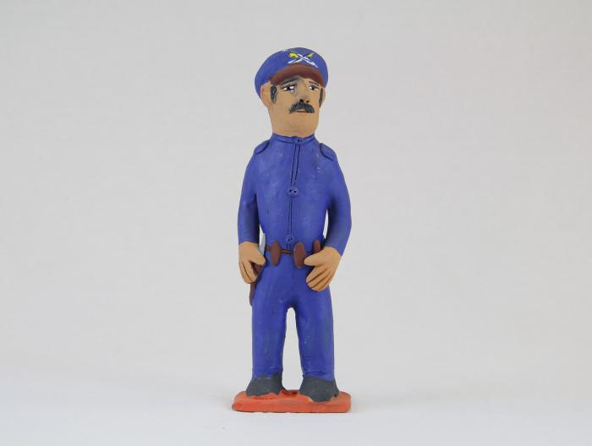
Police Officer (VM16)

Slide 17
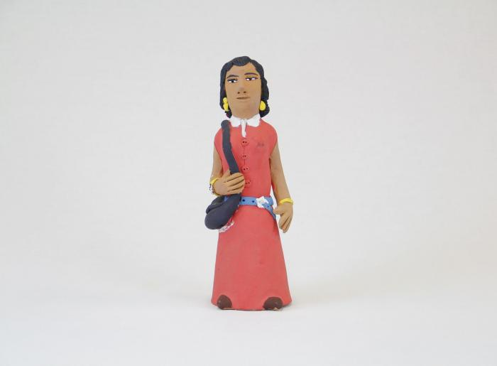
Muñeca with Purse (VM17)

Slide 18
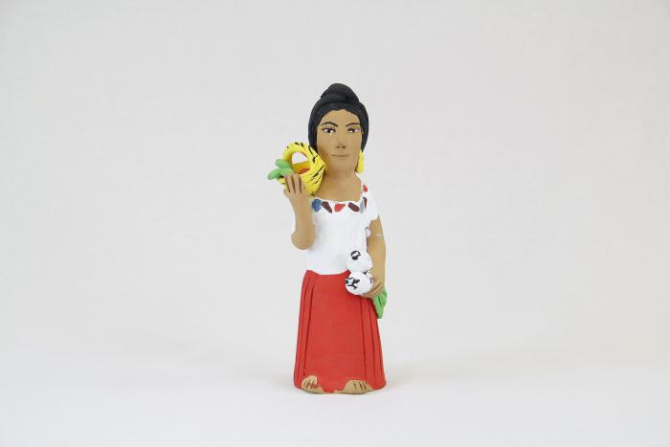
Muñeca with Fruit Basket and Onions (VM18)

Slide 19
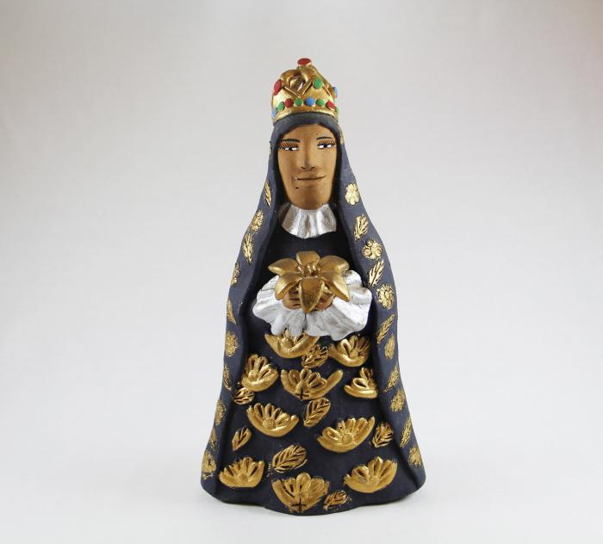
Virgen de la Soledad (Virgin of Solitude) (M1013)

Slide 20
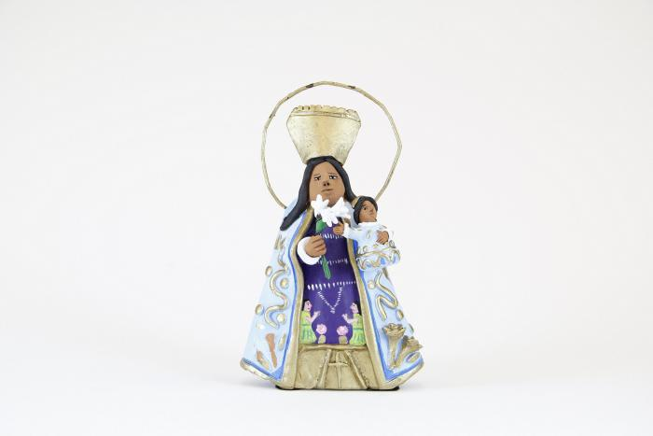
Virgen de los Desamparados (M1014)

Slide 21
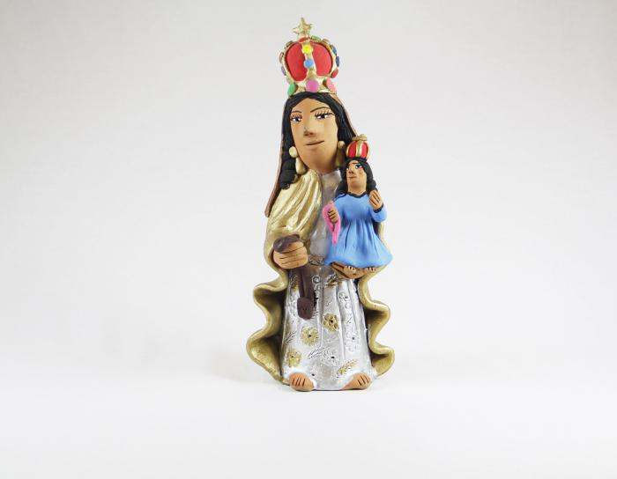
Madonna with Child Virgen del Carmen (M1015)

Slide 22
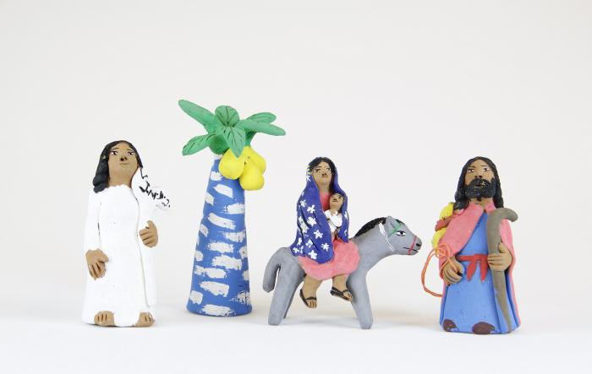
Aguilar Flight into Egypt (4 pieces) (M1017)

Slide 23
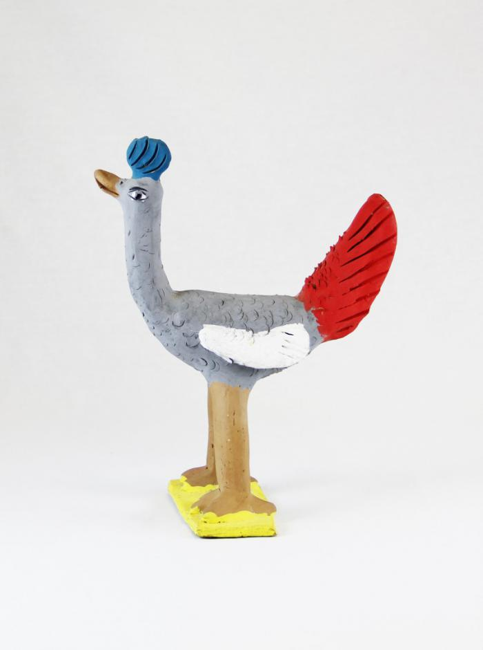
Clay Bird (M1018)

Slide 24
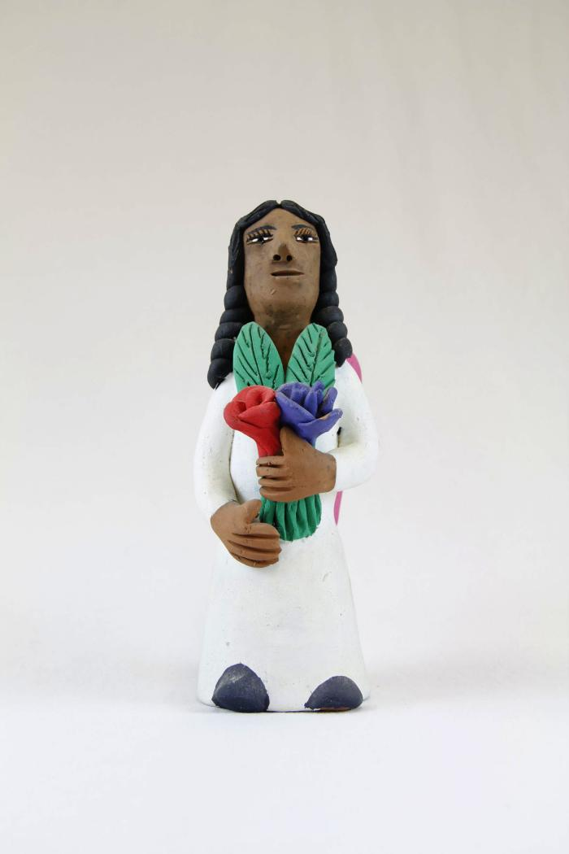
Angel with Purple and Red Flower (SH13)

Slide 25
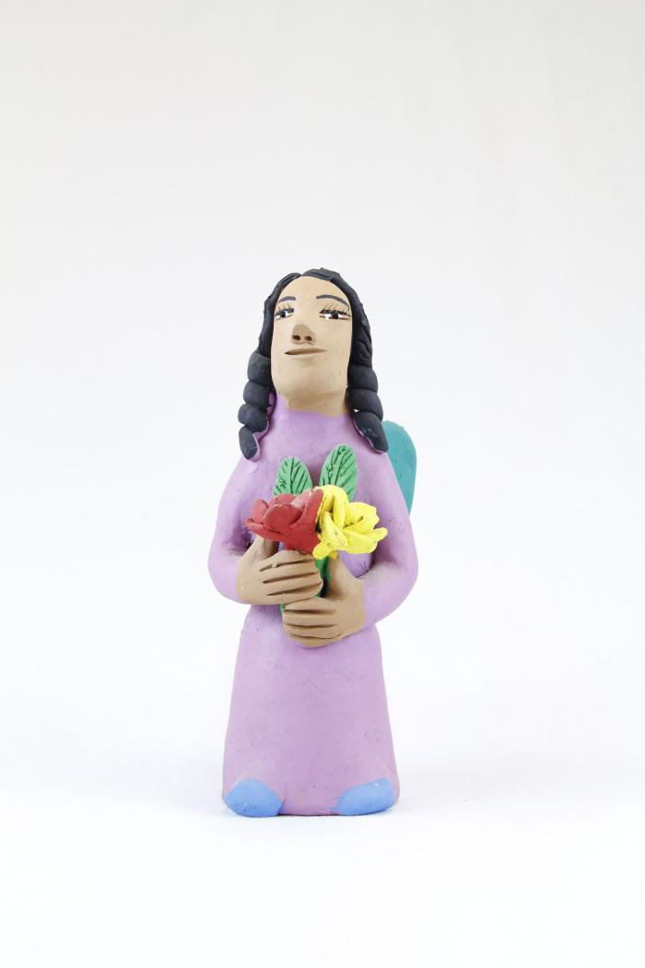
Angel with Red and Yellow Flower (SH14)

Slide 26
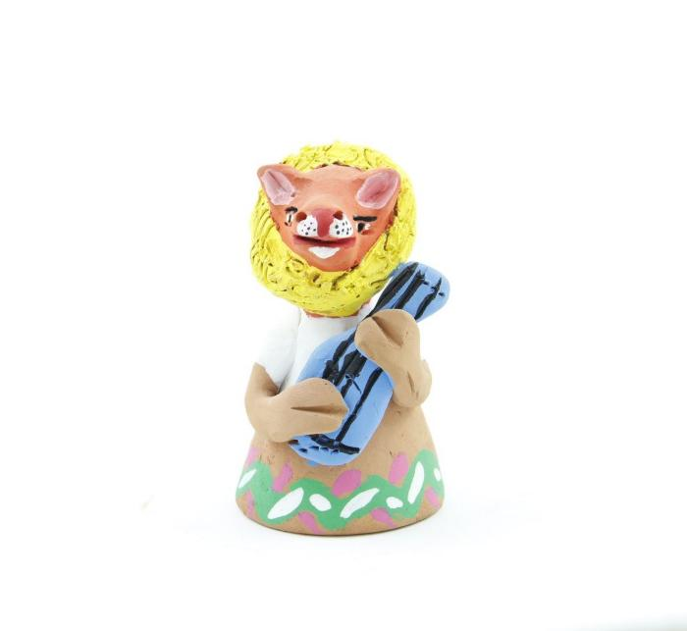
Animal Bell (SH17)

Slide 27
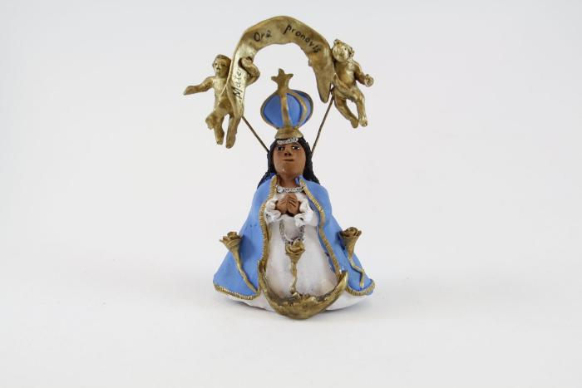
La Virgen de San Juan de los Lagos (SH75)

Slide 28
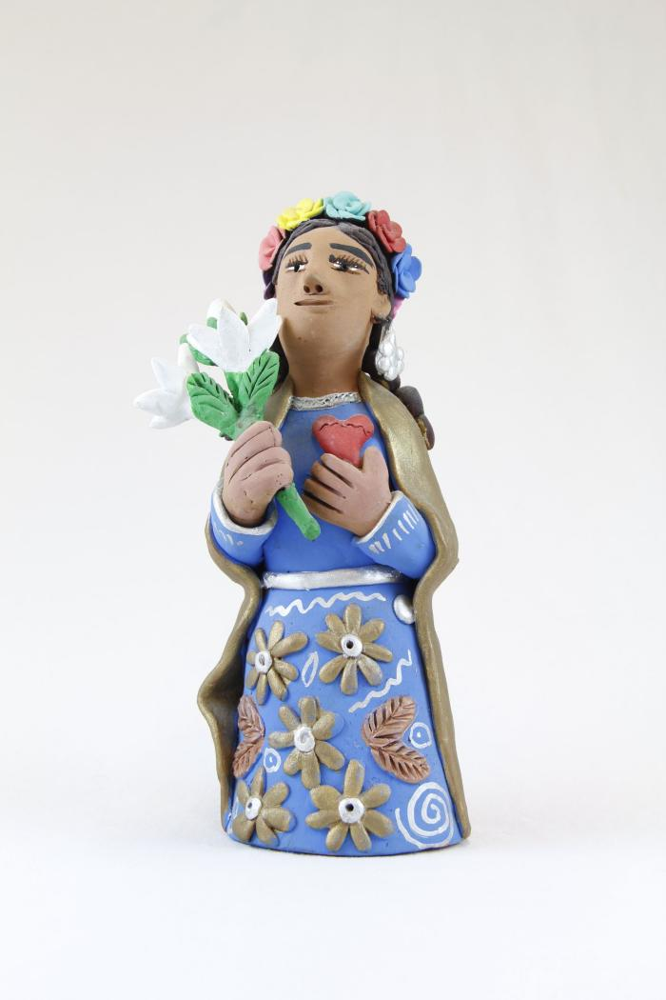
Woman with White Flowers (SH78)

Slide 29
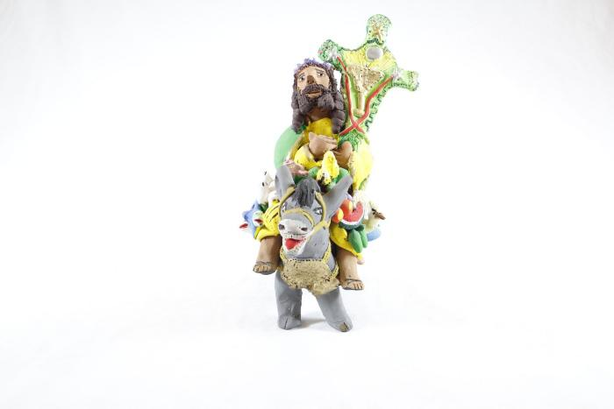
Man riding with Animals (SH87)

Slide 30
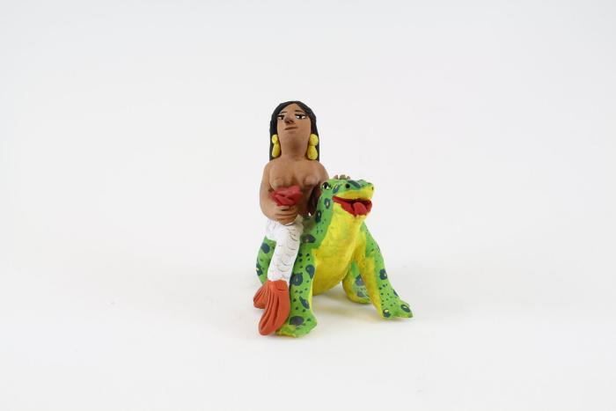
Mermaid with Frog (SH91)

Slide 31
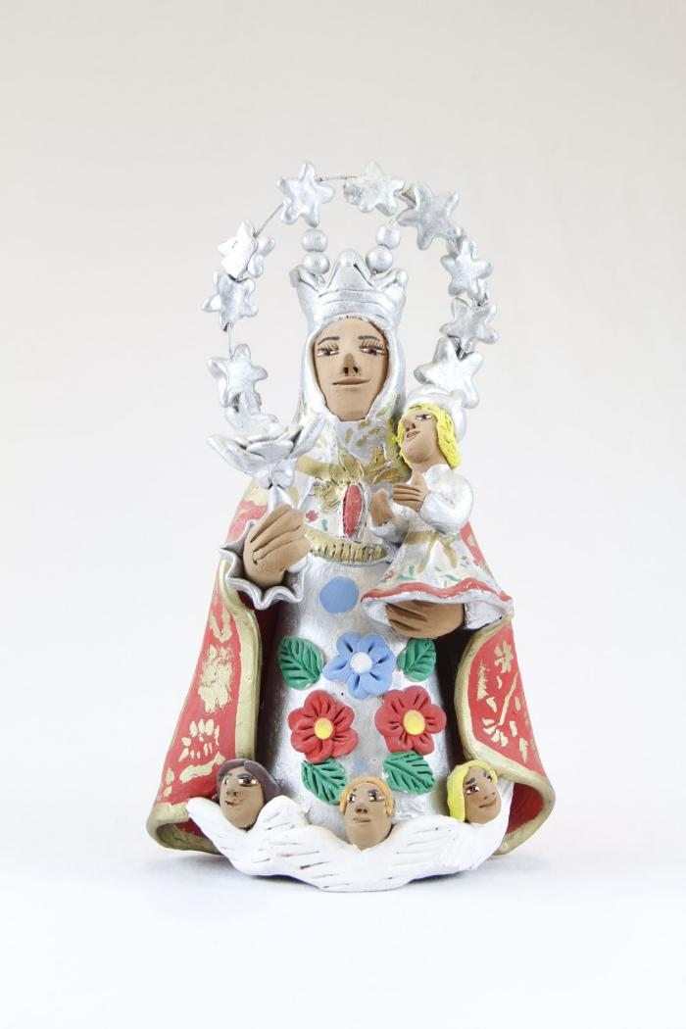
Virgin de Guadalupe (SH119)

Slide 32
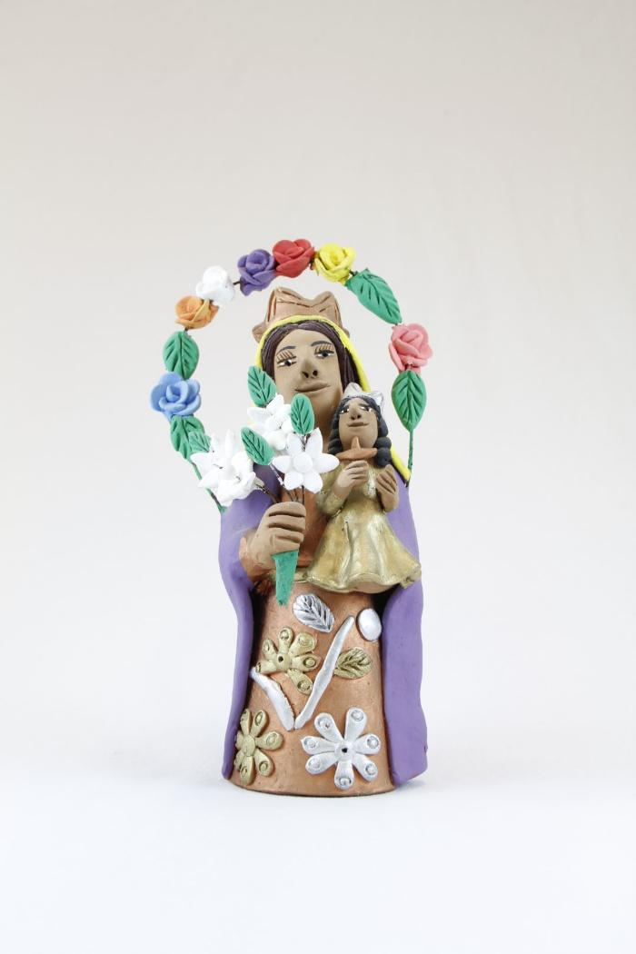
Virgin de Guadalupe (SH120)

Slide 33
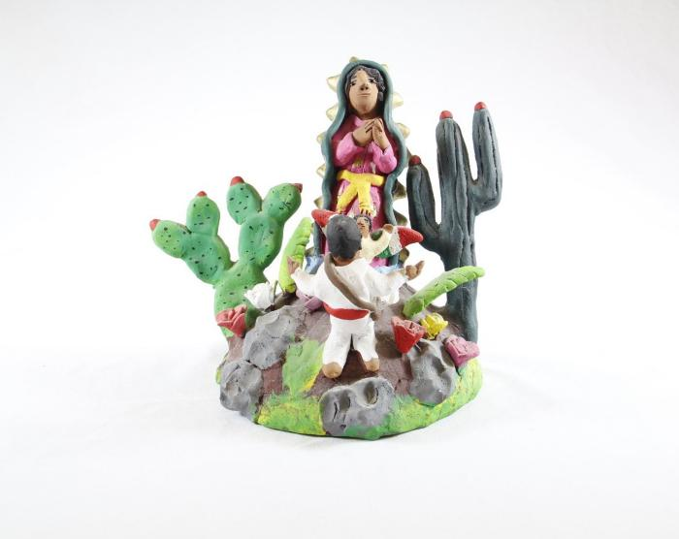
Virgin de Guadalupe (SH121)

Slide 34
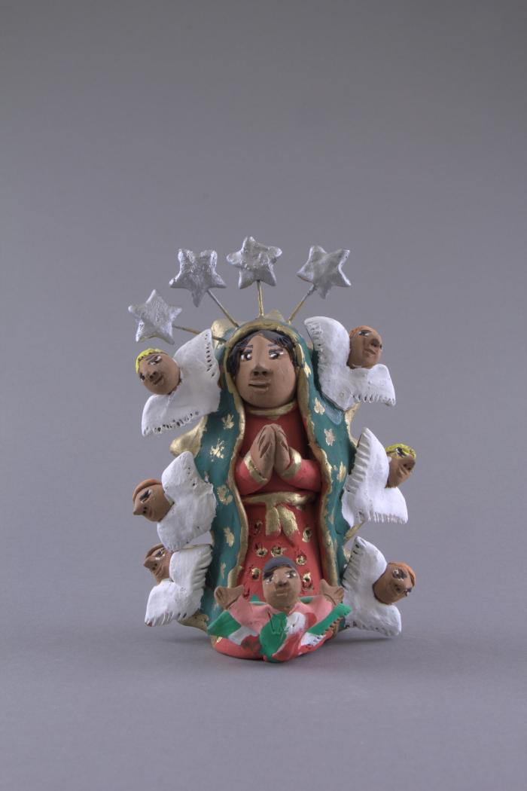
Virgin Figure Surrounded by Angels (FR81)

