Slide 1
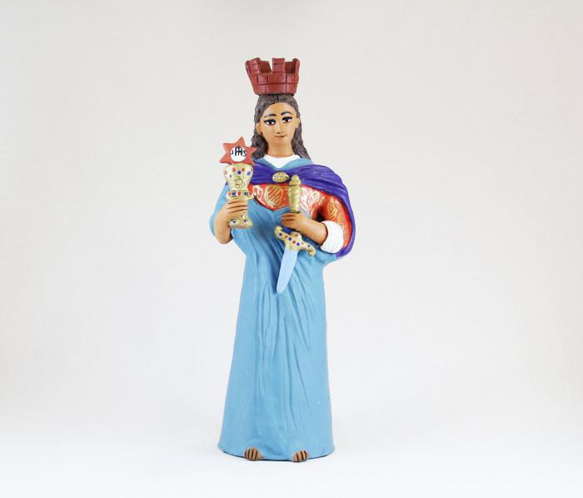
Virgen with Sword (M1019)

Slide 2
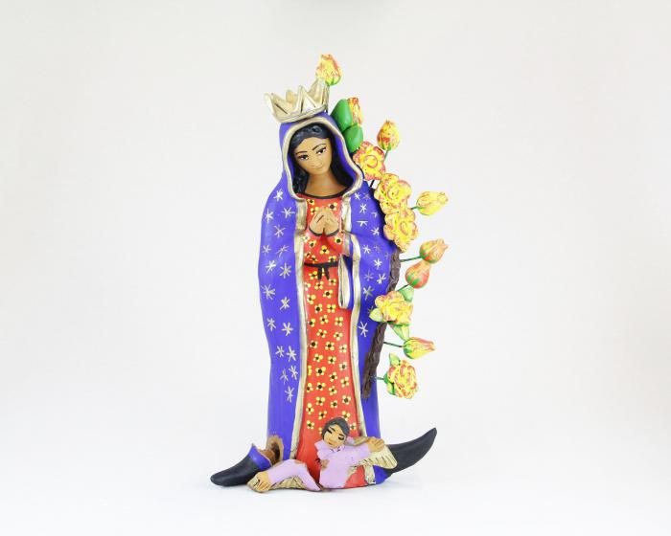
Virgen de Guadalupe (M1021)

