Slide 1
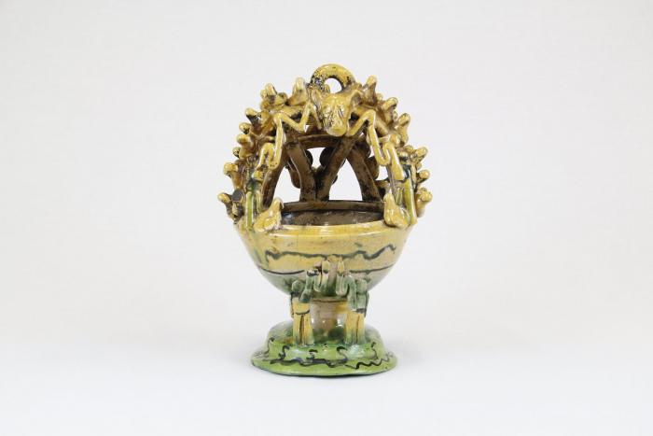
Mayolica Incense Burner (CA5)

Slide 2
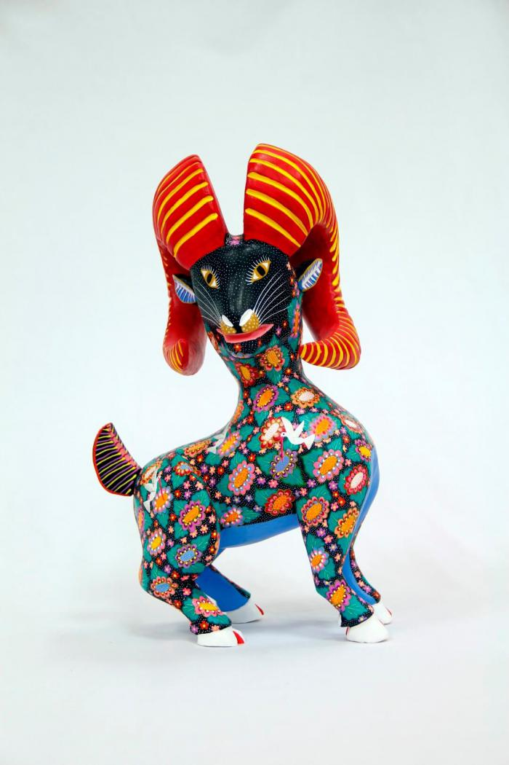
Horned goat (CA8)

Slide 3
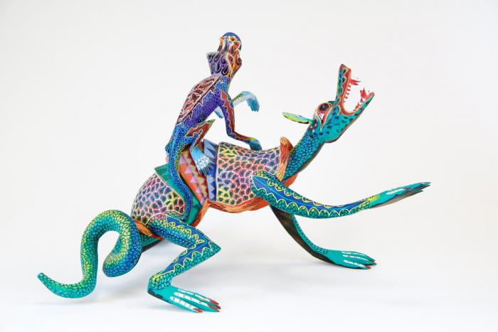
Two lizards (CA9)

Slide 4
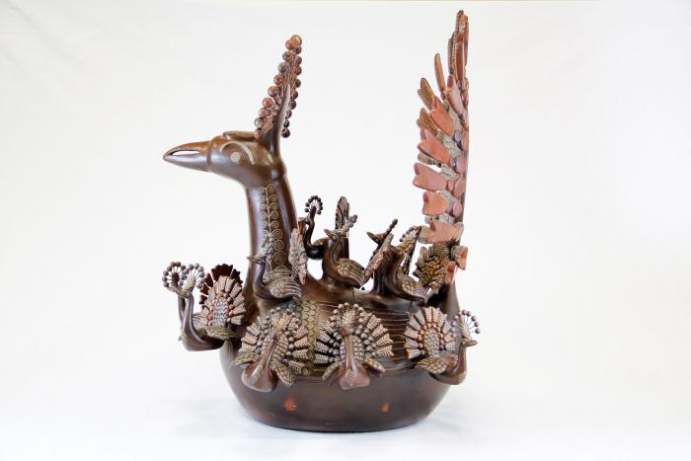
Peacock and Babies (CA20)

Slide 5
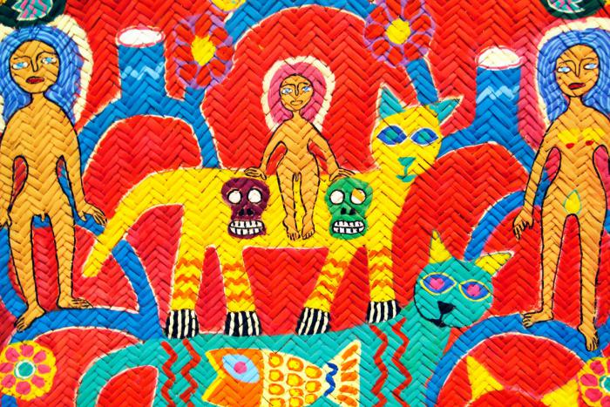
Woven Tree of Life Mat (CA28)

Slide 6
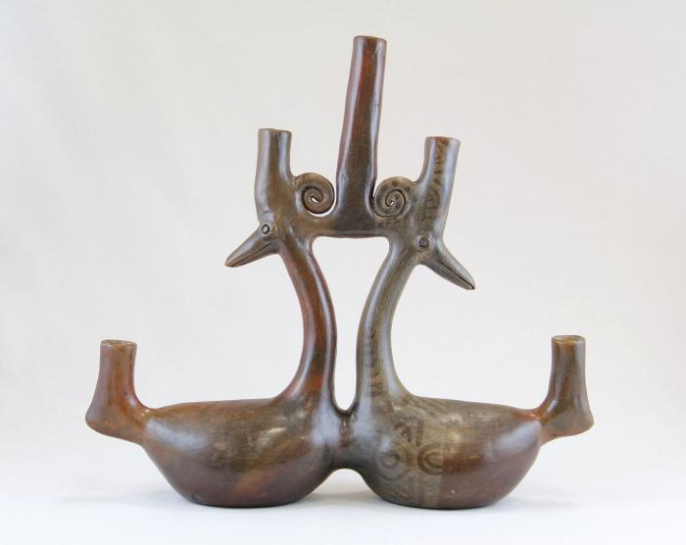
Parallel Ducks Candelabra (JO6)

Slide 7
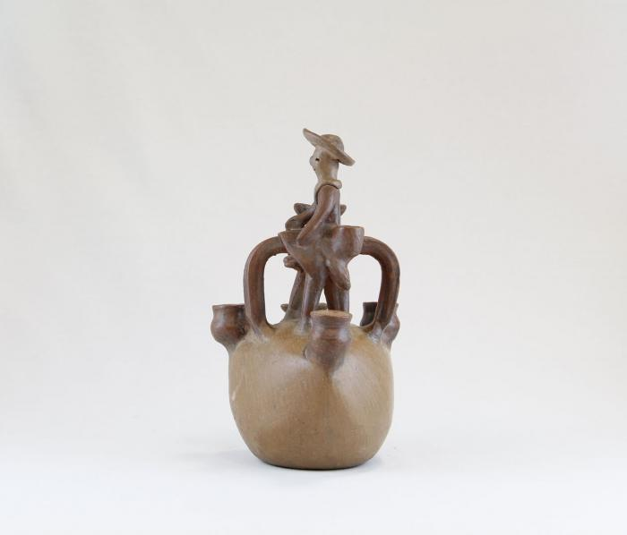
Man on Horse Candelabra (JO10)

Slide 8
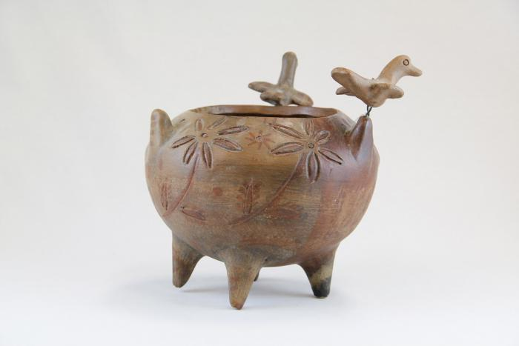
Incised Pot with Three Birds (JO11)

Slide 9
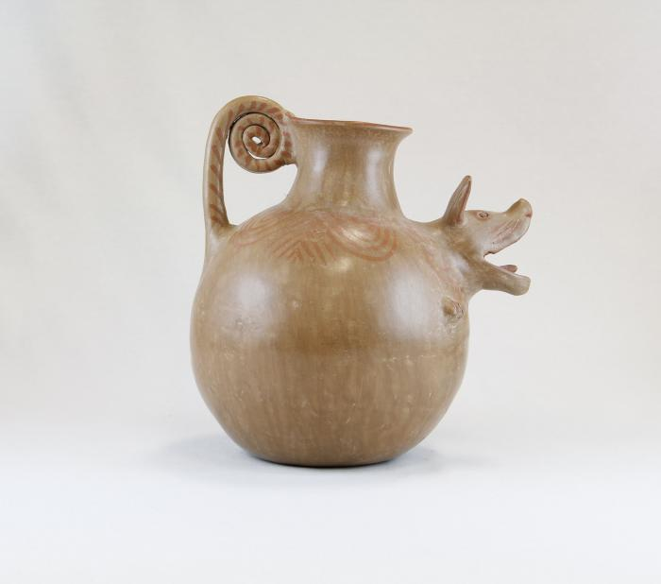
Barking Dog Pot (JO12)

Slide 10
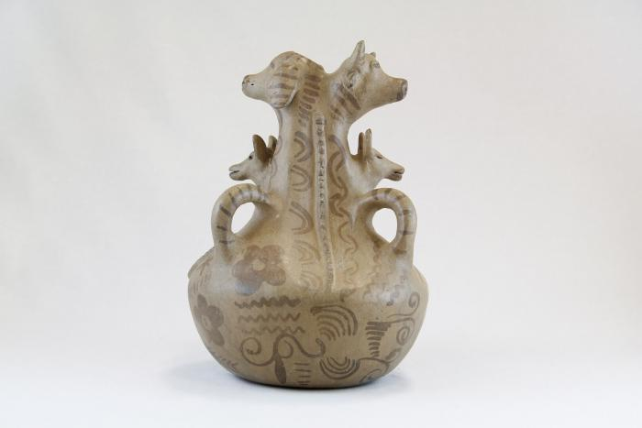
Three Dogs and a Cow Pot (JO13)

Slide 11
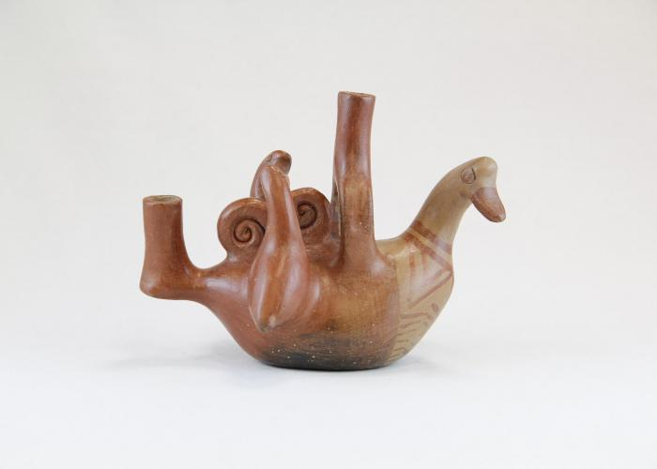
Bird and Two Baby Birds Candelabra (JO25)

Slide 12
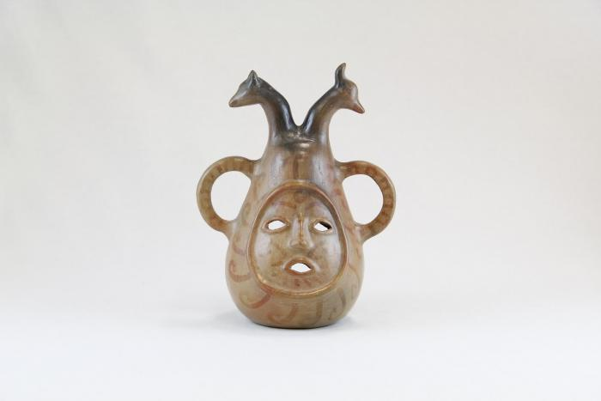
Face and Two Animal Head Candelabra (JO31)

Slide 13
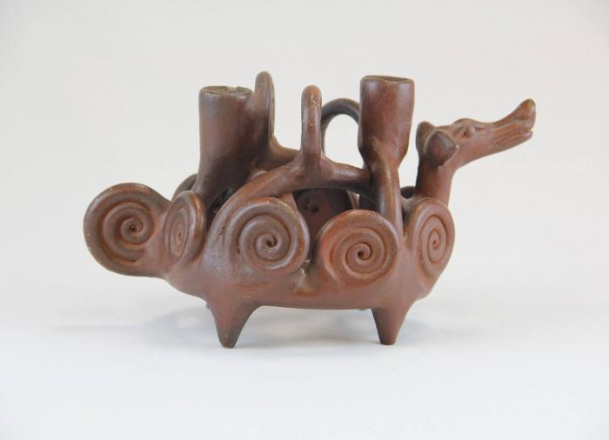
Dog Candelabra with Curled Designs (JO32)

Slide 14
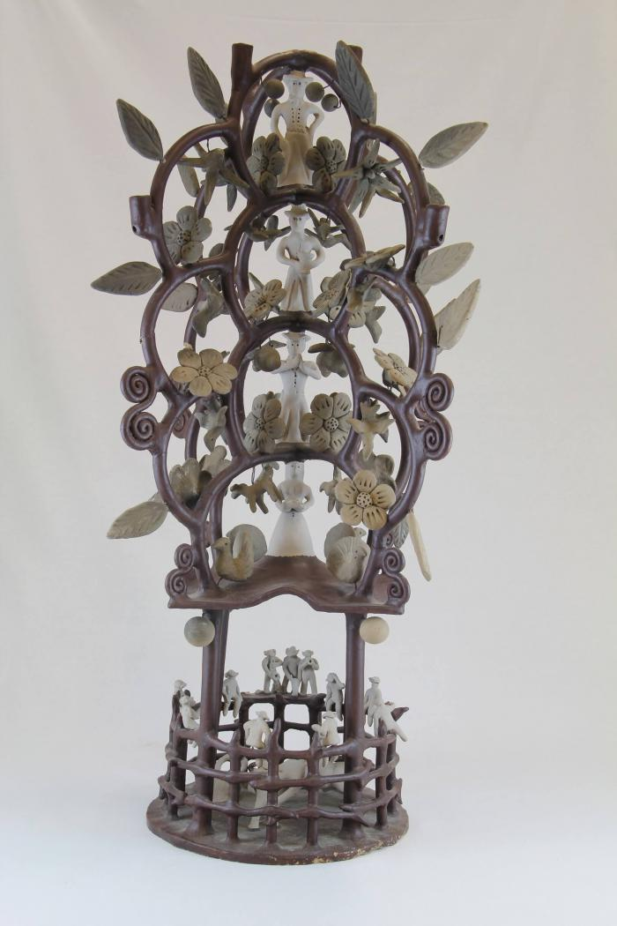
Circular Tree Candelabra (JO59)

Slide 15
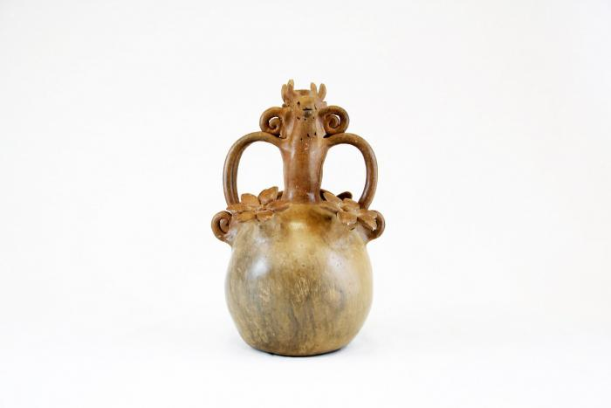
Candelabra with Animals and Flowers (M1001)

Slide 16
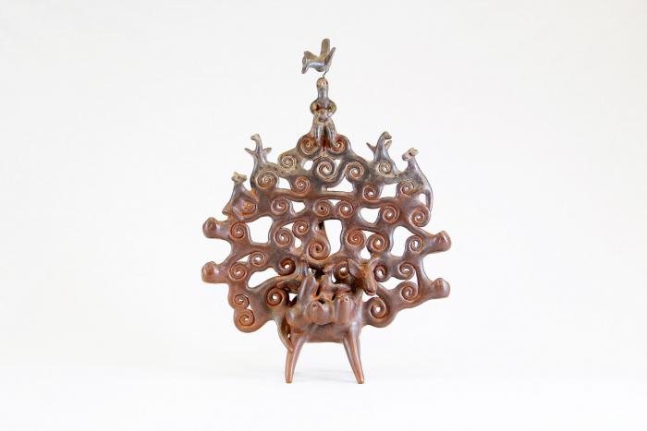
Tree of Life on Donkey (M1002)

Slide 17
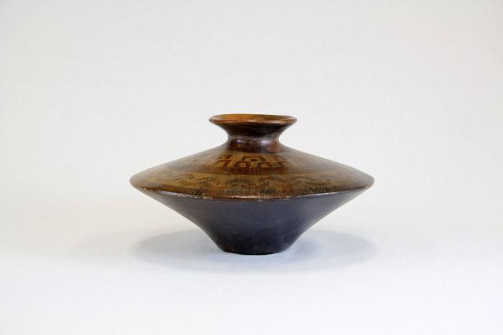
Angular Vessel (M1003)

Slide 18
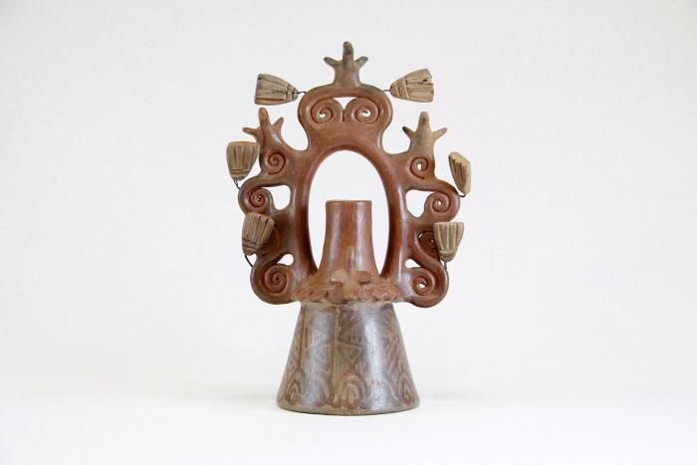
Tree of Life Candle Holder (M1004)

Slide 19
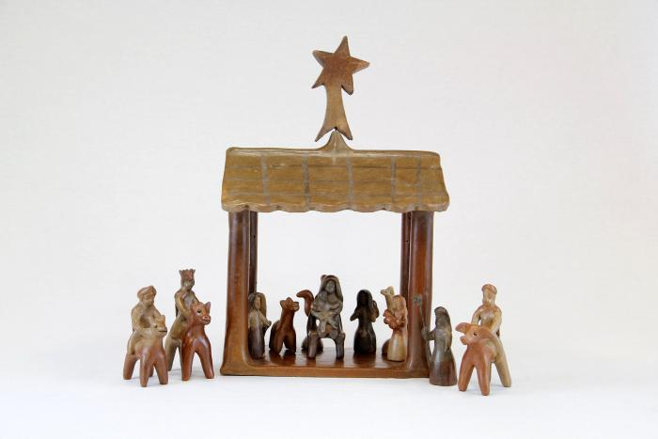
12 Piece Nativity Scene (M1005 / 1006)

Slide 20
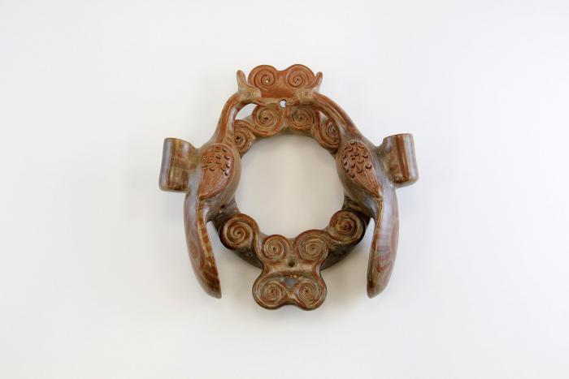
Circular Wall Sconces with 2 Birds ( 2 Pieces) (M1007)

Slide 21
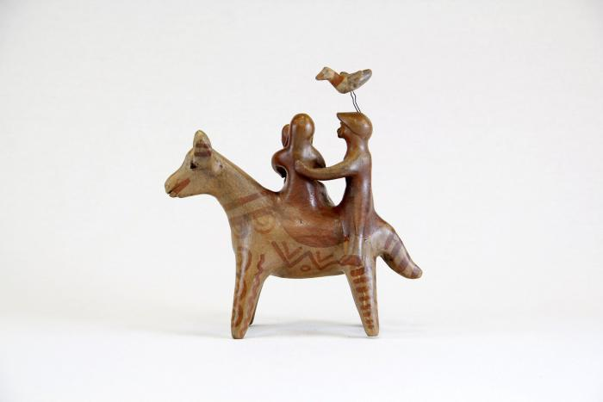
Flight Into Egypt (M1008)

Slide 22
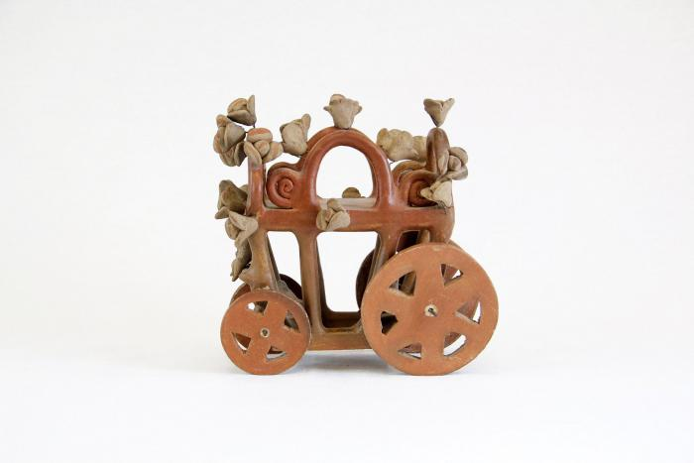
Cart with Team of Horses (M1009)

Slide 23
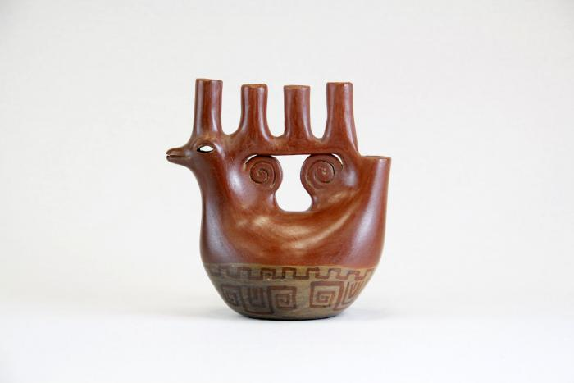
Bird Shaped Candelabra (M1010)

Slide 24
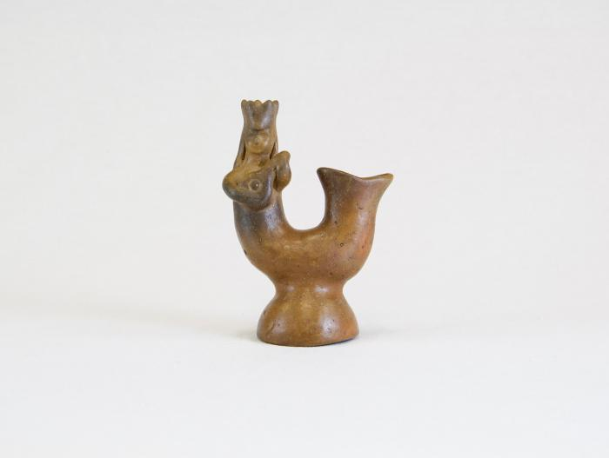
Mermaid (M1011)

Slide 25
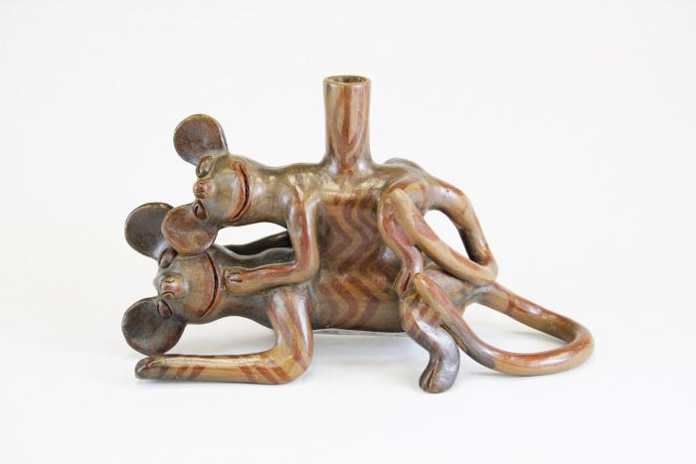
Two Mice Candle Holder (M1012)

Slide 26
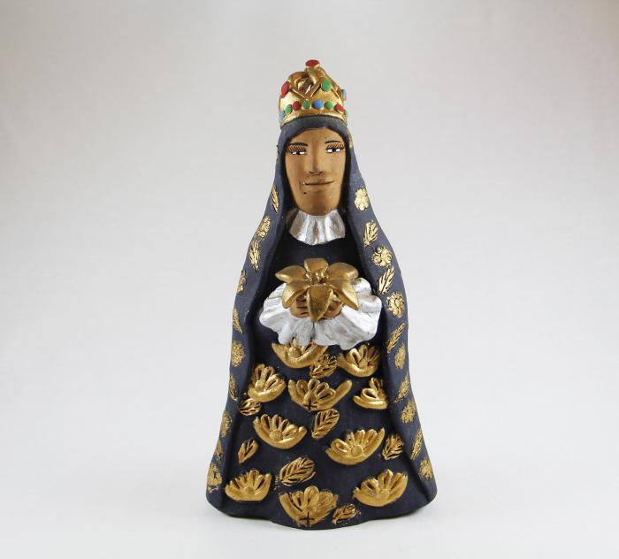
Virgen de la Soledad (Virgin of Solitude) (M1013)

Slide 27
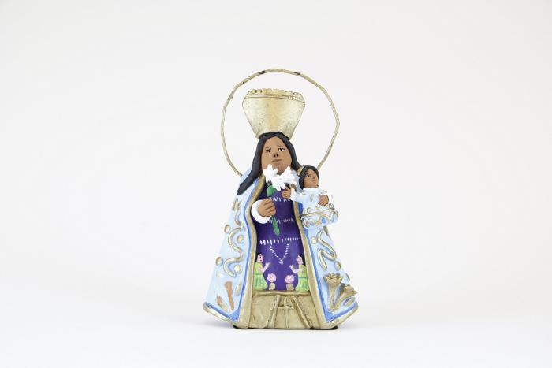
Virgen de los Desamparados (M1014)

Slide 28
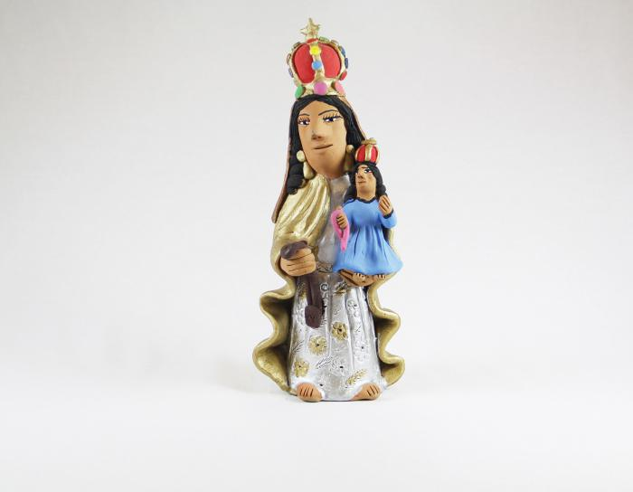
Madonna with Child Virgen del Carmen (M1015)

Slide 29
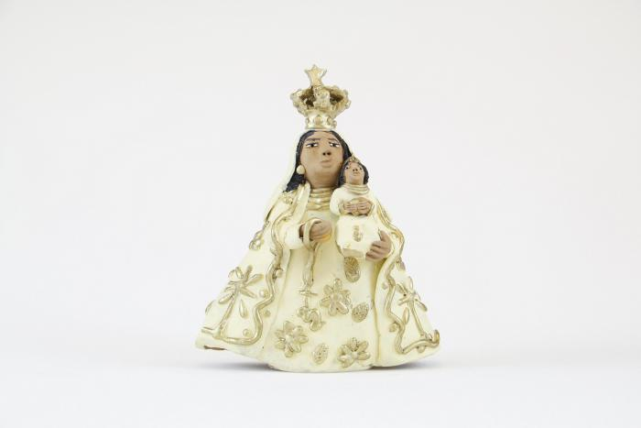
Virgen Madonna with Gold Crown (M1016)

Slide 30
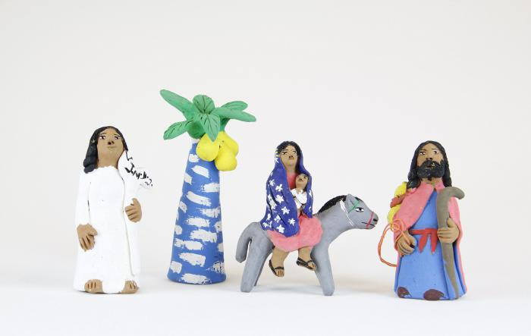
Aguilar Flight into Egypt (4 pieces) (M1017)

Slide 31
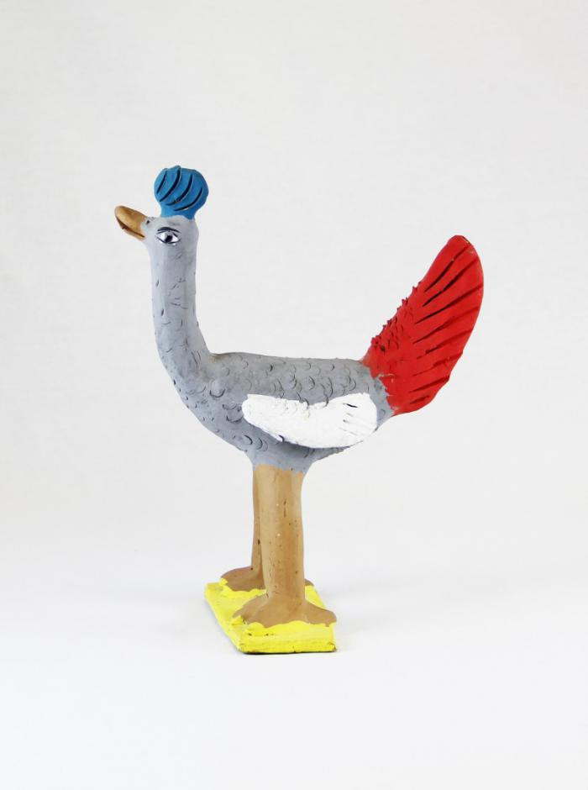
Clay Bird (M1018)

Slide 32
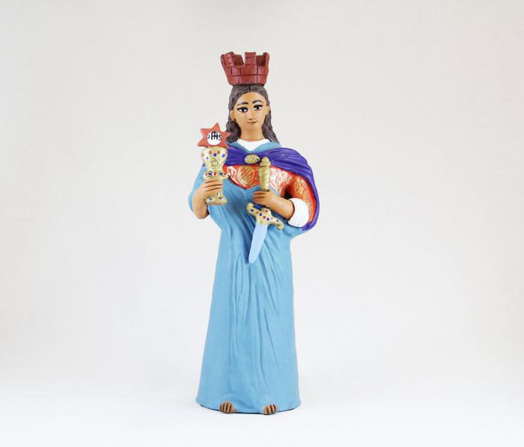
Virgen with Sword (M1019)

Slide 33
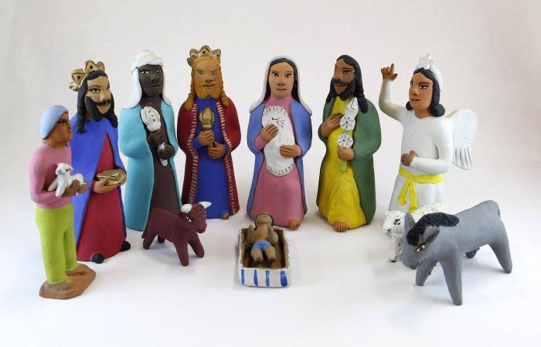
Oaxacan Aguilar Nativity #1 (12 pieces) (M1020a)

Slide 34
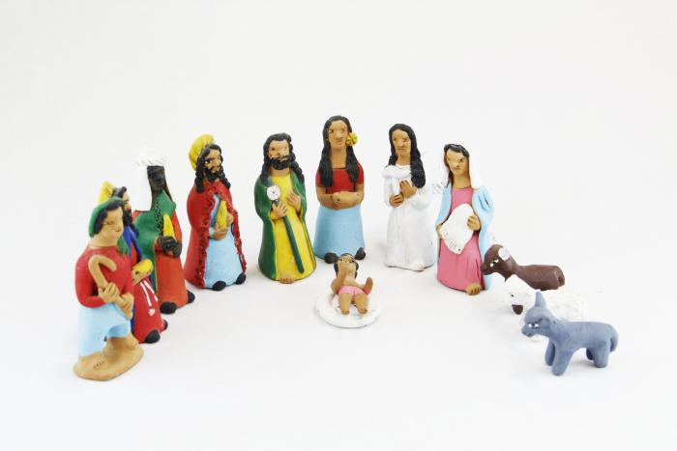
Oaxacan Aguilar Nativity #2 (13 pieces) (M1020b)

Slide 35
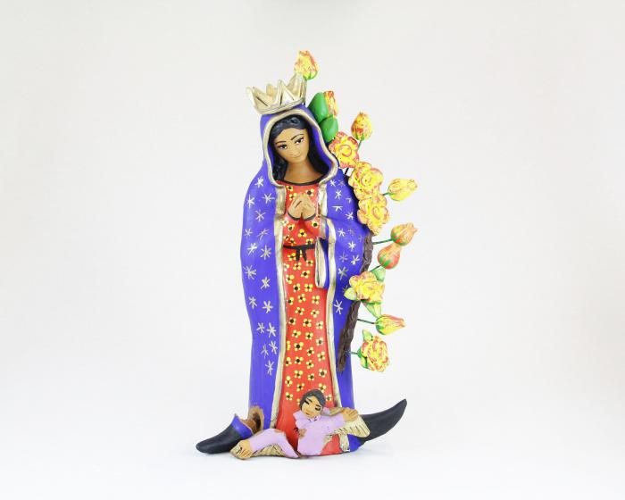
Virgen de Guadalupe (M1021)

Slide 36
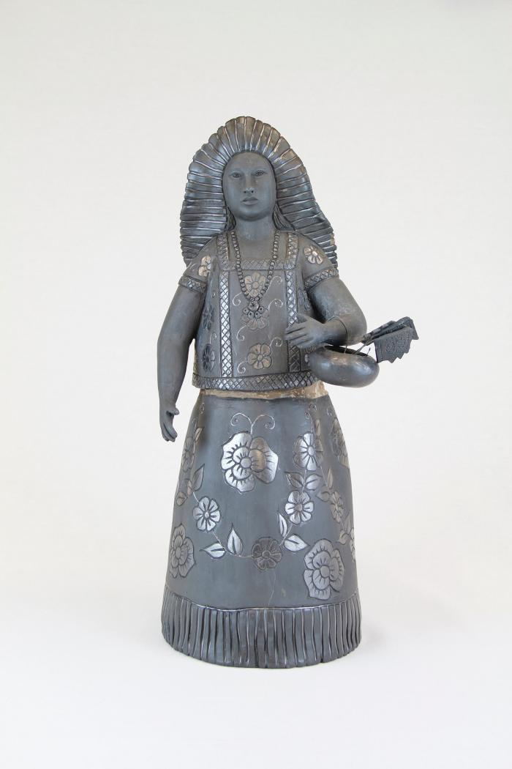
Black Maiden with Basket (M1023)

Slide 37
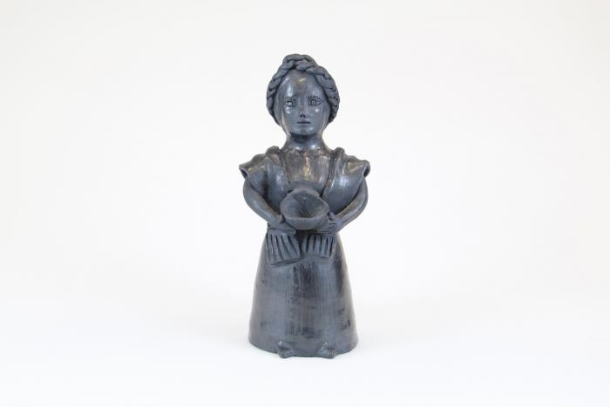
Muñeca holding Bowl (M1024)

Slide 38
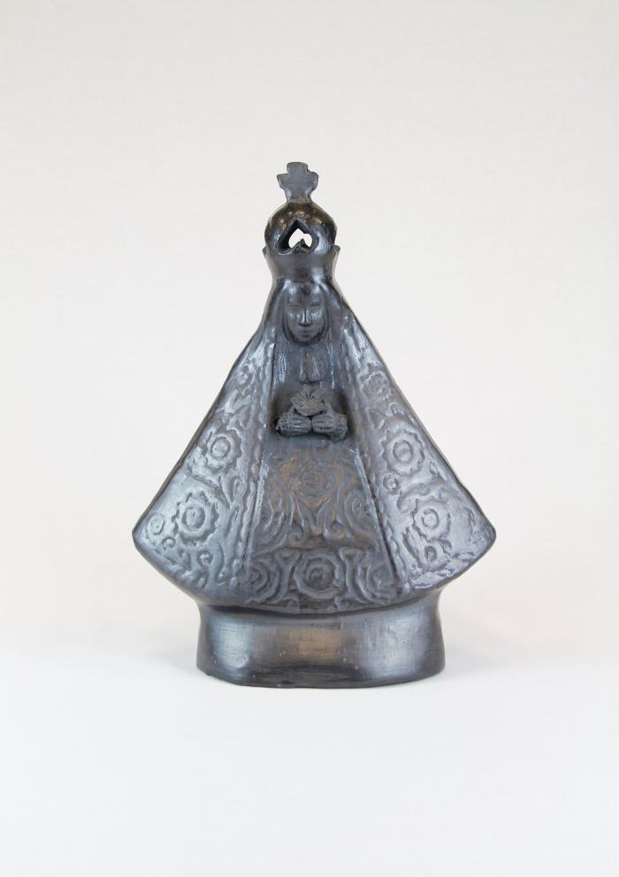
Black Clay Virgen de la Soledad (M1025)

Slide 39
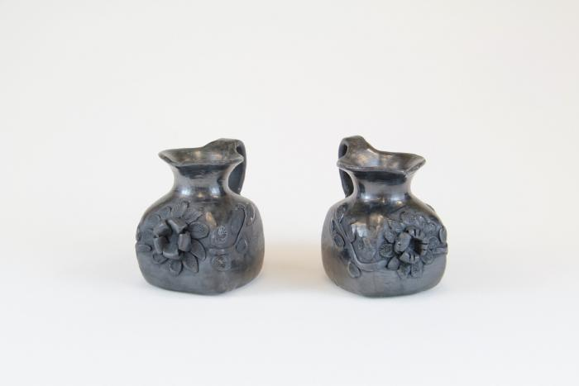
Black Clay Pitchers (M1026)

Slide 40
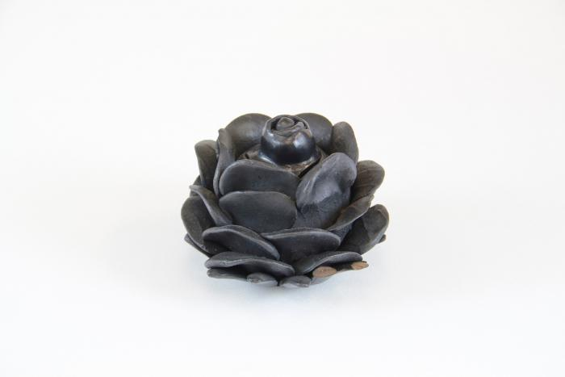
Black Clay Flower (M1027)

Slide 41
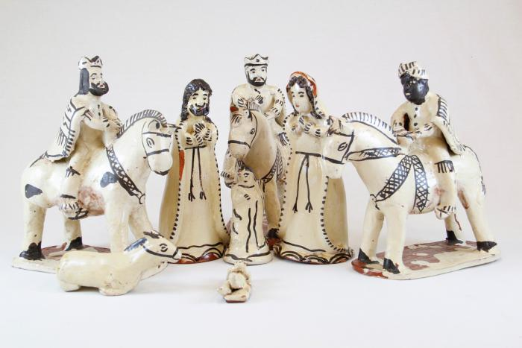
White and Black Nativity (Nacimiento) (8 pieces) (M1028)

Slide 42
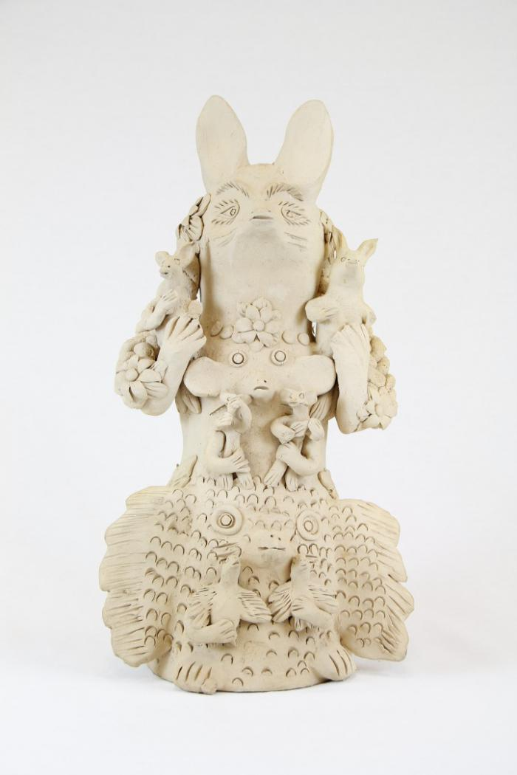
Rabbit Totem (M1029)

Slide 43
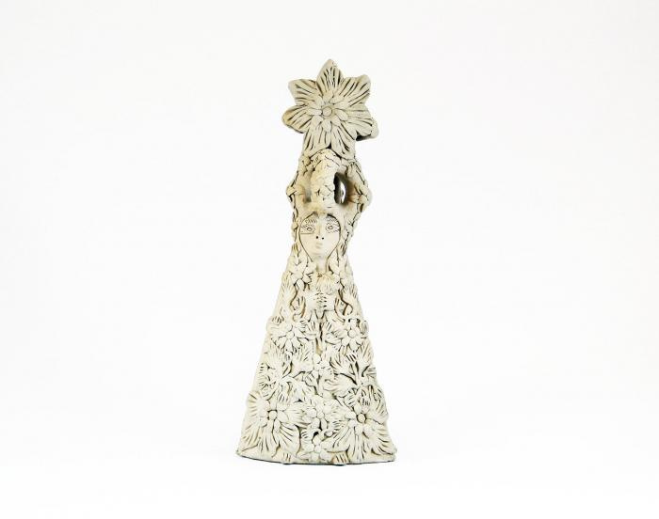
White Clay Virgin covered with Flowers (M1030)

Slide 44
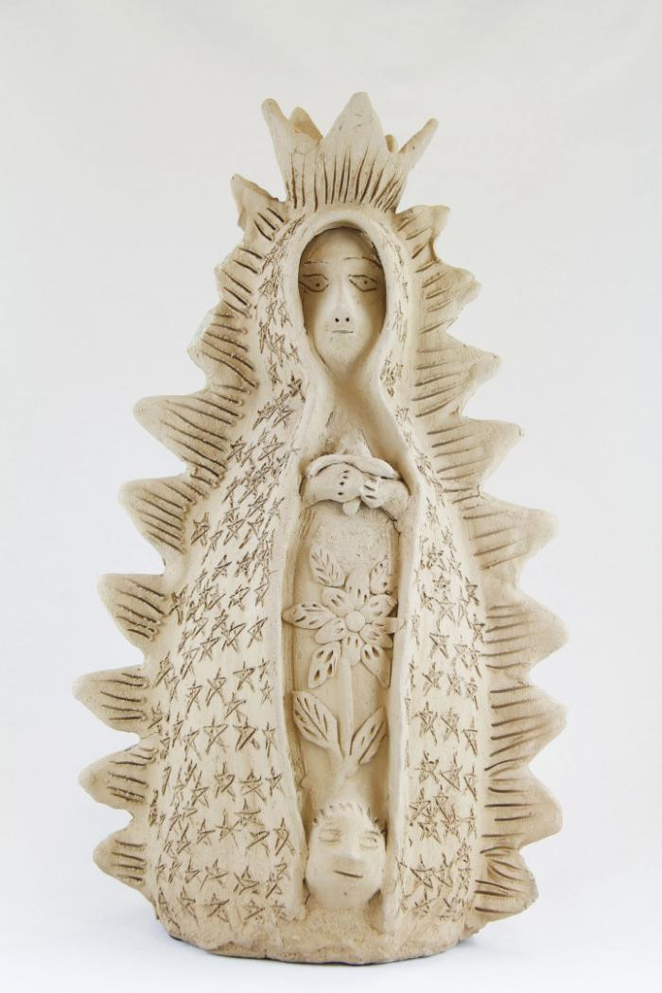
Virgen de Guadalupe (M1031)

Slide 45
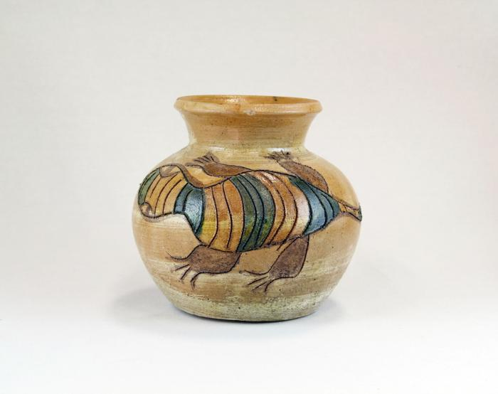
Tan Clay Pot with Lizards (M1032)

Slide 46
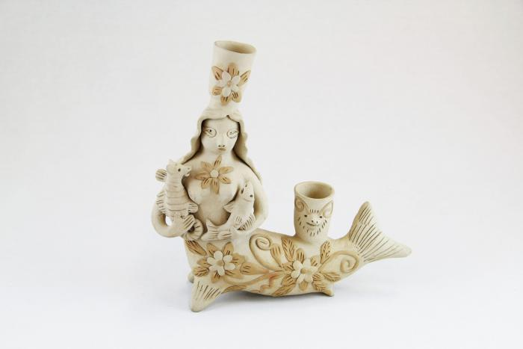
Mermaid Candelabra (M1033)

Slide 47
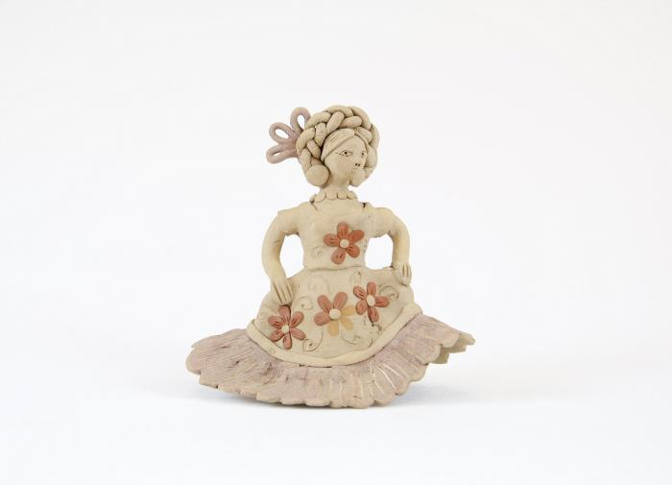
Clay Muñeca dressed in the style of Isthmus of Tehuantepec (M1034)

Slide 48
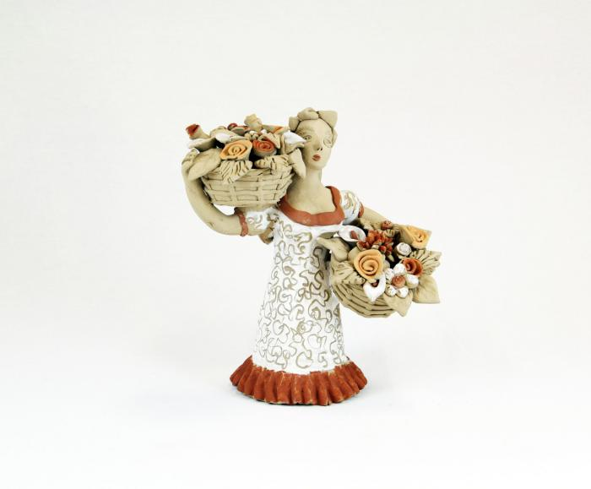
Dancer with Two Flower Baskets (M1035)

Slide 49
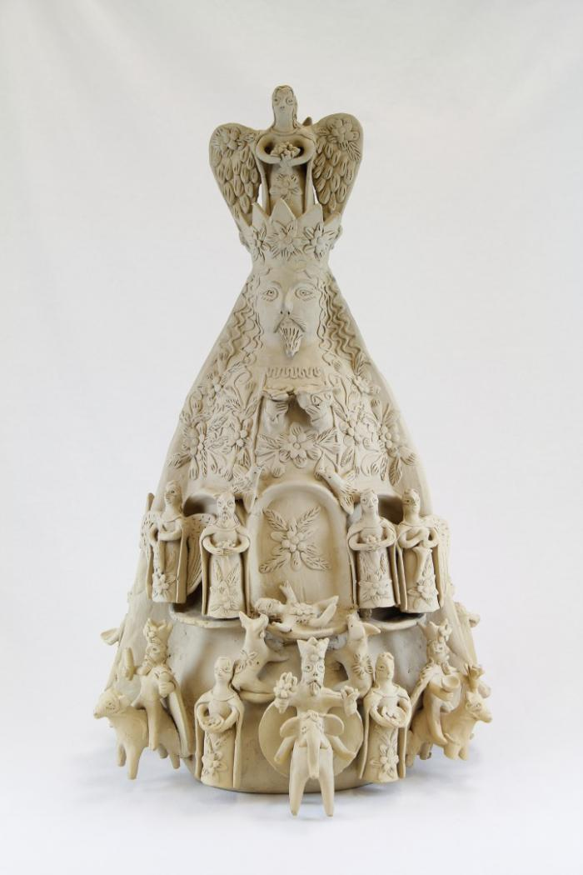
Two Sided Sculpture with Nativity Scenes (M1036)

Slide 50
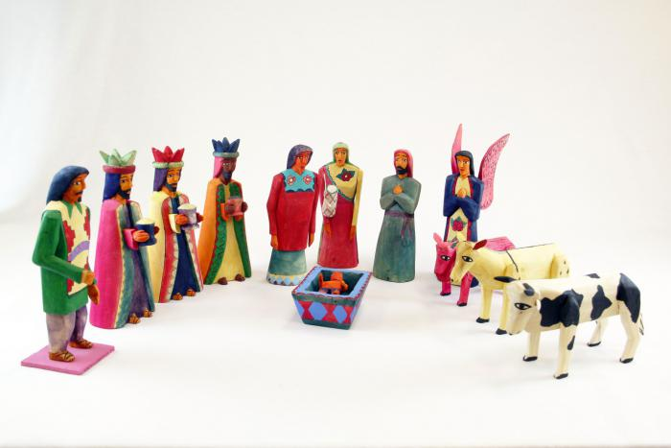
Dyed Wood Nativity (12 pieces) (M1037)

Slide 51
Wisemen Standing (3 pieces) (M1038)

Slide 52
Three Wood Carved Wiseman riding on Animals (M1039)

Slide 53
Virgin (M1040)

Slide 54
Praying Angel, 1981 (M1041)

Slide 55
Nativity with Corn in Shelter (1 piece) (M1042)

Slide 56
Tonalá Burnished Nativity (11 Pieces) (M1043)

Slide 57
Mexican Nativity (Nacimiento) (10 pieces) (M1055)

Slide 58
Tree of Life Nativity (Nacimiento) Candle Holder (M1056)

Slide 59
Angel with Guitar Candle Holder (M1057)

Slide 60
Nativity (Nacimiento) with Stars Candle Holder (M1059)

Slide 61
Tree of Life Candelabra with Owls (M1061)

Slide 62
Tree of Life Candelabra with Person, Birds, Animals (M1062)

Slide 63
Wood Nativity (12 pieces) (M1063)

Slide 64
Circular Clay Nativity (1 piece) (M1065)

Slide 65
Nepal Nativity (11 pieces) (M1066)

Slide 66
Bolivia Church Scene Nativity (1 of 2) (M1067a)

Slide 67
Bolivia (Bell Scene) Nativity (2 of 2 ) (M1067b)

Slide 68
Native American Nativity (13 pieces) (M1068)

Slide 69
Wales Nativity (3 pieces) (M1070)

Slide 70
Uruguayan Nativity (13 pieces) (M1071)

Slide 71
3 Candle Candelabra Nativity (M1072)

Slide 72
African Nativity (11 pieces) (M1073)

Slide 73
Nativity Bas-Relief Carved from Tree (M1077)

Slide 74
Clay Madonna and Child in Oval Pot (M1084)

Slide 75
Spotted Feline (M1086)

Slide 76
Painted Armadillo (M1088)

Slide 77
Barro Negro Round Pot (M1092)

Slide 78
Unglazed Clay Pot with Blue Glaze Inside (M1093)

Slide 79
Eskimo Nativity (14 pieces) (M1096)

Slide 80
Peruvian Nativity Retablo (M1100)

Slide 81
Mexico Box Nativity set (Nicho) (9 pieces) (M1103)

Slide 82
Vessel with Face (M1105)

Slide 83
Barro Negro Candelabra (M1109)

Slide 84
Tree Single Candle Holder on clay base with a few people (M1110)

Slide 85
Vessel with Pre-Columbian Designs (M1111)

Slide 86
Pre-Columbian Reproduction Figure with Skulls on Forehead (M1500)

Slide 87
Clay figure with braided hair (M1502)

Slide 88
Pre-Columbian Figure Reprodiction (M1503)

Slide 89
Reproduction Pre-Columbian Kneeling Warrior (M1511)

Slide 90
Clay Figure holding a Cup (M1515)

Slide 91
Gray Mayan Hut with Figures and Dogs (broken into 9 pieces) (M1519)

Slide 92
Flight into Egypt - Mary on Donkey (M1524)

Slide 93
Clay Nativity (12 pieces) (M1528)

Slide 94
Two Brown Gourds that Open to Nativity (M1547)

Slide 95
Two Wood Carved Birds (M1552)

Slide 96
Mary, Joseph and Jesus Standing Together (M1554)

Slide 97
Santo Virgin of Guadalupe (M1555)

Slide 98
Small Nativity on Wood base (M1559)

Slide 99
Peruvian Nativity Plaque (M1570)

Slide 100
Peruvian Nativity (8 pieces) (M1578)

Slide 101
Painted Angel (M1595)

Slide 102
Three Kings (M1603)

Slide 103
Wind, Water, Light (M1604)

Slide 104
Barro Negro Vase (M1605)

Slide 105
Black Clay Candelabra (M1606)

Slide 106
Barro Negro Incised Vase (M1607)

Slide 107
Barro Negro Pot (M1608)

Slide 108
Two Navajo Dance Wands (MU3471)

Slide 109
Navajo Chief's Blanket Third Phase (MU3473)

Slide 110
Diaguita Duck Pitcher (MU3477)

Slide 111
Zuni Burnished Pot (MU3479)

Slide 112
Cream & White Pot (MU3482)

Slide 113
Terra Cotta Bowl with Bird in Center (MU3483)

Slide 114
"4th World" Painting (MU3523)

Slide 115
Zuni Shalako Kachina Painting (MU3525)

Slide 116
Sun Father and Snake Painting (MU3526)

Slide 117
Storytelling Painted Pot (MU14)

Slide 118
Zuni Pot with Lizard in Center (MU15)

Slide 119
Repeated Wave Pot (MU16)

Slide 120
Angel (EH9)

Slide 121
Three Minstrels (EH10)

Slide 122
Peruvian Church with Market Scene (SE51)

Slide 123
Peruvian Church with Multiple Small Figures (SE53)

Slide 124
Mermaid Mask (PR4)

Slide 125
Tin Mask (PR11)

Slide 126
El Barbón Mask (PR12)

Slide 127
Diablo-Calavera (Devil-Skull) Mask (PR15)

Slide 128
Leather Mask (PR16)

Slide 129
Blue Devil Mask (PR21)

Slide 130
Devil Mask (PR24)

Slide 131
Moon and Star Ceramic Mask (PR26)

Slide 132
Stars Ceramic Mask (PR27)

Slide 133
Venezuelan Tribal Mask (PR28)

Slide 134
Vejigantes Mask (PR31)

Slide 135
Ranga Mask (PR33)

Slide 136
Barong Mask (PR34)

Slide 137
Balinese Long Mask with Lizards (PR36)

Slide 138
Ganesha mask (PR37)

Slide 139
Thai Warrior Mask (PR39)

Slide 140
Foo Dog Wall Hanging (PR41)

Slide 141
Okina Mask (PR45)

Slide 142
Tengu mask (PR46)

Slide 143
Okame (Otafuku) Mask (PR47)

Slide 144
Nojang (monk) mask (PR48)

Slide 145
African Wood Carved Mask (PR50)

Slide 146
Carved Coconut Husk of Man's Head (PR51)

Slide 147
Gemstone Mask (PR53)

Slide 148
Rectangular Wood Mask (PR54)

Slide 149
Monkey Mask (MC12)

Slide 150
Guro Mask (MC13)

Slide 151
African Long Forehead Mask (MC15)

Slide 152
Makonde Shetani Sculpture (SH62)

Slide 153
Garuda (SH66)

Slide 154
Devil Masked Peasant Dancer (SH69)

