Slide 1
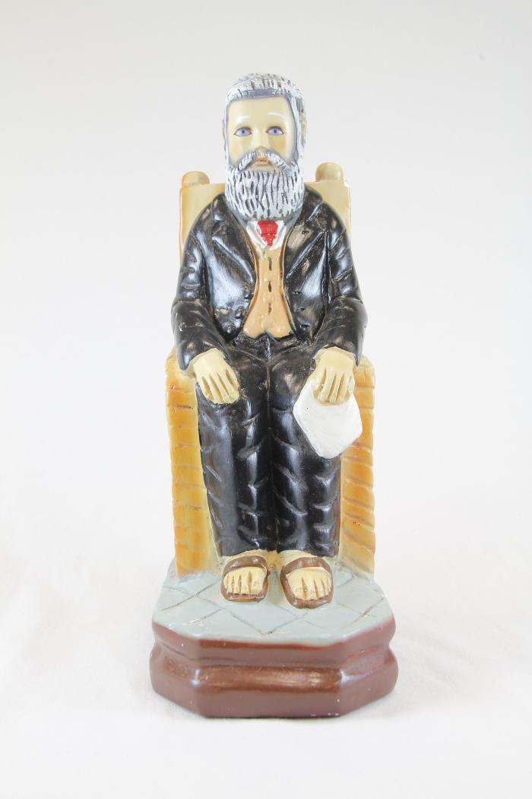
Don Pedrito Jaramillo with chipped nose on blue base (RE1)

Slide 2
Don Pedrito Jaramillo with criss cross base and chair (RE2)

Slide 3
Don Pedrito Jaramillo white and dark grey hair seated in orange chair (RE3)

Slide 4
Don Pedrito Jaramillo with pattern base (RE4)

Slide 5
unknown (RE5)

Slide 6
Don Pedrito Jaramillo with blue and black base and red tie (RE6)

Slide 7
Don Pedrito Jaramillo on a light blue and dark red base (RE7)

Slide 8
Large Don Pedrito Jaramillo wearing hat and white scarf (RE8)

Slide 9
Large Don Pedrito Jaramillo wearing hat with checkered base (RE9)

Slide 10
Don Pedrito Jaramillo wearing hat with black suit and tie (RE10)

Slide 11
Don Pedrito Jaramillo wearing hat with red tie (RE11)

Slide 12
Grey monochromatic Don Pedrito Jaramillo wearing hat (RE12)

Slide 13
Two small identical Don Pedrito Jaramillo figures (RE13)

Slide 14
Small Don Pedrito Jaramillo wearing hat (RE14)

Slide 15
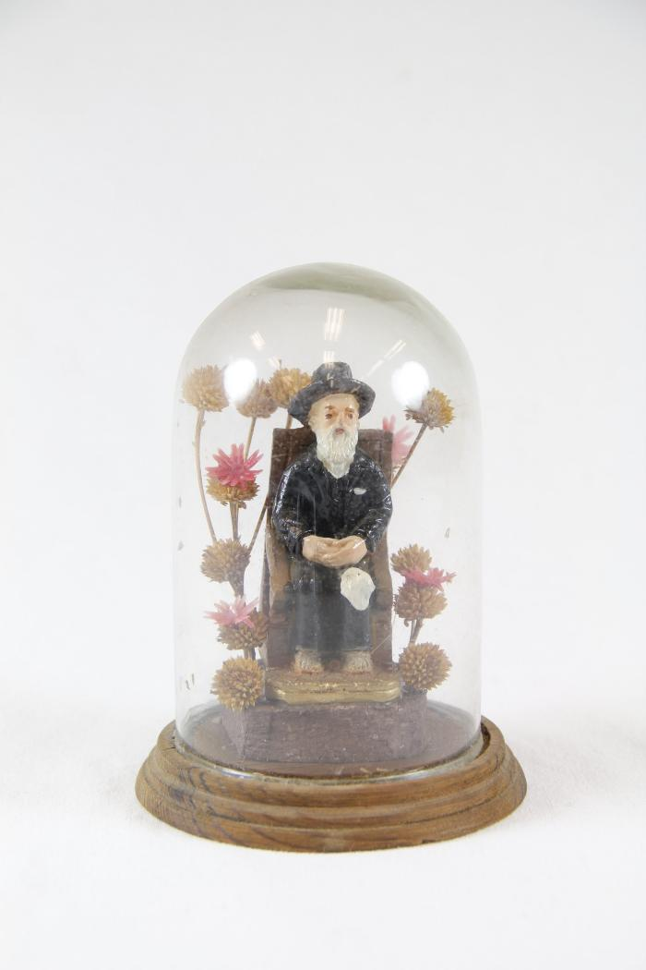
Don Pedrito Jaramillo in glass enclosure with flowers (RE15)

Slide 16
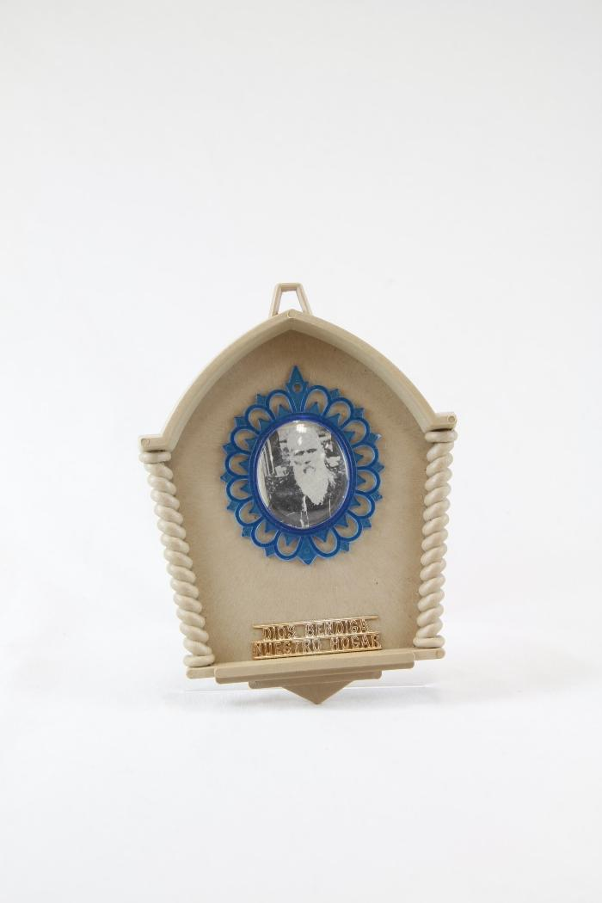
"Dios Bendiga Nustro Hogar" small altar to Don Pedrito Jaramillo (RE16)

Slide 17
A small gold altar to Don Pedrito Jaramillo with two angels (RE17)

Slide 18
"Bless Our Home" small altar to Don Pedrito Jaramillo (RE18)

Slide 19
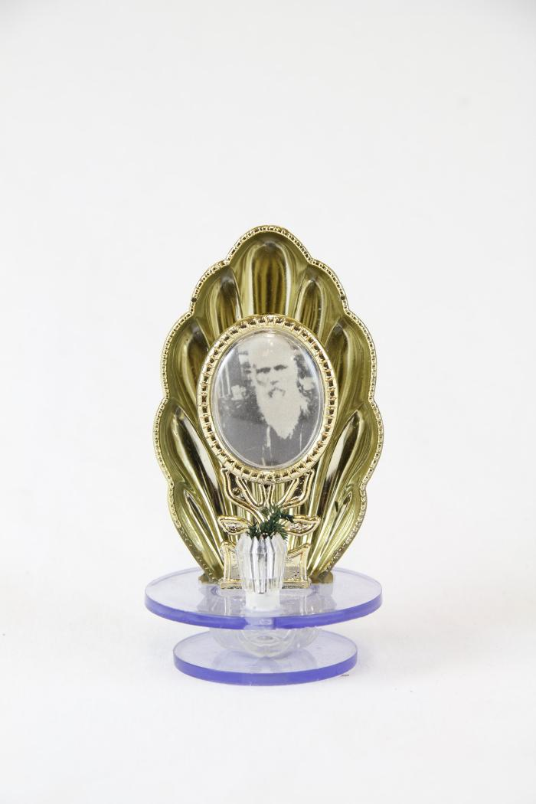
A small altar to Don Pedrito Jaramillo in gold shell (RE19)

