Slide 1
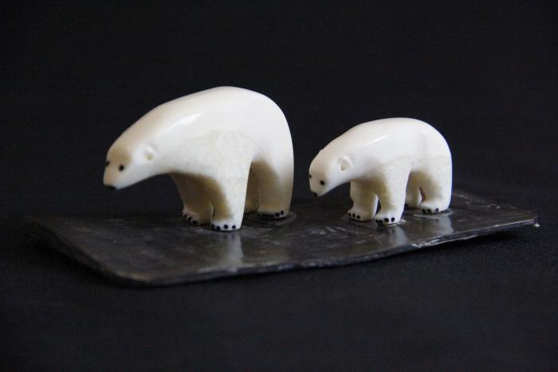
Polar bear with Cub (AC1)

