Slide 1
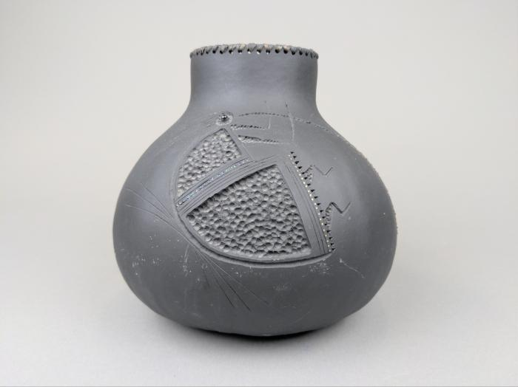
Robert Rivera Gourd with Flute Player (FR153)

