Slide 1
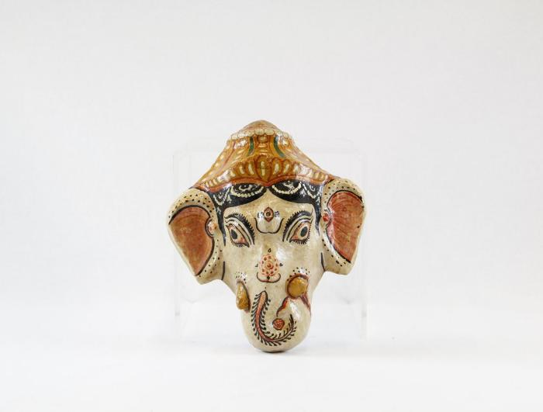
Ganesha mask (PR37)

