Slide 1
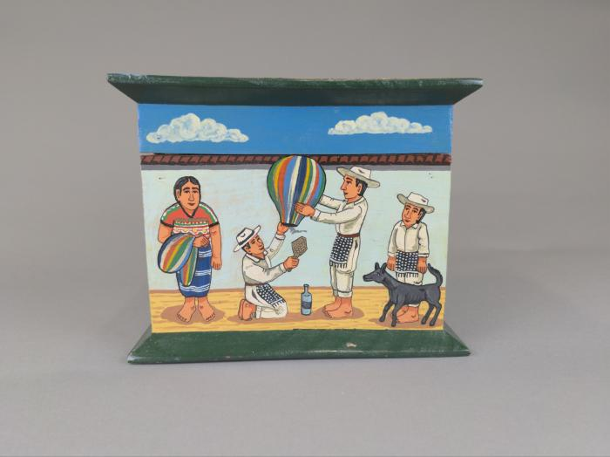
Painted Cofre by Filiberto Simon (FR49)

