Slide 1
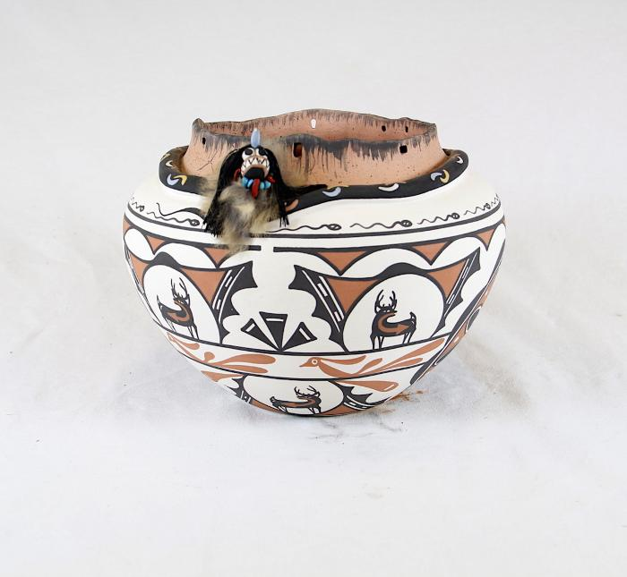
Serpent Pottery Vessel (SH108)

