Slide 1
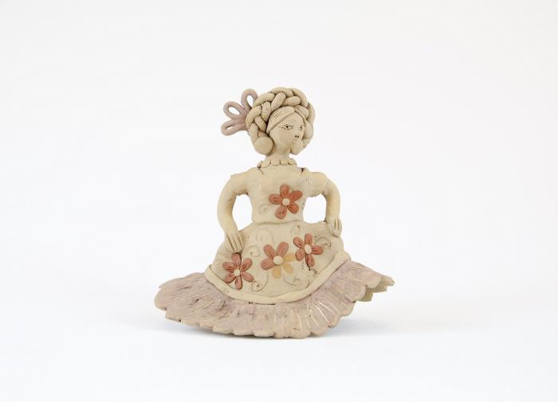
Clay Muñeca dressed in the style of Isthmus of Tehuantepec (M1034)

