Slide 1
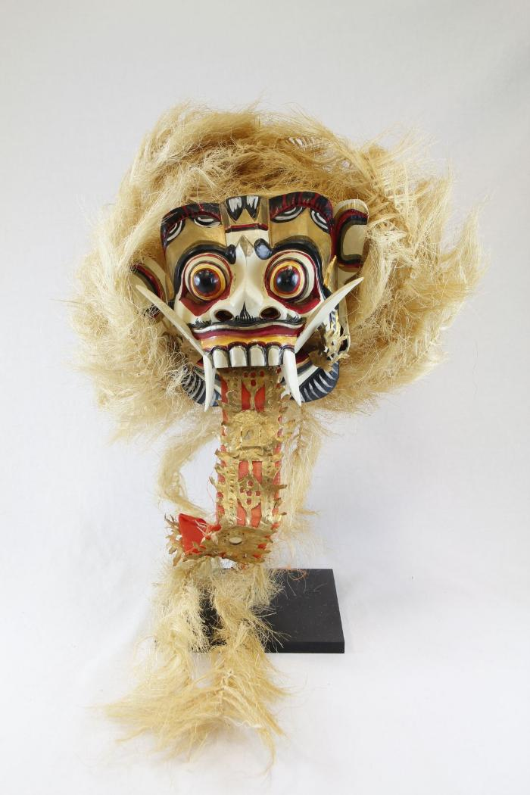
Ranga Mask (PR33)

Slide 2
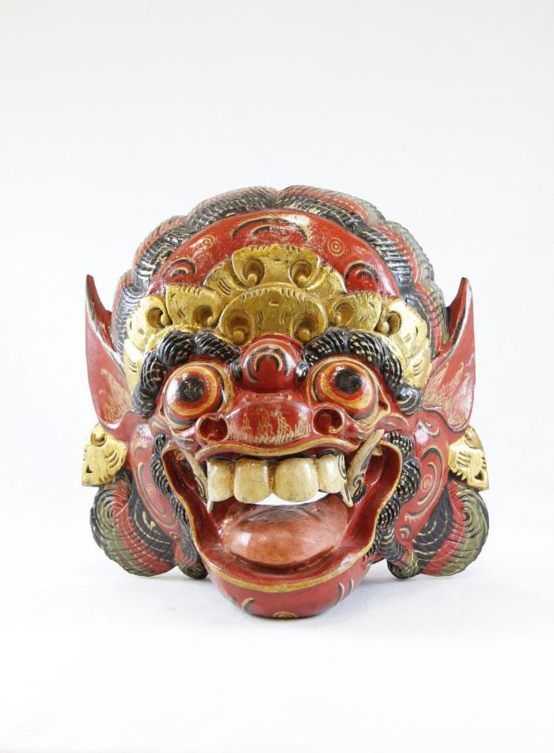
Indonesian Barong Mask (PR34)

Slide 3
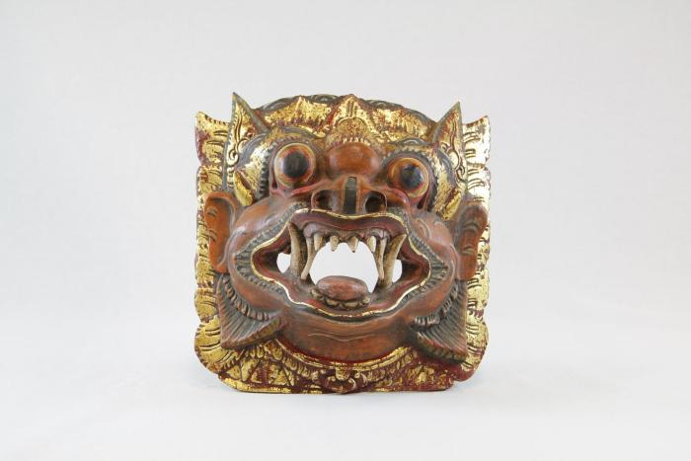
Indonesian Barong Mask (PR35)

Slide 4
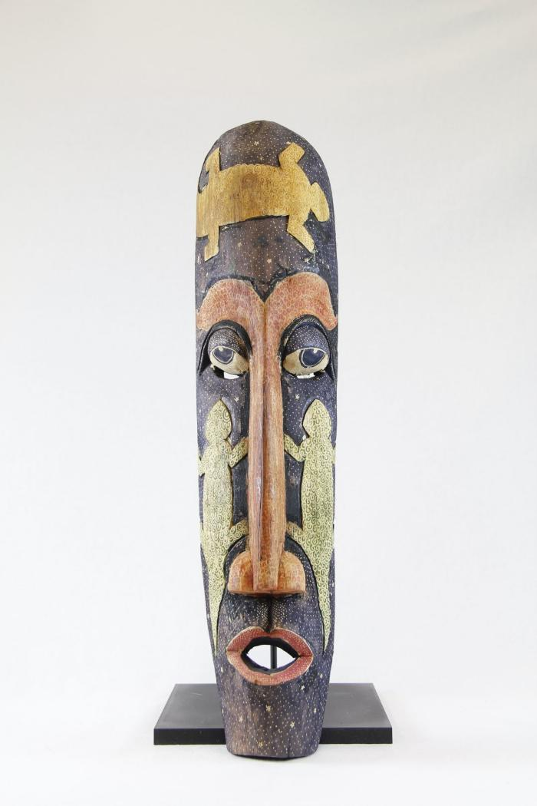
Balinese Long Mask with Lizards (PR36)

Slide 5
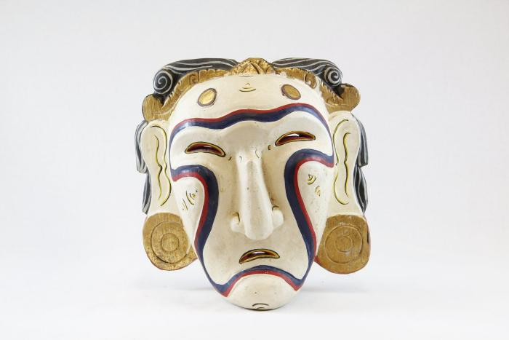
Jero Luh Mask (PR42)

Slide 6
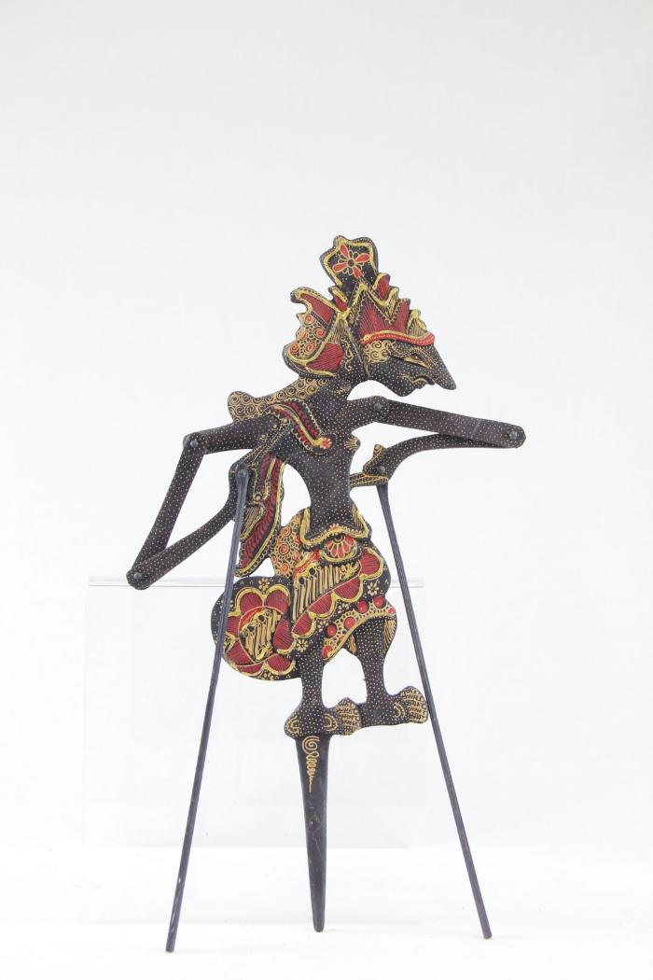
Indonesian Wayang Shadow Puppet (MC10)

