Slide 1
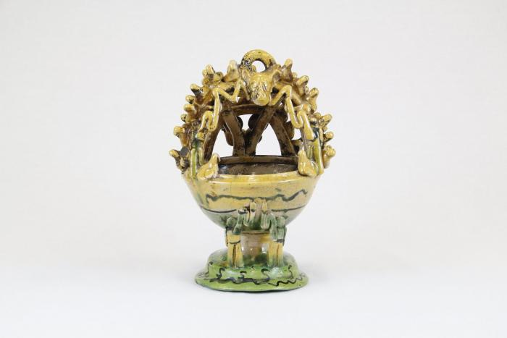
Mayolica Incense Burner (CA5)

Slide 2
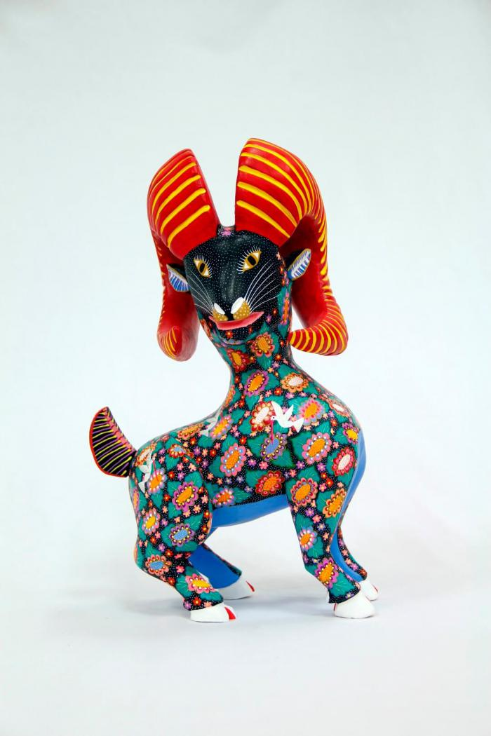
Horned goat (CA8)

Slide 3
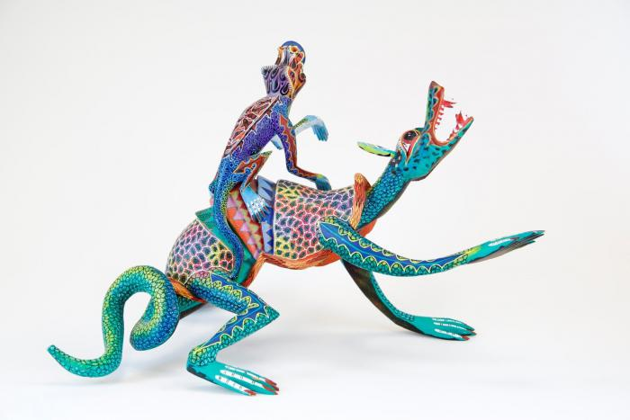
Two lizards (CA9)

Slide 4
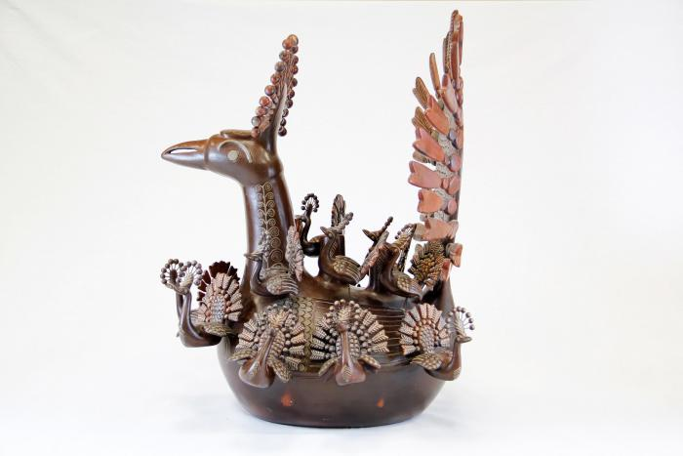
Peacock and Babies (CA20)

Slide 5
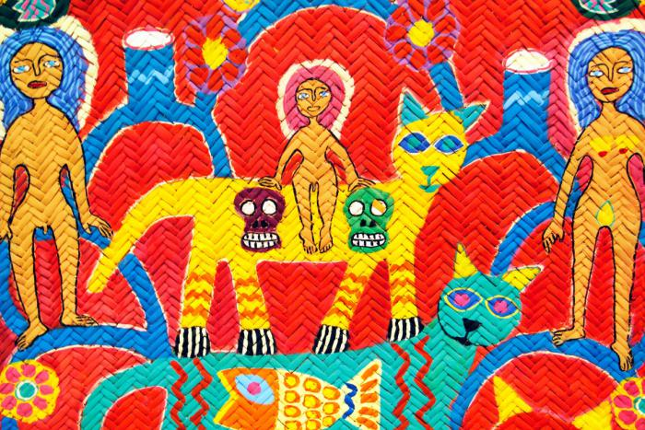
Woven Tree of Life Mat (CA28)

Slide 6
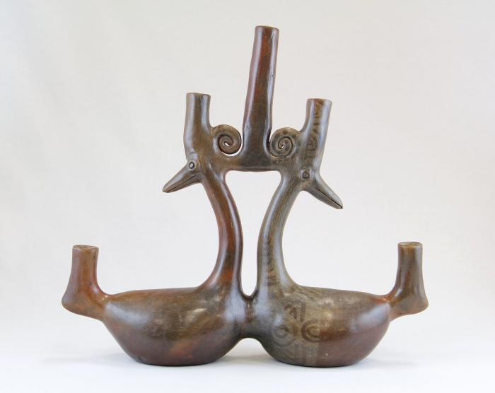
Parallel Ducks Candelabra (JO6)

Slide 7
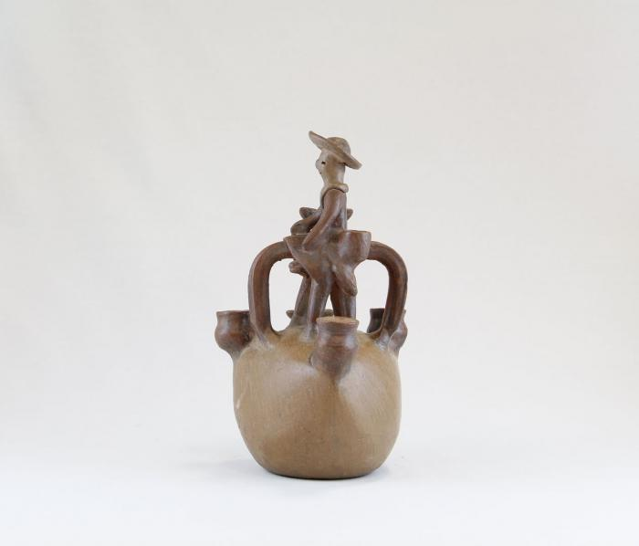
Man on Horse Candelabra (JO10)

Slide 8
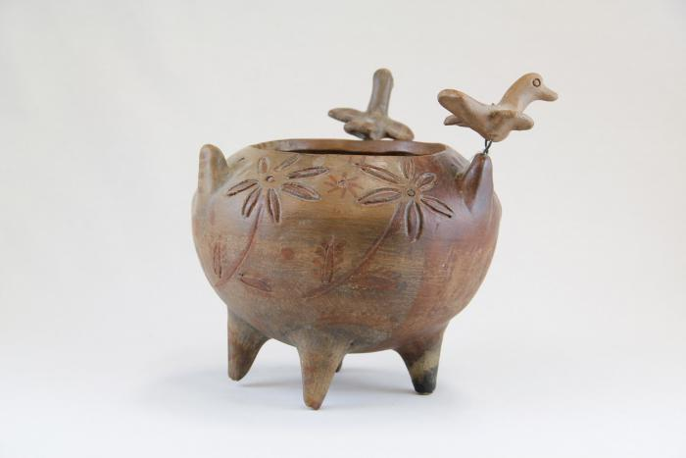
Incised Pot with Three Birds (JO11)

Slide 9
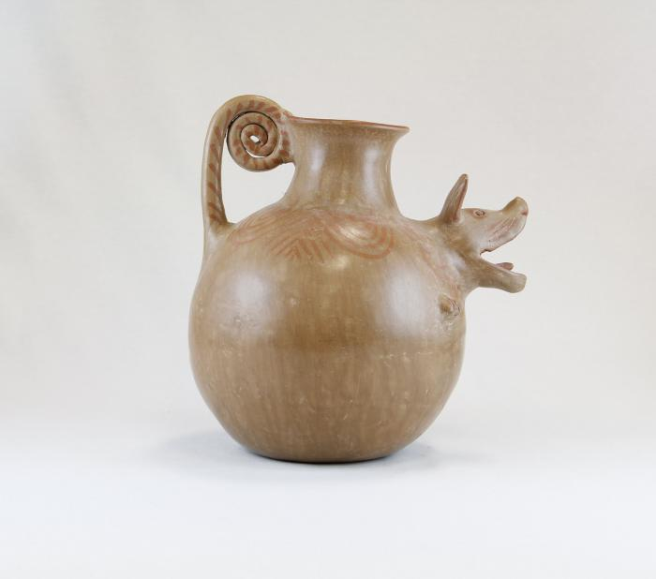
Barking Dog Pot (JO12)

Slide 10
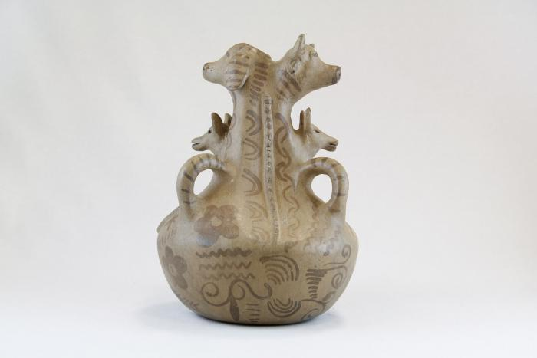
Three Dogs and a Cow Pot (JO13)

Slide 11
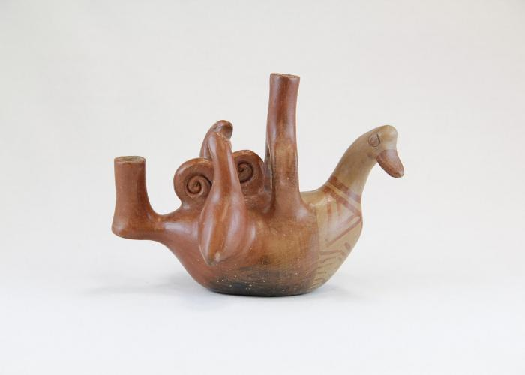
Bird and Two Baby Birds Candelabra (JO25)

Slide 12
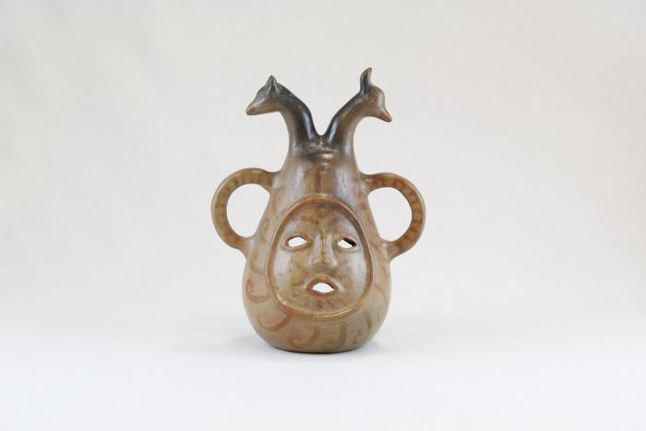
Face and Two Animal Head Candelabra (JO31)

Slide 13
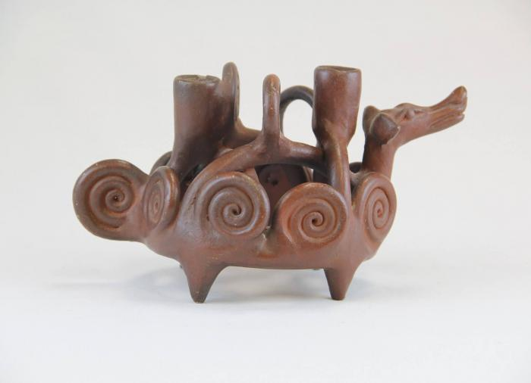
Dog Candelabra with Curled Designs (JO32)

Slide 14
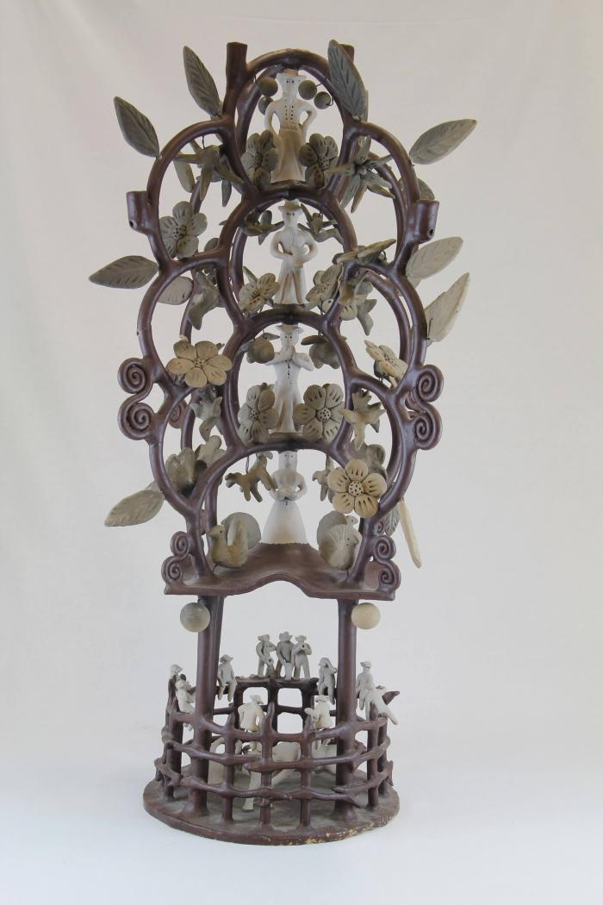
Circular Tree Candelabra (JO59)

Slide 15
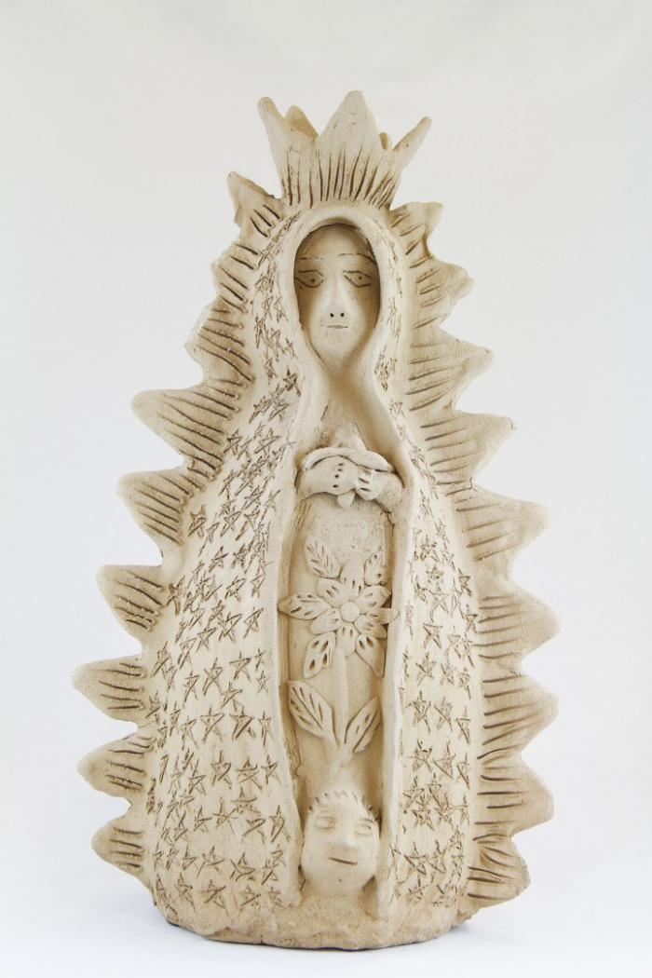
Virgen de Guadalupe (M1031)

Slide 16
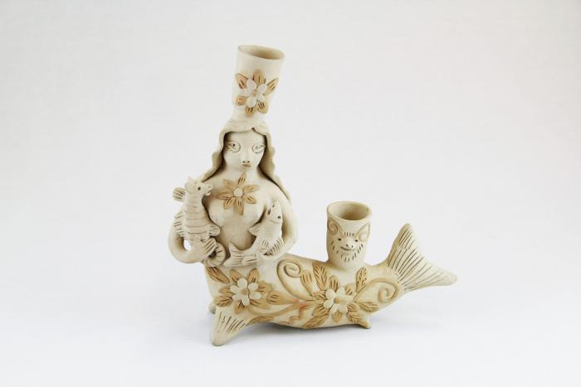
Mermaid Candelabra (M1033)

Slide 17
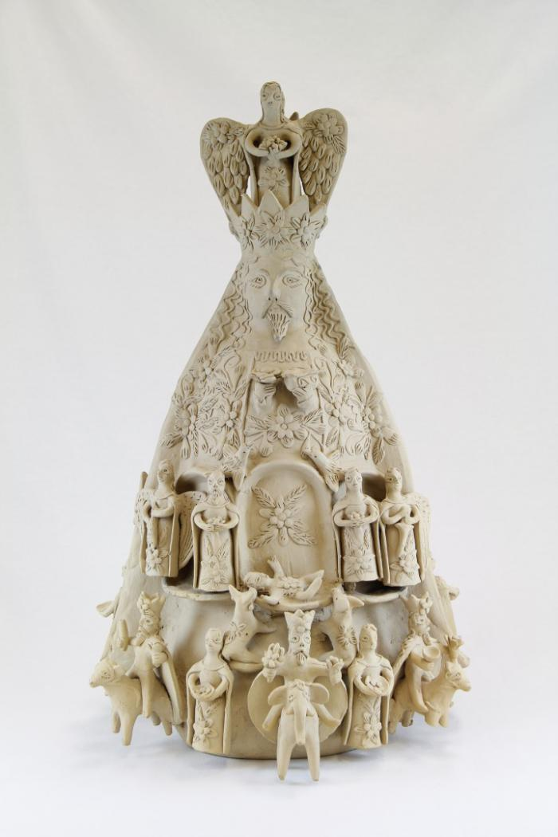
Two Sided Sculpture with Nativity Scenes (M1036)

Slide 18
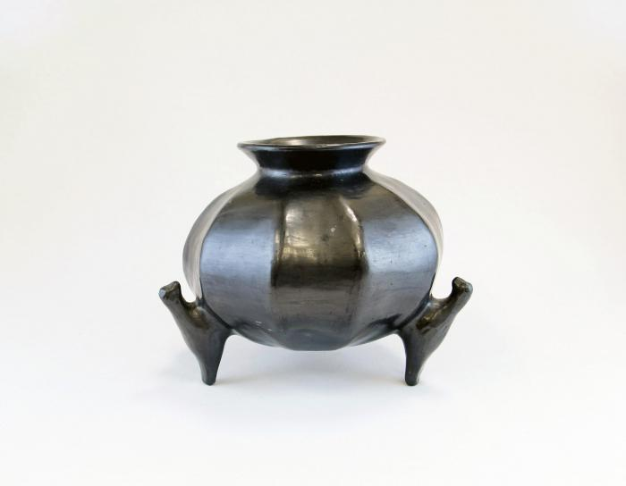
Barro Negro Round Pot (M1092)

Slide 19
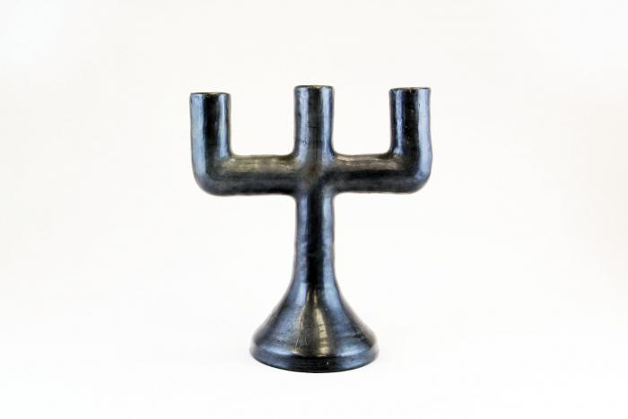
Barro Negro Candelabra (M1109)

Slide 20
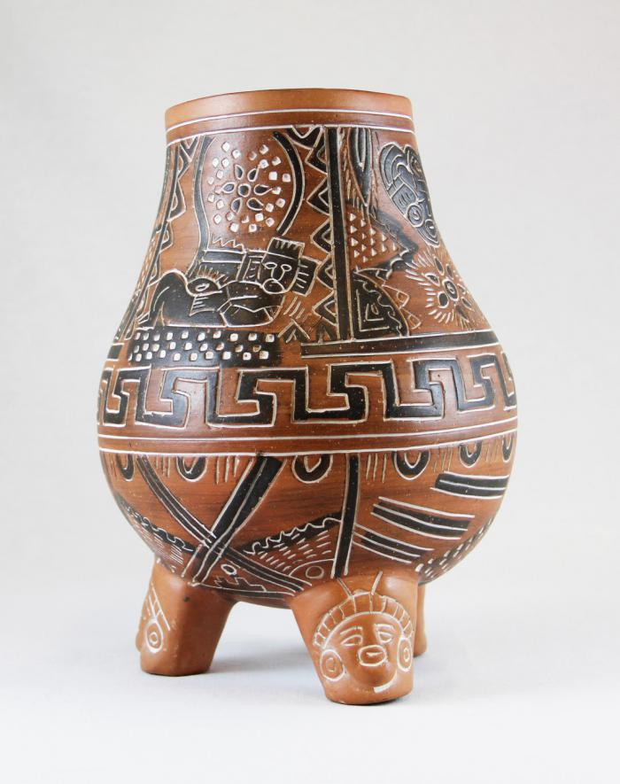
Vessel with Pre-Columbian Designs (M1111)

Slide 21
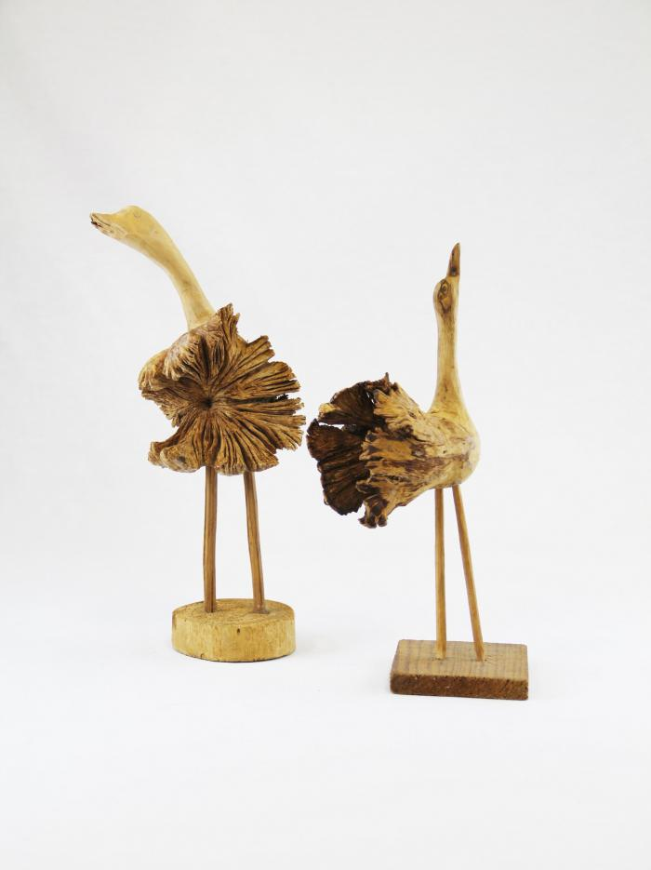
Two Wood Carved Birds (M1552)

Slide 22
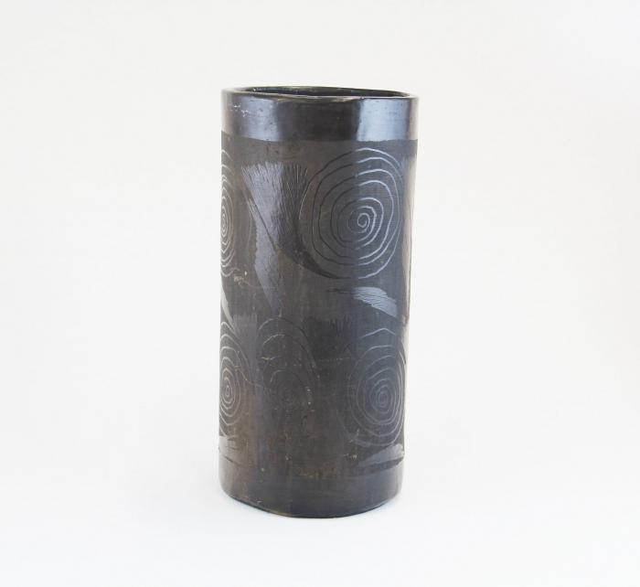
Barro Negro Vase (M1605)

Slide 23
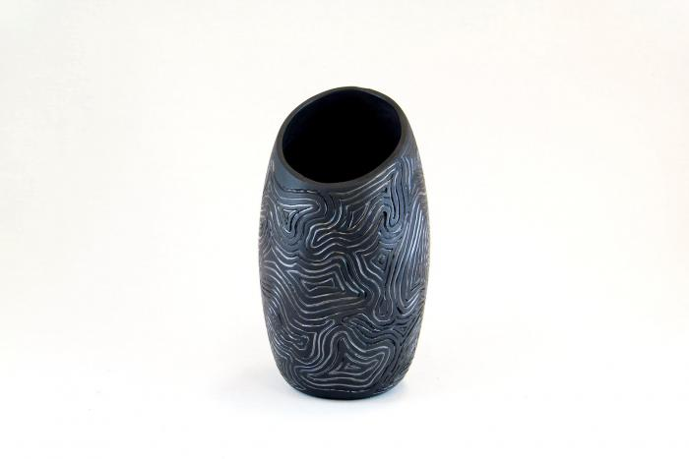
Barro Negro Incised Vase (M1607)

Slide 24
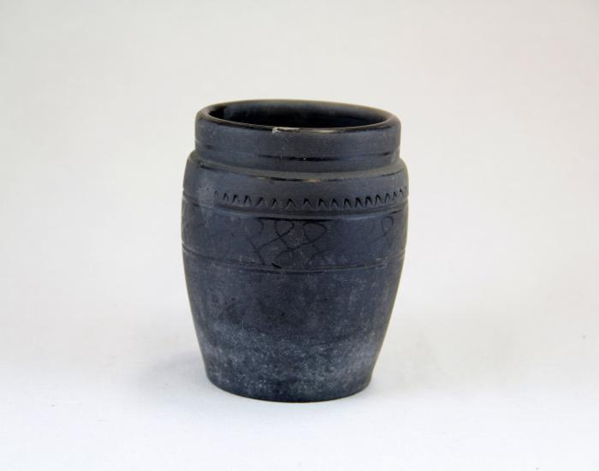
Barro Negro Pot (M1608)

Slide 25
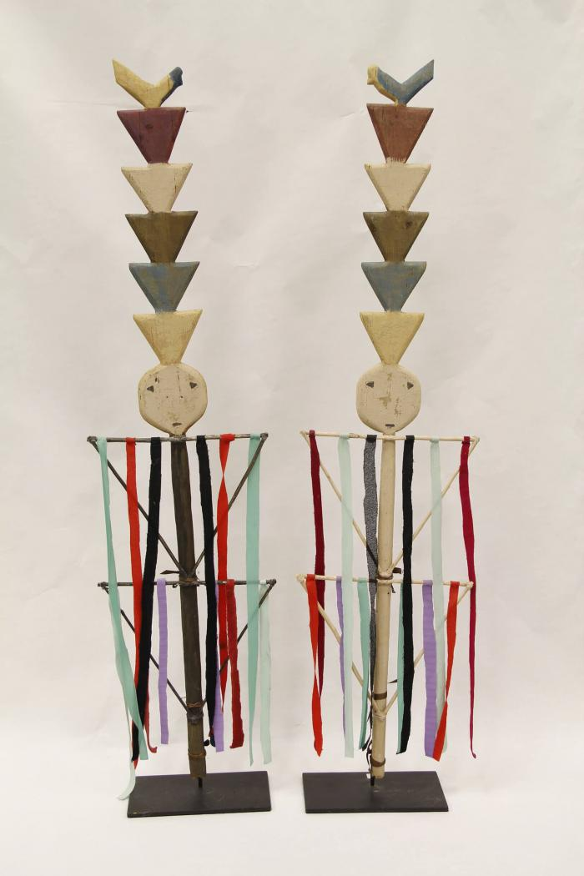
Two Navajo Dance Wands (MU3471)

Slide 26
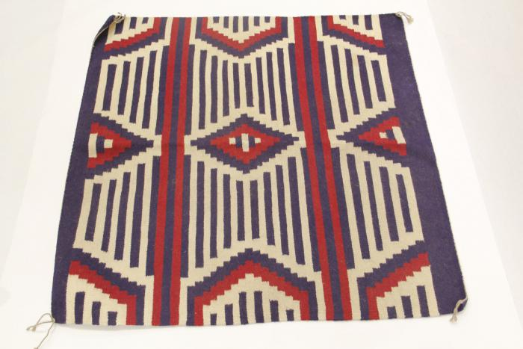
Navajo Chief's Blanket Third Phase (MU3473)

Slide 27
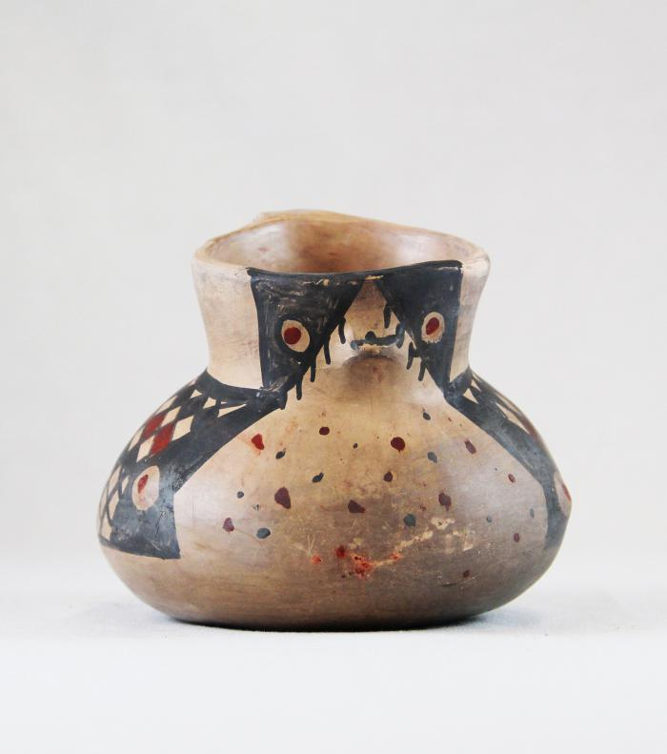
Diaguita Duck Pitcher (MU3477)

Slide 28
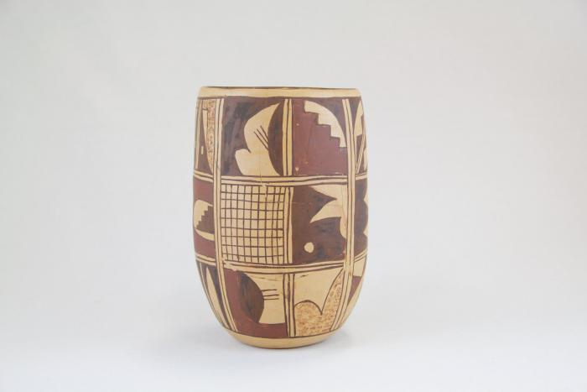
Zuni Burnished Pot (MU3479)

Slide 29
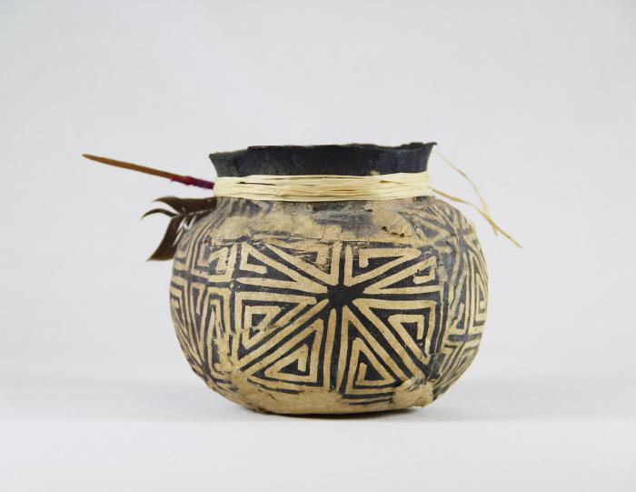
Cream & White Pot (MU3482)

Slide 30
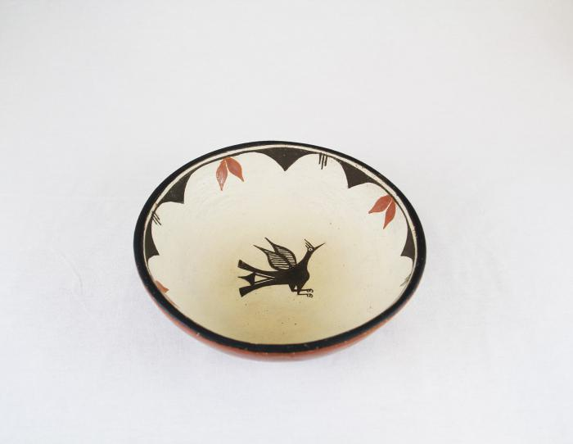
Terra Cotta Bowl with Bird in Center (MU3483)

Slide 31
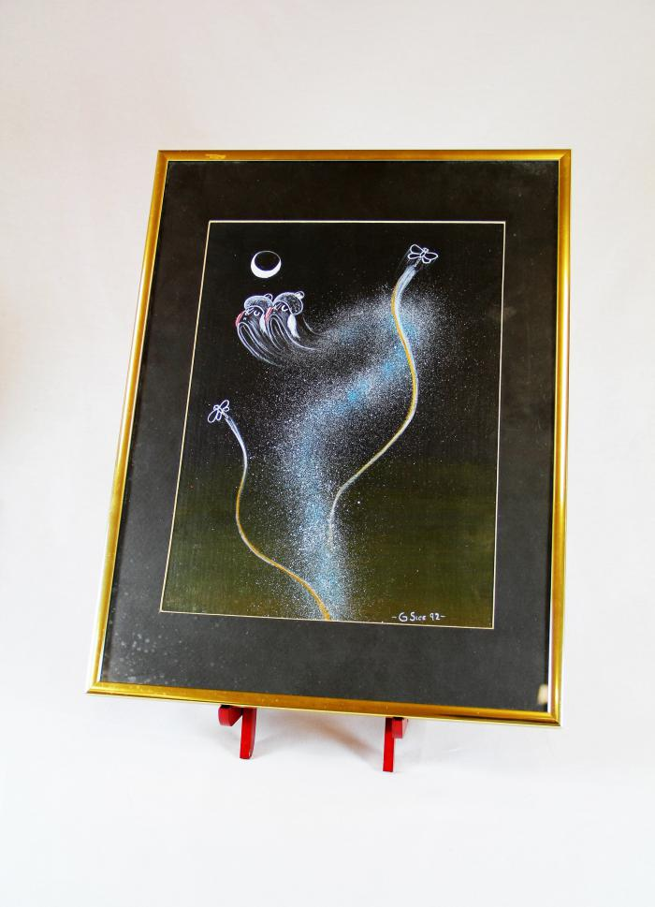
"4th World" Painting (MU3523)

Slide 32
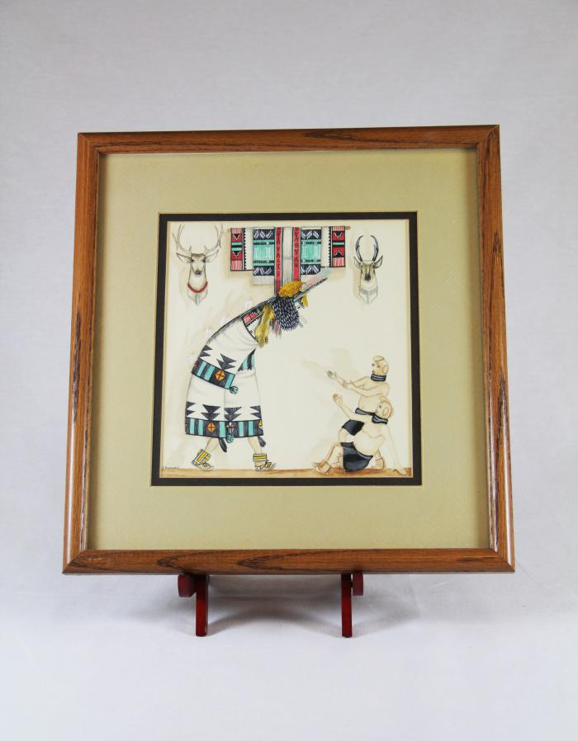
Zuni Shalako Kachina Painting (MU3525)

Slide 33
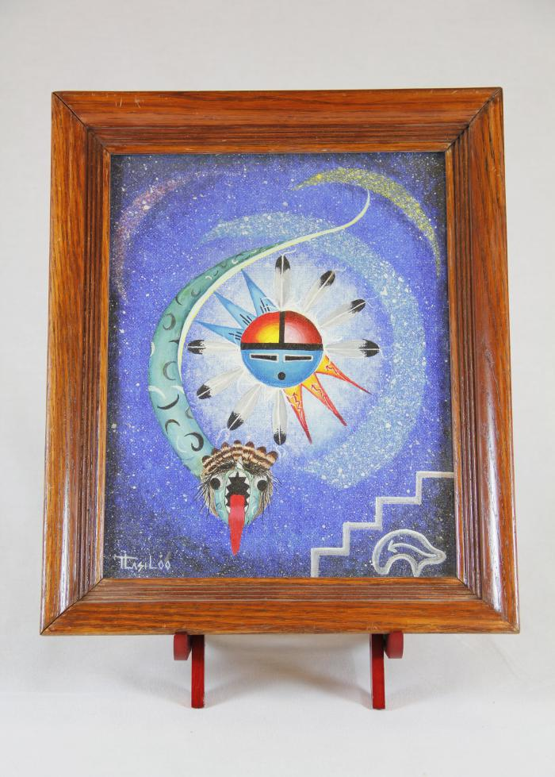
Sun Father and Snake Painting (MU3526)

Slide 34
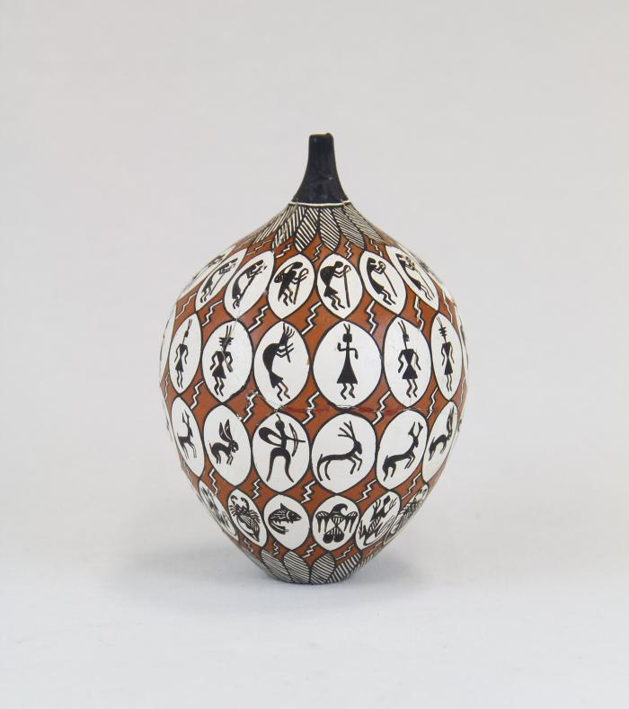
Storytelling Painted Pot (MU14)

Slide 35
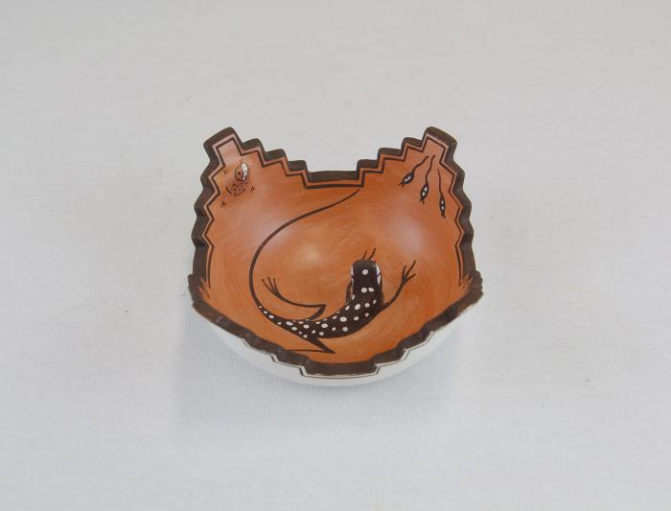
Zuni Pot with Lizard in Center (MU15)

Slide 36
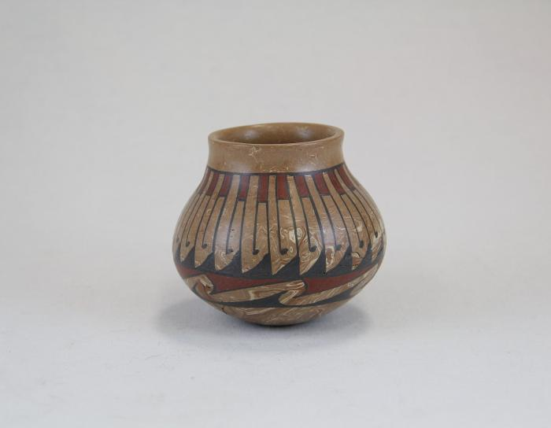
Repeated Wave Pot (MU16)

Slide 37
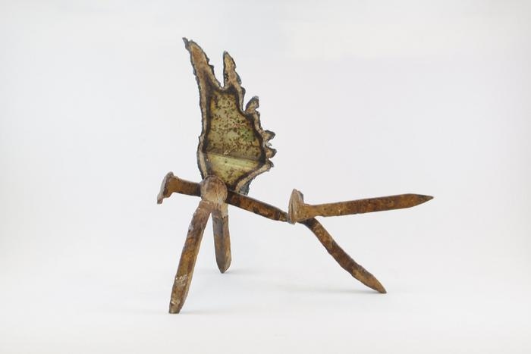
Angel (EH9)

Slide 38
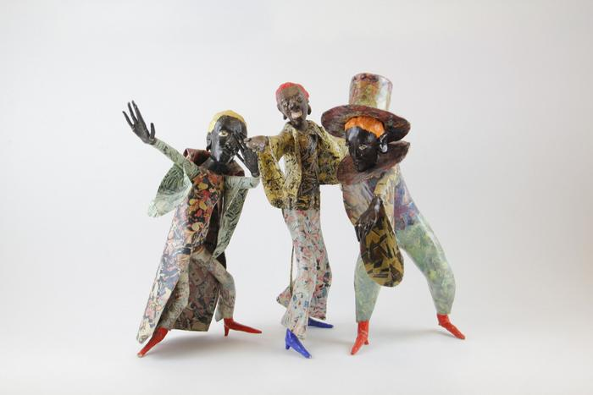
Three Minstrels (EH10)

Slide 39
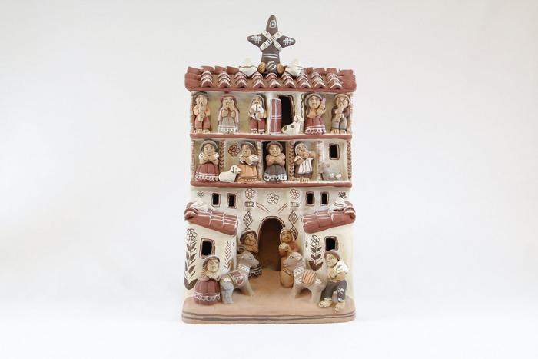
Peruvian Church with Market Scene
(SE51)

Slide 40
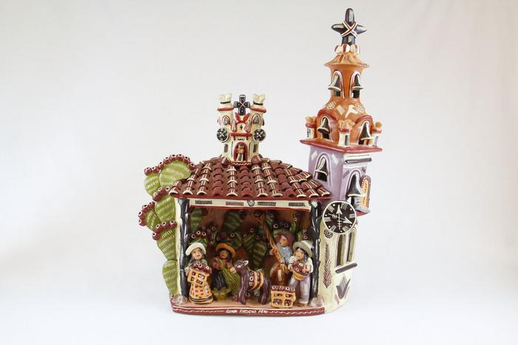
Peruvian Church with Multiple Small Figures (SE53)

Slide 41
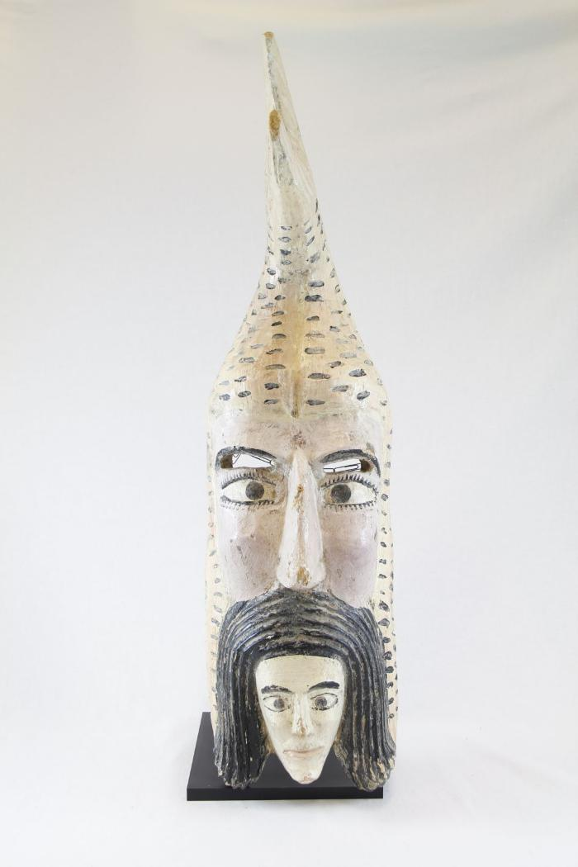
Mermaid Mask (PR4)

Slide 42
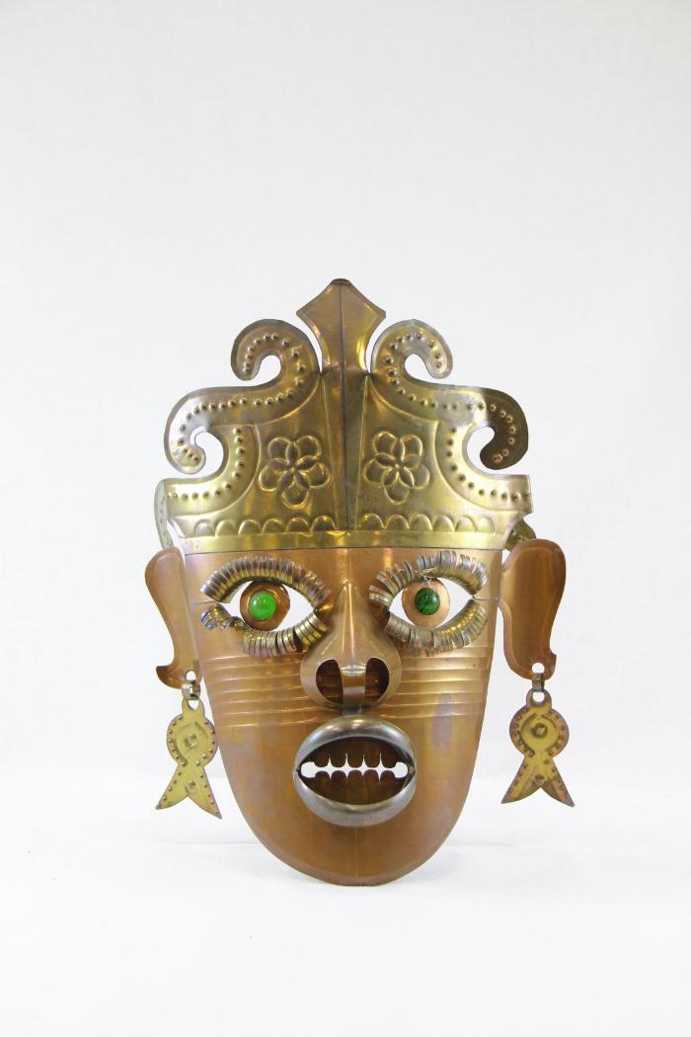
Tin Mask (PR11)

Slide 43
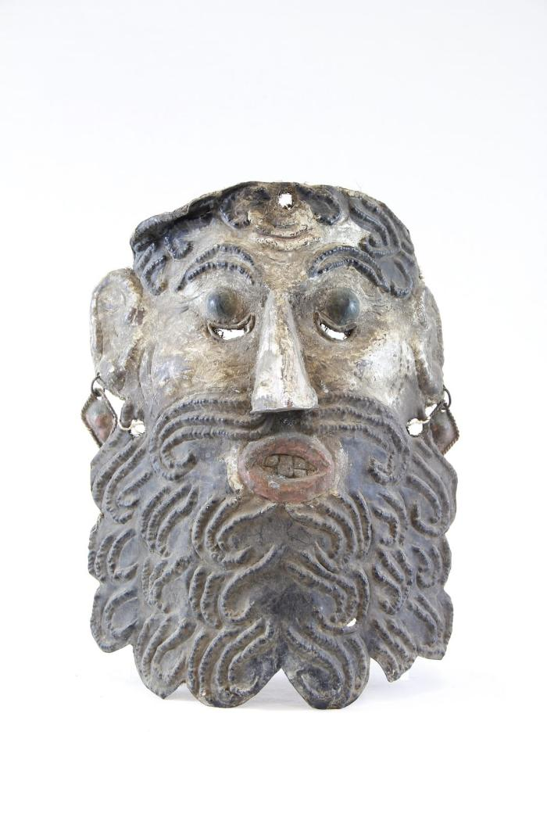
El Barbón Mask (PR12)

Slide 44
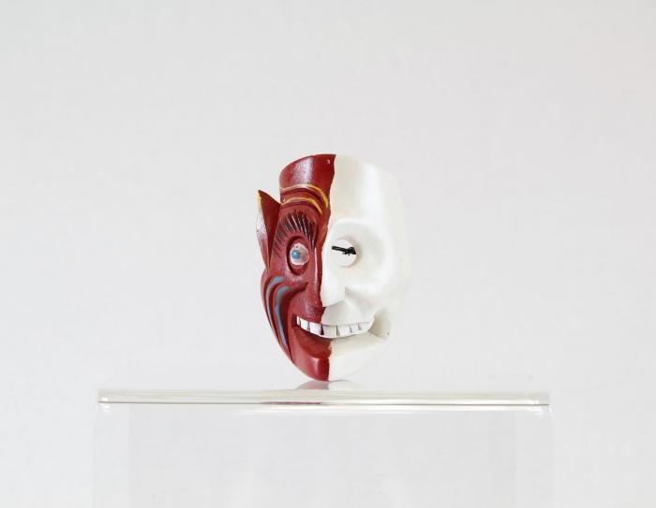
Diablo-Calavera (Devil-Skull) Mask (PR15)

Slide 45
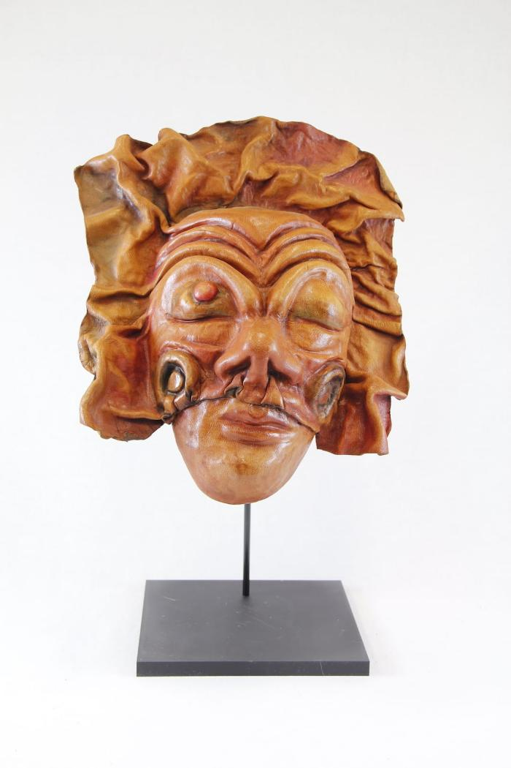
Leather Mask (PR16)

Slide 46
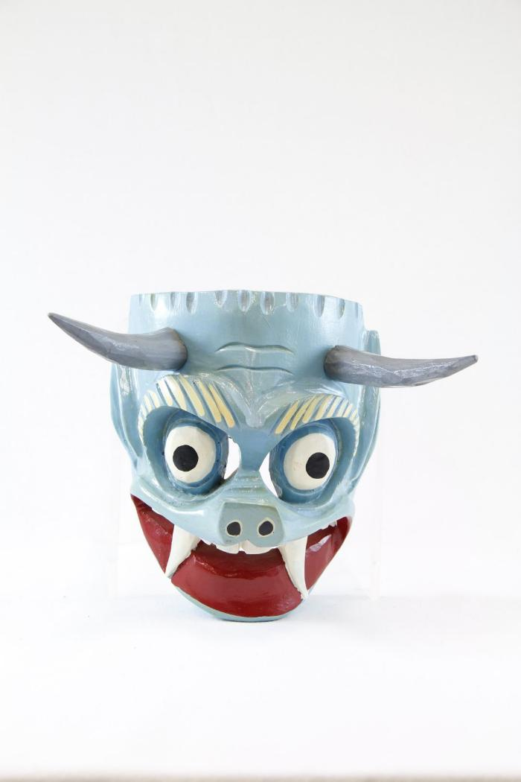
Blue Devil Mask (PR21)

Slide 47
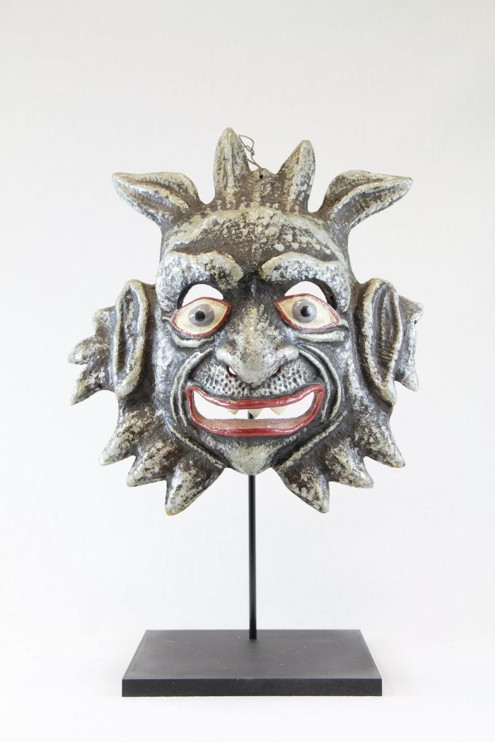
Devil Mask (PR24)

Slide 48
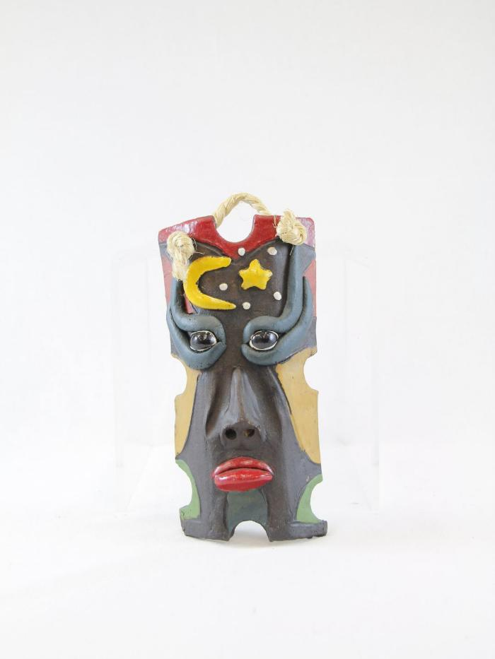
Moon and Star Ceramic Mask (PR26)

Slide 49
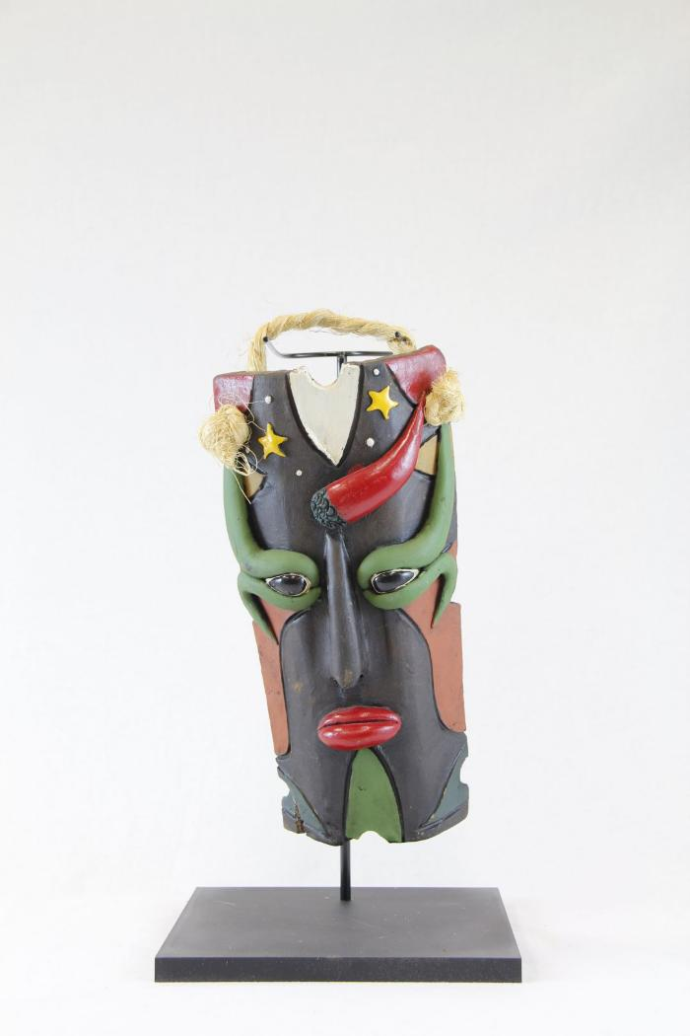
Stars Ceramic Mask (PR27)

Slide 50
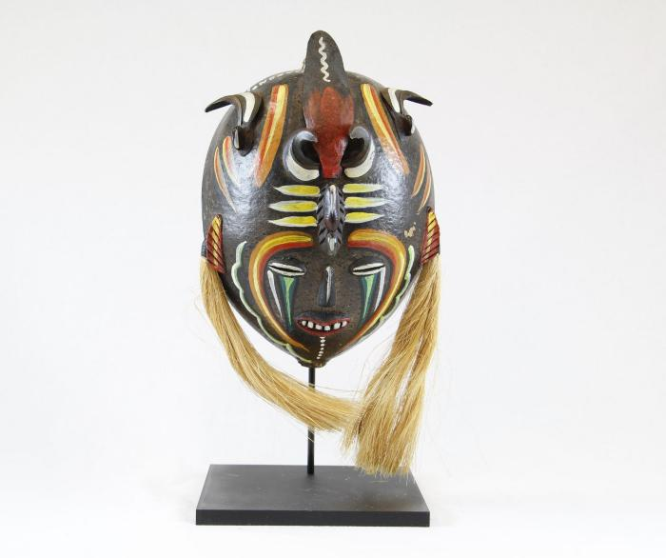
Venezuelan Tribal Mask (PR28)

Slide 51

Vejigantes Mask (PR31)

Slide 52

Ranga Mask (PR33)

Slide 53

Barong Mask (PR34)

Slide 54

Balinese Long Mask with Lizards (PR36)

Slide 55

Ganesha mask (PR37)

Slide 56

Thai Warrior Mask (PR39)

Slide 57

Foo Dog Wall Hanging (PR41)

Slide 58

Okina Mask (PR45)

Slide 59

Tengu mask (PR46)

Slide 60

Okame (Otafuku) Mask (PR47)

Slide 61

Nojang (monk) mask (PR48)

Slide 62

African Wood Carved Mask (PR50)

Slide 63

Carved Coconut Husk of Man's Head (PR51)

Slide 64

Gemstone Mask (PR53)

Slide 65

Rectangular Wood Mask (PR54)

Slide 66

Monkey Mask (MC12)

Slide 67

Guro Mask (MC13)

Slide 68

African Long Forehead Mask (MC15)

Slide 69

Makonde Shetani Sculpture (SH62)

Slide 70

Garuda (SH66)

Slide 71

Devil Masked Peasant Dancer (SH69)

