Slide 1
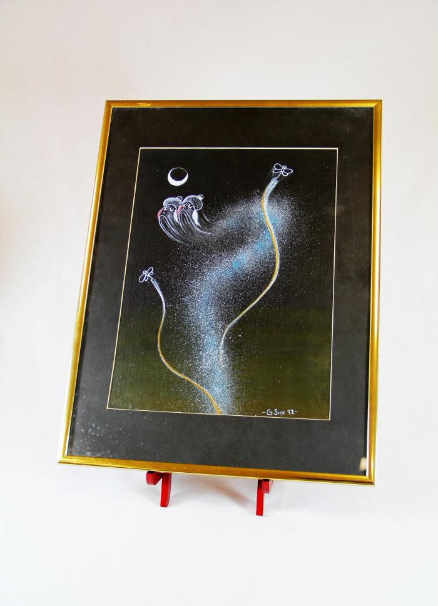
"4th World" Painting (MU3523)

Slide 2
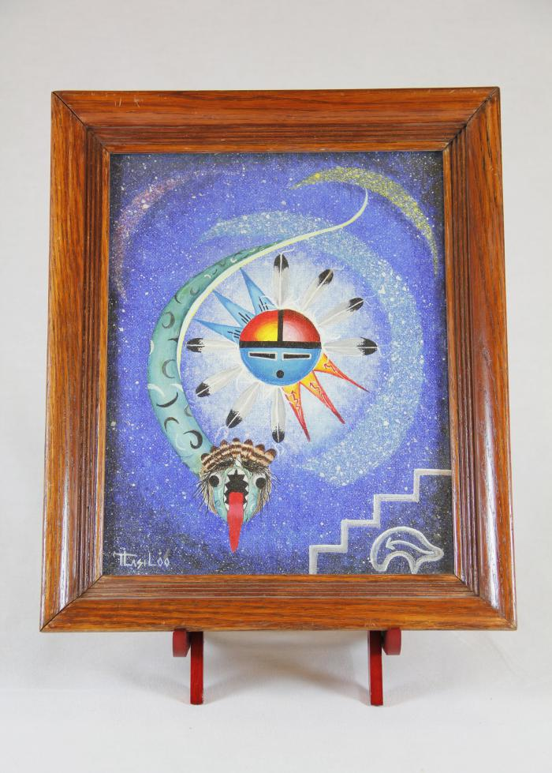
Sun Father and Snake Painting (MU3526)

Slide 3
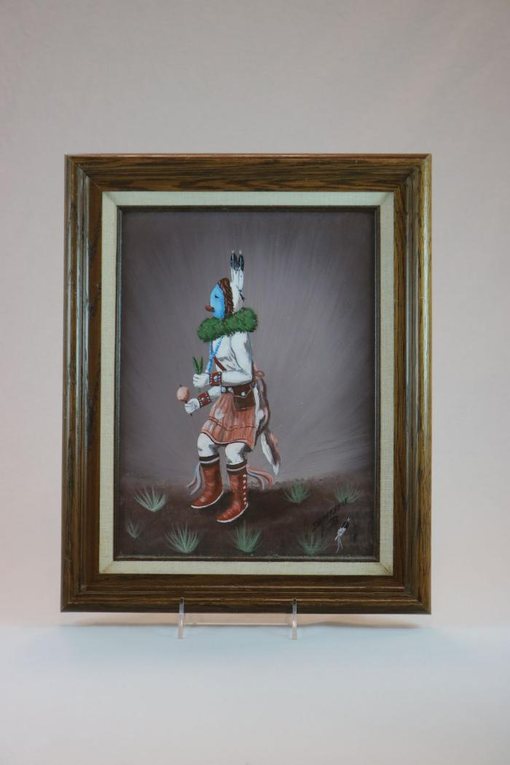
Oil Painting of Kachina Figure Framed in Wood (MU3524)

Slide 4
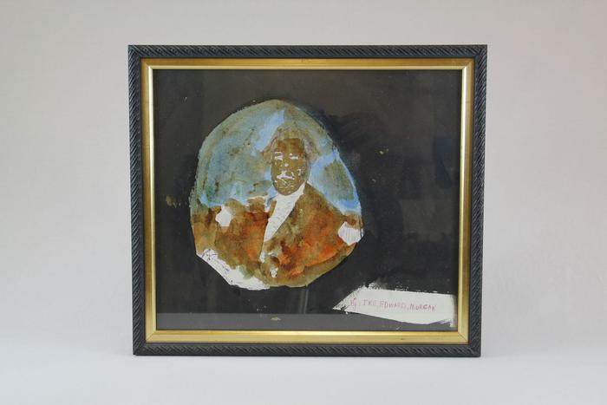
George Washington (EH21)

Slide 5
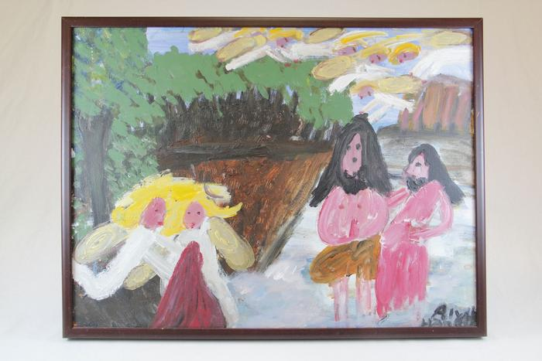
John the Baptist, with Yellow Haired Angels (EH22)

Slide 6
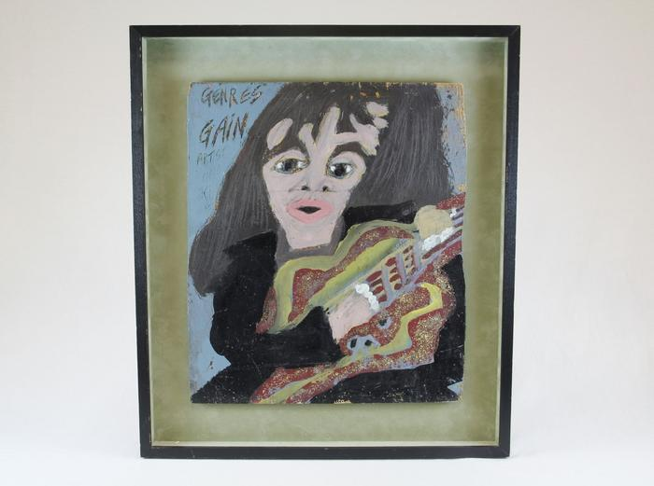
Woman Guitarist (EH23)

Slide 7
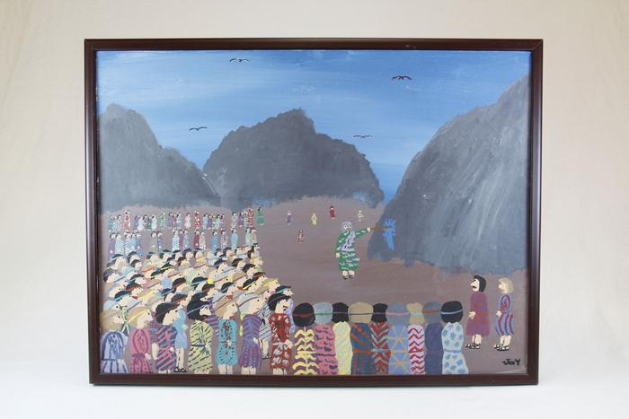
Moses Strikes the Rock at Kadesh (EH24)

Slide 8
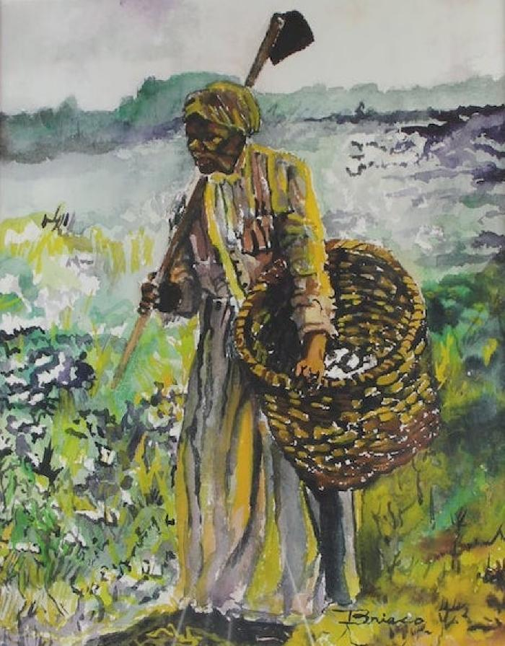
"Land Carer" (PE1)

Slide 9
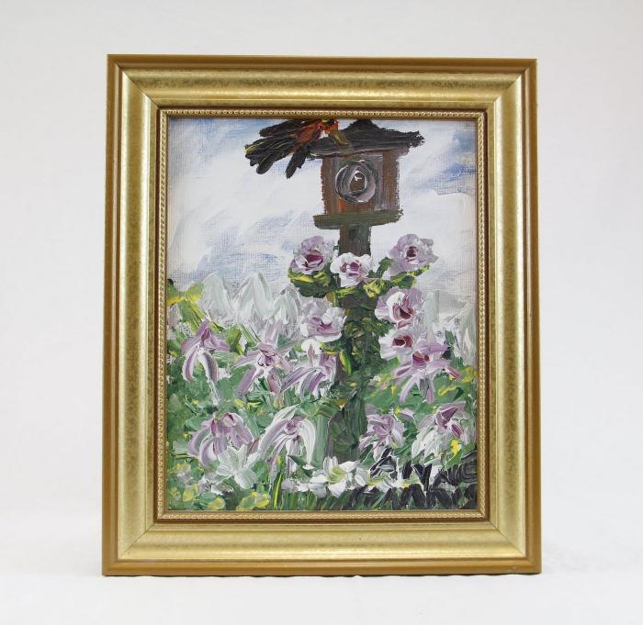
Bird House and Flowers (HA1)

Slide 10
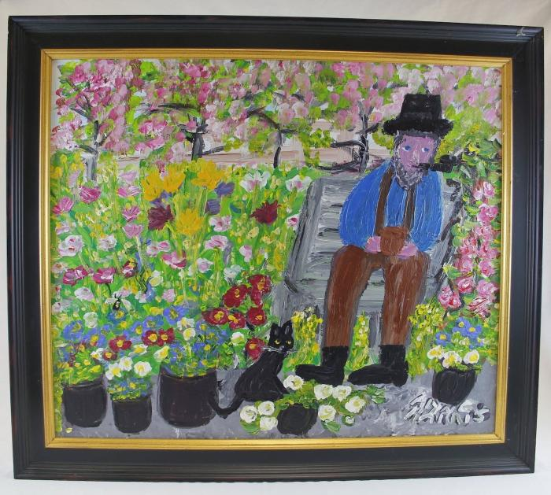
Man smoking pipe with cat and flowers (HA2)

Slide 11
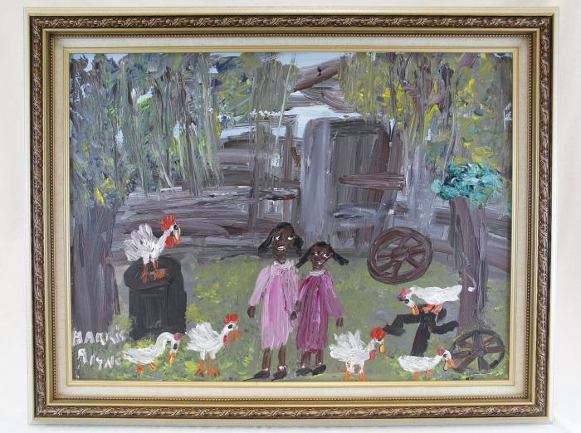
Two girls and chickens (HA3)

Slide 12
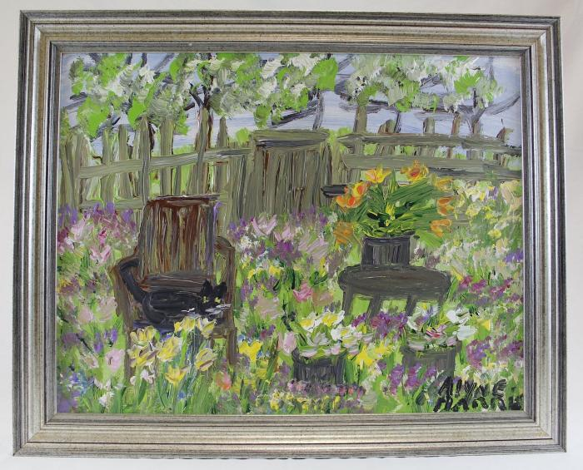
Cat sits on chair surrounded by flowers (HA4)

Slide 13
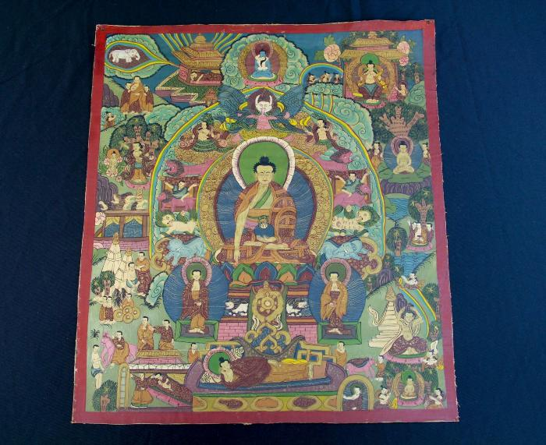
Tibetan Thangka (WI29)

Slide 14
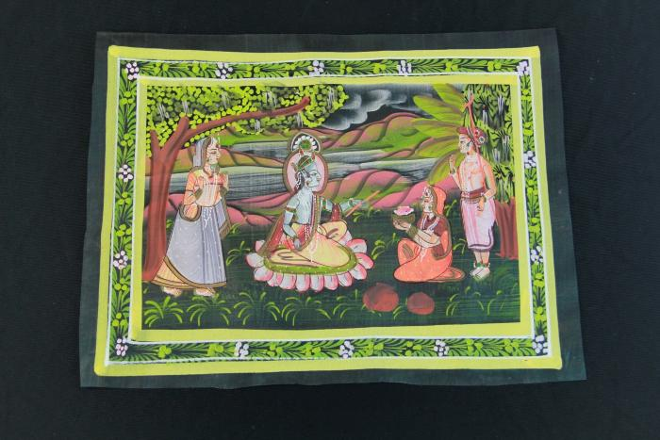
Krishna and Three Wives Fabric Painting (Pichhwai) (WI30)

Slide 15
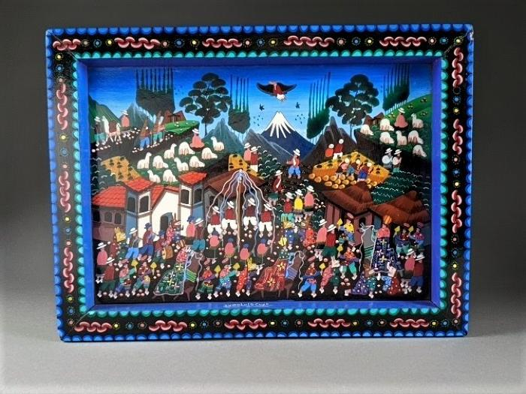
La Fiesta de la Virgen de la Candelaria by Juan Luis Cuyo (FR177)

