Slide 1
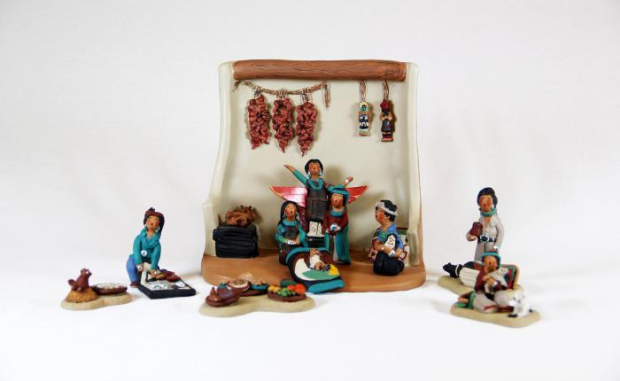
Native American Nativity (13 pieces) (M1068)

