Slide 1
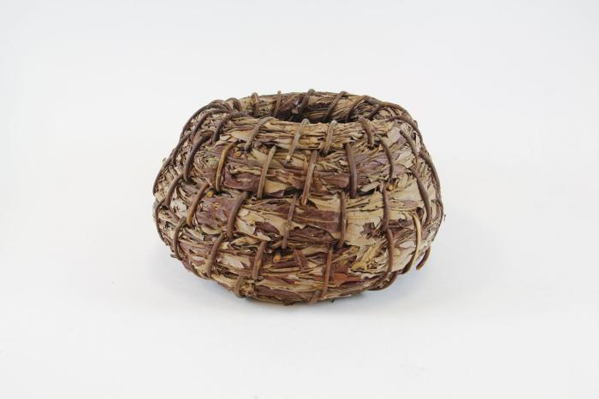
Willow Kumeyaay PaiPai Basket (SH35)

