Slide 1
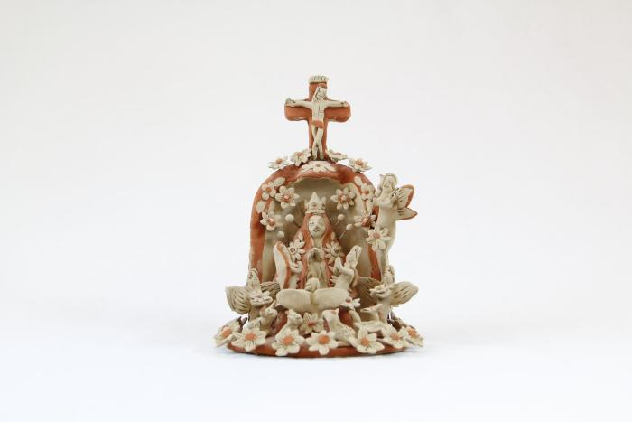
Virgin de Guadalupe (SH117)

