Slide 1
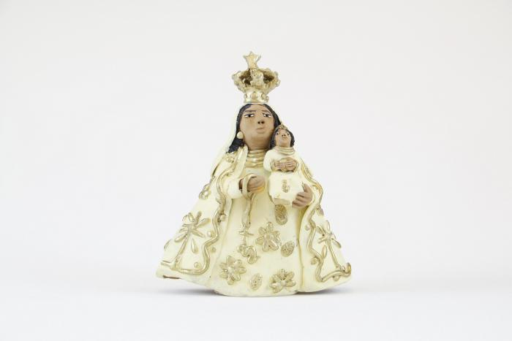
Virgen Madonna with Gold Crown (M1016)

