Slide 1
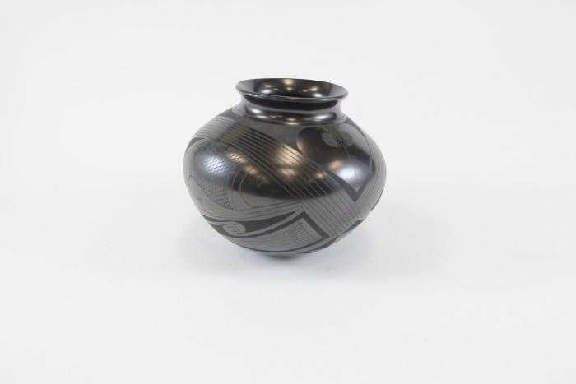
Black Vase (SH28)

Slide 2
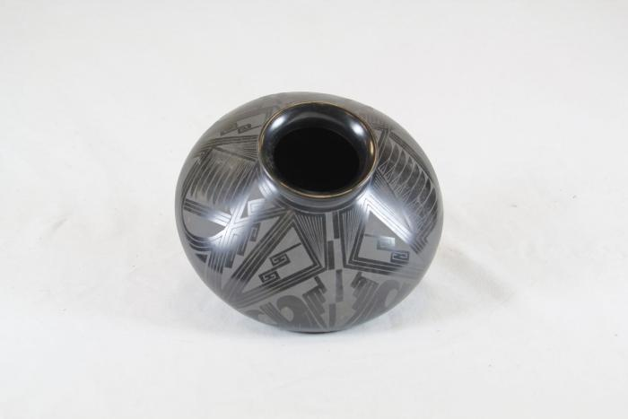
Mata Ortiz Black Vase (SH29)

Slide 3
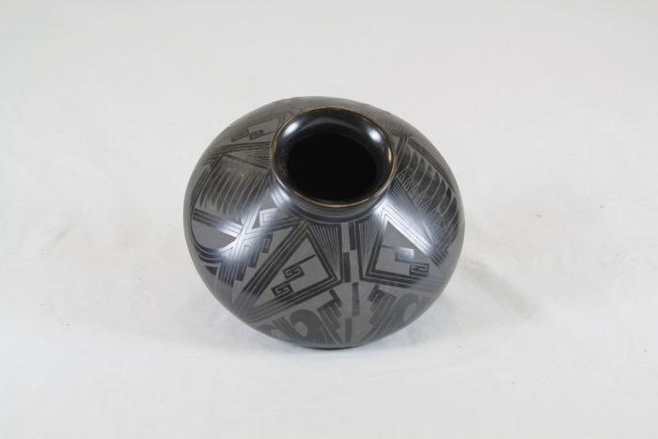
Black Vase (SH30)

