Slide 1
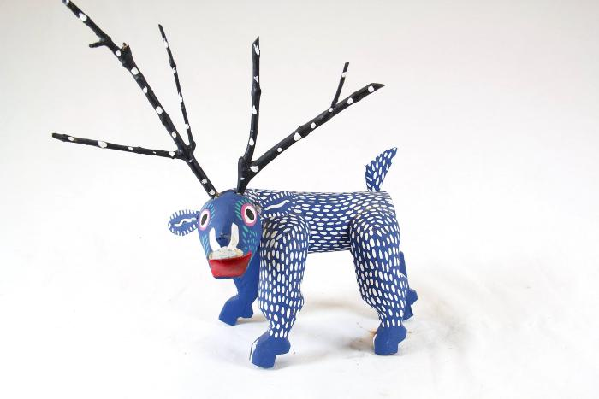
Deer Alebrije (SH71)

