Slide 1
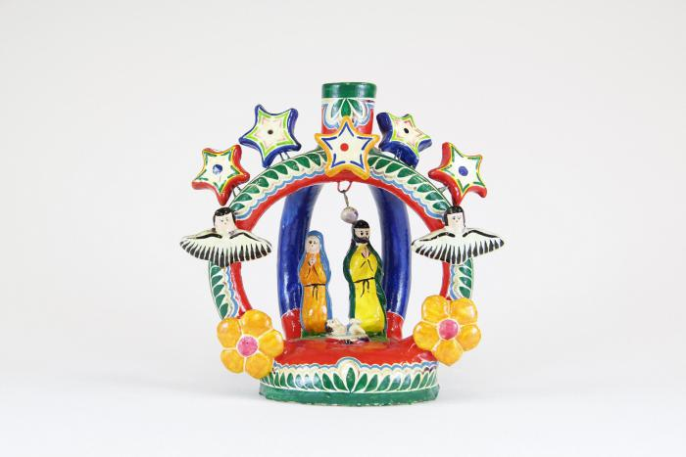
Tree of Life Nativity (Nacimiento) Candle Holder (M1056)

Slide 2
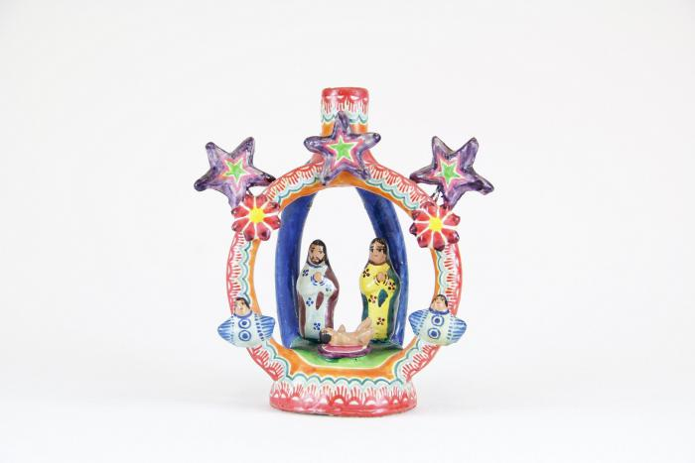
Nativity (Nacimiento) with Stars Candle Holder (M1059)

Slide 3
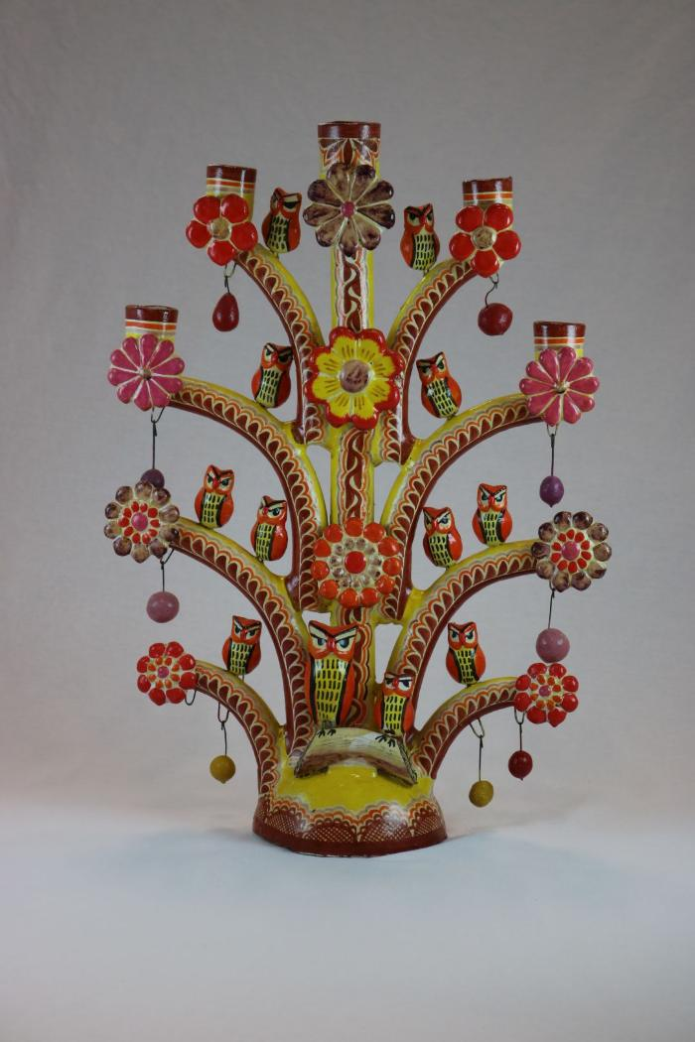
Tree of Life Candelabra with Owls (M1061)

