Slide 1
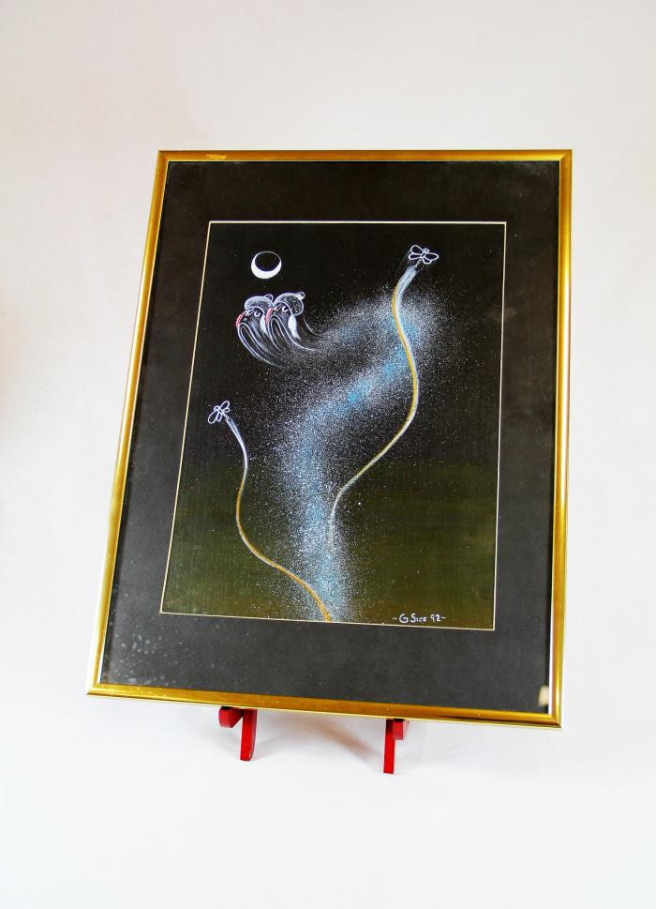
"4th World" Painting (MU3523)

