Slide 1
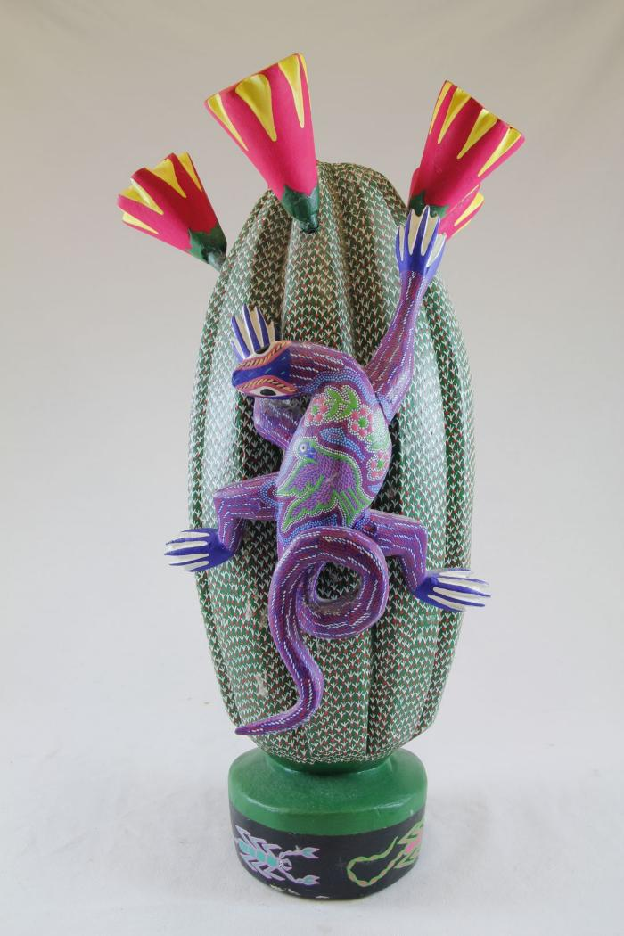
Cactus (SH38)

