Slide 1
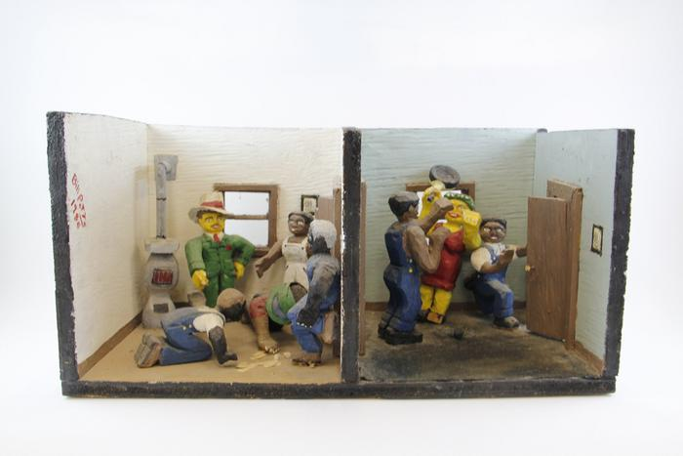
Two Carved Wood Indoor Scenes (EH29)

