Slide 1
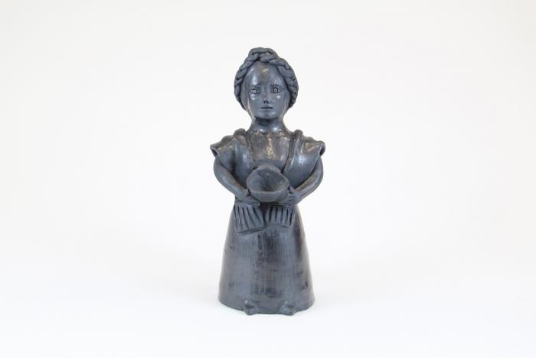
Muñeca holding Bowl (M1024)

Slide 2
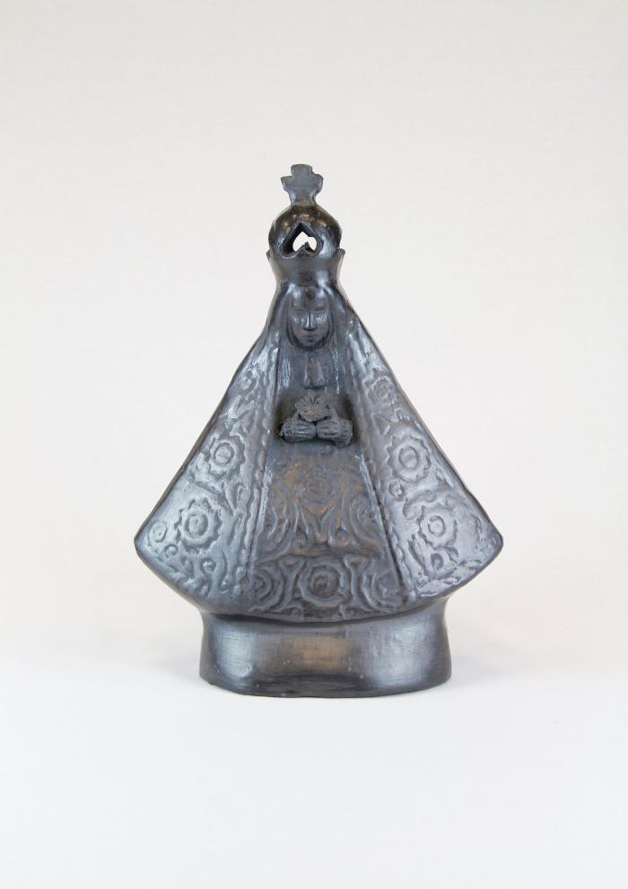
Black Clay Virgen de la Soledad (M1025)

Slide 3
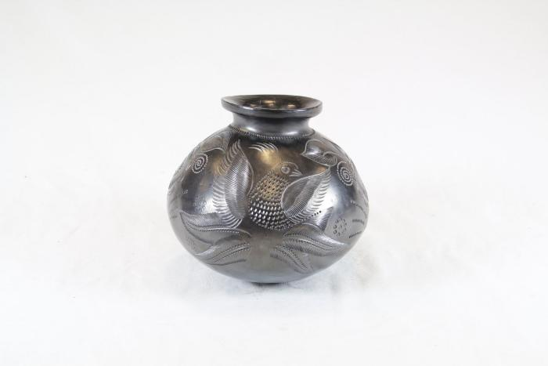
Black Vase (SH25)

Slide 4
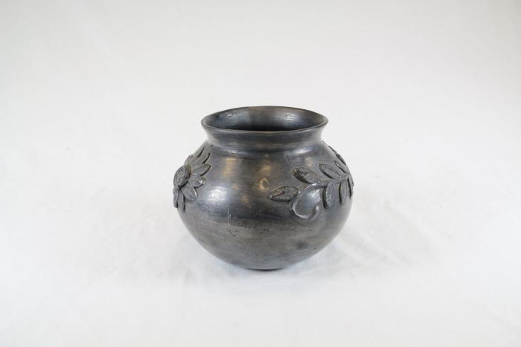
Black Vase (SH26)

Slide 5
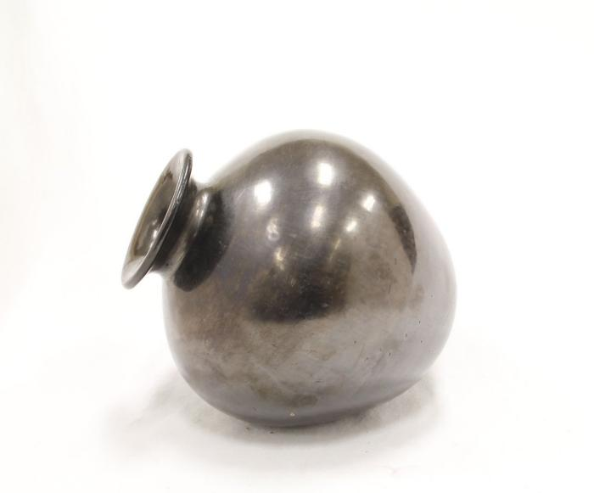
Giant Vase (SH67)

