Slide 1
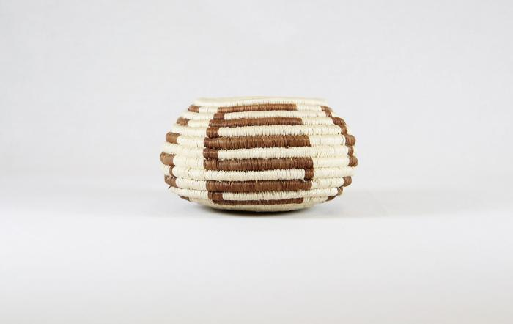
Tohona-O’Odham Small Woven Cream & Brown Coil Pot (MU3500)

Slide 2
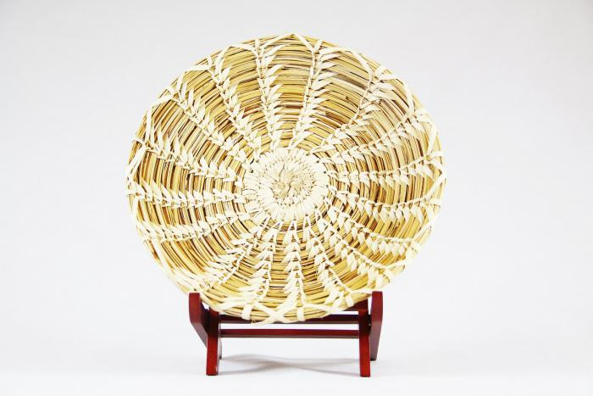
Tohona-O’Odham Yucca & Devil Claw Round Basket with Rim (MU3501)

Slide 3
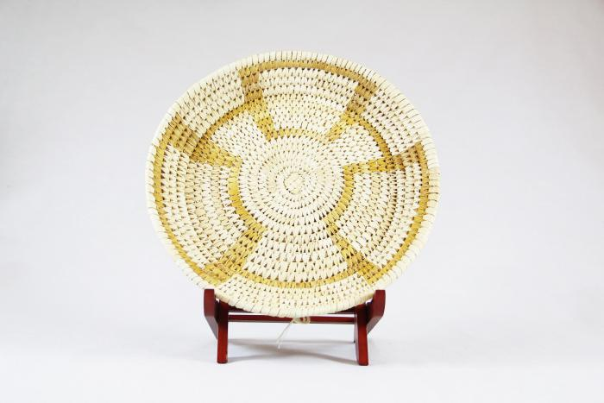
Tohono-O’Odham Woven Yucca Round Basket (MU3502)

Slide 4
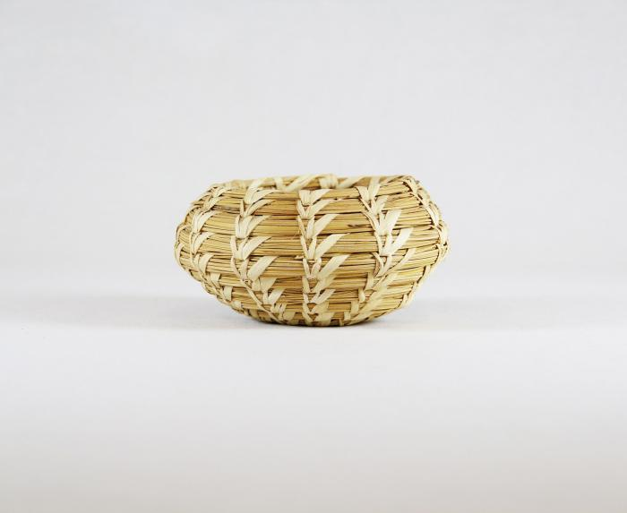
Tohono-O’Odham Woven Yucca Basket (MU3503)

Slide 5
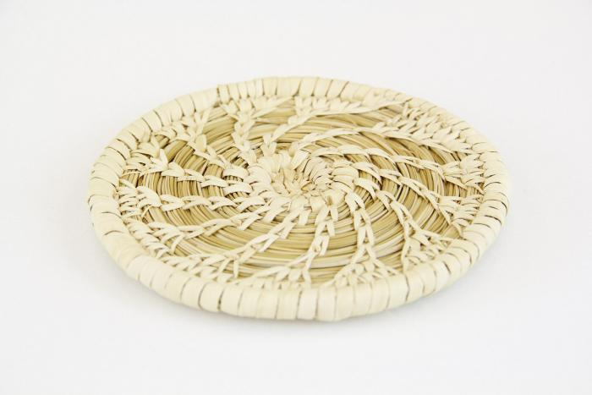
Tohono-O’Odham Flat, Round Basket with Yucca Flower Pattern (MU3504)

Slide 6
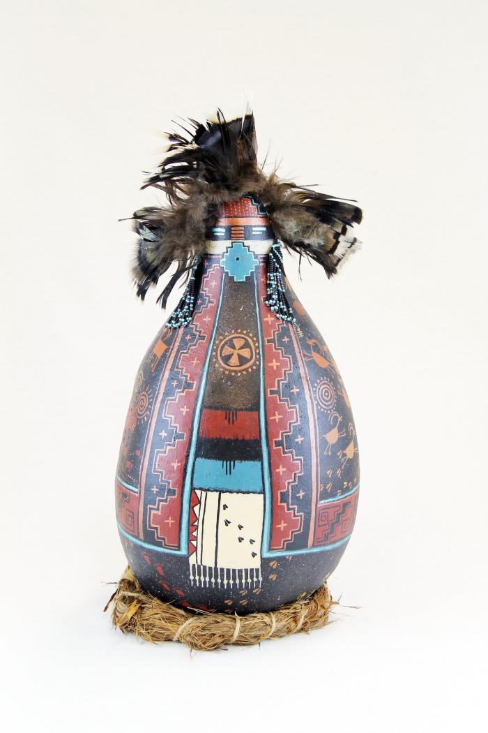
Gourd Doll on Grass Ring Pedestal (MU3506)

Slide 7
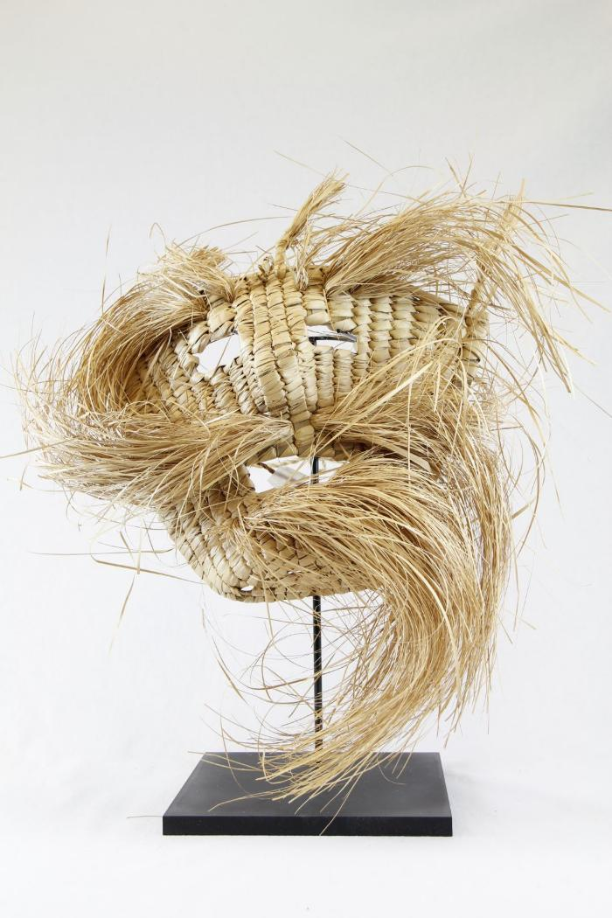
Straw or Palm Mask (PR22)

Slide 8
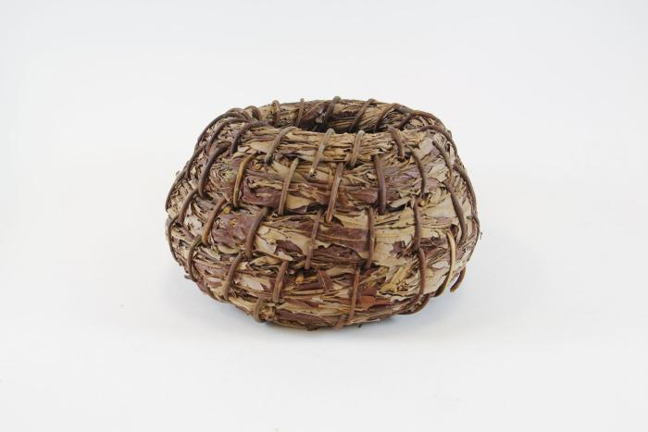
Willow Kumeyaay PaiPai Basket (SH35)

Slide 9
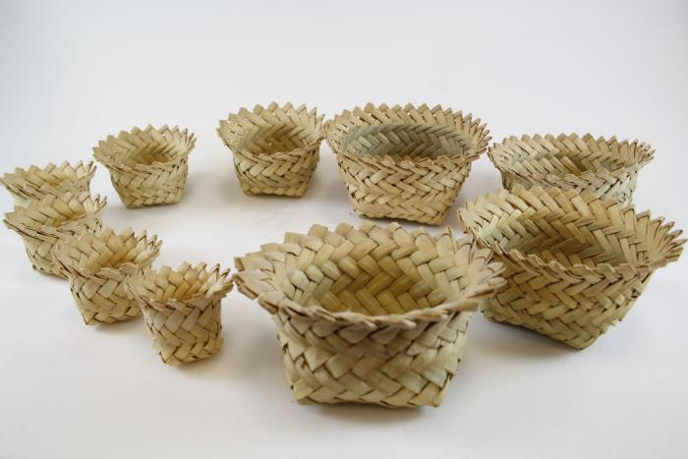
Tarahumara Indian Baskets (SH36)

Slide 10
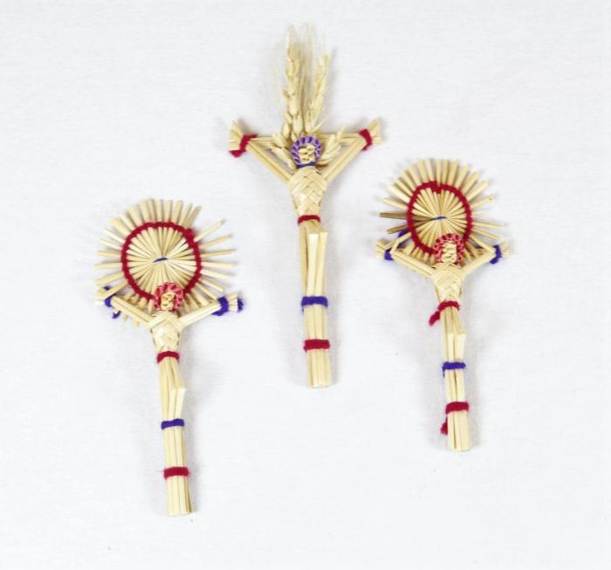
Crucification (SH47)

Slide 11
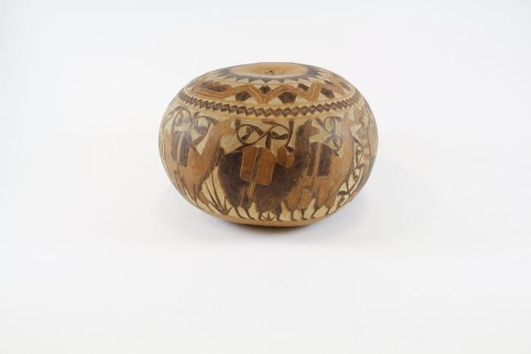
Farmers on Parade (SH61)

Slide 12
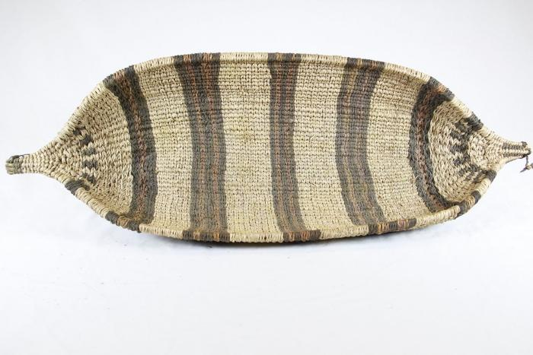
Ethiopian Canoe Gambella Basket (SH97)

Slide 13
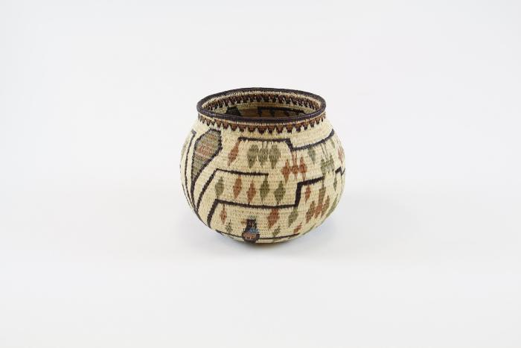
Vase (SH115)

Slide 14
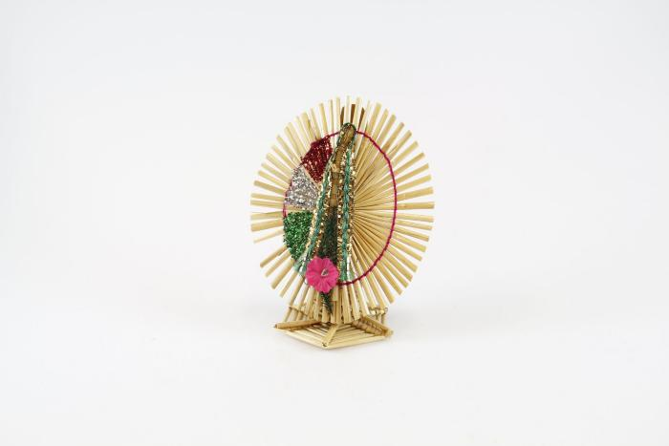
Virgin Mary (SH125)

Slide 15
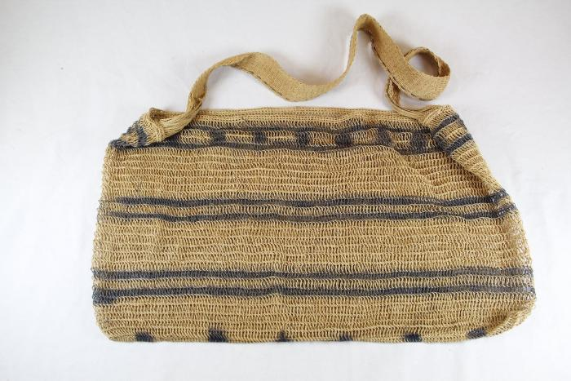
Shipibo Woven Bag (SHA10)

Slide 16
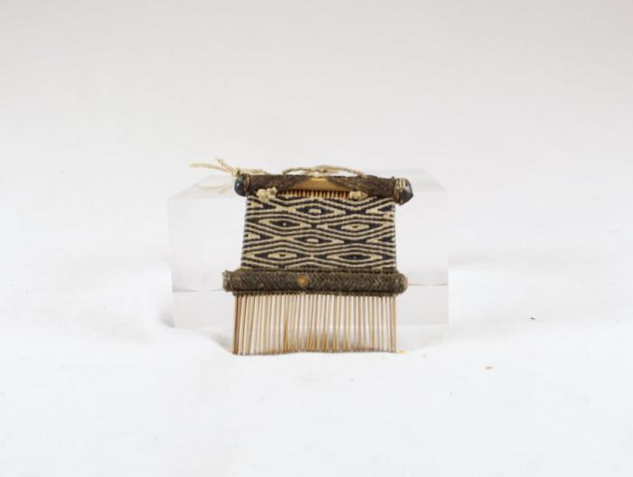
Shipibo Comb (SHA13)

Slide 17
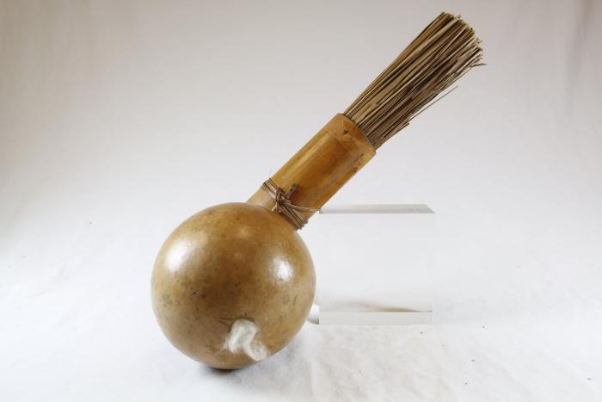
Shipibo Dart Quiver with Goard (SHA14)

Slide 18
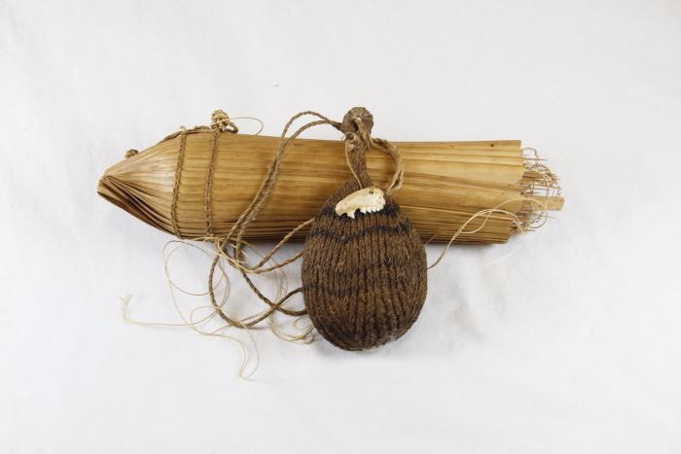
Shipibo Dart Quiver with Jaw Bone (SHA15)

Slide 19
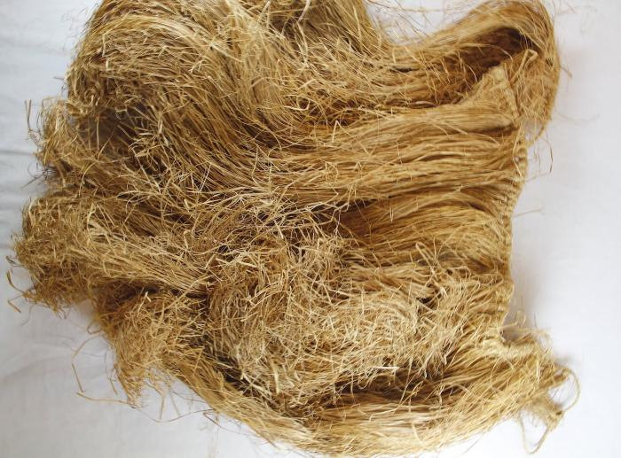
Shipibo Grass Clothing (SHA22)

Slide 20
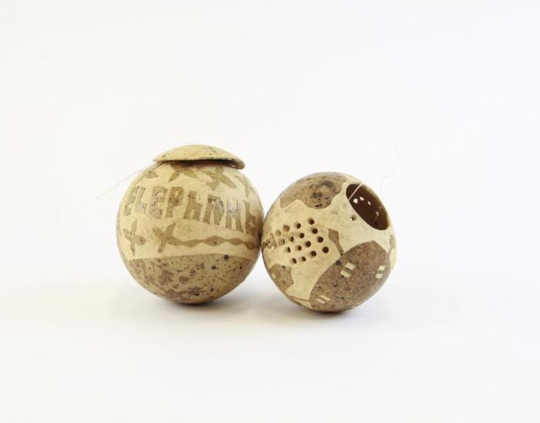
"Elephant" Carved Dried Gourd with Lid (YO1)

Slide 21
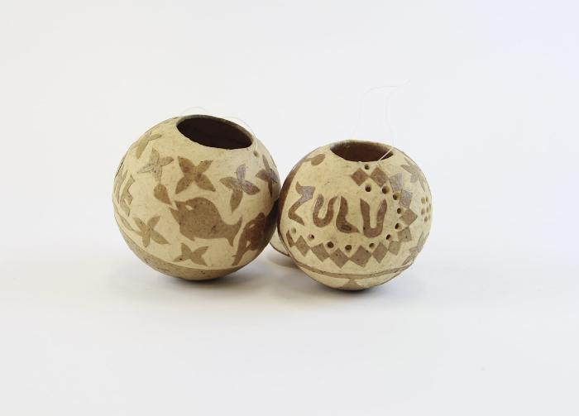
"Zulu" Carved Dried Gourd (YO2)

Slide 22
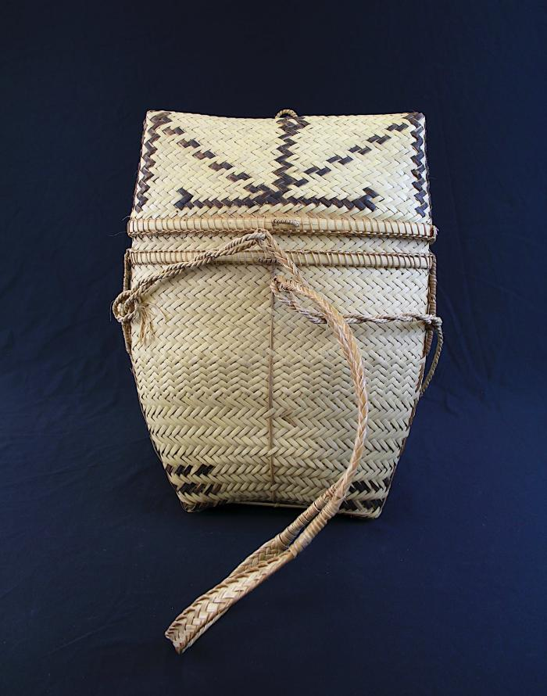
Pasiking (Rattan Backpack) (YO7)

Slide 23
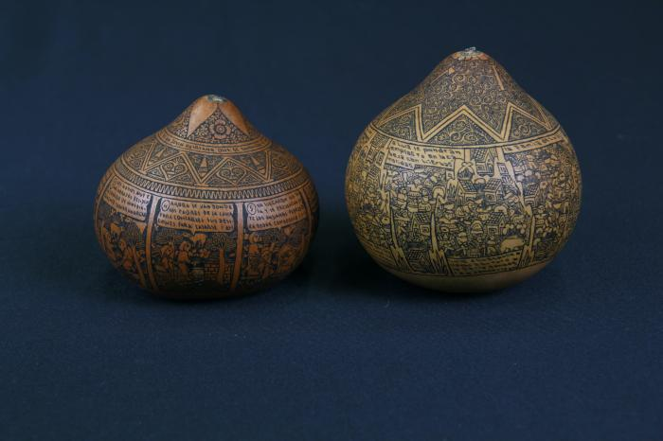
Peruvian Carved Gourds (FR125)

