Slide 1
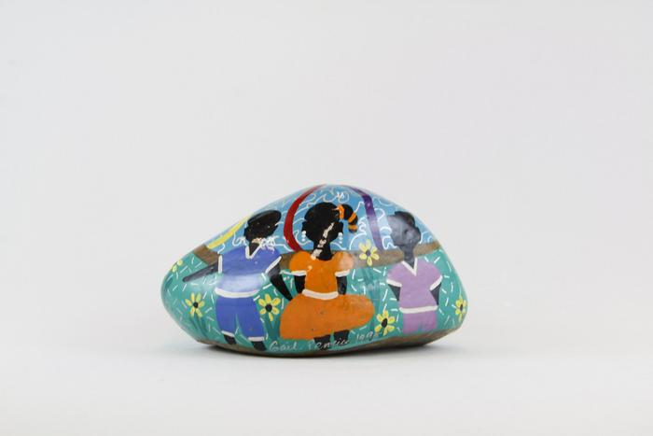
"Sisters in Progress", Painted Rock Paperweight (EH19)

