Slide 1
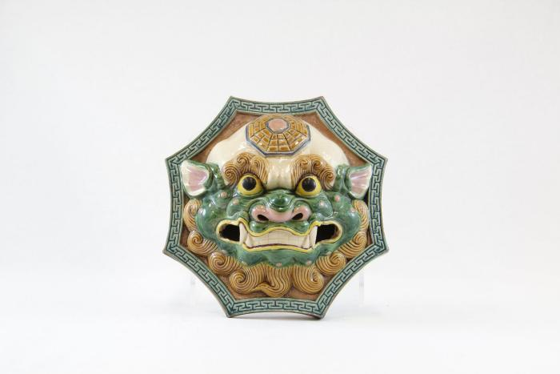
Foo Dog Wall Hanging (PR41)

Slide 2
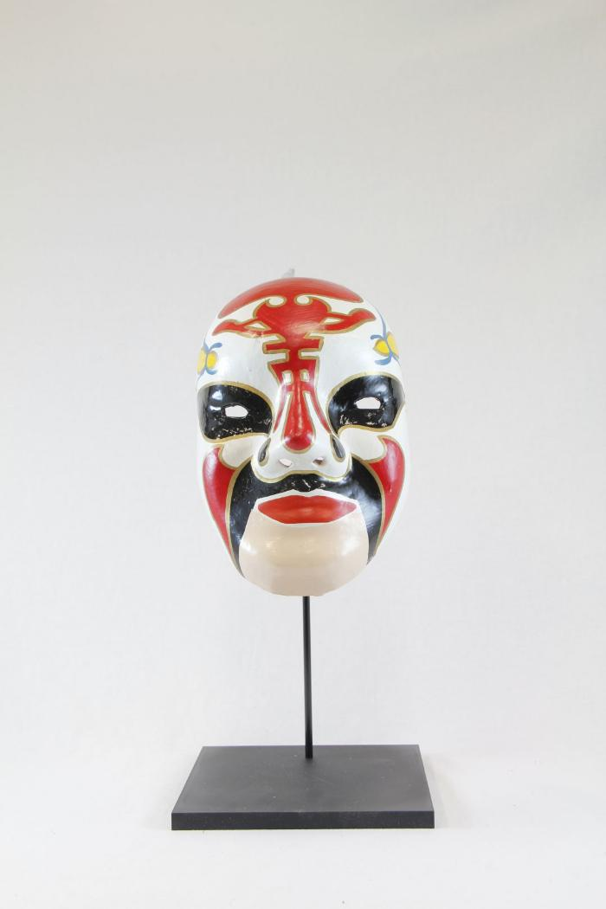
Meng Liang, white opera mask (PR44)

Slide 3
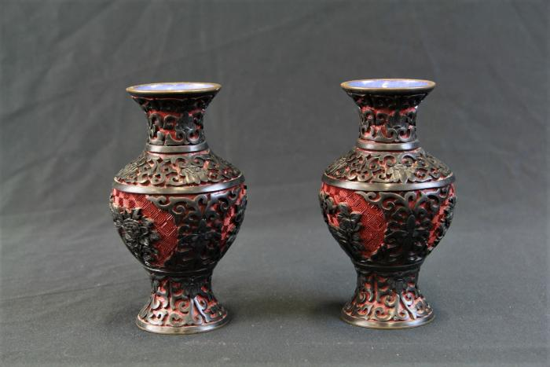
Chinese Carved Lacquer Vases (WI31)

Slide 4
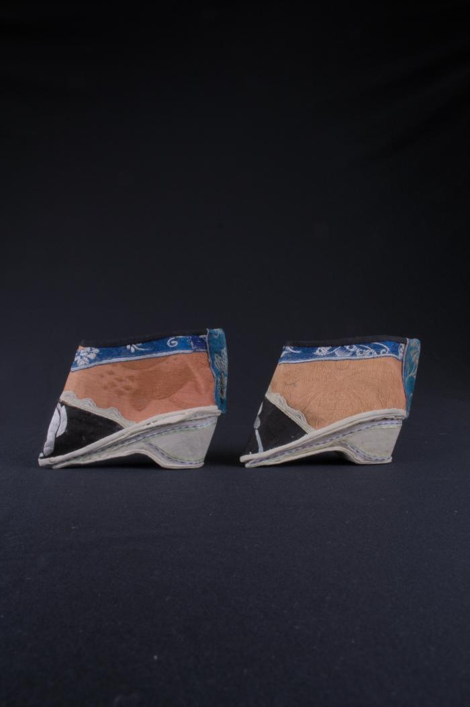
Chinese Lotus Shoes (FR10)

Slide 5
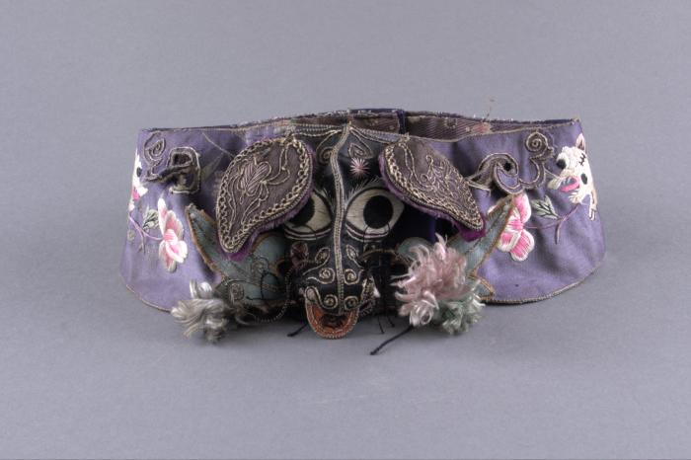
Chinese Embroidered Headband (FR11)

Slide 6
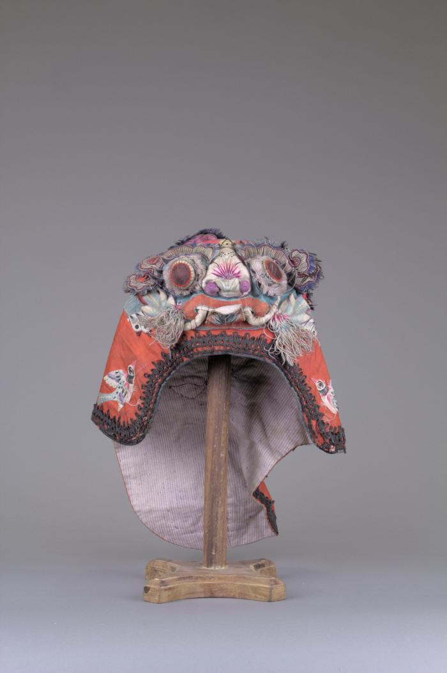
Chinese Children's Tiger Hat (FR12)

Slide 7
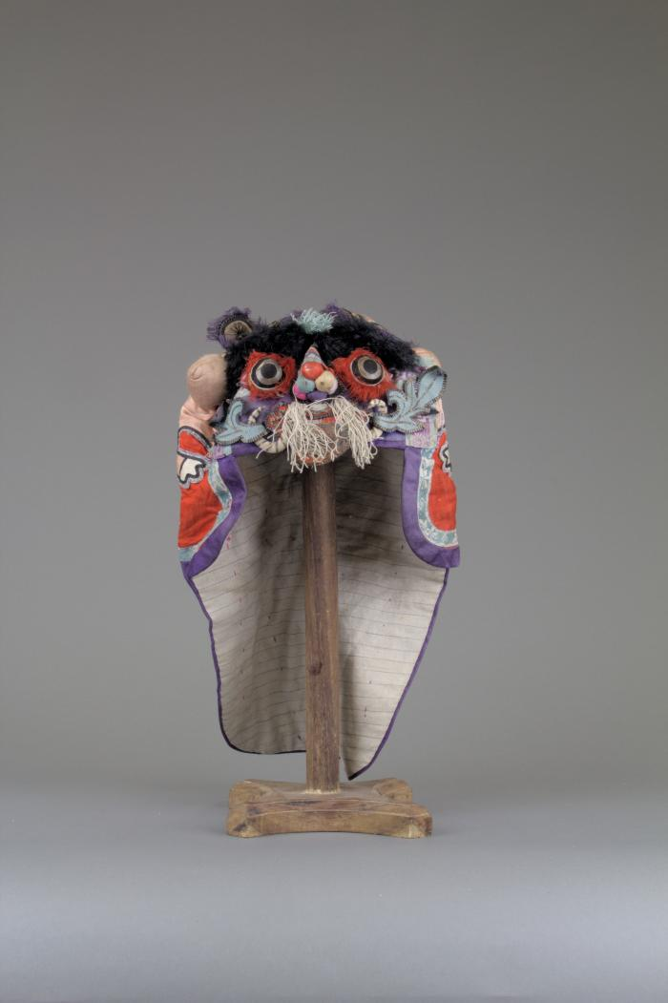
Chinese Tiger Hat (FR13)

Slide 8
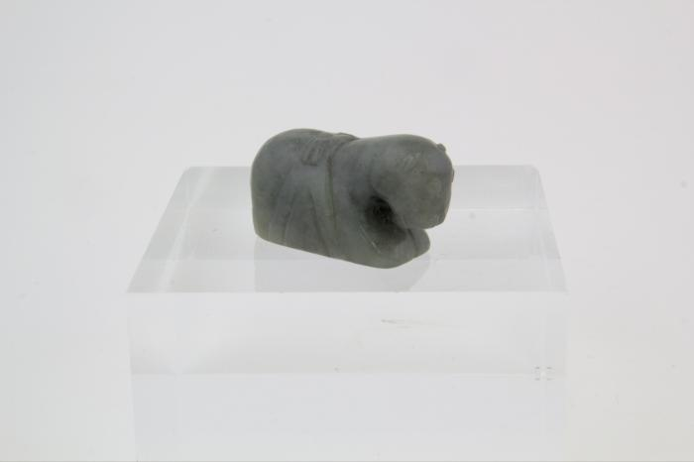
Jade Horse Incense Burner (FR14)

Slide 9
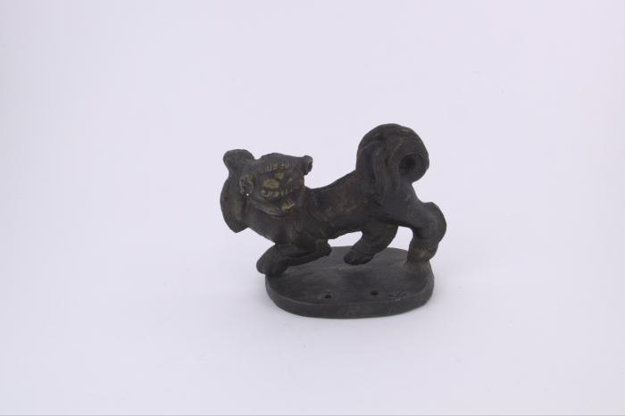
Lion Incense Holder (FR15)

Slide 10
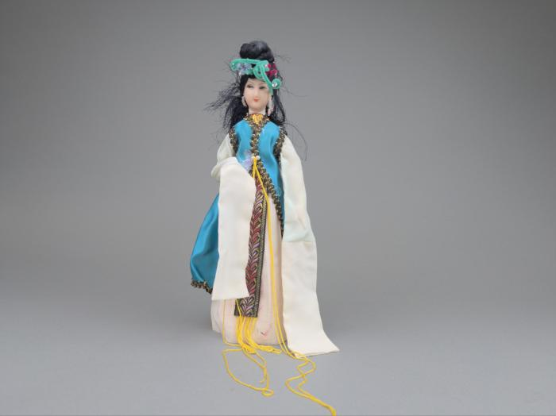
Chinese Pose Doll (FR16)

Slide 11
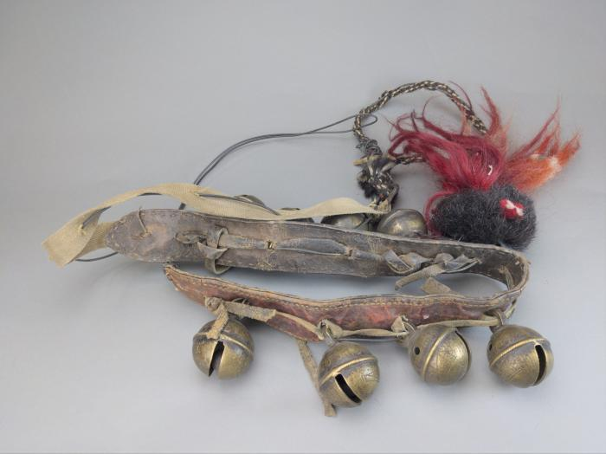
Chinese Horse Bells (FR17)

Slide 12
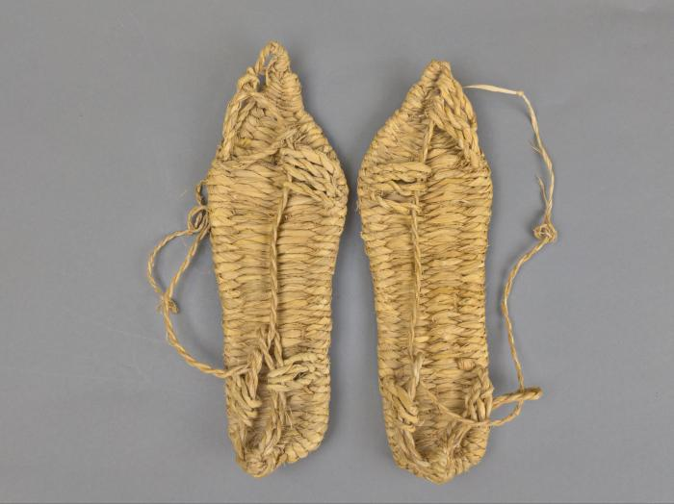
Chinese Traditional Straw Sandals (FR18)

Slide 13
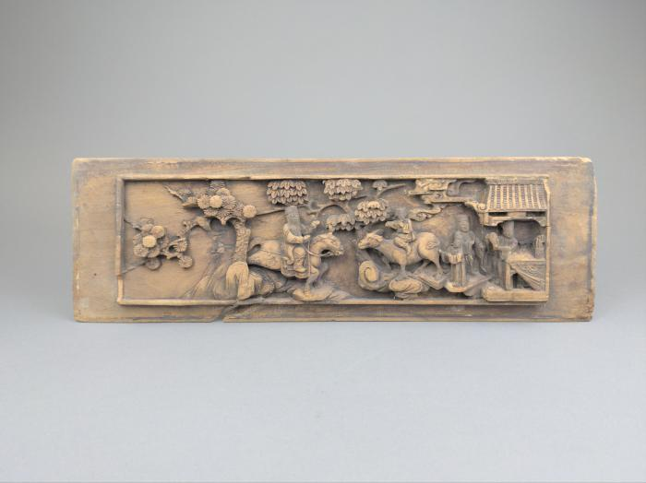
Chinese Wood Carved Panel (FR19)

Slide 14
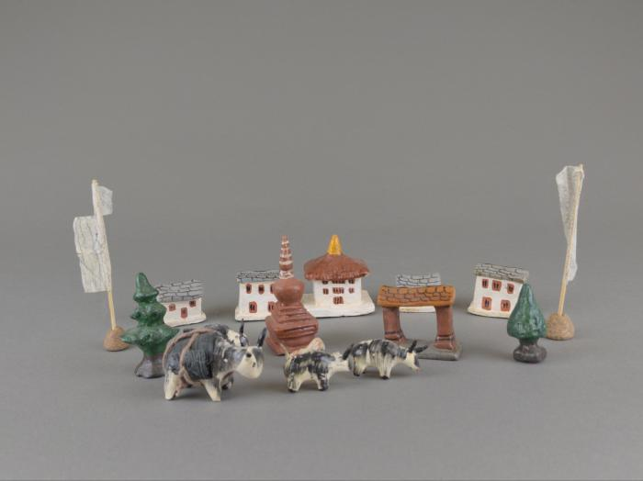
Tibetan Miniature Village (FR20)

Slide 15
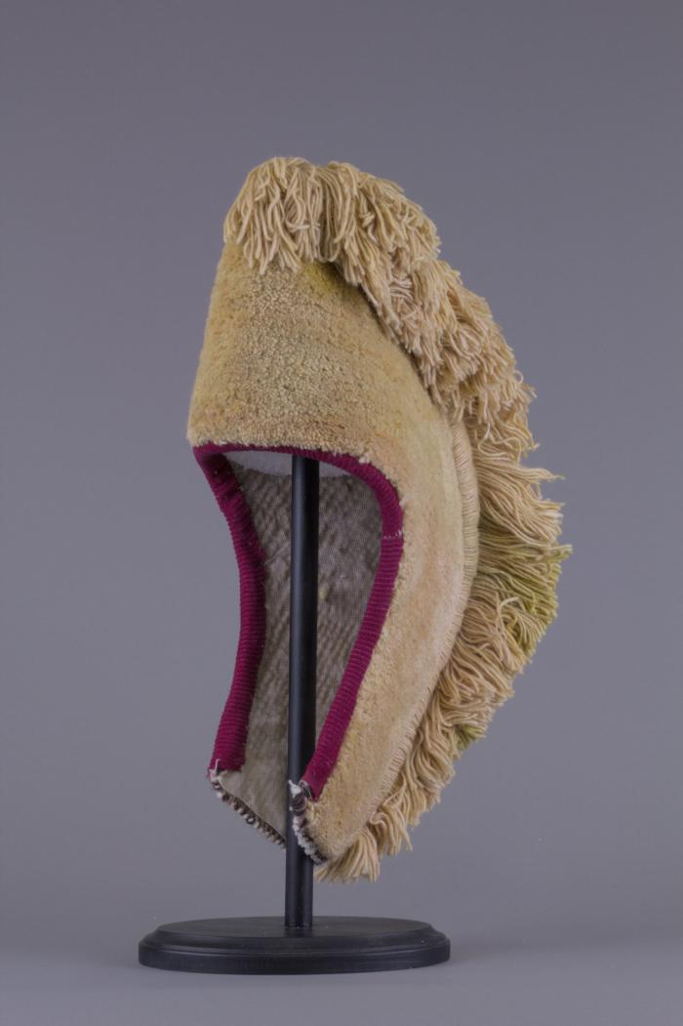
Tibetan Monk's Hat (FR21)

Slide 16
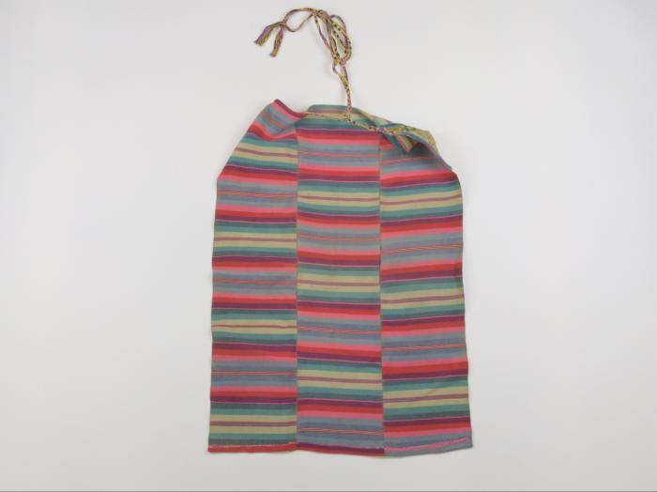
Tibetan Apron (FR22)

Slide 17
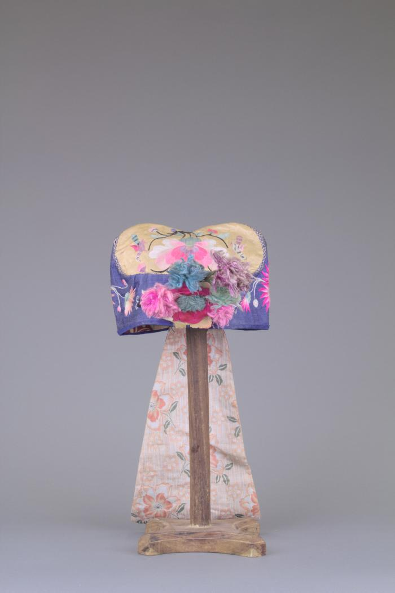
Tibetan Embroidered Silk Hat (FR23)

Slide 18
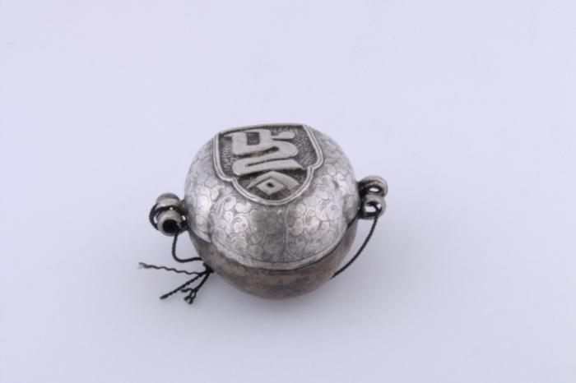
Tibetan Buddhist Amulet (FR24)

Slide 19
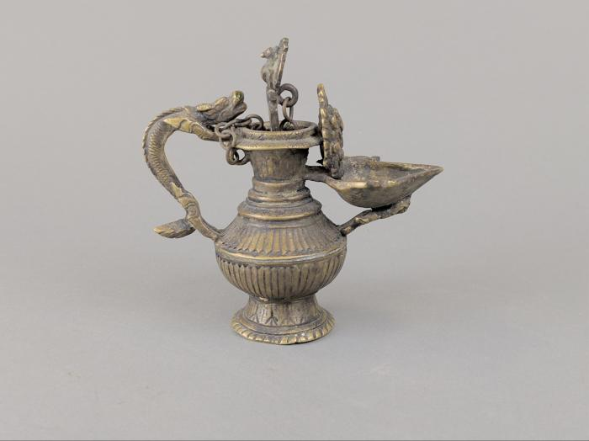
Tibetan Oil Lamp (FR25)

Slide 20
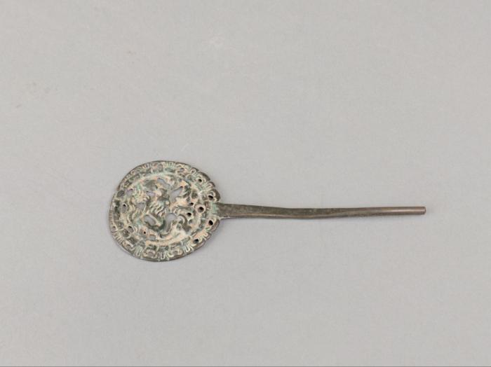
Tibetan Metal Fastener (FR26)

Slide 21
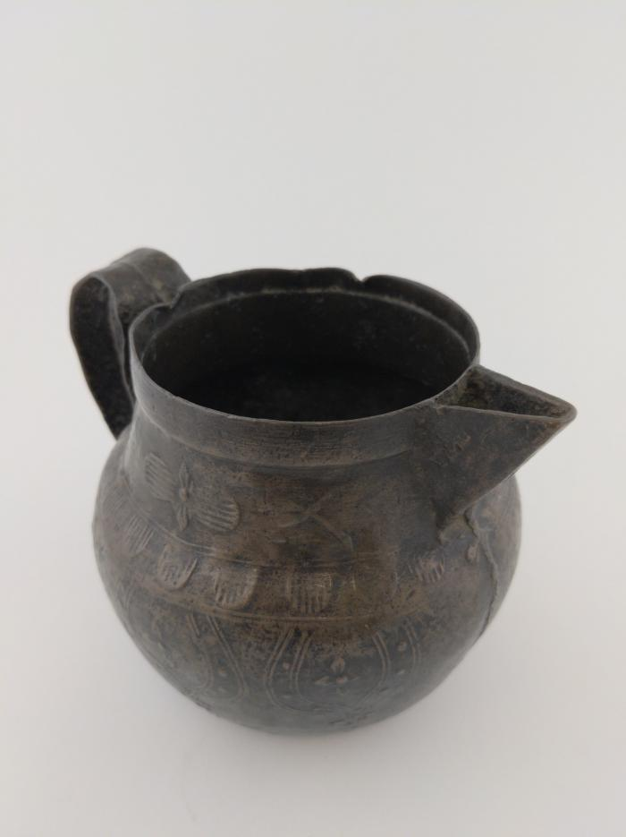
Tibetan Copper Pitcher (FR27)

Slide 22
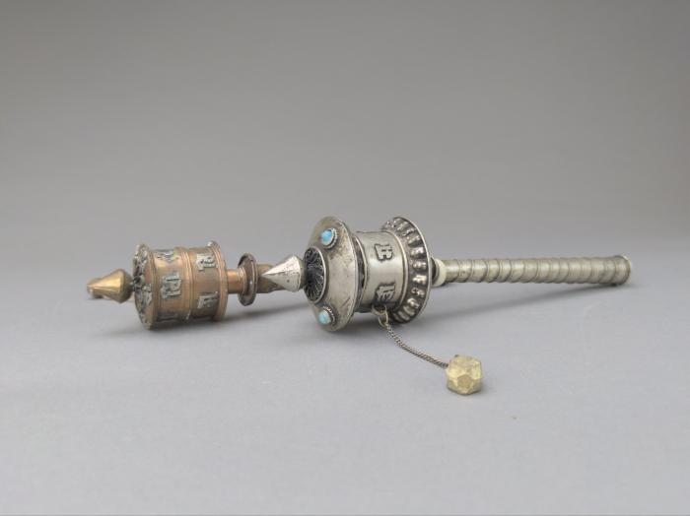
Tibetan Prayer Wheels (FR28)

Slide 23
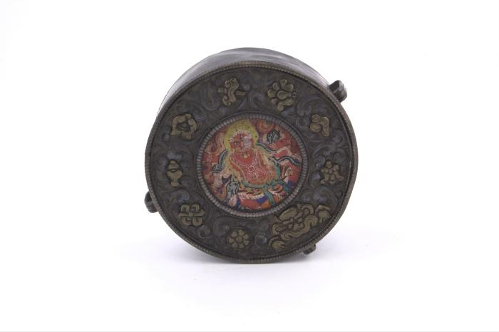
Tibetan Gau (FR29)

Slide 24
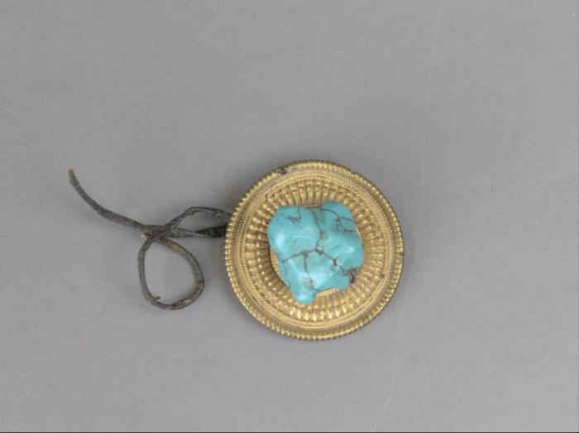
Tibetan Turquoise Pendant (FR30)

Slide 25
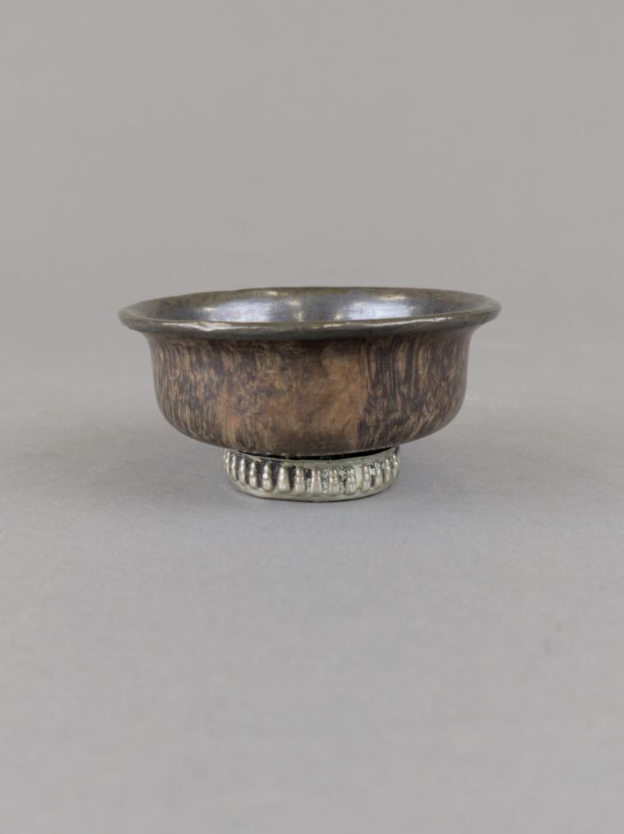
Tibetan Bowl (FR31)

Slide 26
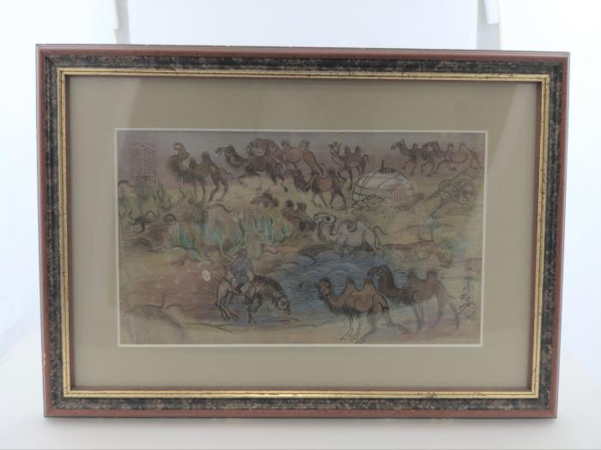
Tibetan Camels Print (FR32)

Slide 27
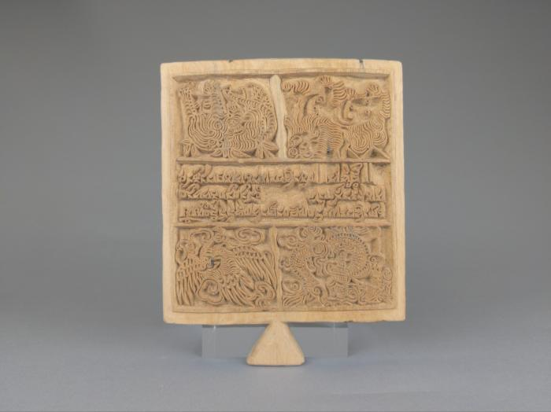
Tibetan Wood Printing Block (FR33)

Slide 28
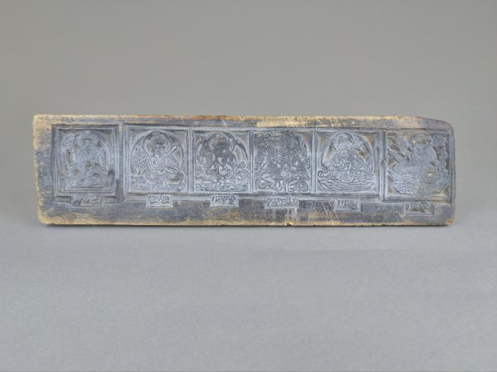
Tibetan Six Panel Printing Block (FR34)

Slide 29
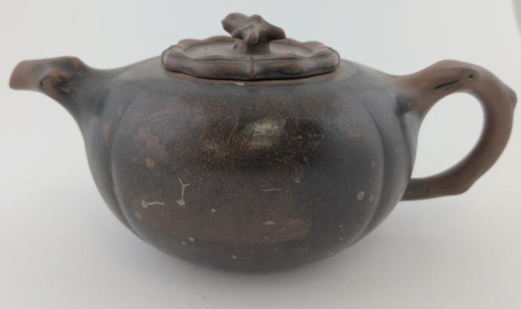
Chinese Tea pot (FR176)

