Slide 1
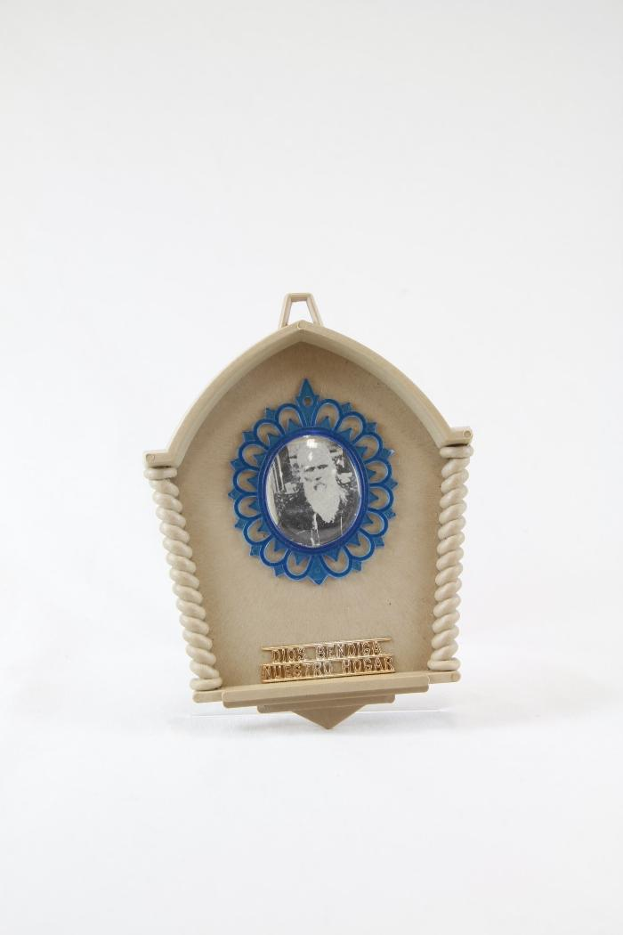
"Dios Bendiga Nustro Hogar" small altar to Don Pedrito Jaramillo (RE16)

Slide 2
A small gold altar to Don Pedrito Jaramillo with two angels (RE17)

Slide 3
"Bless Our Home" small altar to Don Pedrito Jaramillo (RE18)

Slide 4
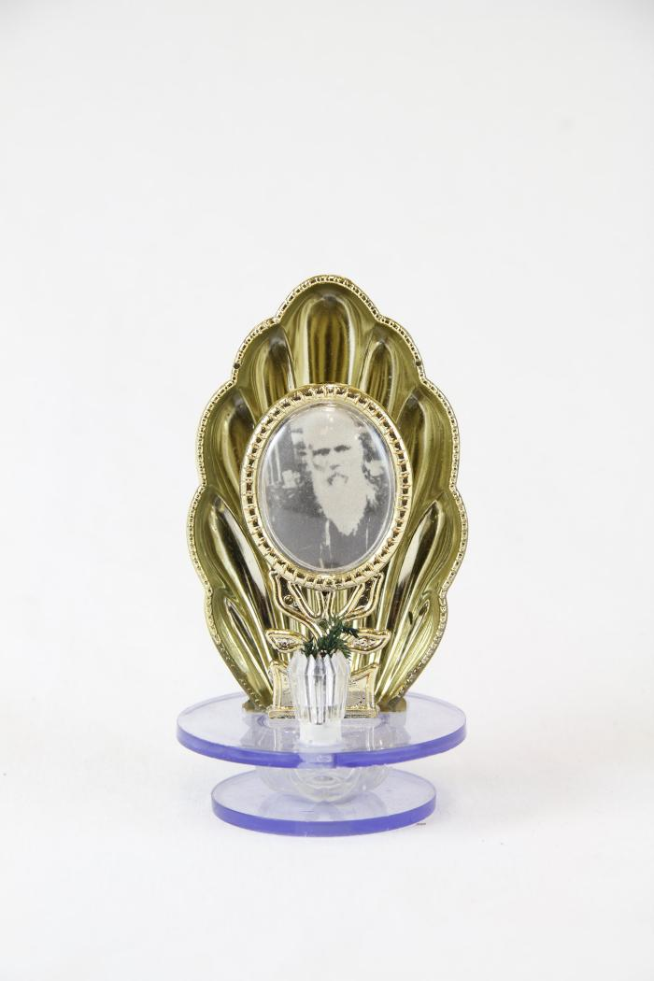
A small altar to Don Pedrito Jaramillo in gold shell (RE19)

