Slide 1
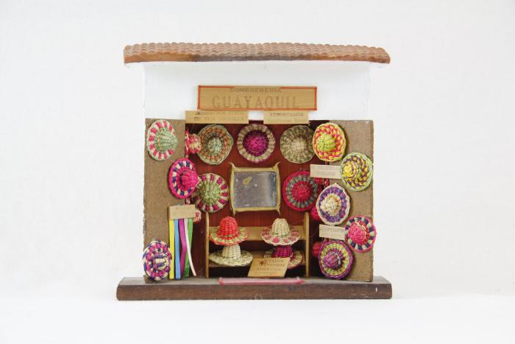
Sombreria Market Scene (MC1)

Slide 2
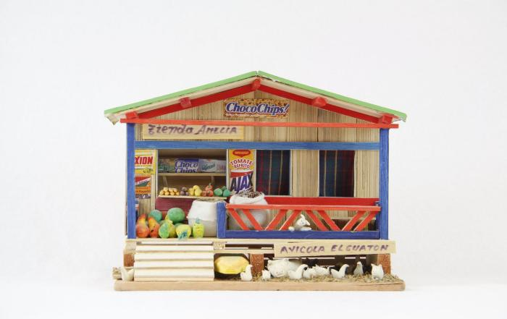
Grocery Store Scene "Tienda Amelia" (MC2)

Slide 3
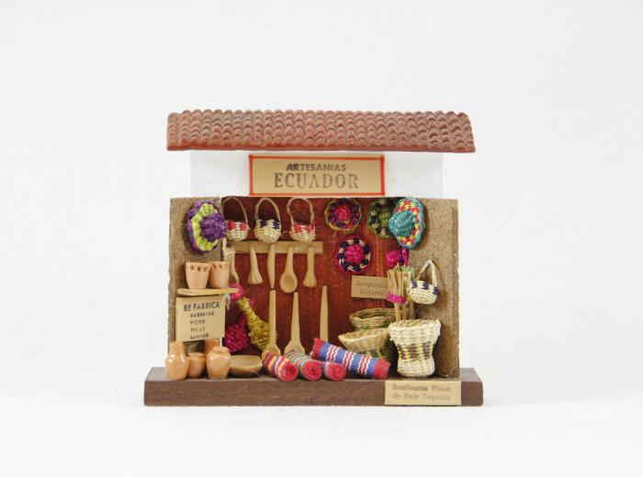
"Artesanias Ecuador" Market Scene (MC3)

Slide 4
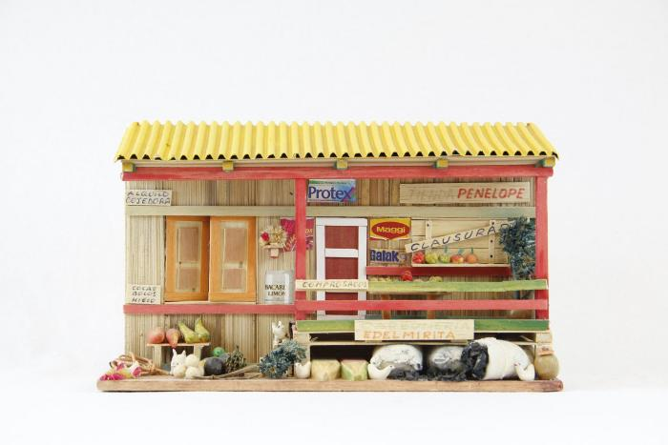
Grocery Store Scene "Tienda Penelope" (MC4)

Slide 5
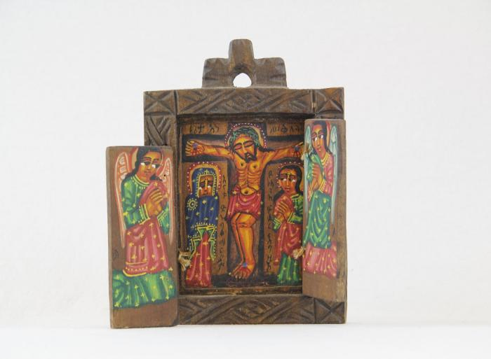
Christ on Cross with Angels Wood Wall Hanging (MC5)

Slide 6
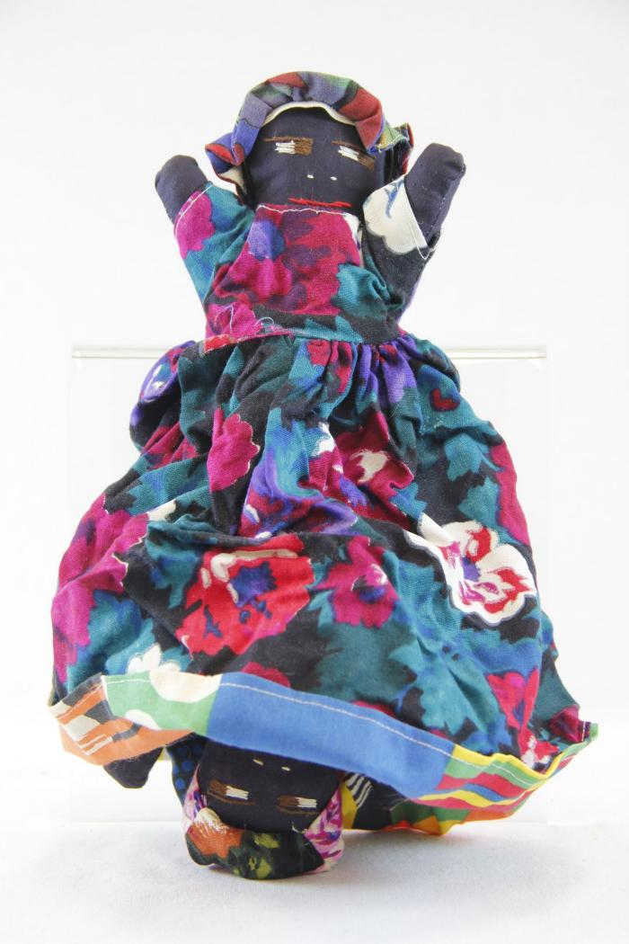
Topsy Turvy Doll (MC6)

Slide 7
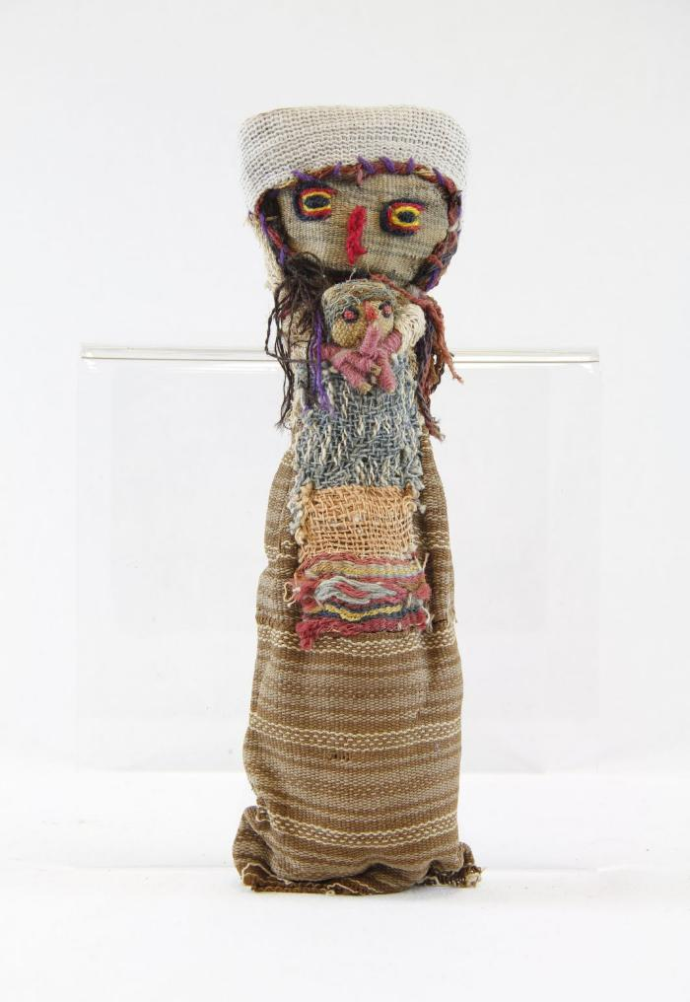
Chancay Doll, Mother and Child (MC7)

Slide 8
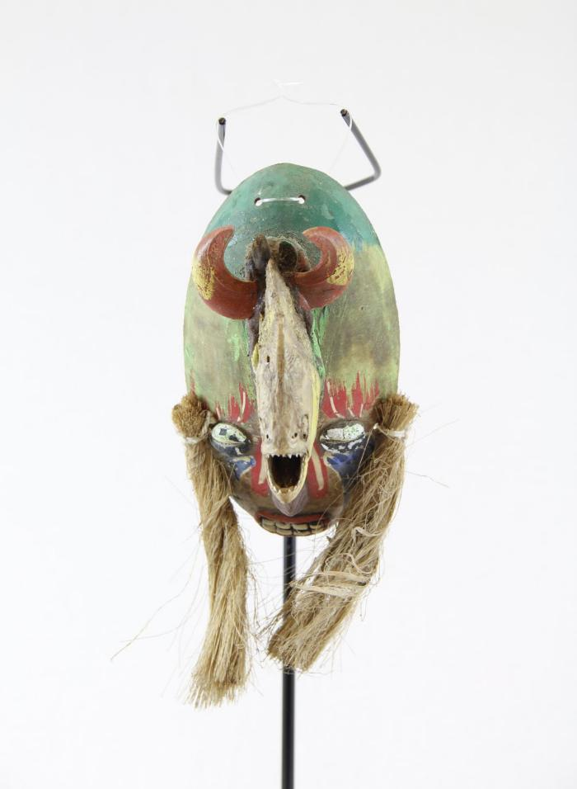
Venezuelan Piranha Mask (MC8)

Slide 9
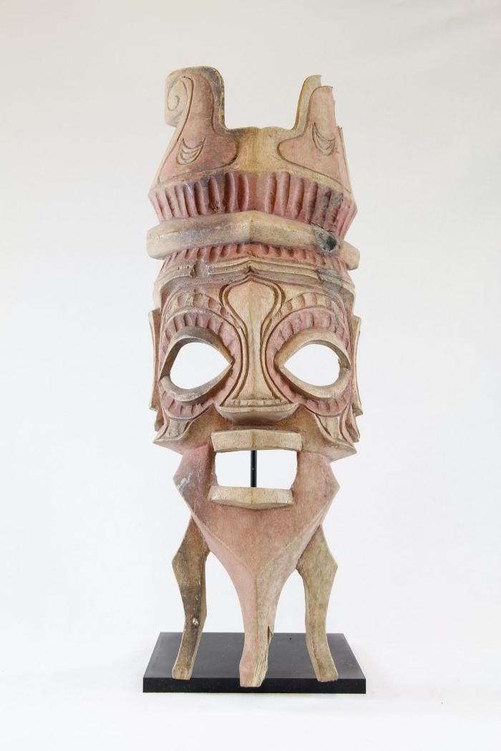
Wooden Mask, Stained Pink (MC9)

Slide 10
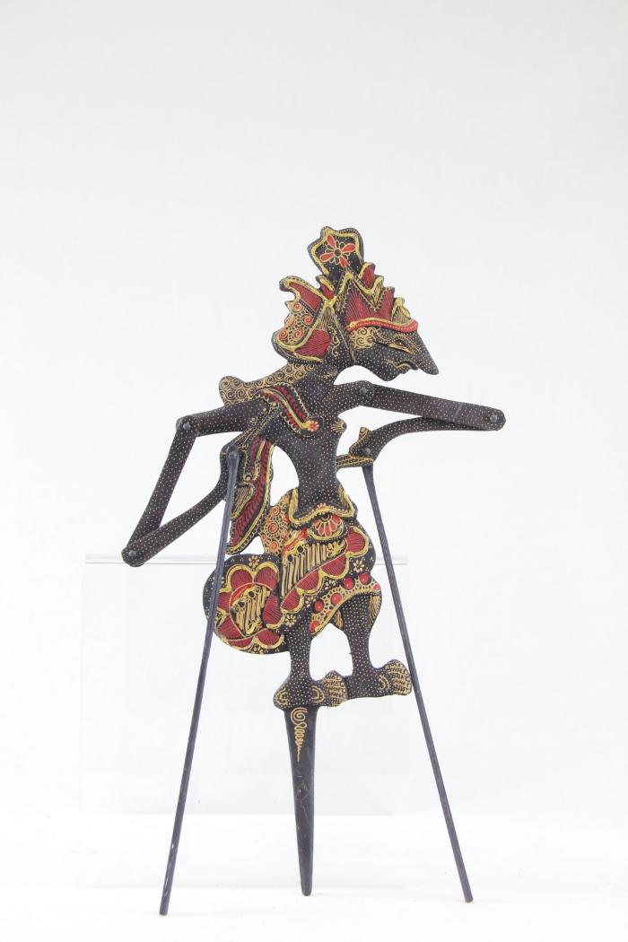
Indonesian Wayang Shadow Puppet (MC10)

Slide 11
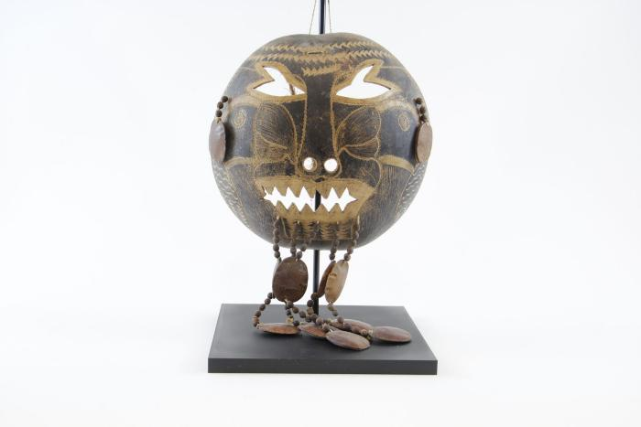
Yagua Mask (MC11)

Slide 12
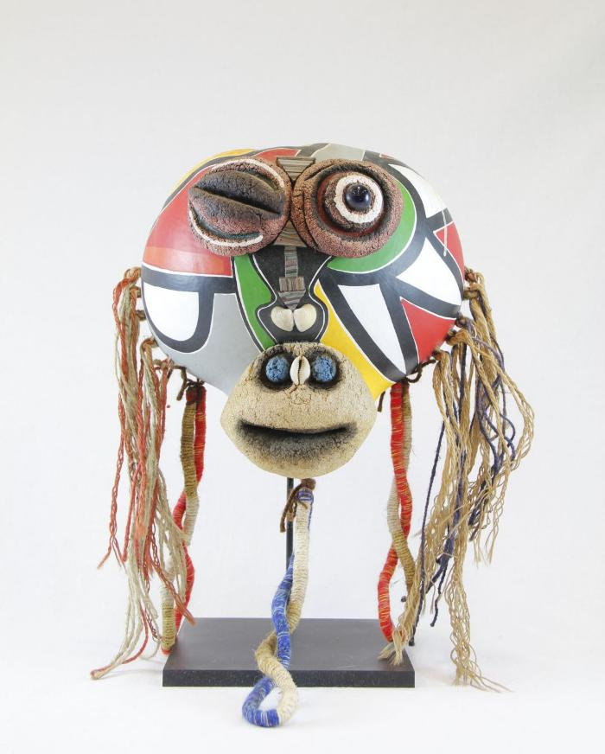
Monkey Mask (MC12)

Slide 13
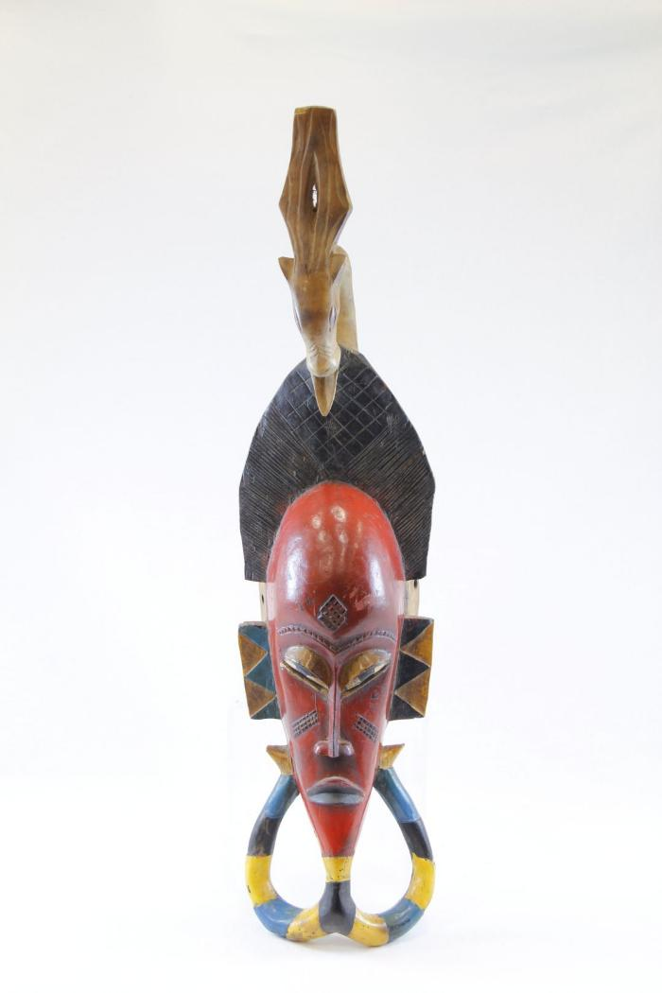
Guro Mask (MC13)

Slide 14
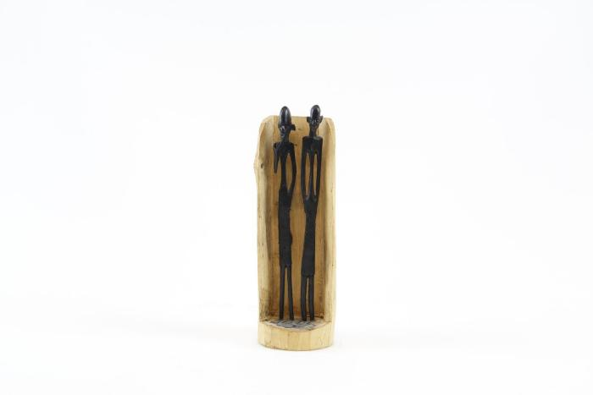
Ebony Carved Figures from Makonde Tribe (MC14)

Slide 15
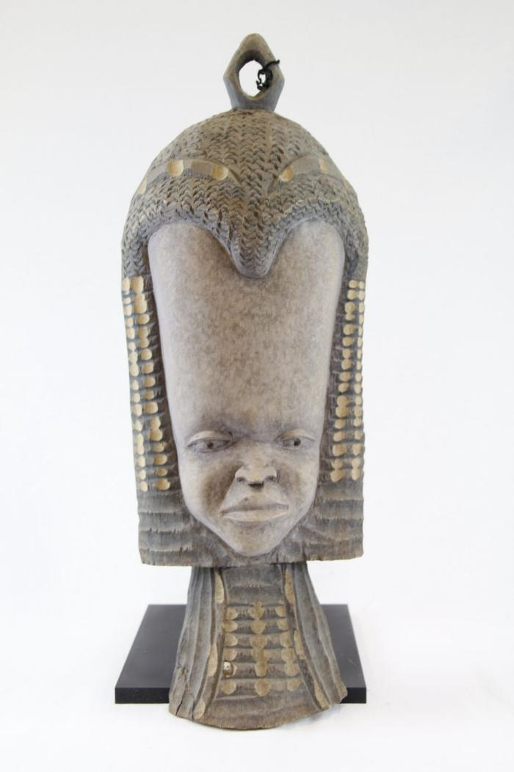
Long Forehead Face Mask (MC15)

Slide 16
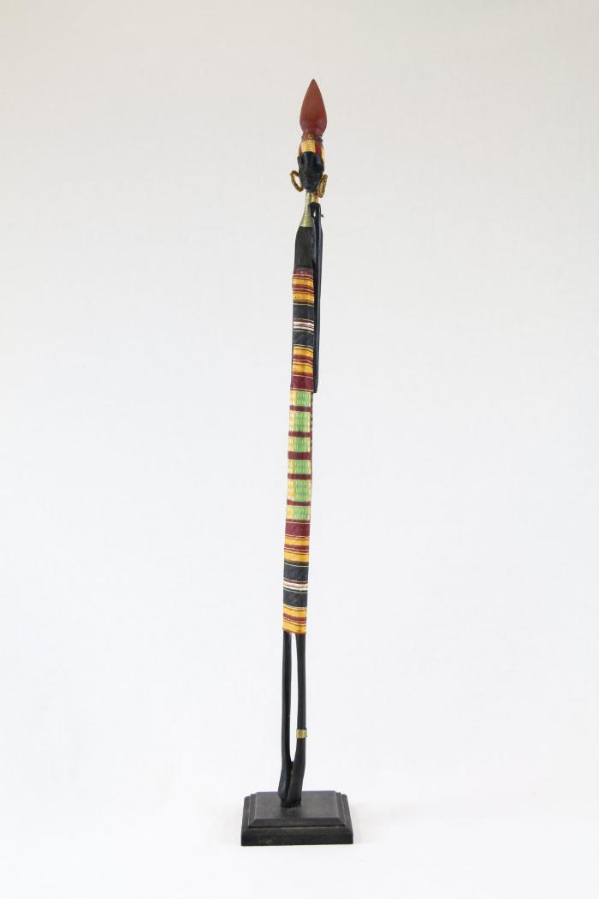
Ebony Carved Woman with Fabric Dress, Metal Neck Wrap, Beaded Earrings (MC16)

Slide 17
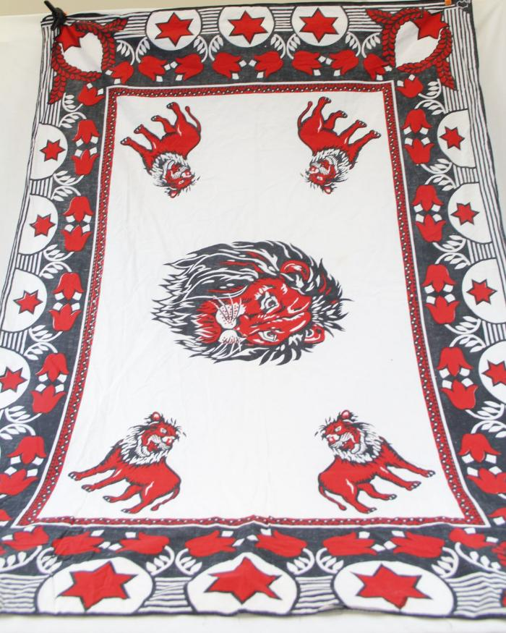
Mapula (Mother of Rain) Flower and Lion Cloth (MC17)

Slide 18
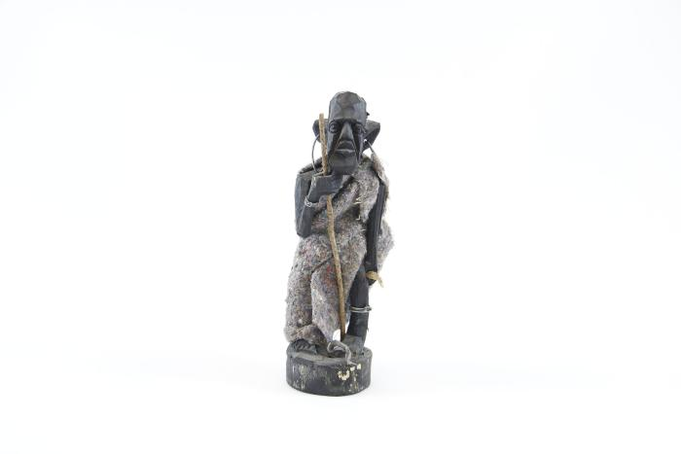
Small Wood Carved Figure with Wire Earrings and Staff (MC18)

Slide 19
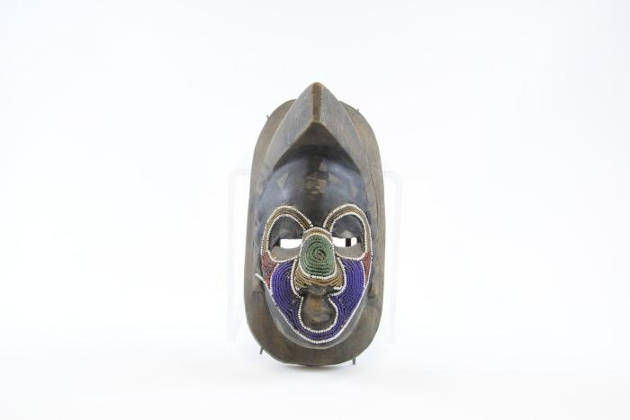
Ashanti Small Mask (MC19)

Slide 20
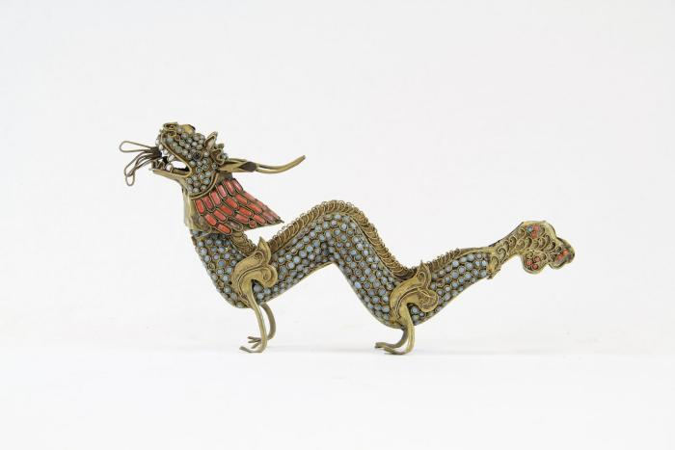
Beaded Metal Dragon (MC20)

