Slide 1
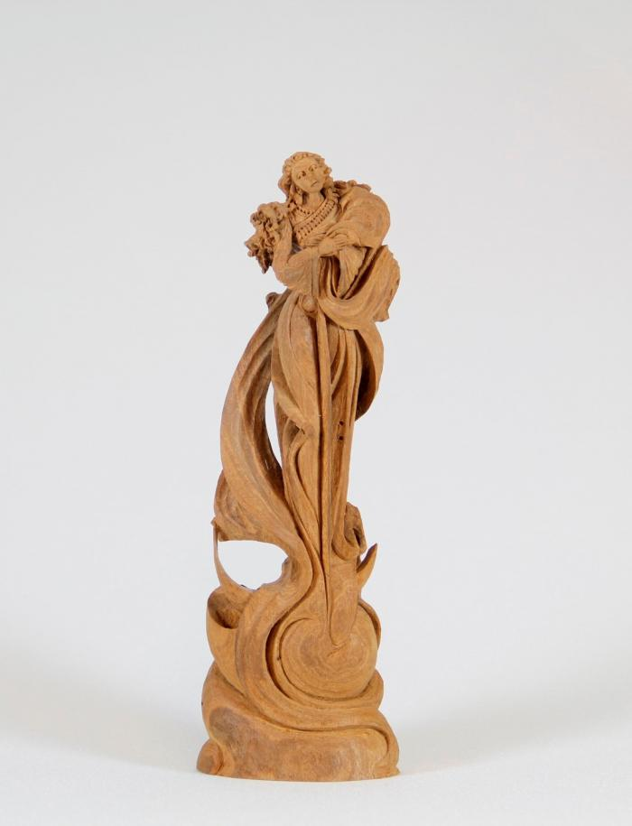
Angel (CA11)

