Slide 1
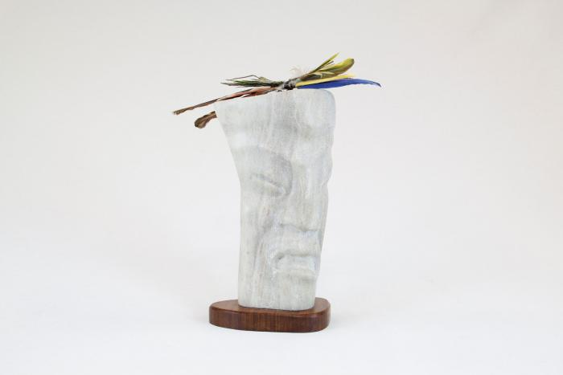
Singer Stone Figure Sculpture with Bird Feathers (MU3507)

