Slide 1
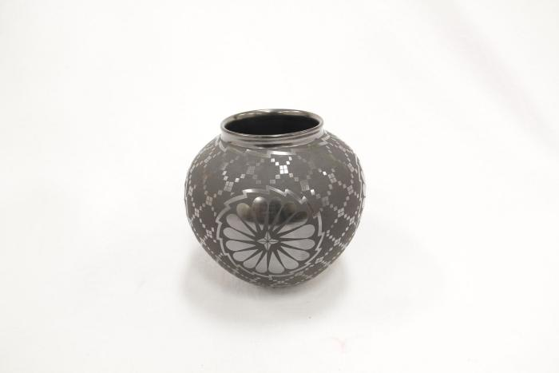
Black Vase (SH27)

