Slide 1
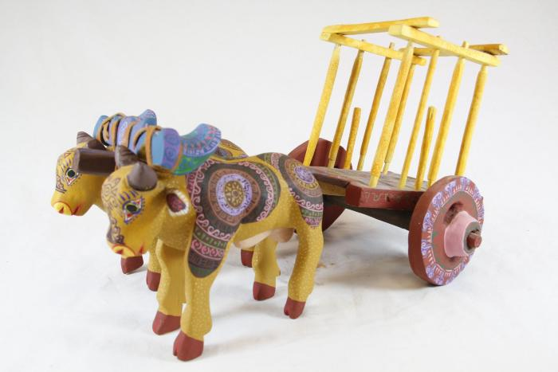
Decorated Cows with Cart (SH53)

