Slide 1
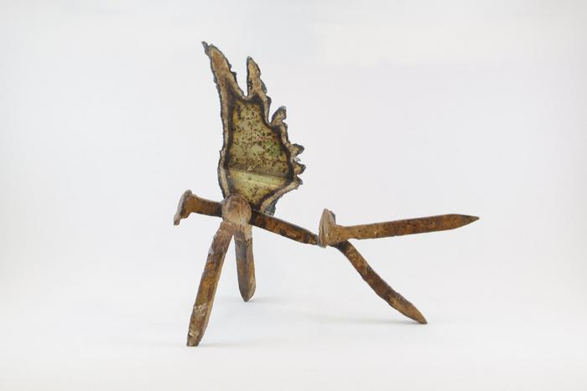
Angel (EH9)

Slide 2
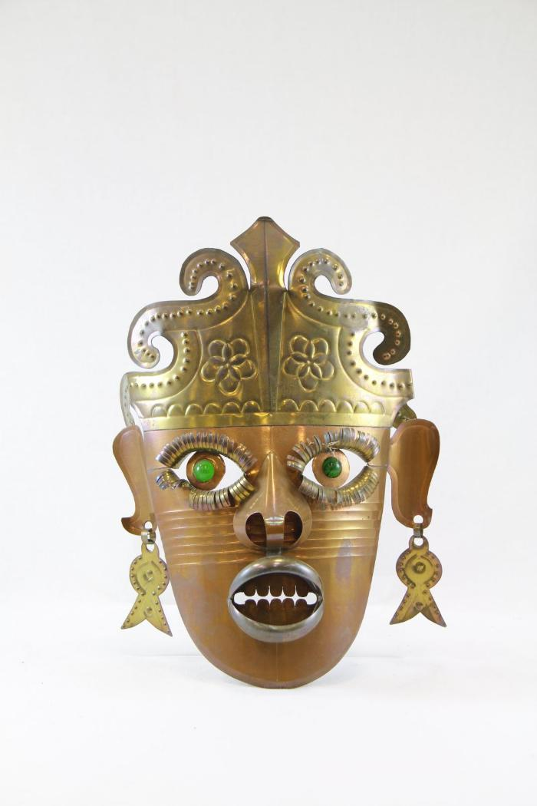
Tin Mask (PR11)

Slide 3
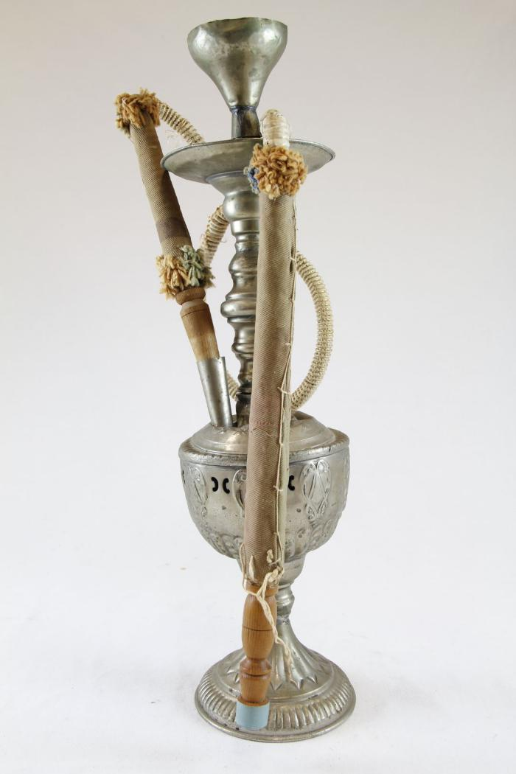
Hookah (SH70)

Slide 4
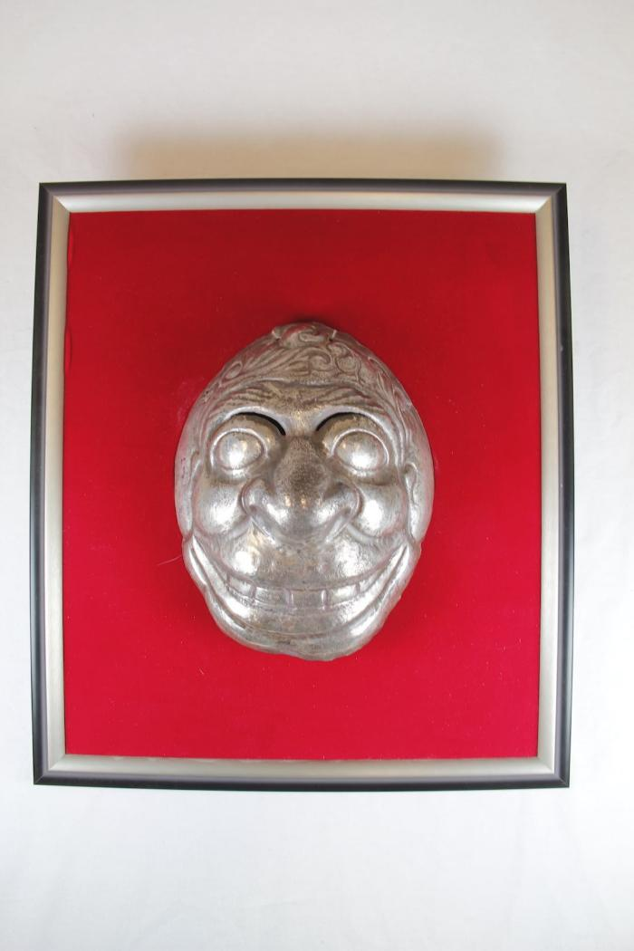
Impressioned Silver Mask (SHA1)

Slide 5
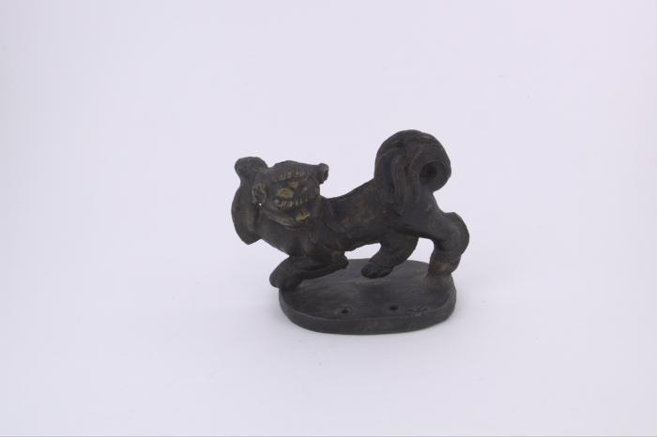
Lion Incense Holder (FR15)

Slide 6
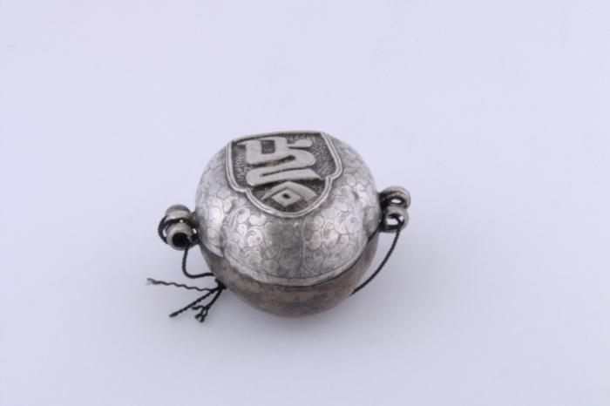
Tibetan Buddhist Amulet (FR24)

Slide 7
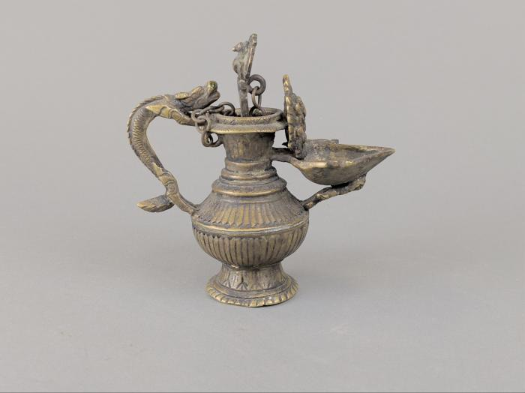
Tibetan Oil Lamp (FR25)

Slide 8
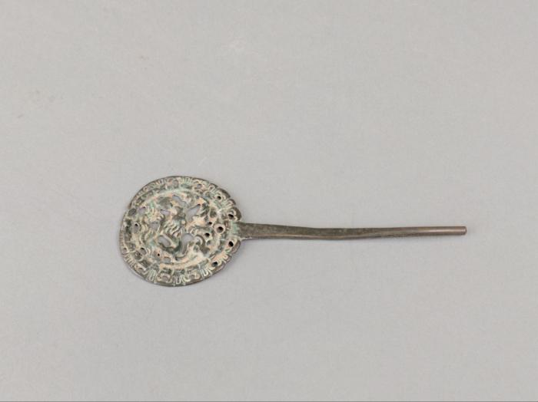
Tibetan Metal Fastener (FR26)

Slide 9
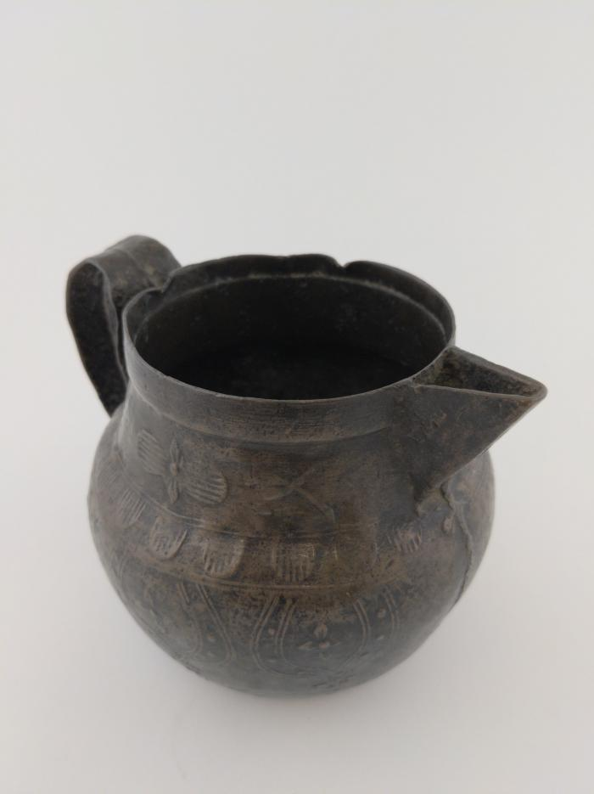
Tibetan Copper Pitcher (FR27)

Slide 10
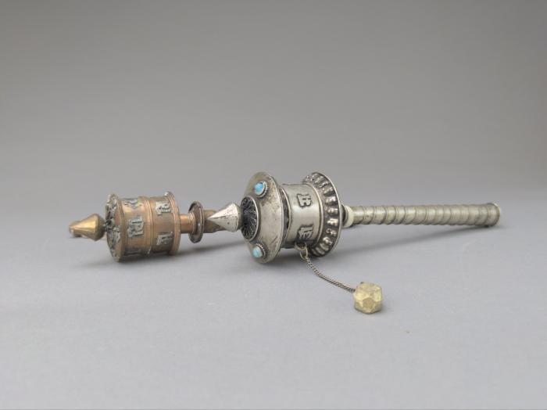
Tibetan Prayer Wheels (FR28)

Slide 11
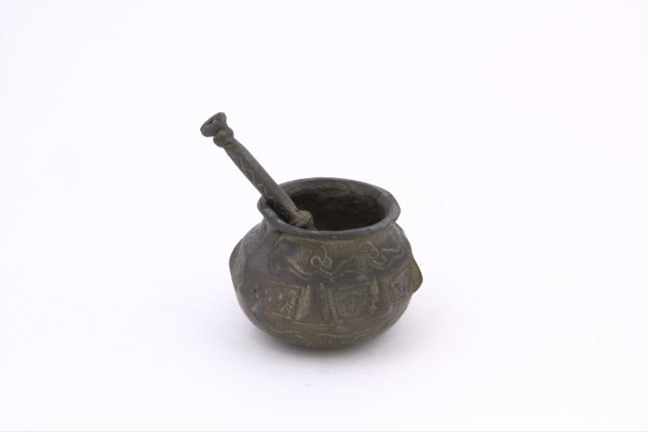
Mortar and Pestle (FR55)

Slide 12
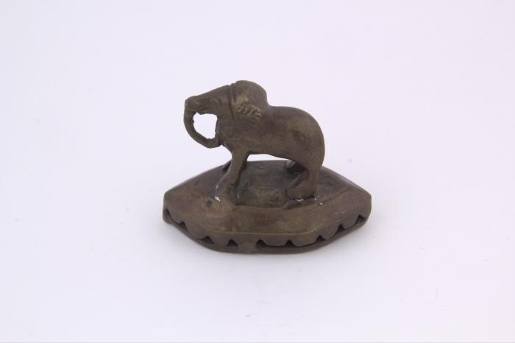
Indian Stamp with Elephant (FR56)

Slide 13
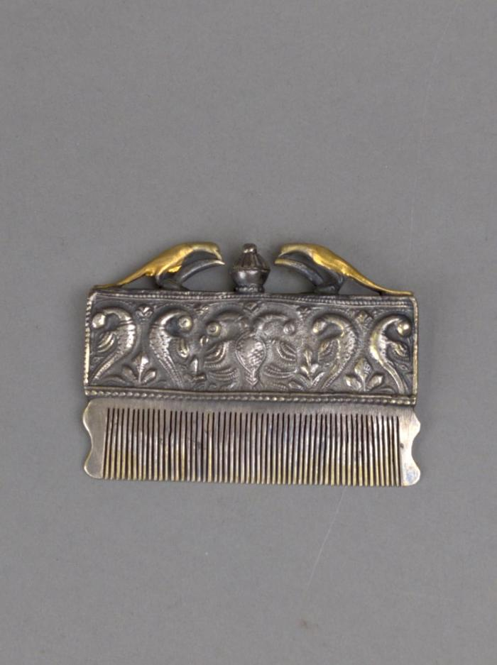
Indian Parcel-Gilt Silver Comb (FR57)

Slide 14
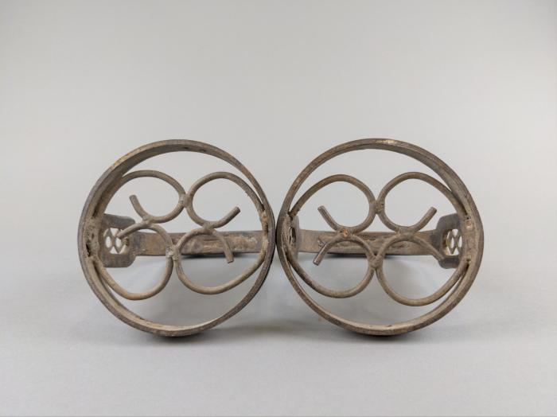
Indian Horseshoes (FR58)

Slide 15
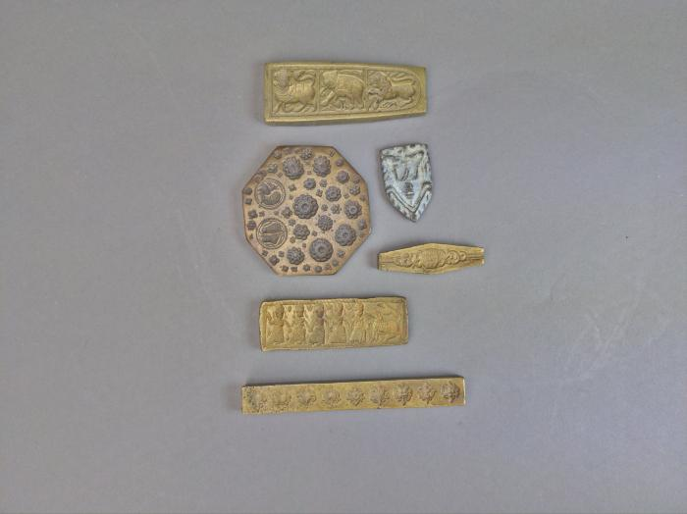
Brass Jewelry Mold (FR59)

Slide 16
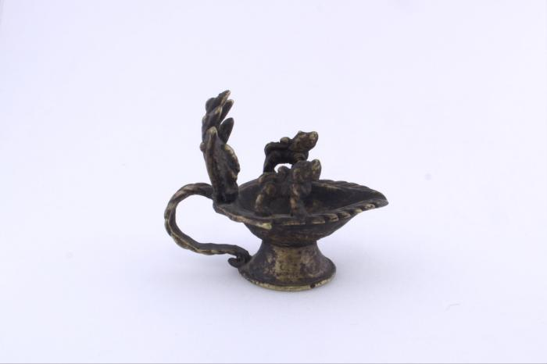
Brass Incense Burner (FR108)

Slide 17
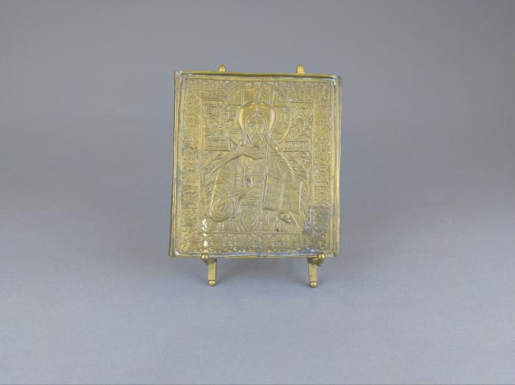
Brass Russian Icon of St. Nicholas (FR139)

Slide 18
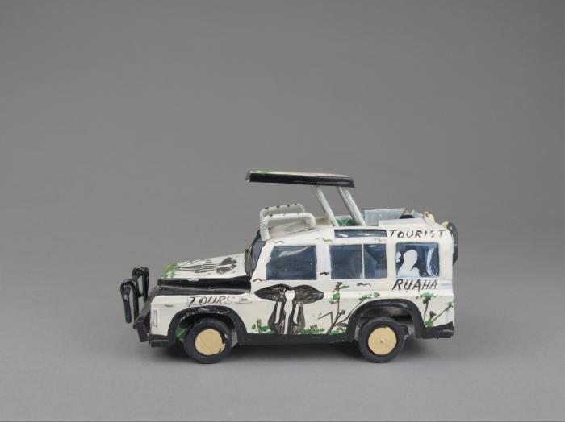
Tanzanian Tin Safari Jeep (FR144)

Slide 19
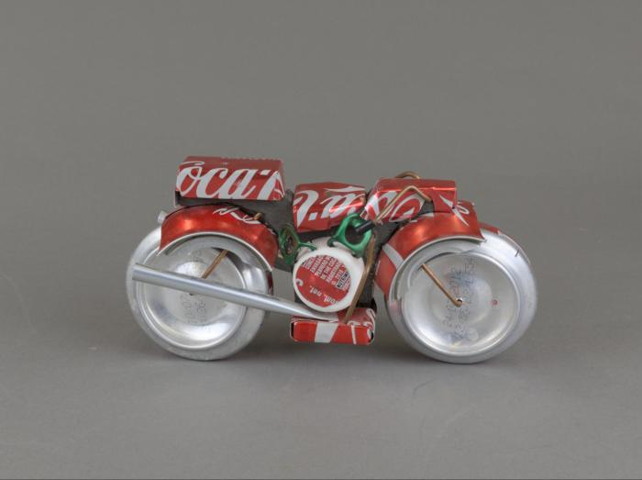
Coca Cola Can Motorcycle (FR160)

