Slide 1
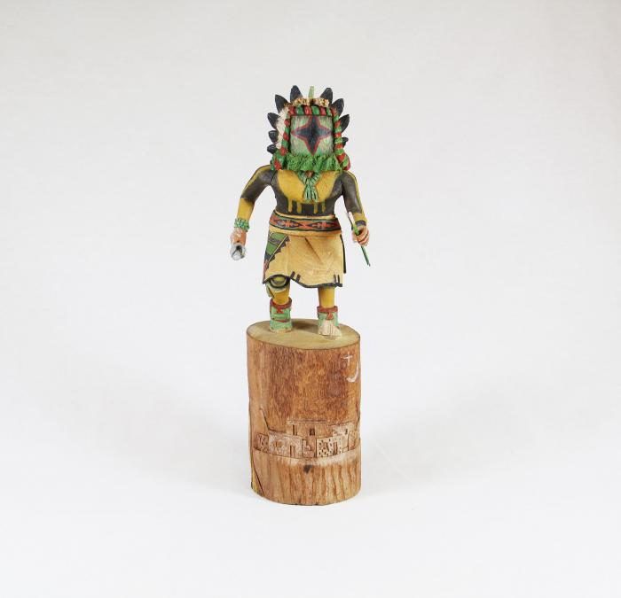
Kachina Doll (Chasing Star) (MU3511)

